Slide 1




Failed Banking Transaction Analysis
By suryateja Bommalata

Slide 2

tools & Services Used:
Google cloud storage
Google cloud dataproc
pyspark
Cloud SQL (mysql)
Bigquery

Slide 3
MySQL Instance Setup
Steps For Execution:
Create
Create mysql instance
Add
Add user, password
Create
Create database: new_database
Create
Create table: failed_transactions

Slide 4
Create Dataproc Cluster
Command:
gcloud dataproc clusters create new-cluster --region=us-central1 --zone=us-central1-c --single-node --master-machine-type=n1-standard-2 --image-version=2.0-debian10

Slide 5
Connect Dataproc to MySQL
1. Copy VM instance external IP address
2. Add to Cloud SQL connections (Add Network)

Slide 6
Prepare Data and Scripts
DATA INGESTION:
1. Upload CSV files to bucket/transactions
2. Upload Python scripts to bucket/scripts
Gsutil cp C:/Users/Surya/Downloads/failed_banking_txn_analysis
/data/*.csv gs://new-project1-bucket/transactions/
gcloud cp C:/Users/Surya/Downloads/failed_banking_
txn_analysis/scripts/job_file.py gs://new-project1-bucket/scripts/

Slide 7
Run PySpark Job on Dataproc
Command:
gcloud dataproc jobs submit pyspark gs://my_project1_bucket/scripts/clean_merge_data_and_filter_failed_txns.py --cluster=new-cluster --region=us-central1

Slide 8
Verify Data in Cloud SQL
Verify failed_transactions table and data insertion

Slide 9
Federated Connection: BigQuery to MySQL
1. Go to BigQuery →Add Data→Mysql→
CloudSql(Biquery)Federation
2. Connect Cloud SQL to BigQuery

Slide 10

Configure IAM Permissions
1. Copy service account id from external connection
2. Add it to IAM with 'cloud SQL client' role

Slide 11
BigQuery Analysis and Visualization
1. Query on external table
2. Export results to CSV ,json or bigquery tables etc
3. Visualize data using bigquery charts or looker studio

Slide 12
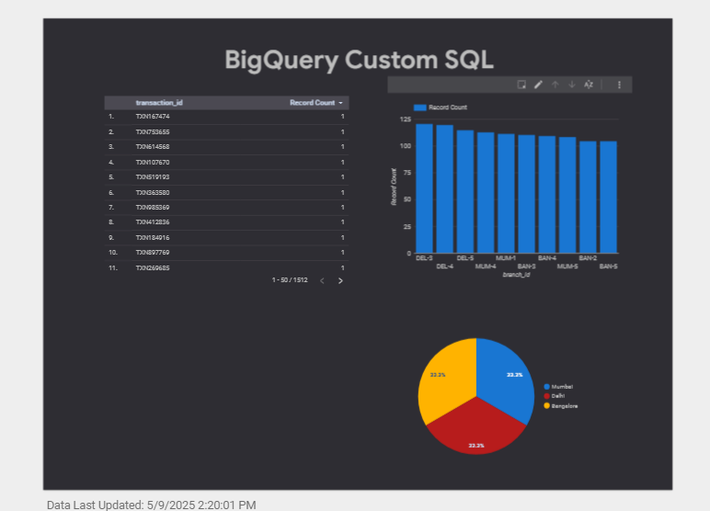
Output structure:

Slide 13
Conclusion:
This project solves an important problem for banks — tracking and reducing failed transactions from different branches. We built a complete data pipeline using Google Cloud services that automatically collects, cleans, and analyzes transaction data from several bank branches.With the help of PySpark on Dataproc, Cloud Storage, Cloud SQL, and BigQuery, we created a system that quickly identifies failed transactions. This helps bank managers and teams get timely information to fix issues, improve customer service, run operations smoothly, and make better decisions based on real data.

Slide 14


