Slide 1

The Stellar Consensus Protocol
November 29, 2018

Slide 2
INTRODUCTION TO SCP
Stellar Consensus Protocol (SCP) is a construction for Federated Byzantine Agreement (FBA).
Performing worldwide transactions requires trusted and regulated financial institutions.
This exclusivity conflicts with newer more innovative participants who posses modest resources, hence it hinders organic growth.

Slide 3
INTRODUCTION TO SCP
To solve these problems we need financial infrastructure that supports organic growth and innovation like the internet does and also maintain the integrity of the financial transactions.
A solution is having a worldwide financial network that is open to everyone so that new organizations can join easily.
But with having a low barrier to join will decrease integrity and erode the users’ trust.

Slide 4
INTRODUCTION TO SCP
Also with worldwide reach, a single entity will not be able to operate the network.
Hence a decentralized system is required.
FBA is a model suitable for worldwide consensus.
In FBA each participant knows of other participants that it considers important.
The participant waits for the vast majority of others to agree on the transaction before it considers the transaction settled.

Slide 5
INTRODUCTION TO SCP
The important participants do not agree to the transaction until the participants it considers important agree as well and so on.
Eventually enough of the network accepts the transaction.
Finally the participants will consider the transaction as settled.
Hence FBA’s consensus ensures the integrity of the financial network and its decentralized control helps in expanding the network.

Slide 6
INTRODUCTION TO SCP
The SCP is a construction for FBA.
It has 4 key properties
Decentralized control: Anyone can participate and no central authority.
Low latency: Nodes can reach consensus at timescales similar to web transactions – i.e few seconds.
Flexible trust: Users can trust any combination of party they see fit.
Asymptotic security: Transactions are protected by digital signatures and hash families which require a very vast amount of computing power to crack.

Slide 7
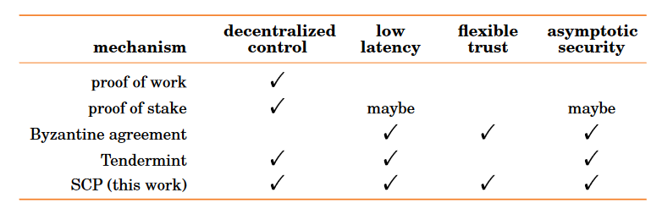
SCP COMPARED TO OTHER MODELS

Slide 8
Federated Byzantine agreement System (FBAS)
FBAs Combine Byzantine agreement with decentralized control by determine quorums in a decentralized way
FBAS achieves this using quorum slices and consensus protocol
Quorum slices:
•Each node v picks one or more group of nodes (quorum slices)
•v acts on a statement only if one of its slices eventually agrees
Def :FBAS is a pair <V;Q> comprising a set of nodes V and a quorum function Q : V →2^(2^v ) specifying one or more quorum slices for each node, where a node belongs to all of its own quorum slices—i.e., ∈ ∀v∈V, ∀q∀Q(v), v∈q
Quorum: A set of nodes U ⊆ V in FBAS <V;Q> is a quorum iff U =ø and U contains a slice for each member—i.e., (∀v ∈ U, ∃q ∈ Q(v) such that q ⊆ U).
Notes:
addresses the problems involved in updating replicated states
traditional majority-based quorums do not work, malicious parties
each update by a unique slot
Node v, slot i, change x. Draw on board
Quorum:A quorum is a set of nodes sufficient to reach agreement.

Slide 9

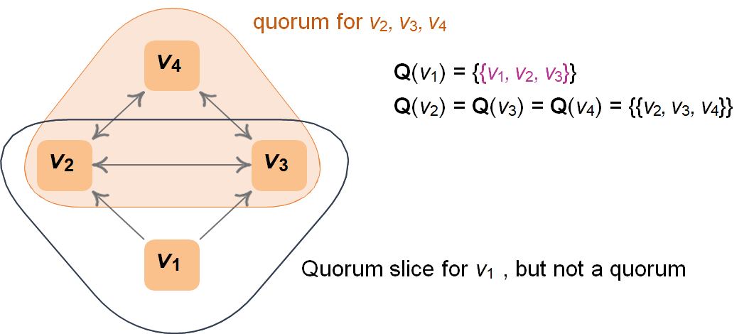

Slide 10

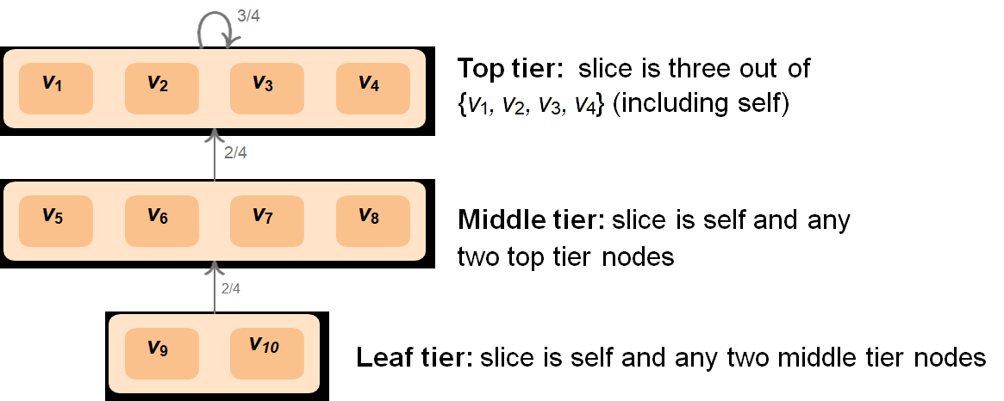
Notes:
top tier, Practical Byzantine Fault Tolerance f =1

Slide 11
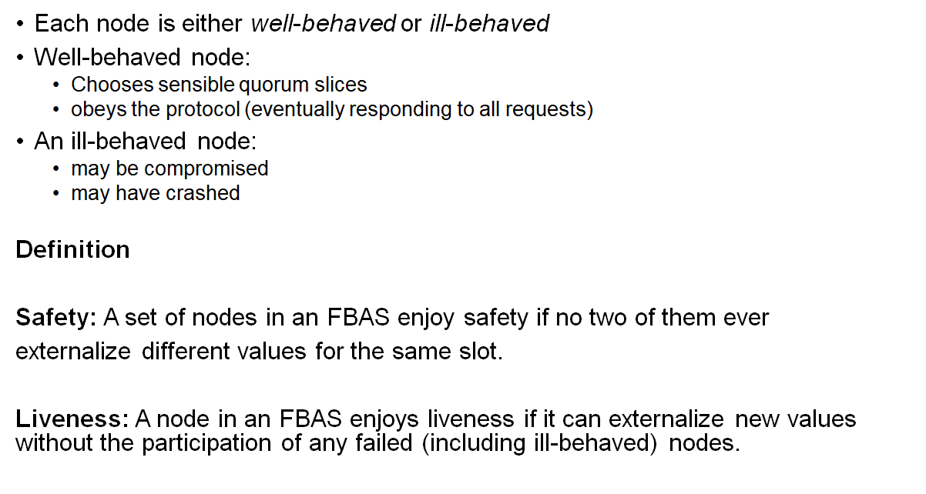
Notes:
well behaved externalize correct, 2 issues :externalizing diff values, nodes can actually externalize values

Slide 12
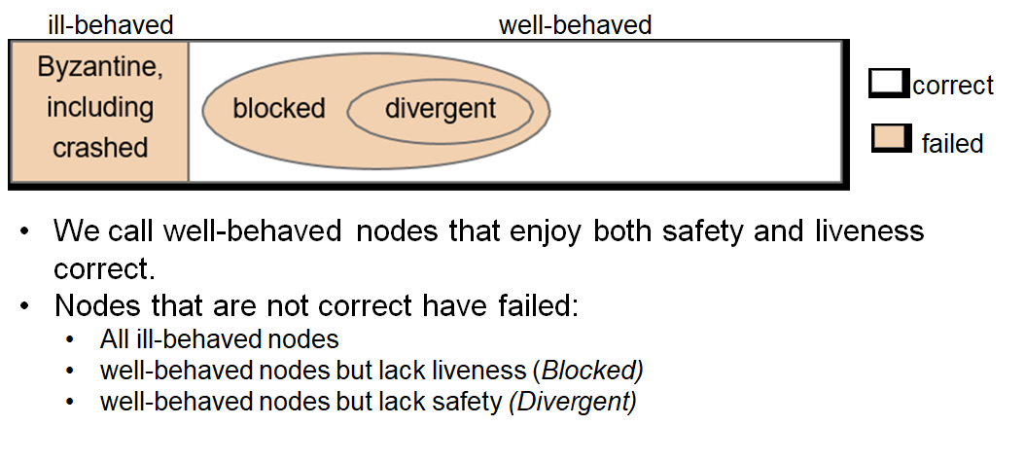
Federated Byzantine agreement System (FBAS)

Slide 13
OPTIMAL RESILIENCE: A few terms
Slots:
Can be a numbered position in sequentially applied log
2) Externalising a value

Slide 14
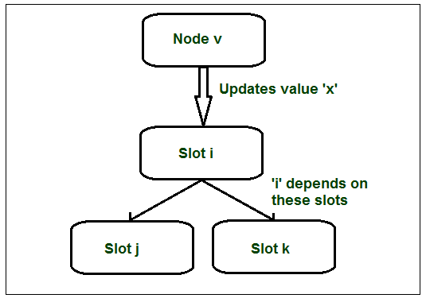
SLOTS AND EXTERNALISATION

Slide 15
OPTIMAL RESILIENCE
Goal:
1) Safety
2) Liveness

Slide 16
OPTIMAL RESILIENCE
Depends on many factors, example:
1) Quorum slices
2) Ill-behaved nodes
3) Consensus protocol
4) Network behaviour

Slide 17
BEST WAY TO GAURANTEE AGREEMENT?
HOW DO WE WAY TO GAURANTEE AN AGREEMENT IN FEDERATED BIZANTINE AGREEMENT SYSTEMS?

Slide 18
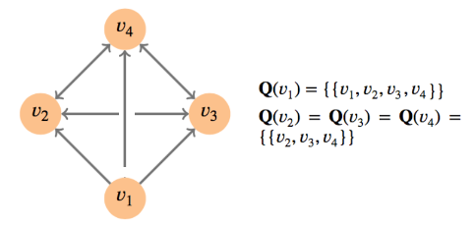
OPTIMAL RESILIENCE
Quorum intersection
The quorums share a node

Slide 19
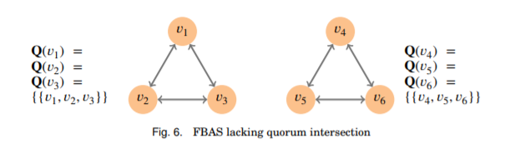
OPTIMAL RESILIENCE
Quorum intersection:
Any two of the quorums share a node

Slide 20
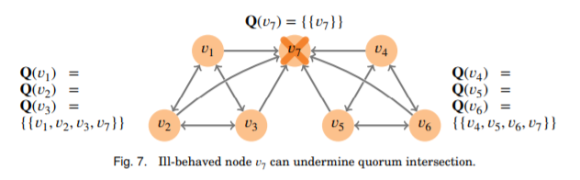
OPTIMAL RESILIENCE
Quorum intersection:

Slide 21
OPTIMAL RESILIENCE: Conclusion?
Quorum intersection:
In short, FBAS (V,Q) can survive Byzantine failure by a set of nodes B ⊆ V iff (V,Q) enjoys quorum intersection after deleting the nodes in B from V and from all slices in Q.
V: Set of nodes B: Faulty nodes that are a subset of V
Q: Quorum function

Slide 22
OPTIMAL RESILIENCE
Dispensable sets:
Set of failed nodes in spite of which it is possible to guarantee both safety and liveliness.

Slide 23
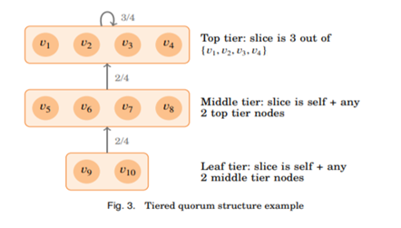
OPTIMAL RESILIENCE
Dispensable sets:

Slide 24
OPTIMAL RESILIENCE
Dispensable sets:
To prevent a misbehaving DSet from affecting the correctness of other nodes, two properties must hold:
Deleting the DSet cannot undermine quorum intersection
2) The DSet cannot deny other nodes a functioning quorum.

Slide 25
Stellar Consensus Protocol (SCP)
•First FBA protocol, guarantees safety & liveness for intact nodes
•Also guarantees safety for nodes enjoying quorum intersection
-Conservative quorum slices endanger liveness, not safety
•SCP does not optimize all axes, however:
-Communication complexity (# messages/rounds)
-Recovery from liveness failures (after reconfiguration)
-Efficient over Byzantine network behavior
•The core of the protocol is federated voting
-Nodes exchanges votes to agree on statements
-Every vote includes the voter’s quorum slices
-Dynamically discover quorums while assembling votes

Slide 26
Stellar Consensus Protocol (SCP)
Consists of two sub-protocols, at high level:
-Nomination Protocol
-Ballot Protocol
Nomination Protocol- produces candidate values
- conciliator: synchronous strategy based on timing assumption
- works by converging on a set of candidate values for a slot
Properties:
- Intact nodes can produce at least one candidate value
- set of possible candidate values stop growing
- if node considers x as candidate value, eventually every intact node will consider x to be a candidate value
Caveats:
- no-way of knowing when the nomication protocol has reached the point of convergence
- Even after convergence, ill-behaved nodes may be able to reset the nomination process a finite number of times
Notes:
prop1- irrefutable
prop2- finite amount of time
prop3 - theorem 11

Slide 27
Stellar Consensus Protocol (SCP)
Ballot Protocol- nodes that have a composite value
- a ballot b is a pair of the form b = <n,x>
where x is the value, b is the referendum to externalize x, and n is counter to indicate ballot number
Properties:
- at most one value chosen for a given slot
- all committed and stuck ballots must have same value
States:
- prepare - commit b is valid to vote only if b is confirmed prepared
- commit - to commit b and externalize x, SCP nodes first accept and confirm b is prepared, then accept and confirm commit b. Before the first intact node votes for commit b, the prepare step, through federated voting, ensuring all intact nodes can eventually confirm b is prepared

Slide 28
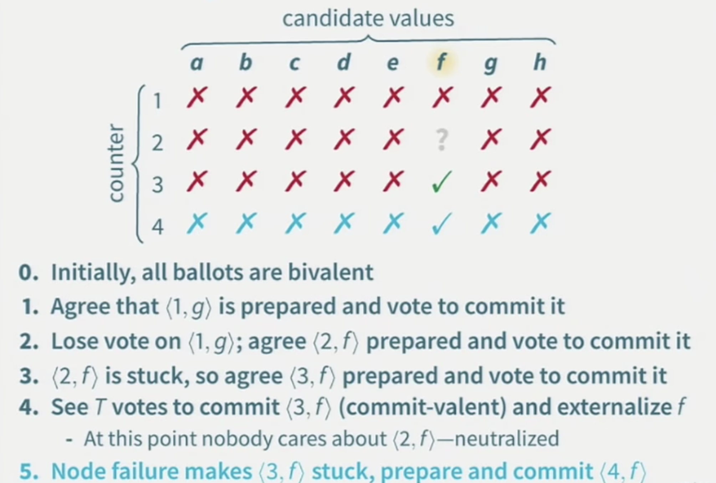
Stellar Consensus Protocol (SCP)

Slide 29
Federated voting
•Each node v can vote for a statement a provided
1.a is valid and consistent with past statements v accepted, and
2.v has never voted against a and promises it never will.
Definition (ratify): A quorum Ua ratifies a statement a iff every member of Ua votes for a. A node v ratifies a iff v is a member of a quorum Ua that ratifies a.
•Result: well-behaved nodes enjoying quorum intersection cannot ratify contradictory statements
•Problem: intact node v may be unable to ratify a after others do
- v might have voted against a, or
- Some nodes that voted for a may subsequently have failed

Slide 30
Core Idea -FV
1.)Nodes exchanges vote messages to agree on statements
2.)Every message also specifies the voters quorum slices.
3.)Allows dynamic quorum discovery while assembling votes.

Slide 31
Ratify
1.) A quorum U ratify a statement “a” if every member of u votes for a.
2.) A node v ratifies “A” if v is member of a quorom u that ratifies a.
Well behaved nodes enjoy quorum intersection despite with ill nodes –Won’t ratify contradictory statements

Slide 32
Accepting
Node v accepts statement a consistent with history if either
1.)A quorum containing v each either voted for or accepted a
2.)Each member of set claims to accept A
Intact nodes cannot accept contradictory statements
Problems:-
1.)Suboptimal safety
2.)Intact nodes cannot accept the statement.

Slide 33
Confirmation
1.) A Quorum confirms a statement a by ratifying the statement “we accepted a” A node confirmed a if its is in such a Quorum
Once a single intact node confirms a statement all intact nodes will eventually confirms it.
Solution-
1.Suboptimal safety-Straight up ratification
2.Intact vote won’t vote against the fact the statements are accepted

Slide 34
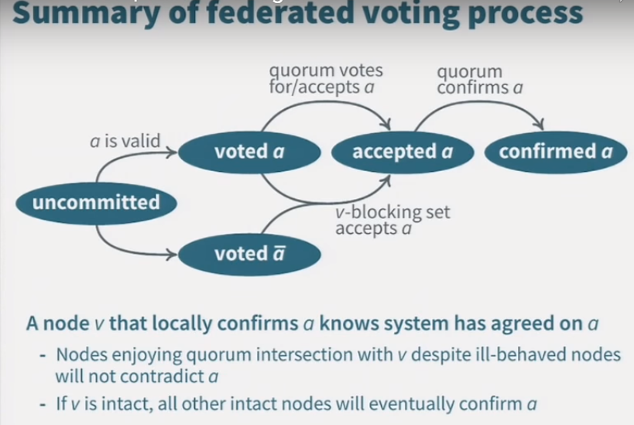

Slide 35
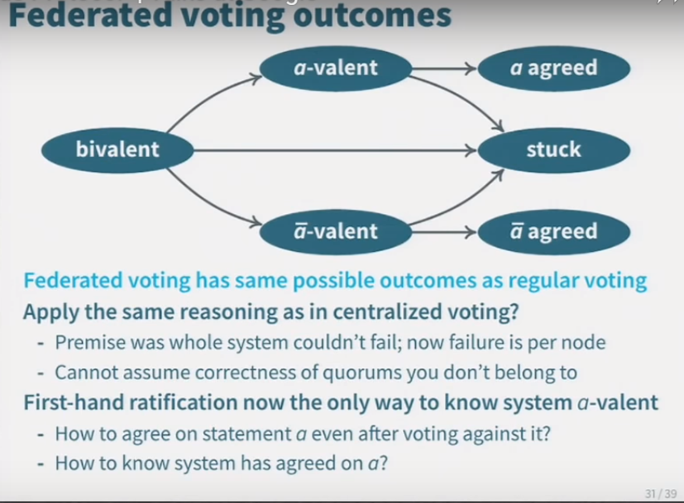

Slide 36
LIMITATIONS OF SCP
SCP can only guarantee safety if nodes choose adequate quorum slices. If security depends on a user-configurable parameter, there is always a possibility of human error.
Even if the proper quorum slices are chosen it does not rule out the possibility of some security issues like a trusted node using their position in the network to obtain information for unethical purposes.

Slide 37
LIMITATIONS OF SCP
It requires continuity of participants over time.
If all the nodes simultaneously and permanently leave the network it will cause an outage and restarting consensus will require central co-ordination or human level agreement.

