Slide 1

Presented By :
SuryaVamsi Pasam

Slide 2
Sea-Cuts
Vitamin-Sea
Abstract :
Seafood is a vital source of protein and nutrients for many people, and there is no lack of seafood lovers across the world. After cereals, seafood is believed to be the most important food source for humans, one that accounts for about 15% of the world population’s protein intake.
It serves as a vital source of protein, essential fatty acids like omega-3s, vitamins, and minerals that contribute to human health. Globally, seafood consumption has cultural, nutritional, and economic significance, playing a crucial role in sustaining millions of livelihoods, particularly in coastal communities.

Slide 3
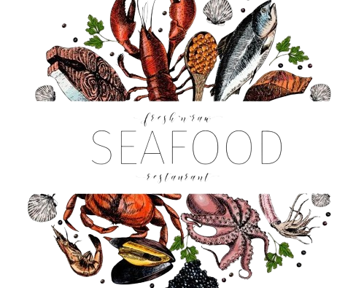
The idea behind selecting seafood as a theme for webpage design is :
Appealing Visual Aesthetic
Vibrant colours , texts and Nature’s beauty.
Soothing, fresh, and dynamic design.
Health and Nutrition.
Showcasing Recipes and Products.
Connection to the Ocean and Lifestyle.
Freshness and Quality.

Slide 4
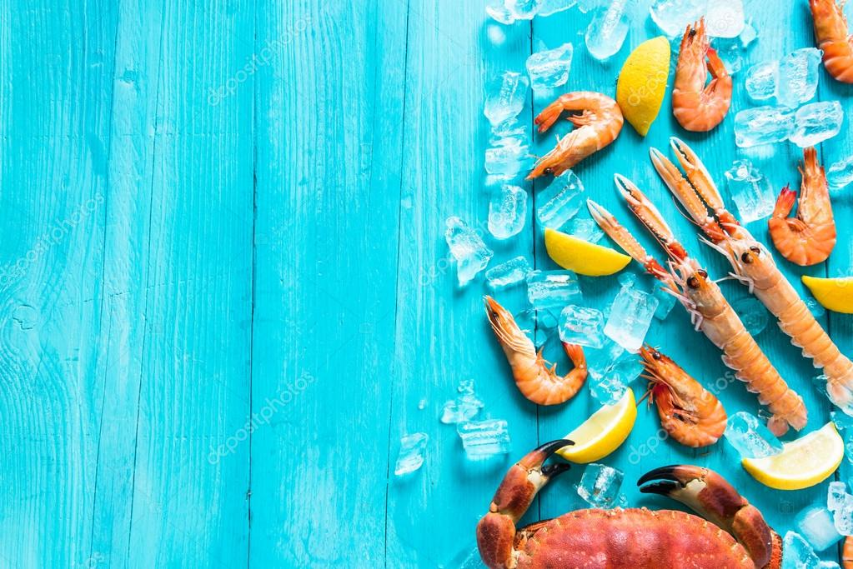
Technologies Used :
HTML5 : Basic Tags like heading, paragraph, div , section etc….
CSS : Basic properties like background-color , padding, font, border etc…..
Bootstrap :
Nav-bar
Carousel
Cards

Slide 5

Webpage URL : https://seacuts-webpage.netlify.app/

