Slide 1
SPLUNK
Deep Dive

Slide 2
Contents:-
Installation in windows and Linux.
Adding Server Logs .
Basic Searching.
Configuring Alerts.
Creating Reports.
Creating Dash Board.
AppDynamics Add-on.
Jenkins Plug-in.
Storage in Splunk.

Slide 3
1. Installation in windows and Linux.
Windows Installation:
For installing Splunk Enterprise, we need to install universal forwarder on the client server where we need to get the logs.
For downloading Universal forwarder,
Go to : https://www.splunk.com/en_us/download/universal-forwarder.html

Slide 4
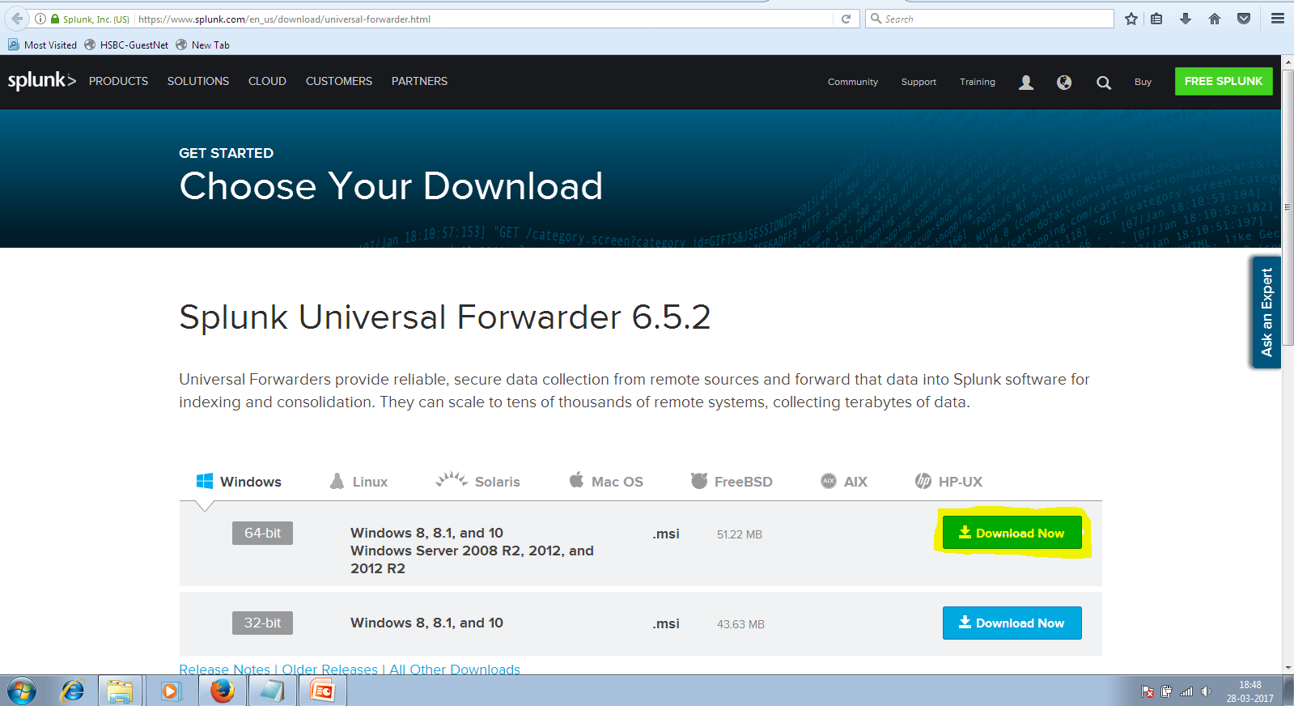
Download the required version based on requirements.

Slide 5
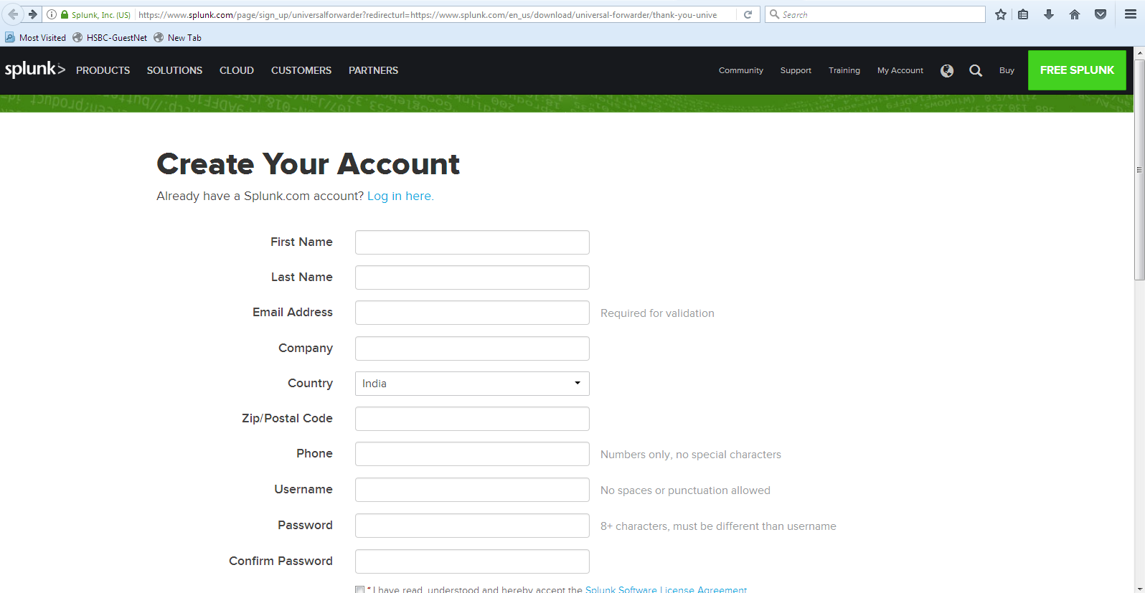
For downloading the Universal Forwarder, we need to login or signup the form.

Slide 6
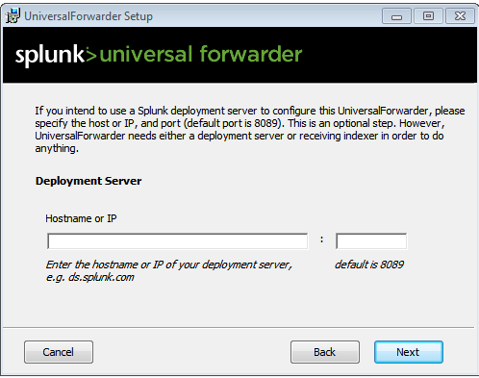
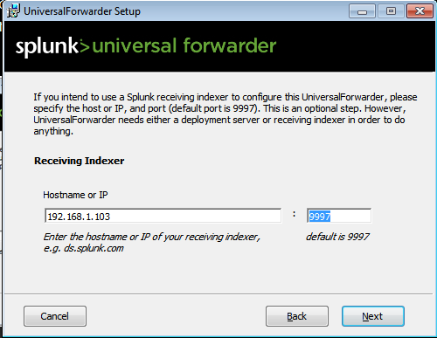
After downloading, click on the application and agree the license.
Enter the hostname and default port number for in the dialogue box as shown below.
Enter the receiver ip address and port number.
Click on install, It will automatically get installed on the client server where we want to get the logs.

Slide 7
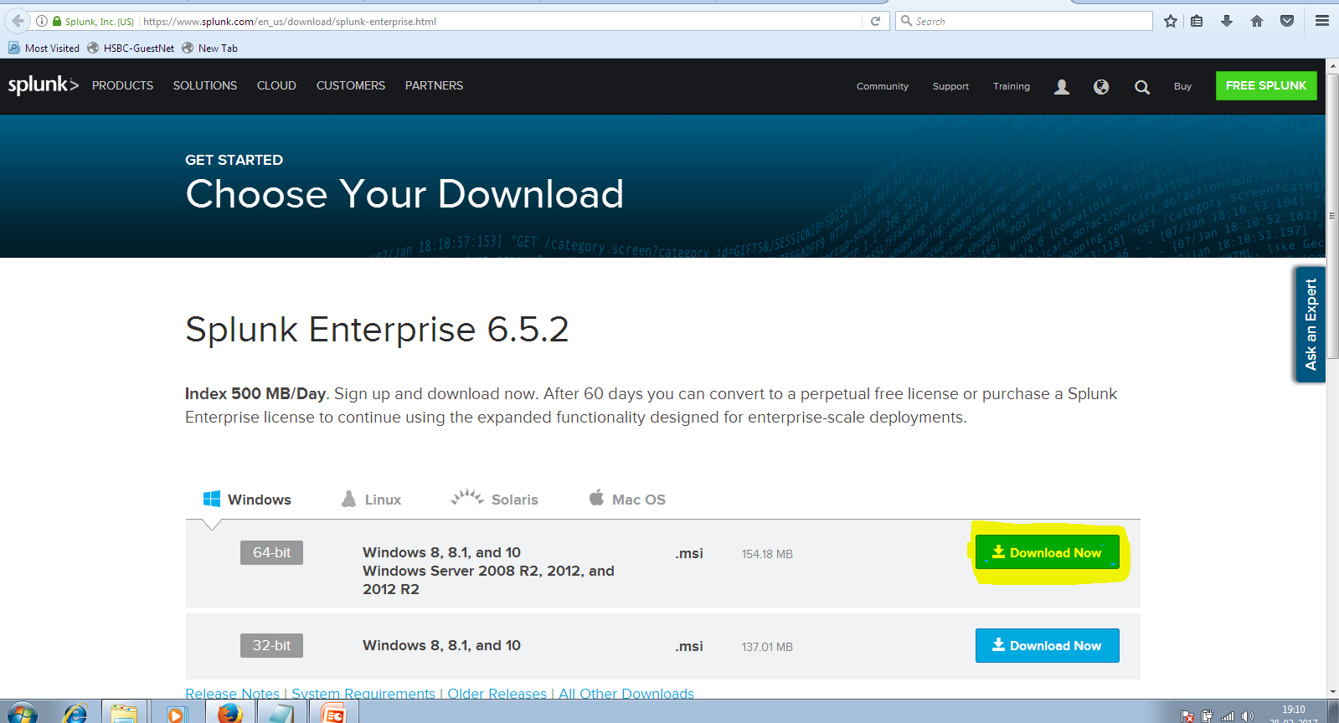
Install Splunk Enterprise on your host.
For that
Goto: https://www.splunk.com/en_us/download/splunk-enterprise.html
Download the required version.

Slide 8
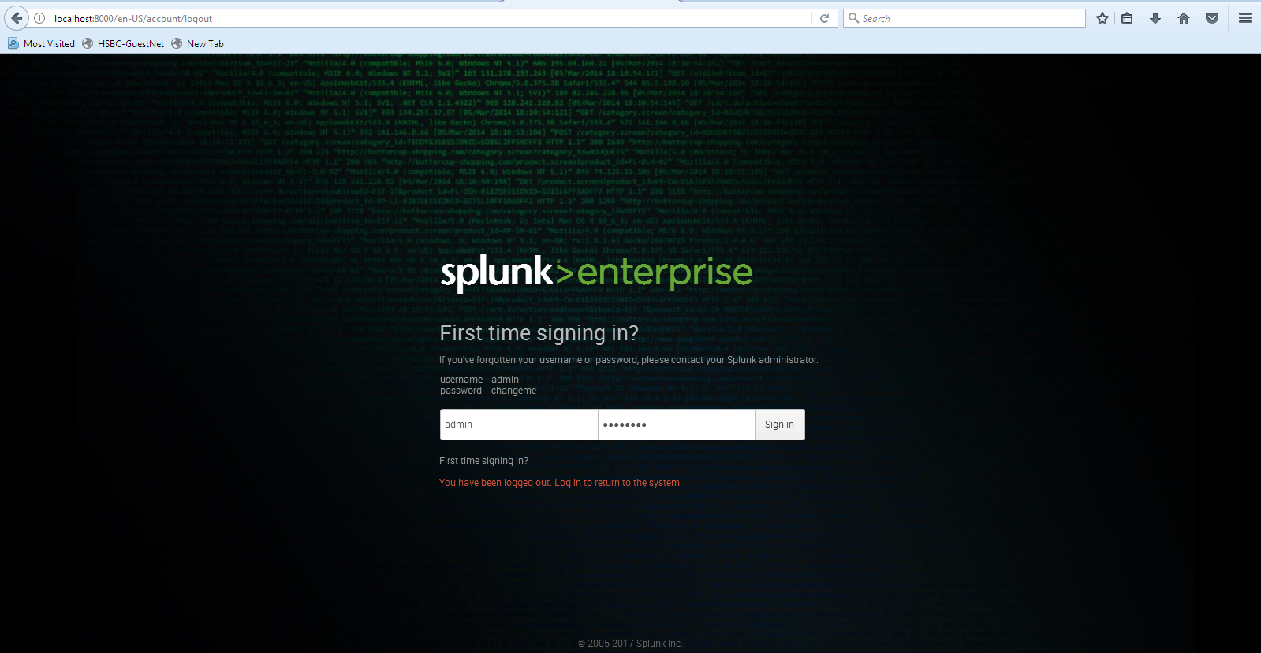
After downloading, click on the .msi file and run the program, you will get the login page.

Slide 9
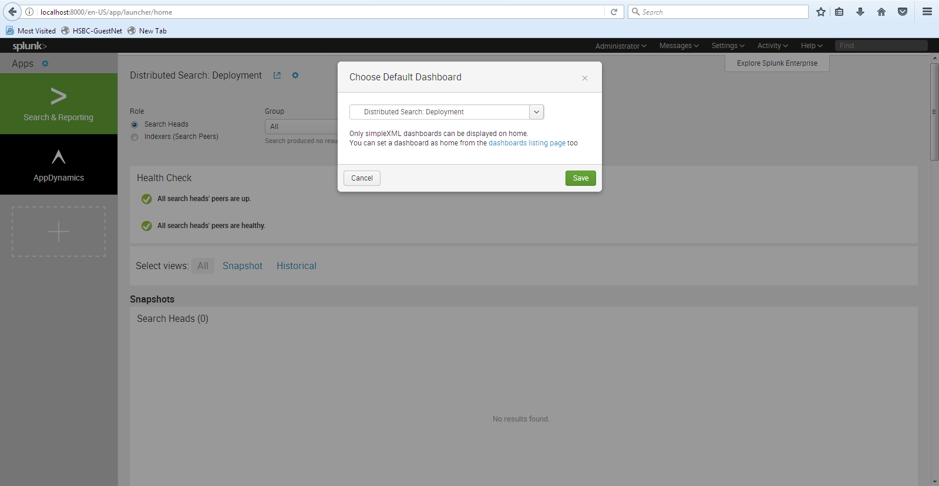
Login with default values as shown . You will get the login page as below.

Slide 10
Linux Installation:
For installation of Universal forwarder through command line.
wget -O splunkforwarder-6.5.2-67571ef4b87d-linux-2.6-x86_64.rpm 'https://www.splunk.com/bin/splunk/DownloadActivityServlet?architecture=x86_64&platform=linux&version=6.5.2&product=universalforwarder&filename=splunkforwarder-6.5.2-67571ef4b87d-linux-2.6-x86_64.rpm&wget=true‘
The splunk forwarder will be downloaded on to your local system.

Slide 11
We need to change the permissions of the downloaded file with below command and move it to /opt/ folder.
Sudo chmod 744 Splunk_package.rpm
To install the rpm file, we need to run the
Sudo rpm –i splunk_packager.rpm
To forcibly install the splunk we used to add the –ivh attributes.
Starting /Stopping the Universal Forwarder:
Goto Splunkforwarder_homedirectory/bin
./splunk start ➔ to start the splunk
./splunk stop ➔ to stop the splunk

Slide 12
Configuring Splunk: Goto bin folder in splunk and
./splunk add forward-server <host name or ip address>:<listening port> ➔ to configure receiving index (splunk server).
To configure the input file to get logs
./splunk add monitor /var/log
After setting the input and output files, restart the splunk server with
./splunk restart.

Slide 13
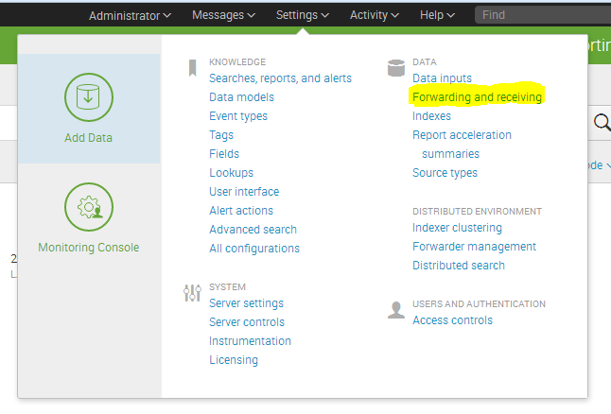
Configuring Splunk Server: For configuring the server, we need to set the forwarder and reciever in data menu.

Slide 14
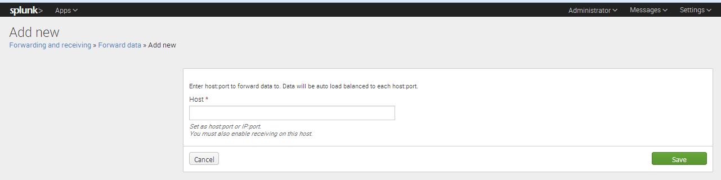
Configuring the Server:
Configuring the forward server

Slide 15
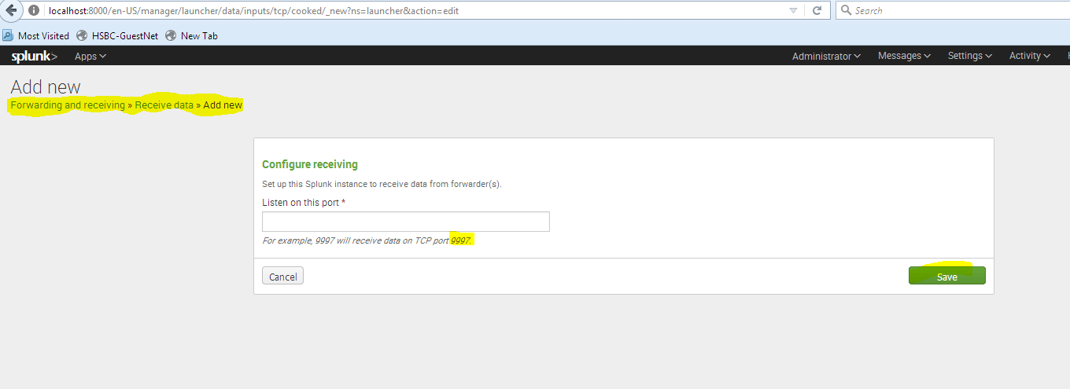
Setting up the receiving data port.
Basically the default port is 9997.

Slide 16
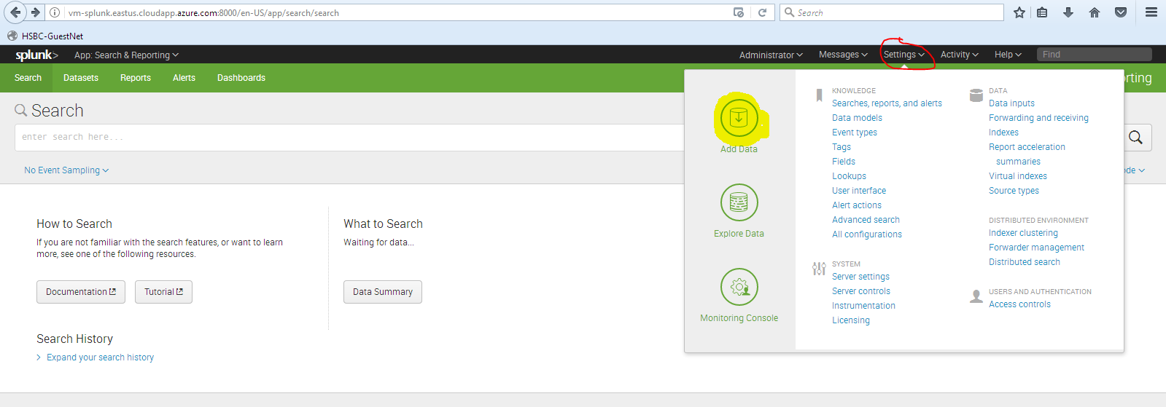
2. Adding Sever Logs
Go to Settings > Add Data > Forwarder

Slide 17
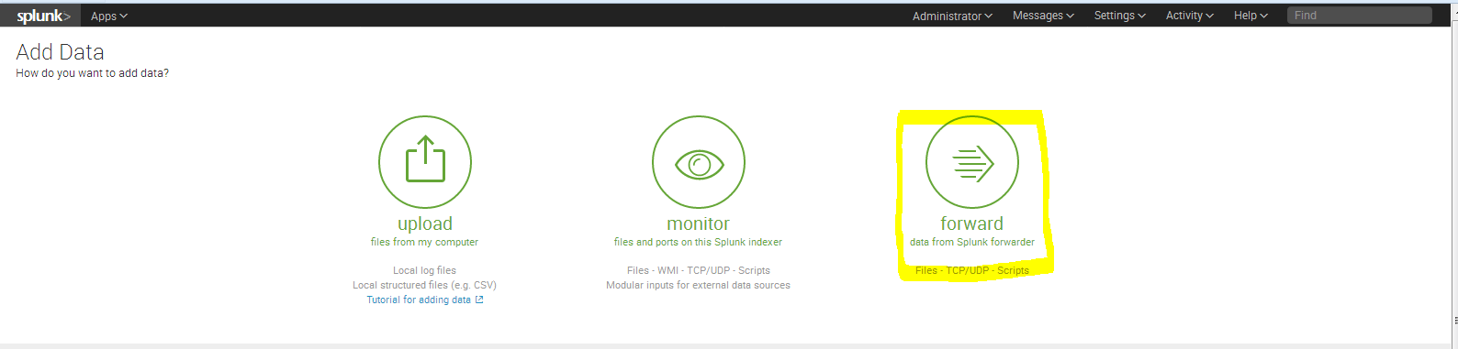
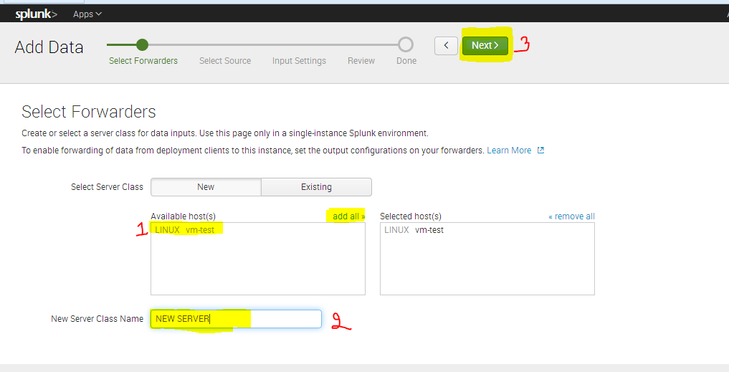

Slide 18
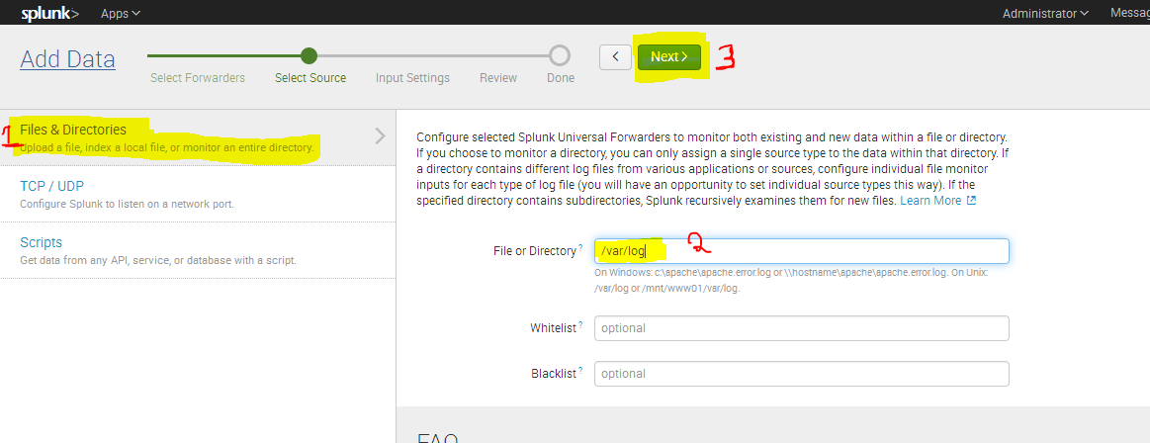
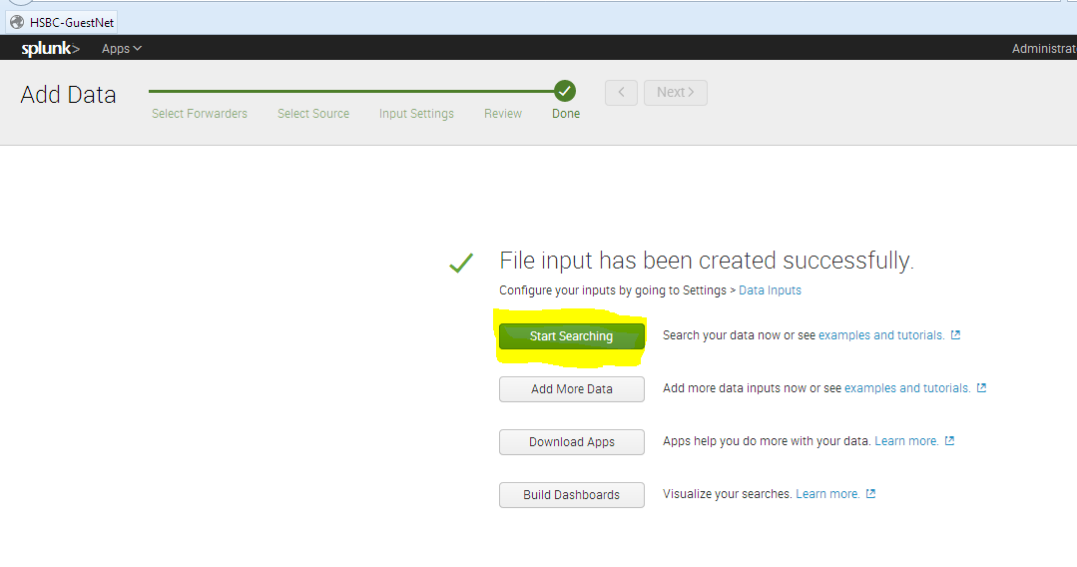
After few clicks you will get like this. Click on start searching.

Slide 19
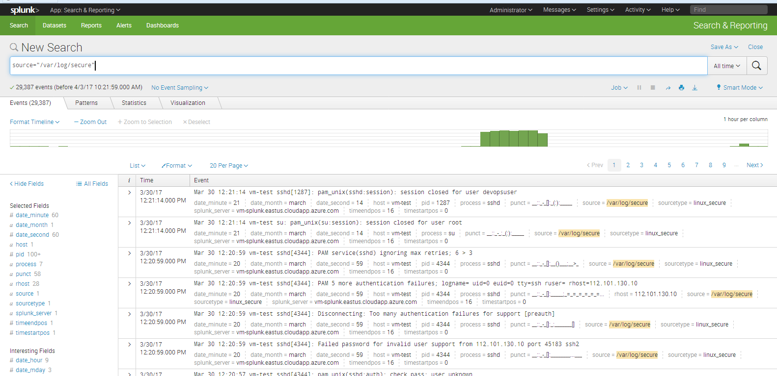

Slide 21
3. Basic Searching.
Searching in Splunk is done through a special language called Search Processing Language (SPL).
We can search the given data with below commands and combinations of regular expressions.
Pipe | plays the special role in the search of the data.

Slide 22
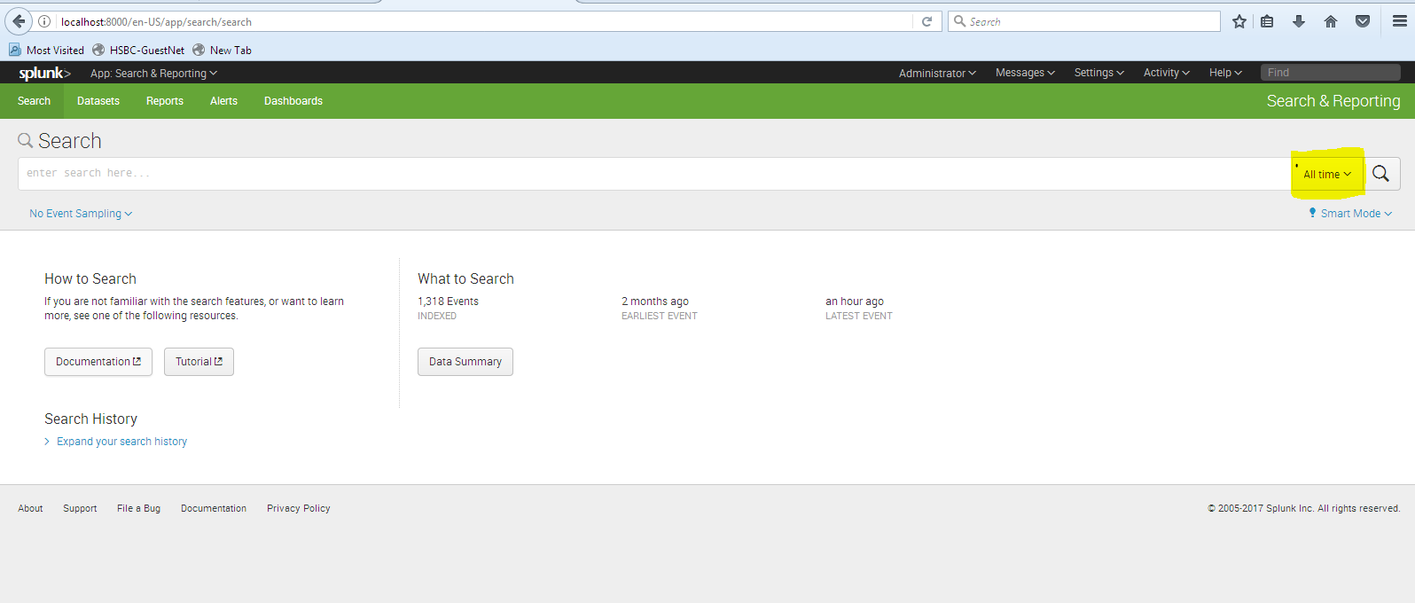
Default search page.

Slide 23
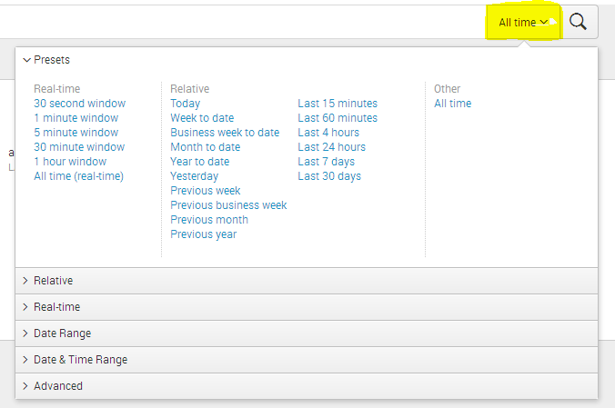
Searching data on time based events.

Slide 24
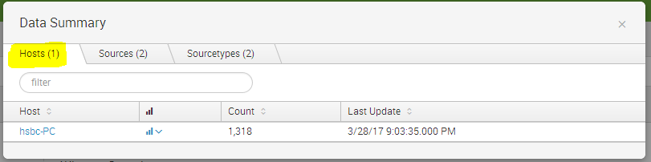
We can choose the ‘host’ from which we can derive data.
After selecting the host . It will display the log data as given below.

Slide 25
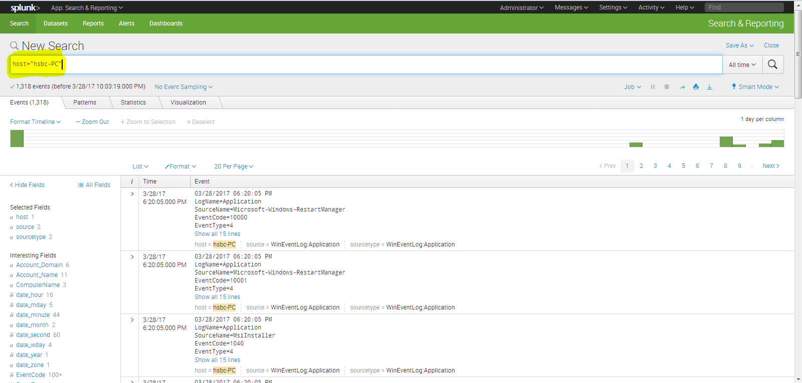

Slide 26
We use the below commands to sort the given data.
* -- to display all commands.
table -- to display in tabular format.
dedup -- to remove duplicate fields.
head -- to see the first ten values.
head 17 -- to see first 17 values.
tail -- last ten values by default. we can set the value by initiating the number.
fields - fieldname -- to remove the fieldname from the table fields.
rename field as "newfield" -- it will rename the field name as newfield.we can rename multiple names using ','(comma).
NOT abc* -- it will not display the field values that contains abc string.

Slide 27
NOT abc* -- it will not display the field values that contains abc string.
replace abc with "ABC" -- it will replace the field value of abc with ABC.we can replace multiple names using ','(comma).
sort fieldname -- it will sort the values of fieldname in ascending order.
sort fieldname + desc -- it will sort in descending order.
search object != fieldvalue -- to delete the field value in an row.
top -- it gives you the first ten values ****head and top***
rare -- it shows you top least values.
stats count -- shows the number of events in the result.
stats count as "EventCount" -- it will display the count and rename as EventCount.
stats sum(salary) by Employee -- it will show each employee salary.
It also uses functions like sum , max, min, avg.

Slide 28
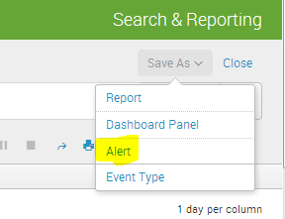
4. Configuring Alerts.
Alerts makes splunk proactive data into reactive.
Use alerts to monitor for and respond to specific events.

Slide 29
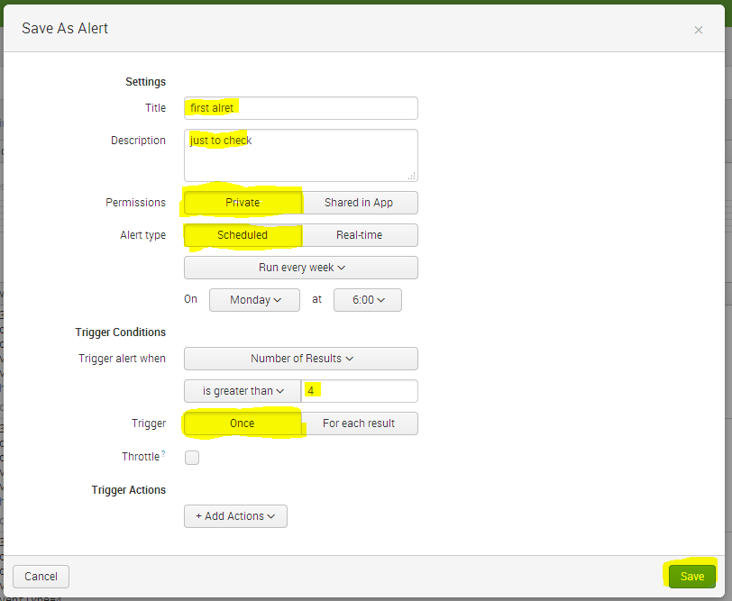

Slide 30
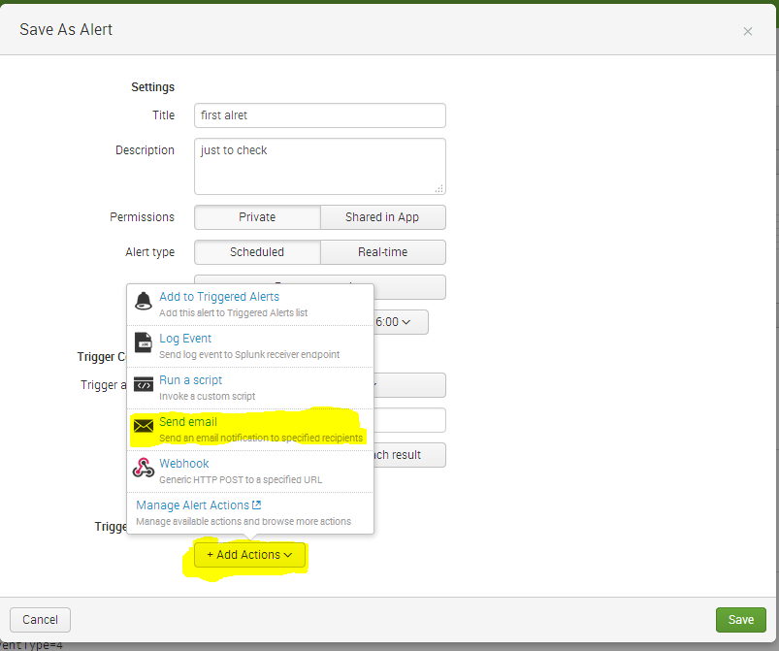

Slide 31
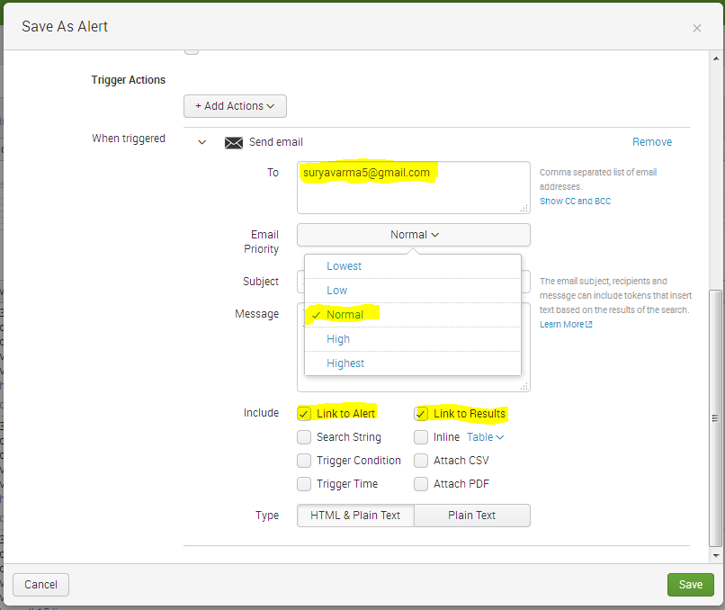

Slide 32
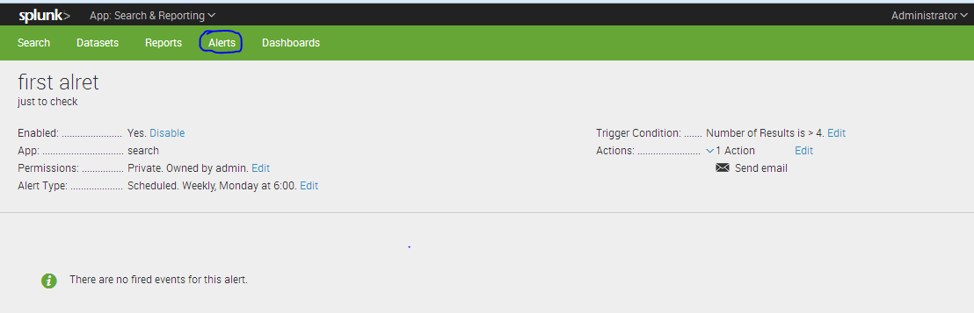
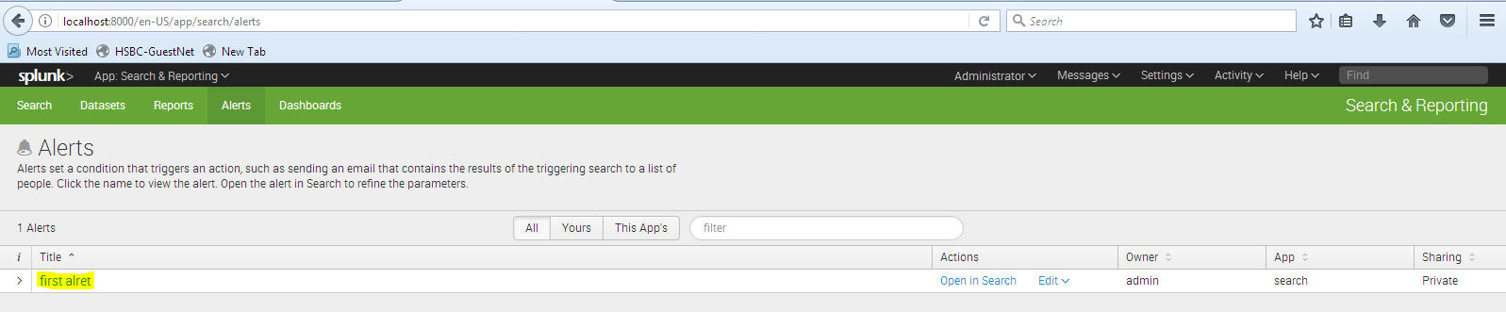
After creating alert, it will show as below.

Slide 33
5. Creating Reports.
Reports are created when you save a search or a pivot for later reuse. After a report is created, there's a lot you can do with it. In this manual, you'll find out how to:
Manually create and edit reports.
Accelerate slow-completing reports.
Set up scheduled reports.
Configure the priority of scheduled reports.
Understand how to generate PDFs of reports , dashboards, searches and pivots.

Slide 34
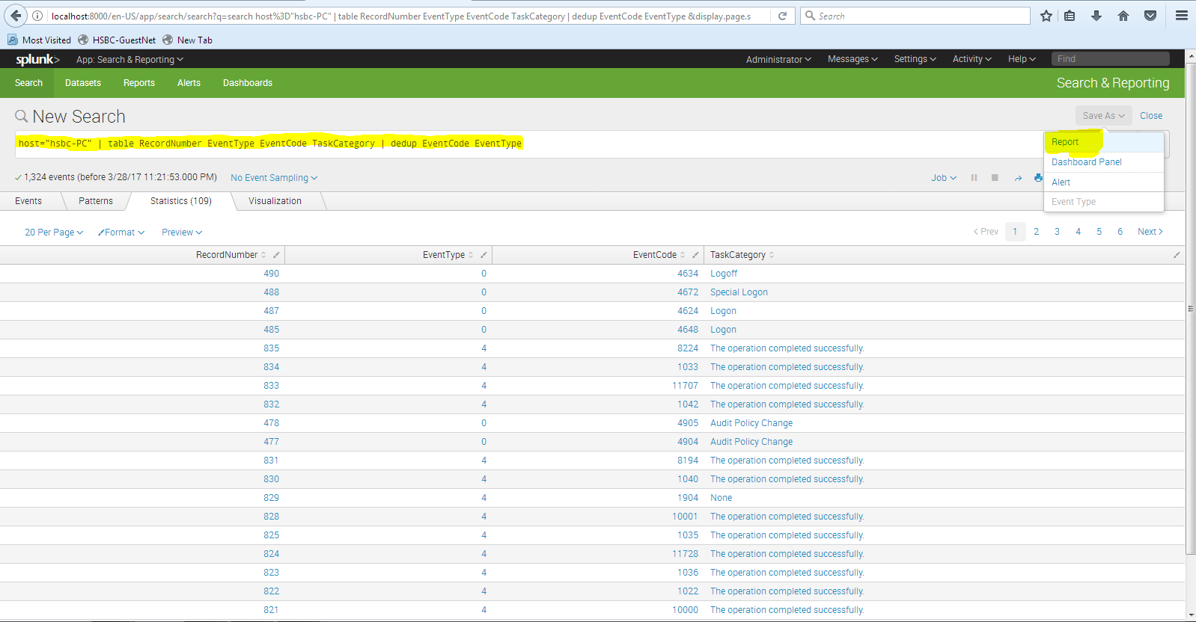

Slide 35
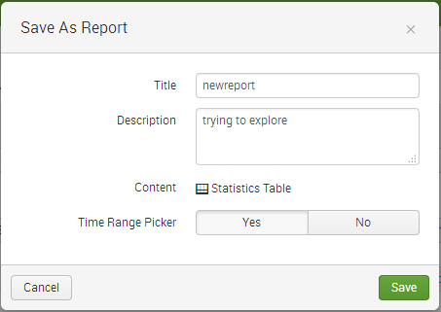
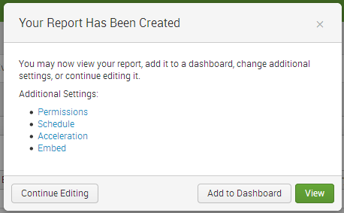
After filtering the data in the required format with required field values, we will create report for further use.

Slide 36
9. Jenkins Plug-in.
Splunk plug-in for Jenkins provides deep insights into your Jenkins master and slave infrastructure, job and build details such as console logs, status, artifacts, and an incredibly efficient way to analyze test results. The plug-in is used together with a Splunk App for Jenkins that provides out-of-the-box dashboards and search capabilities to enable organizations to run a high performing Jenkins cluster and bring operational intelligence into the software development life cycle.

Slide 37
10. Storage in Splunk.
As Splunk indexes your data, it creates a bunch of files. These files contain two types of data:
The raw data in compressed form rawdata.
Indexes that point to the raw data, plus some metadata files index files.
Each of the index directories is known as a bucket To summarize so far:
A Splunk "index" contains compressed raw data and associated index files.
A Splunk index resides across many age-designated index directories.

Slide 38
An index directory is a bucket.
A bucket moves through several stages as it ages:
Hot -$SPLUNK_HOME/var/lib/splunk/defaultdb/db/*
Warm-$SPLUNK_HOME/var/lib/splunk/defaultdb/db/*
Cold -$SPLUNK_HOME/var/lib/splunk/defaultdb/colddb/*
frozen - $SPLUNK_HOME/var/lib/splunk/defaultdb/thaweddb/*
We cannot search data from frozen stage.

