Slide 1
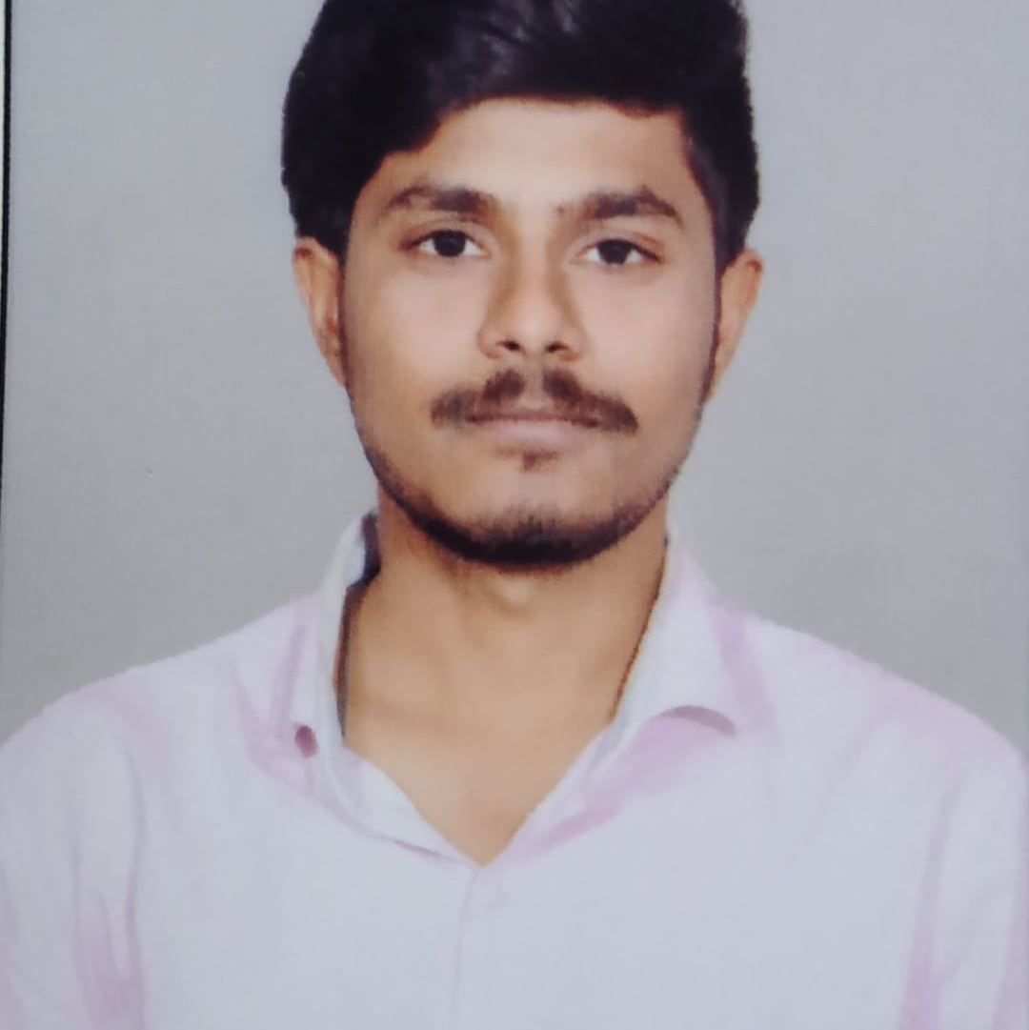
Veeravalli Sri Siva Surya Balaji
Analyst/Software Engineer
Bachelor of Engineering
Civil Engineering : 2018 - 2022
Skills
Java 8 /J2EE | Java Basics, OOPS, Generics, Collections, Arrays, Loops, Lambda Exp, Stream API Junit, Mockito, Servlets
Spring core | IOC & Dependency Injection, Autowired
Spring REST | REST controllers, Implementation of GET, POST, PUT & DELETE, Bean Validation & Exception Handling, Testing Services, Controller & Repository layer
Spring Boot Microservices | Spring Boot Starters, annotations, Messaging Service, Sync/Async comms, Swagger API documents
Spring Cloud | Eureka, Netflix Hystrix, Netflix Zuul & Config Server
React | Components, Hooks, Event handling, Redux, Reducers.
Database | MongoDB
UI Tech | HTML 5 & CSS 3,JavaScript, Reusable templates, Optimized UI Designed
Tools | Git, Postman, Maven, IDE
Add On skills | Communications, Team management. Peer learning
Bangalore
VEERAVALLI-SRI-SIVA-SURYA.BALAJI@CAPGEMINI.COM
+91 8106235579
A4
Full Stack Developer
Hands on experience in creating microservices with Springboot, Spring Security, Spring Cloud API Gateway, Eureka server.
Proficient in creating Single page Web Application in React.
React developer with working knowledge on ReactJS with react hooks, reactive forms, routing and Material UI.
Experience in creating documentation with Java docs and swagger and in unit testing using Junit, Mockito.
Development experience using Eclipse, IntelliJ, VS code, Postman API connection and MongoDB by Atlas.
Flight Booking System Application
Completed end to end case study of Flight Booking System Application along with JWT authentication, Swagger and payment testing using Stripe. Material-UI and React Bootstrap used for user interface.
Online Shopping application
Completed group case study on Online shopping application using spring boot with ReactJS.
Certifications
Certified in AWS cloud practitioner
Certified in Google Cloud Digital Leader

