Slide 1
Name:- suryavnshi shivam seat no-1406 guide name:Mahanoor mam
R.K. DESAI ACHCHHARIWALA COLLEGE OF COMPUTER & APPLIED SCIENCES, VAPI

Slide 2

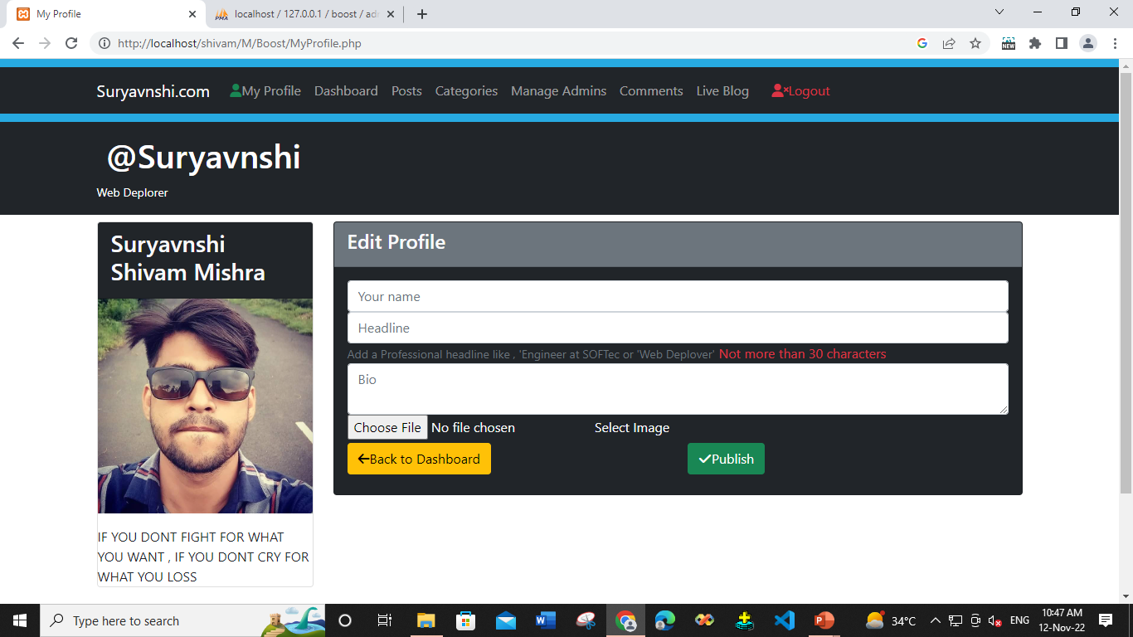
Blog website
Website:- https://uifoodadda.000webhostapp.com/Blog-Site/Blog.php

Slide 3
Front-end : HTML, CSS, JavaScript , jQuery , bootstrap Back-end : PHP , MYSQL Editor : Visual Studio Code Icons : Bootstrap , fontawsome
Required Software for our Website

Slide 4
Index
Serial no : | Topics : | Page no :
1 | Collage Name ,Guide Name , Sit No, Name | 1
2 | Web Site Title , Web Site Link, Web Address Scanner have | 2
3 | Required Software for our Website | 3
4 | Introduction Of Our Website | 5
5 | Objective | 6
6 | Flow chart OF Admin , DFD,1st level DFD, 2nd level DFD , 3rd level DFD,ER diagram | 7 to13
7 | Reference , website screen shorts | 14 to 21

Slide 5
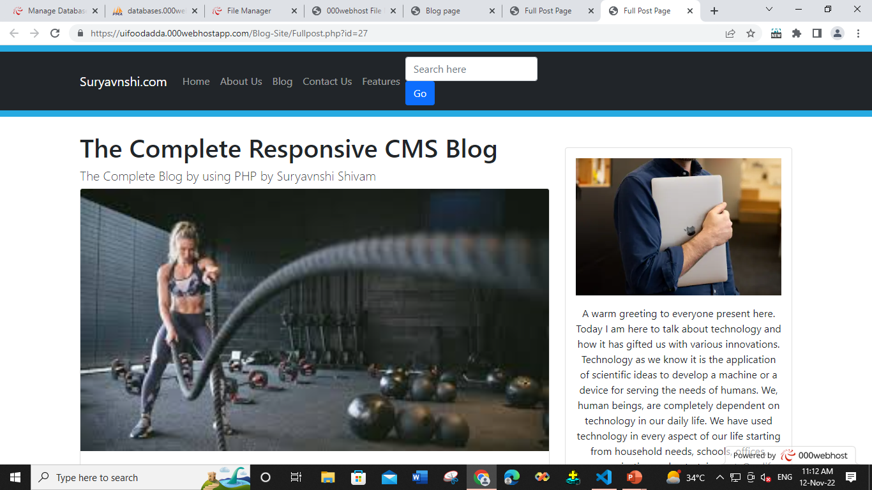
the introduction is basically the first paragraph that appears right below the blog post title. Depending on the blog design, the introduction usually displays above the fold (the section readers see when they visit a blog, without scrolling down)..
Introduction

Slide 6
Objective
s.no: | Advantages of Website
1 | Read Blog 24/7
2 | User Friendly
3 | Web site use any OS
4 | Multi user use web site at one time
5 | User comment of any blog
6 | Web site show any device Mobile , Laptop , Desktop etc Its Responsive website
7 | User see recent 5 post , categories, sign up

Slide 7
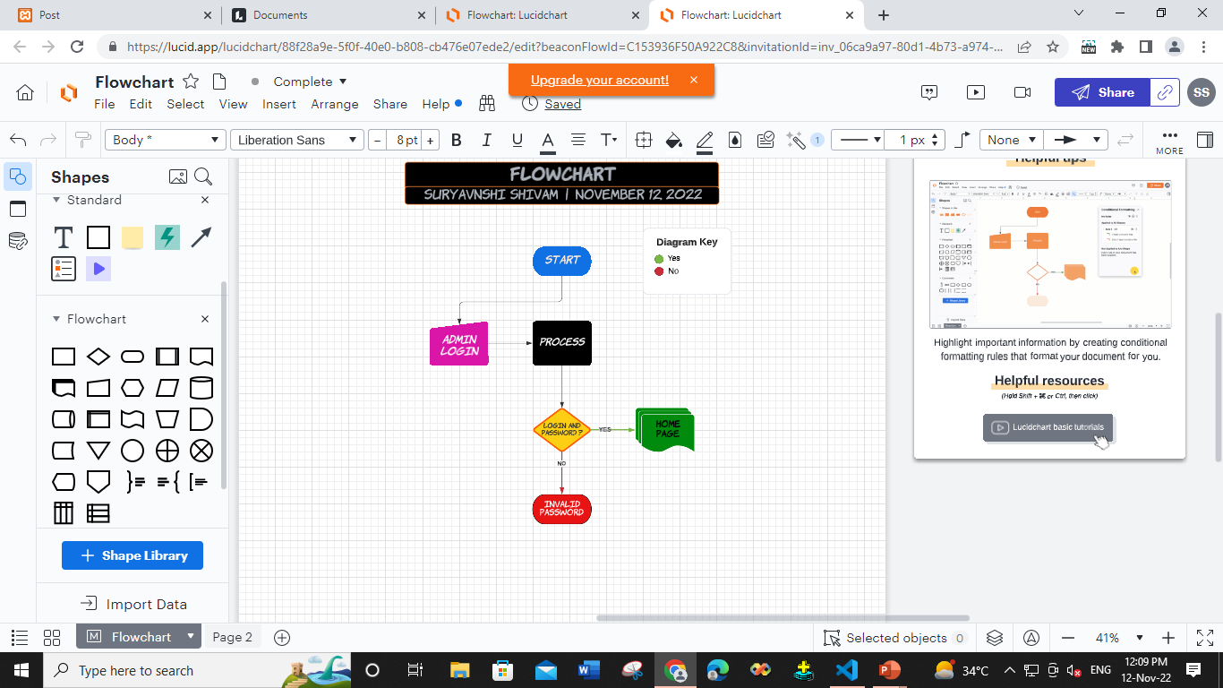
The system request that the enter admin admin name & password. The system validates the entered name and password and logs into the system
Flow Chart Of Admin Login

Slide 8
Data Flow Diagram
Zero Level / Context Level
ADMIN
USER
BLOG WEBSITE
System Give response
System Give response
Admin Connect System
User Connect System

Slide 9
1st Level of DFD
Login Success
1.0
Log in
Give name and Password
Admin
User
2.0
Blog
Response server
Response server
Admin manage Blog post
User read blog
Response server
3.0
Comment
Response server
Admin manage comment
User Send comment
4.0
Logout
Log out Success
Send Log Out Request

Slide 10
^{2nd} Level of DFD for 2.0 (blog post)
Admin
User
2.1
Update Blog
Response server
Admin manage Blog post
Response server
2.2
Delete Blog
Admin manage comment
2.3
View Blog
View blog
Response server
Provide Blog details
View blog

Slide 11
^{3rd} Level of DFD for 3.0 (Comment)
Admin
User
3.1
Update Comment
Response server
Admin update Comment
Response server
3.2
Delete Comment
Admin manage delete comment
3.4
Approved Comment
Response server
Approve comments

Slide 12
E-R diagram of admin management system
name
id
Admin Register
name
password
has
login
admin
Approve
password
name
Admin permission
Author by name
Date
manage
Delete
Admin
Name
Deleted

Slide 13
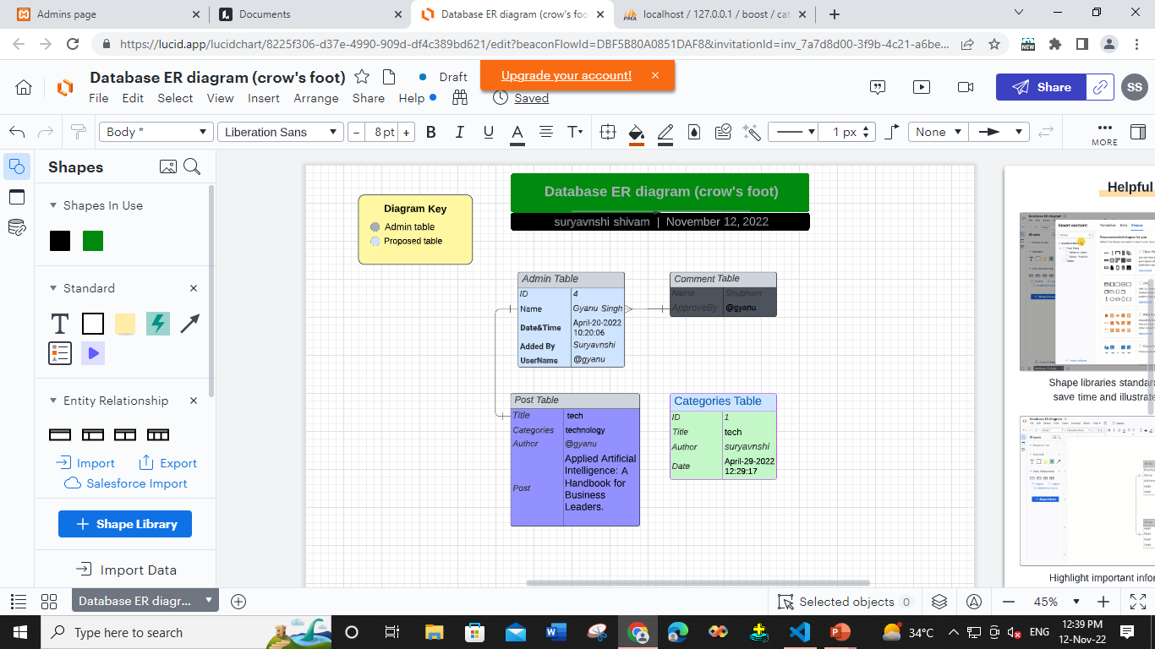
ER DIAGRAM

Slide 14
Projects Limits
s.No | Topic
1 | User login , log out
2 | User read comment without approval
3 | User set profile
4 | User shared blog
5 | User edit profile and comments
6 | User contact on our technical team
7 | User send message to specific admin

Slide 15
https://www.w3schools.com/ https://getbootstrap.com/ https://fontawesome.com/ https://locallhost.me/phpmyadmin https://www.youtube.com/ https://www.google.co.in/ https://stackoverflow.com/ https://unsplash.com/
Reference

Slide 16
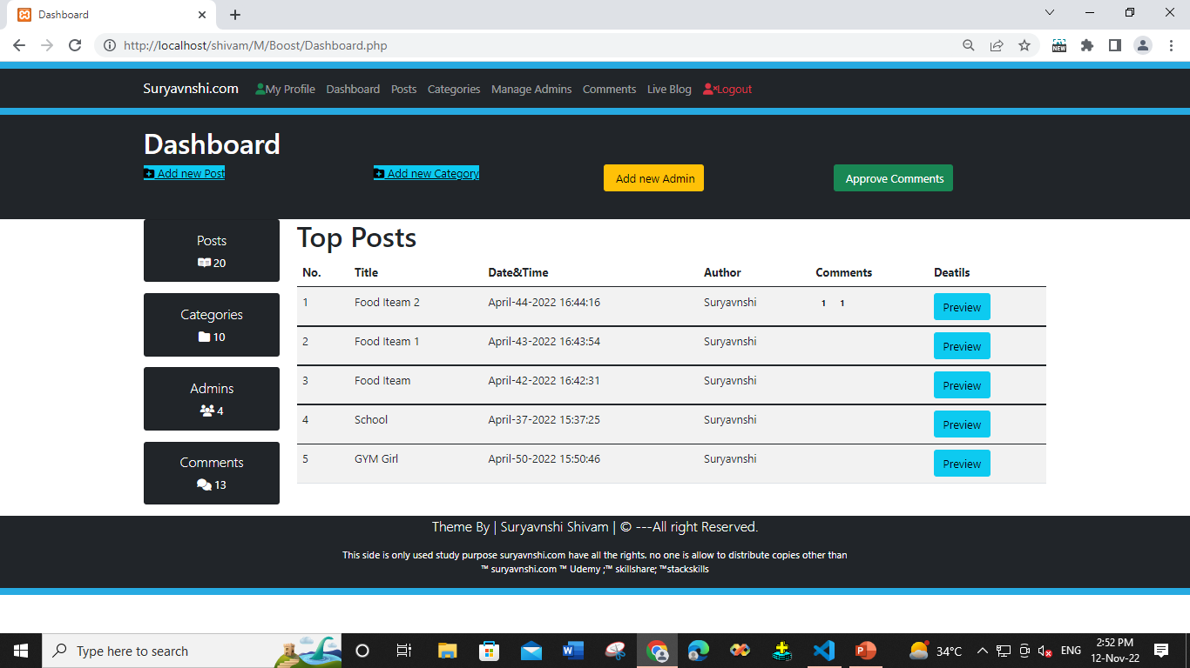
Home page

Slide 17
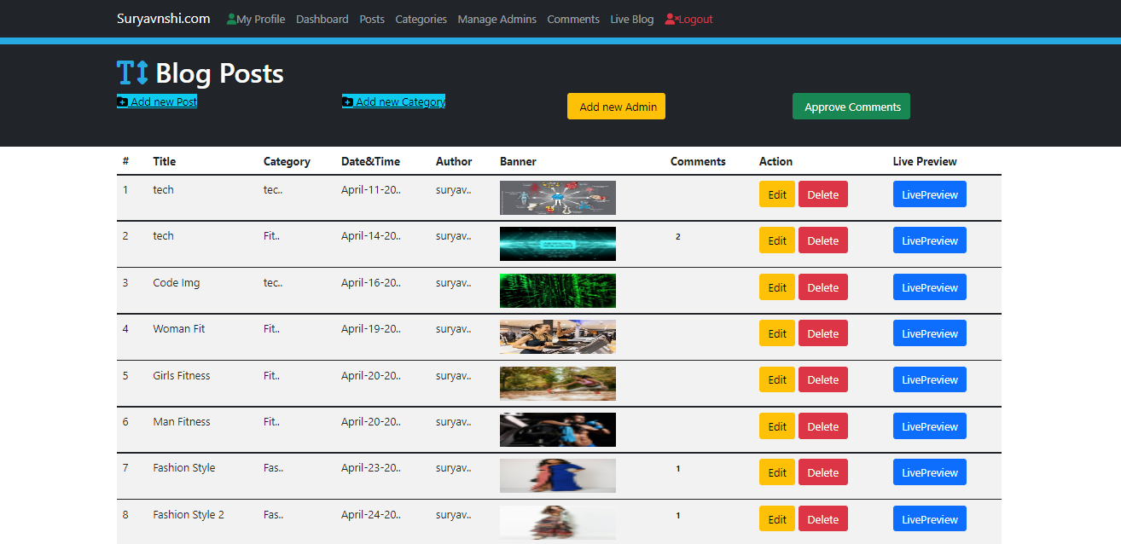
Blog Post

Slide 18
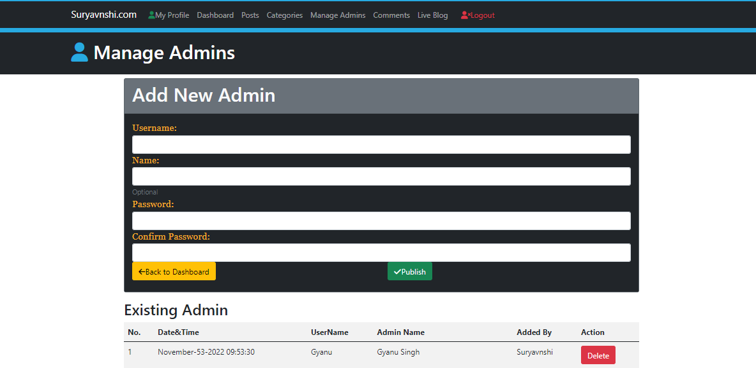
Manage Admin

Slide 19
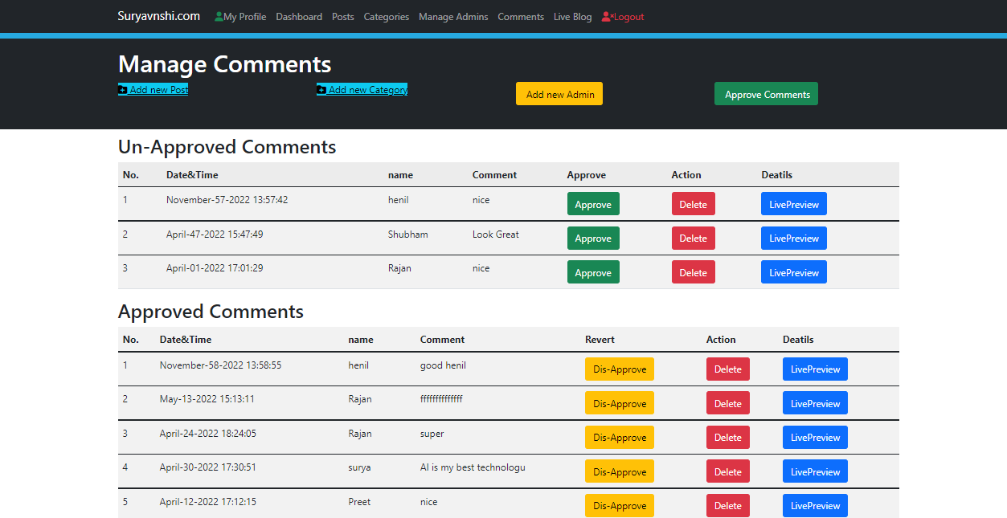
Manage comment

Slide 20
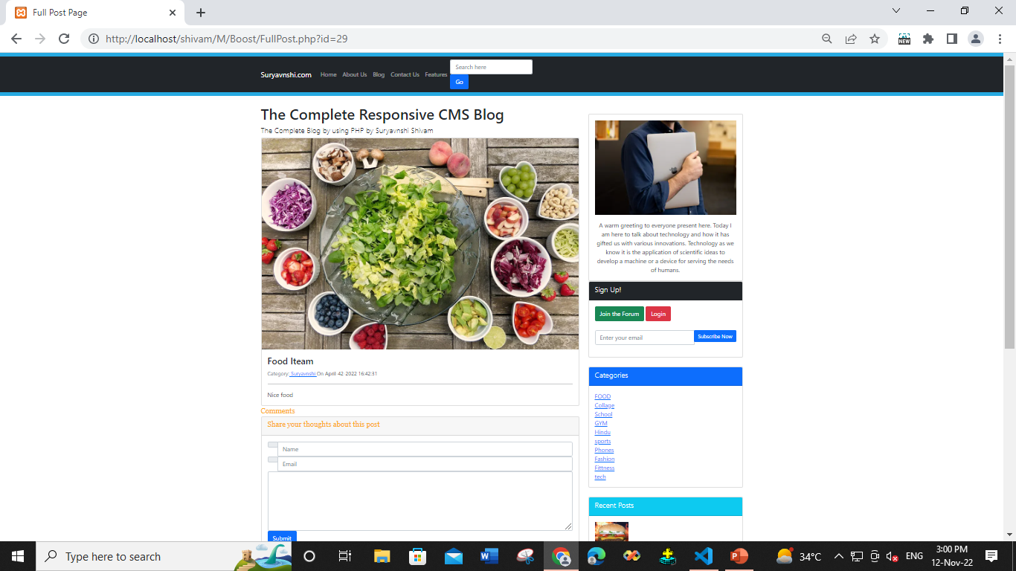
Blog Page

Slide 21


