Slide 1
Customer shopping behavior
A concise view of purchase patterns, category performance, and growth levers

Slide 2
3,900 purchases reveal a loyal customer base with room to grow subscriptions
$59.76
Average purchase
3.75
Average rating
CUSTOMER MIX
RETURNING
NEW
3,116 loyal
701
83

Slide 3
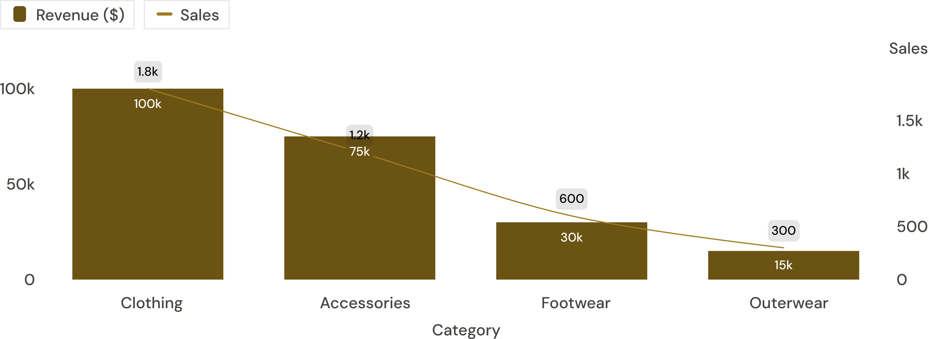
Clothing drives the business, while accessories form the second engine
Revenue and sales by category
Clothing approximately $100K revenue and roughly 1,800 purchases; Accessories approximately $75K and roughly 1,200.

Slide 4
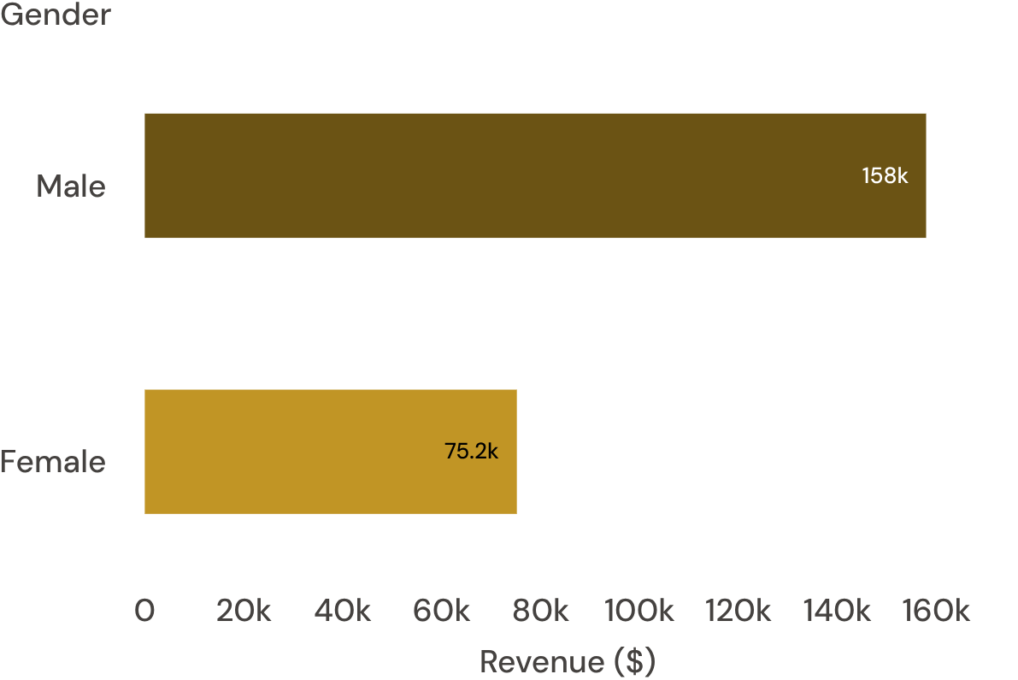
Male customers generate more than twice the revenue of female customers
Male revenue is $157,890; female revenue is $75,191.
Implication: Test whether assortment, promotion, or customer mix explains the gap.

Slide 5
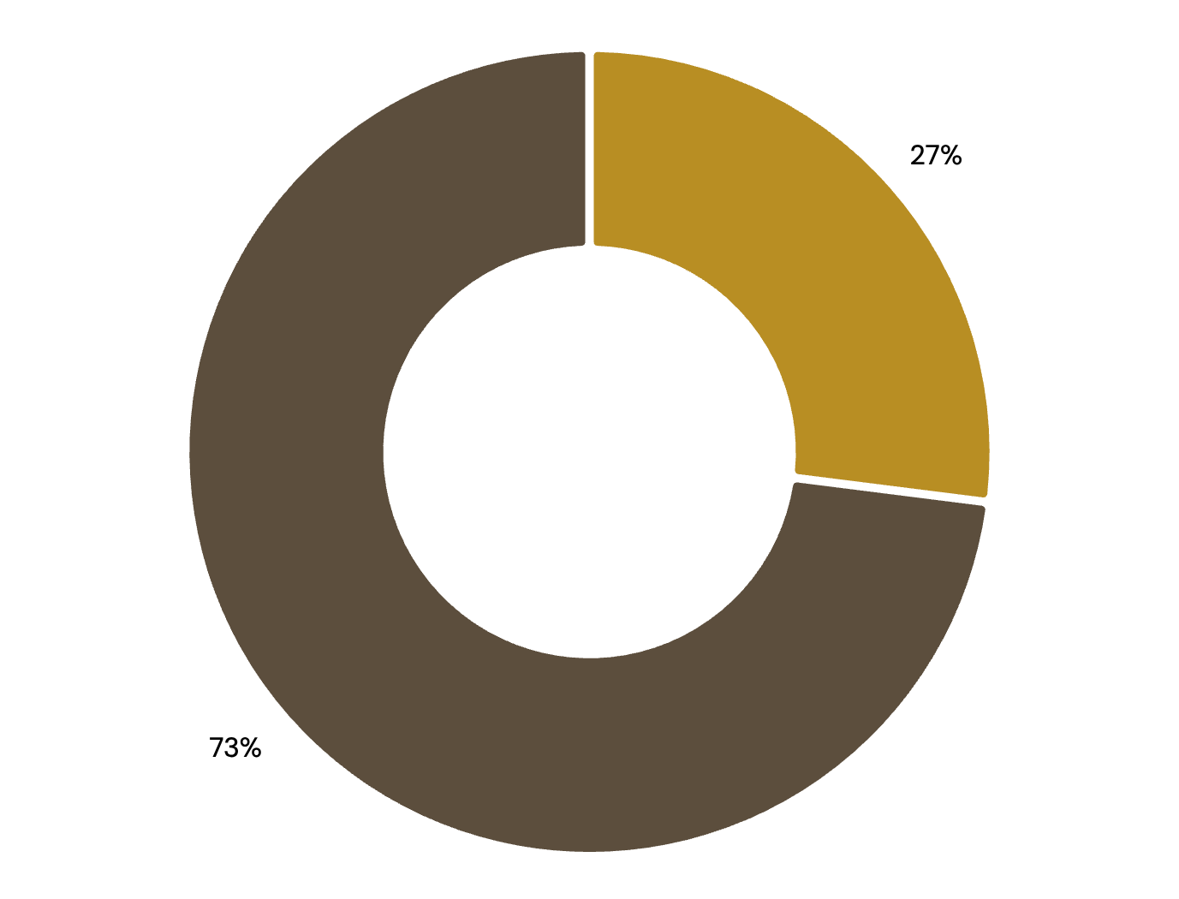
GROWTH LEVER
Subscription is the clearest growth lever: 27% of customers are subscribed
27%
1,053 subscribers out of 3,900 customers
Subscribers generate $62,645 total revenue; non-subscribers generate $170,436.
SUBSCRIBER AVERAGE SPEND
NON-SUBSCRIBER AVERAGE SPEND
$59.49
$59.87

Slide 6
Discounts influence demand without lifting average order value
Treat discounting as a product-level lever, not a blanket growth strategy.
Product | Discount-dependent | Read-through
Hat | 50.00% | Highest signal
Sneakers | 49.66% | High signal
Coat | 49.07% | High signal
Sweater | 48.17% | Meaningful signal
Pants | 47.37% | Meaningful signal
839 high-spending discount users. Average order value does not lift with discount use.

Slide 7
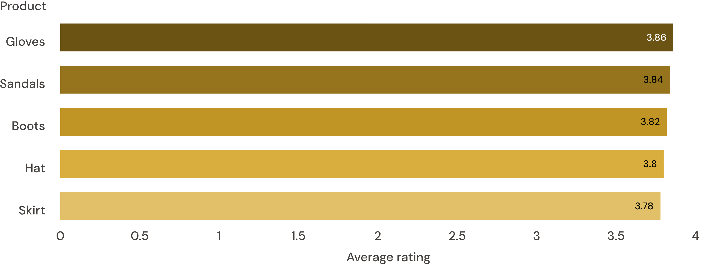
Small product signals can sharpen merchandising
Top-rated products, average rating
Category leaders: Jewelry, Blouse and Pants, Sandals, and Jacket.

Slide 8
Young adults are the largest age-group revenue contributor
Age group | Revenue
Young Adult | $62,143
Middle-aged | $59,197
Adult | $55,978
Senior | $55,763
Young Adult leads at $62,143, but the four age groups are relatively close.
The spread from Young Adult to Senior is $6,380.

Slide 9
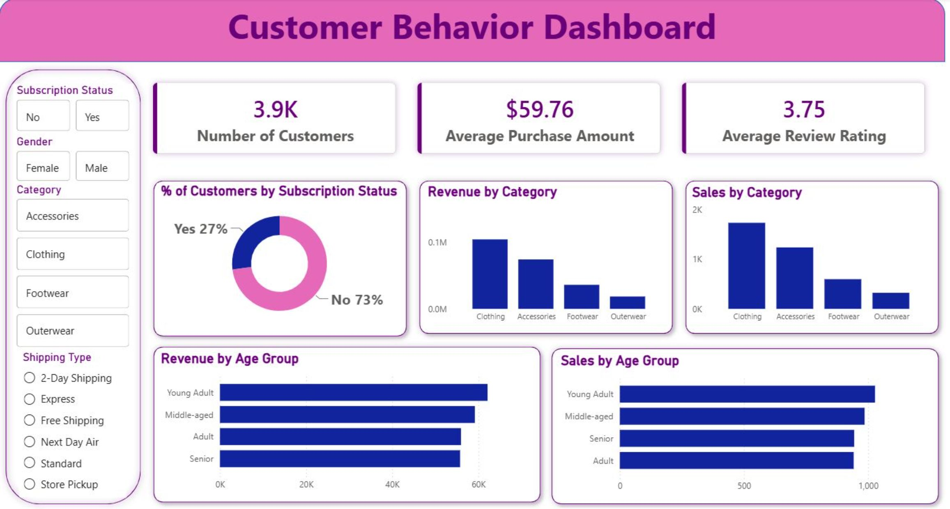
The dashboard brings the customer story into one view
Customer count, average purchase, review rating, subscription mix, category revenue, category sales, age-group revenue, and age-group sales.
Supplied Power BI dashboard · the complete customer story in one view.

Slide 10

Five moves can turn the analysis into action
Boost subscriptions: Test exclusive benefits designed to convert loyal non-subscribers.
Reward loyalty: Use repeat-purchase benefits to move returning customers upward.
Refine discounts: Focus promotions on discount-dependent products.
Merchandise the winners: Feature top-rated and best-selling products.
Target by value: Prioritize high-revenue age groups and express-shipping users.

