Slide 1
IBM University Engagement Project Submission
“Exploring the Power of Agentic AI with IBM Granite”

Slide 2

Project Tile – VitalMind AI: An AI-Powered Fitness & Wellness Buddy using IBM Granite
Domain of Project – Healthcare
Student Name | Recent Passport Photo | Email ID | Mobile number [WhatsApp]
Suryendu Das |  | suryendudas6@gmail.com | 7605831782

Slide 3
Problem Statement -
Problem Statement : No. 13 – Fitness Buddy
The Challenge
In this modern world, many individuals struggle to maintain their physical well-being due to busy schedules, lack of personalized guidance.Yes nowdays we have very advance health tracker wearables which can monitor and collect our health data, including sleep patterns, heart rate, HRV, and daily activity, very accurately.But it’s very hard for common non-professional people like us to understand those very complicated health details and take decisions depending on that.
The Objective
Build an AI-powered Fitness & Wellness Buddy that delivers personalized wellness insights and health recommendations using wearable health data. The solution should:
Wearable Health Data Analysis – Analyzed health data from smartwatch e.g. sleep duration, heart rate, heart rate variability (HRV) and daily step count from uploaded CSV data.
Wellness & Recovery Assessment – Calculate Wellness Score and Recovery Score which makes users understand their overall health condition.
AI-Powered Personalized Recommendations – Generate tailored wellness recommendations using user health data and trends, powered by IBM Granite on IBM watsonx.ai.
Health Trend Analysis – Look for patterns in your sleep quality, heart rate, HRV, and physical activity, so you can maintain and encourage healthy choices.
Preventive Wellness Focus – Promote healthy habits through actionable recommendations while avoiding medical diagnosis and encouraging preventive healthcare.
Interactive Dashboard – Deliver health statistics, wellness scores, trend analysis, and AI suggestions via a user-friendly web interface

Slide 4
Proposed Solution -
Proposed Solution: VitalMind AI – AI-Powered Fitness & Wellness Buddy
The proposed solution is VitalMind AI, an AI-powered Fitness & Wellness Buddy developed using React, FastAPI, IBM watsonx.ai, and the IBM Granite Foundation Model to provide personalized wellness insights from wearable health data. The system addresses the challenge of interpreting complex health metrics by converting smartwatch data into simple, actionable recommendations through an intelligent and user-friendly architecture.
At its core, the solution allows users to upload wearable health data in CSV format. The backend processes the uploaded data to calculate important wellness indicators such as Wellness Score, Recovery Score, average sleep duration, heart rate variability (HRV), resting heart rate, and daily step count. It also identifies health trends that help users better understand their overall well-being.
The system consists of three major components:
Health Data Analysis Engine – Processes wearable health data, calculates wellness metrics, and identifies health trends using Python and Pandas.
AI Wellness Recommendation Engine – Utilizes IBM Granite on IBM watsonx.ai to analyze the processed health summary and generate personalized wellness recommendations focused on improving sleep, recovery, physical activity, and overall healthy habits.
Interactive Dashboard – Built using React, the dashboard presents wellness scores, health metrics, trend analysis, and AI-generated recommendations through a clean and intuitive interface.
The solution follows a modular architecture where the FastAPI backend performs data processing and AI integration, while the React frontend provides a responsive user experience. IBM watsonx.ai enables secure access to the Granite Foundation Model, which powers natural language reasoning and personalized wellness guidance.
Overall, VitalMind AI delivers an end-to-end AI-powered fitness and wellness platform that transforms wearable health data into meaningful insights, helping users understand their health trends and adopt healthier lifestyles through personalized recommendations.

Slide 5
Technology Used
React.js: Developed a responsive and interactive user interface for uploading wearable health data, visualizing wellness metrics, and displaying AI-generated recommendations.
FastAPI: Built a high-performance REST API to process uploaded CSV files, calculate health metrics, and communicate with IBM watsonx.ai services.
IBM Granite 4.0-H-Small: Used as the core Large Language Model (LLM) to analyze processed health data and generate personalized wellness recommendations, lifestyle guidance, and actionable health insights.
IBM watsonx.ai: Provided secure access to IBM Granite models, enabling AI-powered reasoning and natural language generation for personalized wellness analysis.
IBM Cloud: Served as the cloud platform hosting IBM watsonx.ai services, providing a secure, scalable, and enterprise-grade environment for AI model inference.
Python: Implemented the backend logic, health data processing pipeline, CSV parsing, wellness score calculation, recovery score computation, and business logic.
Pandas: Processed wearable health datasets, calculated averages, identified trends, and prepared structured health summaries for AI analysis.
Axios: Enabled seamless communication between the React frontend and the FastAPI backend through REST API requests.
Render: Deployed and hosted the FastAPI backend, making the AI services accessible over the internet.
Vercel: Deployed and hosted the React frontend, providing a fast, scalable, and publicly accessible web application.

Slide 6
System Components Used-
1) CSV Upload Component – Allows users to upload wearable health data in CSV format (Apple Health, Fitbit, Garmin, Samsung Health, etc.) for analysis.
2) Health Data Analysis Engine – Processes the uploaded health data, calculates key metrics such as Wellness Score, Recovery Score, average sleep duration, resting heart rate, HRV, and daily step count, and identifies health trends.
3) IBM watsonx.ai Agent – Sends the processed health summary to IBM watsonx.ai, where the IBM Granite model analyzes the data and generates personalized wellness recommendations.
4) IBM Granite Model – Granite-4.0-H-Small (or replace this with the exact Granite model you used). Used for natural language reasoning, health insight generation, and personalized wellness recommendations.
5) AI Response Component – Displays AI-generated wellness insights, recovery suggestions, sleep recommendations, heart health observations, and healthy lifestyle guidance.
6) Interactive Dashboard – Built using React to visualize Wellness Score, Recovery Score, health metrics, trend analysis, and AI-generated recommendations in a user-friendly interface.

Slide 7
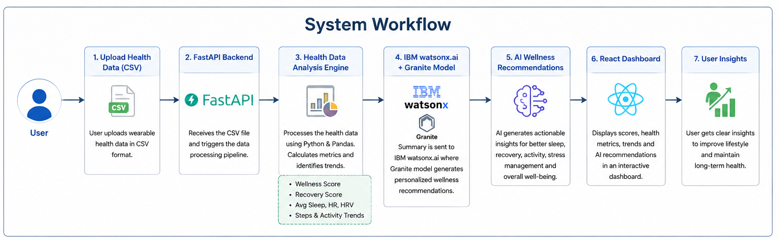

Slide 8
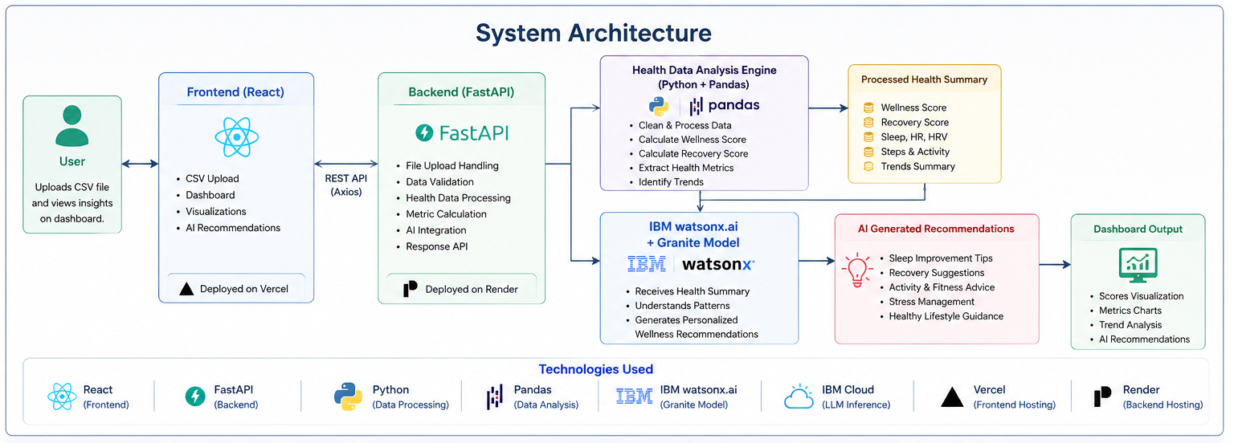

Slide 9

Role of Agentic AI in the solution
Role of IBM Granite AI in VitalMind AI
IBM Granite serves as the intelligent decision-making engine of VitalMind AI, transforming processed wearable health data into meaningful and personalized wellness recommendations. Rather than simply displaying raw health metrics, the Granite model interprets the analyzed data and provides easy-to-understand guidance that helps users improve their daily lifestyle and overall well-being.
The FastAPI backend first processes the uploaded wearable health data by calculating important wellness indicators such as Wellness Score, Recovery Score, sleep duration, heart rate, heart rate variability (HRV), and daily step count. This structured health summary is then securely sent to IBM watsonx.ai, where the IBM Granite model performs natural language reasoning to understand the user's health patterns and generate personalized recommendations.
IBM Granite also provides context-aware wellness guidance by considering the user's overall health trends instead of individual metrics alone. It identifies areas that require improvement and suggests practical actions such as improving sleep habits, increasing physical activity, managing stress, and maintaining a balanced lifestyle.
Overall, IBM Granite transforms complex wearable health data into clear, personalized, and actionable wellness insights, making VitalMind AI an intelligent fitness and wellness companion rather than a traditional health dashboard.

Slide 10
Novelty and Uniqueness
The proposed VitalMind AI stands out by combining wearable health analytics, AI-powered wellness recommendations, and IBM Granite into a single intelligent fitness and wellness platform.
Wearable Health Data Analysis – Instead of relying only on user conversations, the system analyzes real smartwatch health data, including sleep duration, heart rate, HRV, and daily step count, to provide evidence-based wellness insights.
AI-Powered Personalized Recommendations – Utilizes IBM Granite on IBM watsonx.ai to generate personalized lifestyle and wellness recommendations based on each user's health metrics and trends.
Comprehensive Wellness Assessment – Calculates Wellness Score and Recovery Score, enabling users to easily understand their overall health condition through simplified indicators.
Health Trend Identification – Detects changes in sleep quality, heart rate, HRV, and physical activity, helping users recognize long-term patterns and build healthier habits.
Interactive & User-Friendly Dashboard – Presents health metrics, trend analysis, and AI-generated recommendations through an intuitive React-based dashboard, making complex health information easy to understand.
Preventive Wellness Focus – Encourages proactive health management by providing actionable wellness guidance rather than medical diagnosis, promoting healthier daily lifestyles.
Scalable Cloud-Based Architecture – Built using React, FastAPI, IBM watsonx.ai, and IBM Granite, enabling secure, scalable, and cloud-ready deployment.

Slide 11
Git Hub Link
https://github.com/suryendudas/VitalMind-AI
Live Demo
https://vital-mind-ai.vercel.app
Backend API
https://vitalmind-ai-z6g2.onrender.com/docs
·
·
·

Slide 12
Future Scope
1. Real-Time Wearable Integration
Integrate Apple Health, Google Fit, Fitbit, Garmin, and Samsung Health to automatically synchronize health metrics in real time, eliminating the need for manual CSV uploads.
2. AI Fitness Coaching & Personalized Workout Plans
Enhance VitalMind AI with personalized workout recommendations, daily fitness challenges, motivational coaching, and adaptive exercise plans based on each user's health trends and fitness goals.
3. Nutrition & Hydration Guidance
Expand the platform to provide personalized meal suggestions, hydration reminders, calorie tracking, and healthy eating recommendations based on users' activity levels and wellness objectives.
4. Mobile Application
Develop native Android and iOS applications with real-time notifications, wearable synchronization, and offline health tracking to improve accessibility and user engagement.
5. Predictive Health Analytics
Leverage historical wearable health data and AI models to identify long-term health trends, detect potential wellness risks, and provide proactive lifestyle recommendations before health issues develop.
6. Multi-Language Support
Support multiple regional and international languages to make the platform accessible to a broader and more diverse user base.
7. Healthcare Professional Dashboard
Introduce a secure dashboard for doctors, fitness trainers, and wellness coaches to monitor user progress, review health insights, and provide personalized guidance remotely.
8. Enterprise & Corporate Wellness
Scale the platform for organizations by providing employee wellness analytics, health reports, and AI-driven fitness programs to promote healthier workplaces.
·
·
·

Slide 13
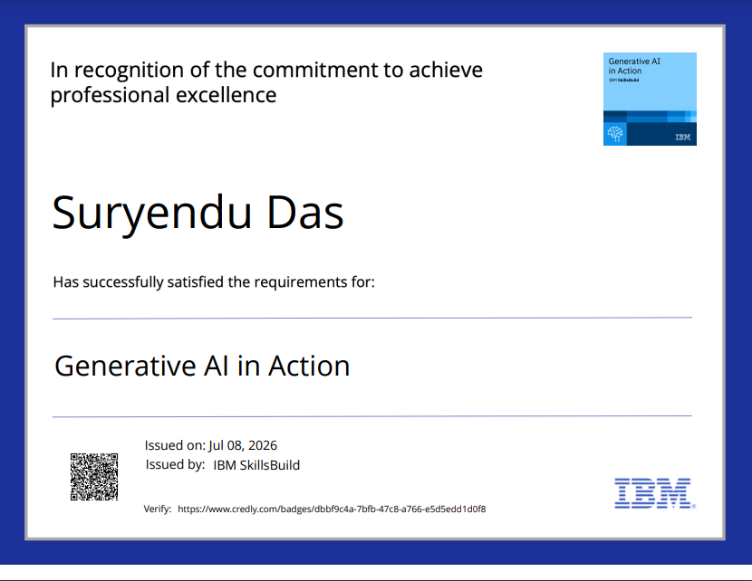
Certificates Earned:
Please add your credly certificate

Slide 14
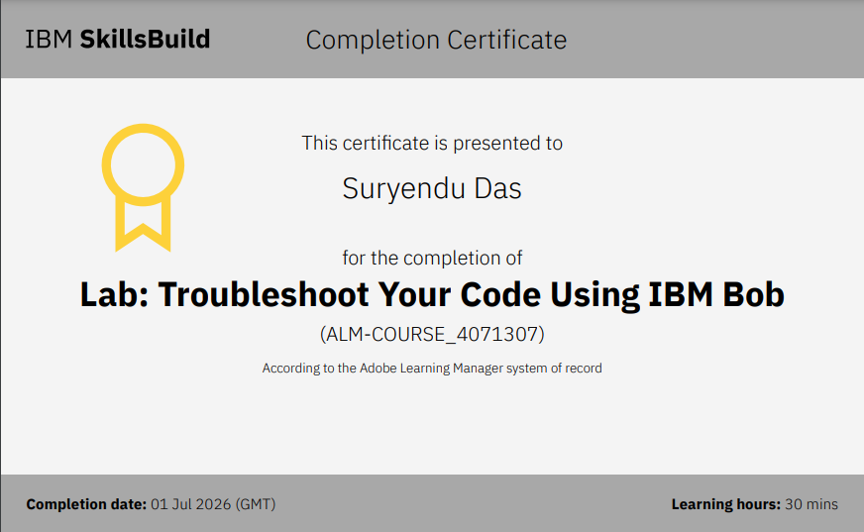
Certificates Earned:​
Add your IBM BOB Certificate

Slide 15


