Slide 1
Breast Cancer Prediction : A Machine Learning Approach
Enhancing Early Diagnosis with SVM and Other Classifiers

Slide 2
Abstract
This project explores machine learning models to predict cancer.
Using the Cancer Wisconsin dataset, five models were evaluated.
Support Vector Machine (SVM) emerged as the best with 97% accuracy and 0.98 F1-score.

Slide 3
Introduction
This type Cancer of is a leading cause of cancer-related deaths.
Early detection improves survival rates. Traditional diagnostic methods are time-consuming and subjective.
Machine learning offers fast, reliable, and accurate alternatives for diagnosis.

Slide 4
Problem Statement
Current cancer diagnosis methods can be subjective and error-prone. There's a need for accurate, automated systems to assist medical professionals. Machine learning provides data-driven decision support to improve diagnostic accuracy.

Slide 5
Proposed Methodology
1. Data Collection: Cancer Wisconsin dataset
2. Data Preprocessing: Handle missing values, scale features
3. Model Training: SVM, KNN, Decision Tree, Random Forest, Naive Bayes
4. Model Evaluation: Accuracy, Precision, F1-score, Confusion Matrix
5. Best Model Selection based on F1-score

Slide 6
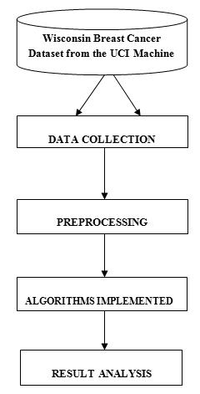
System Architecture

Slide 7
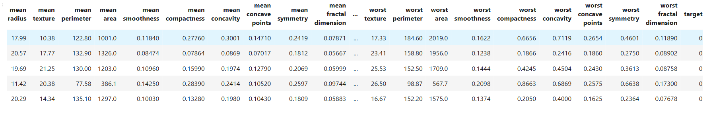
Dataset
The dataset contains 569 samples and 30 features describing tumor characteristics.
Target variable: 'diagnosis' - Malignant (1), Benign (0)
Preprocessing included standard scaling and null value handling.

Slide 8
Model Training & Evaluation
Data split into 80% training and 20% testing.
StandardScaler used for feature normalization.
Evaluated models:
- K-Nearest Neighbors
- Decision Tree
- Random Forest
- SVM
- Naive Bayes

Slide 9
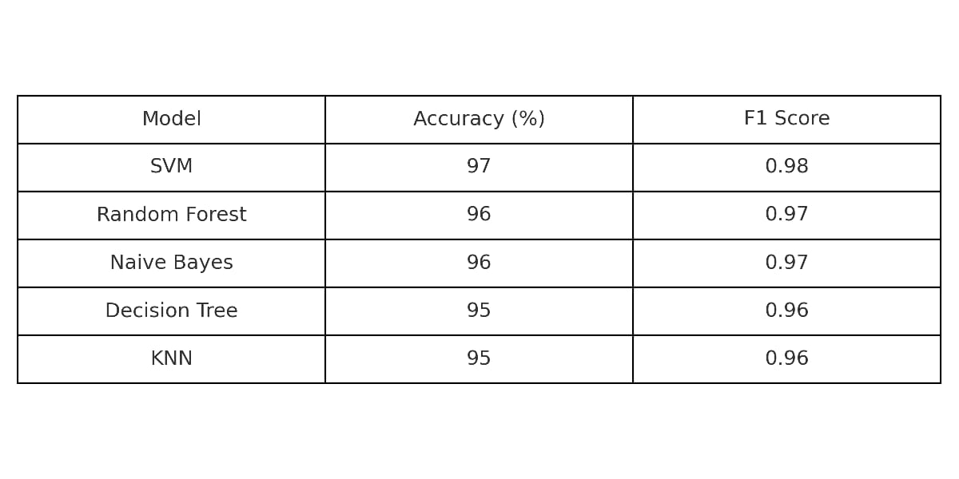
Result

Slide 10
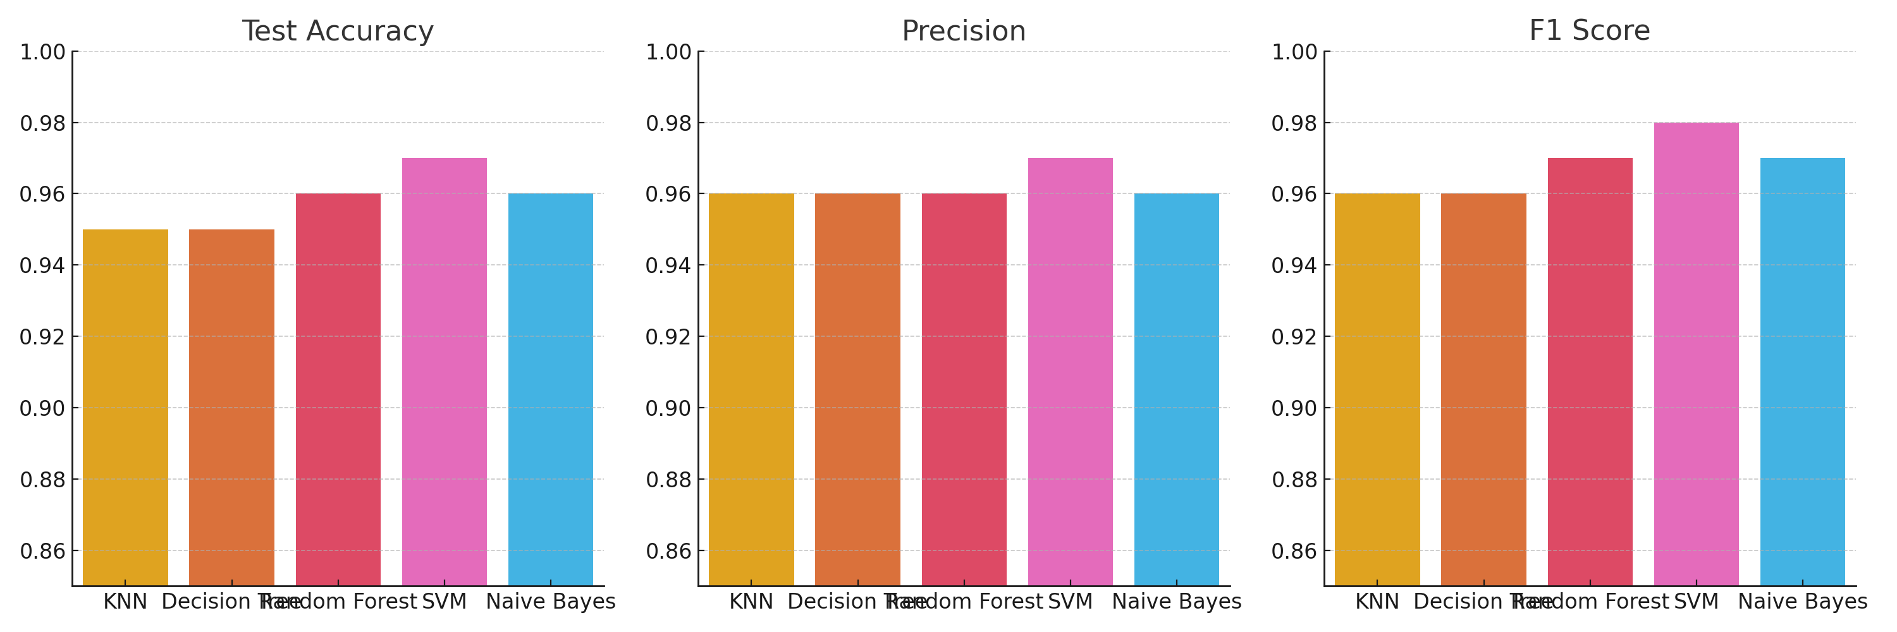
Data visualization for Model evaluation metrices

Slide 11
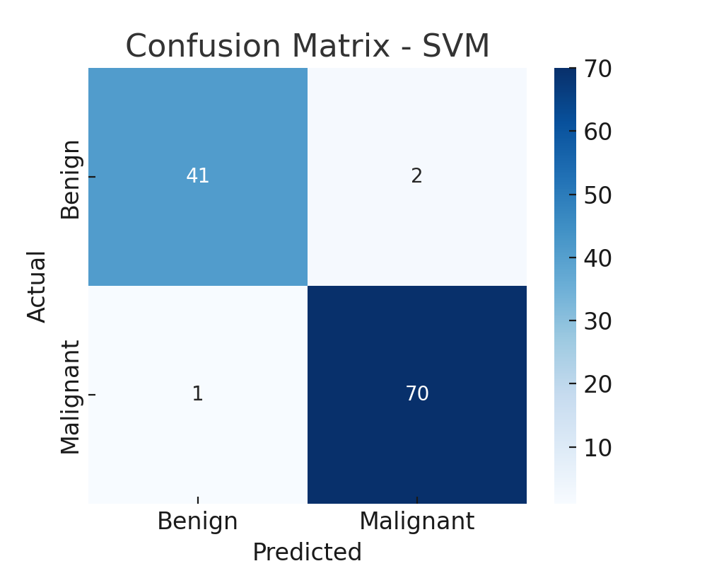
Result Analysis of Best Model
Evaluation Metrics (Test Data):
- SVM: Accuracy = 97%, F1 Score = 0.98
- Random Forest: Accuracy = 96%, F1 Score = 0.97
- Naive Bayes: Accuracy = 96%, F1 Score = 0.97
- Decision Tree & KNN: Accuracy = 95%, F1 Score = 0.96
SVM selected as best model based on highest F1 score.

Slide 12
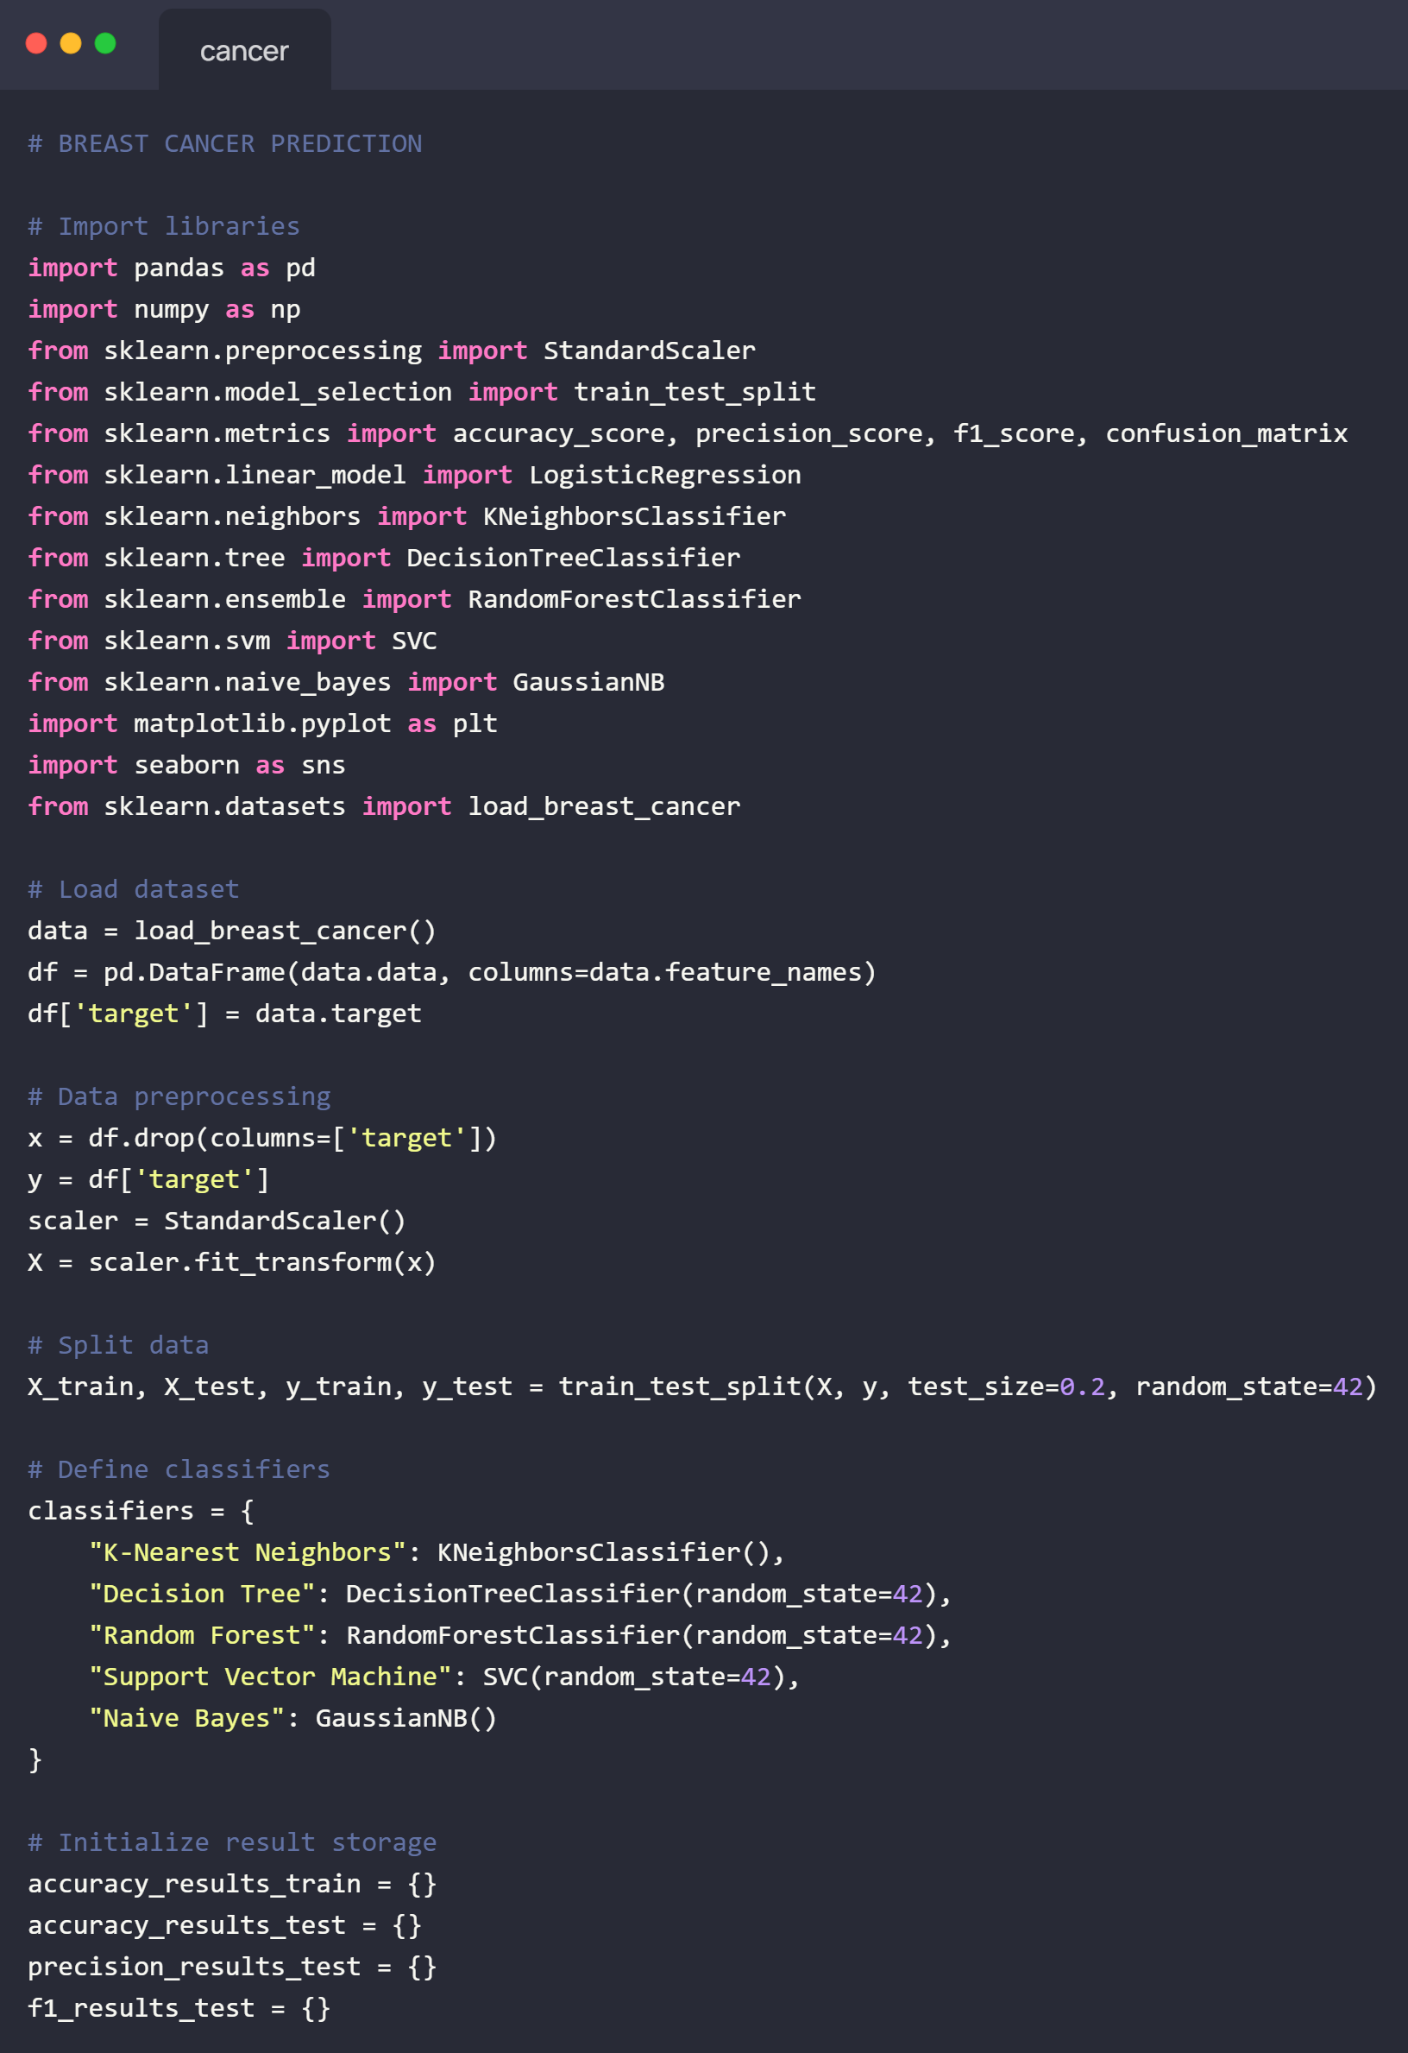
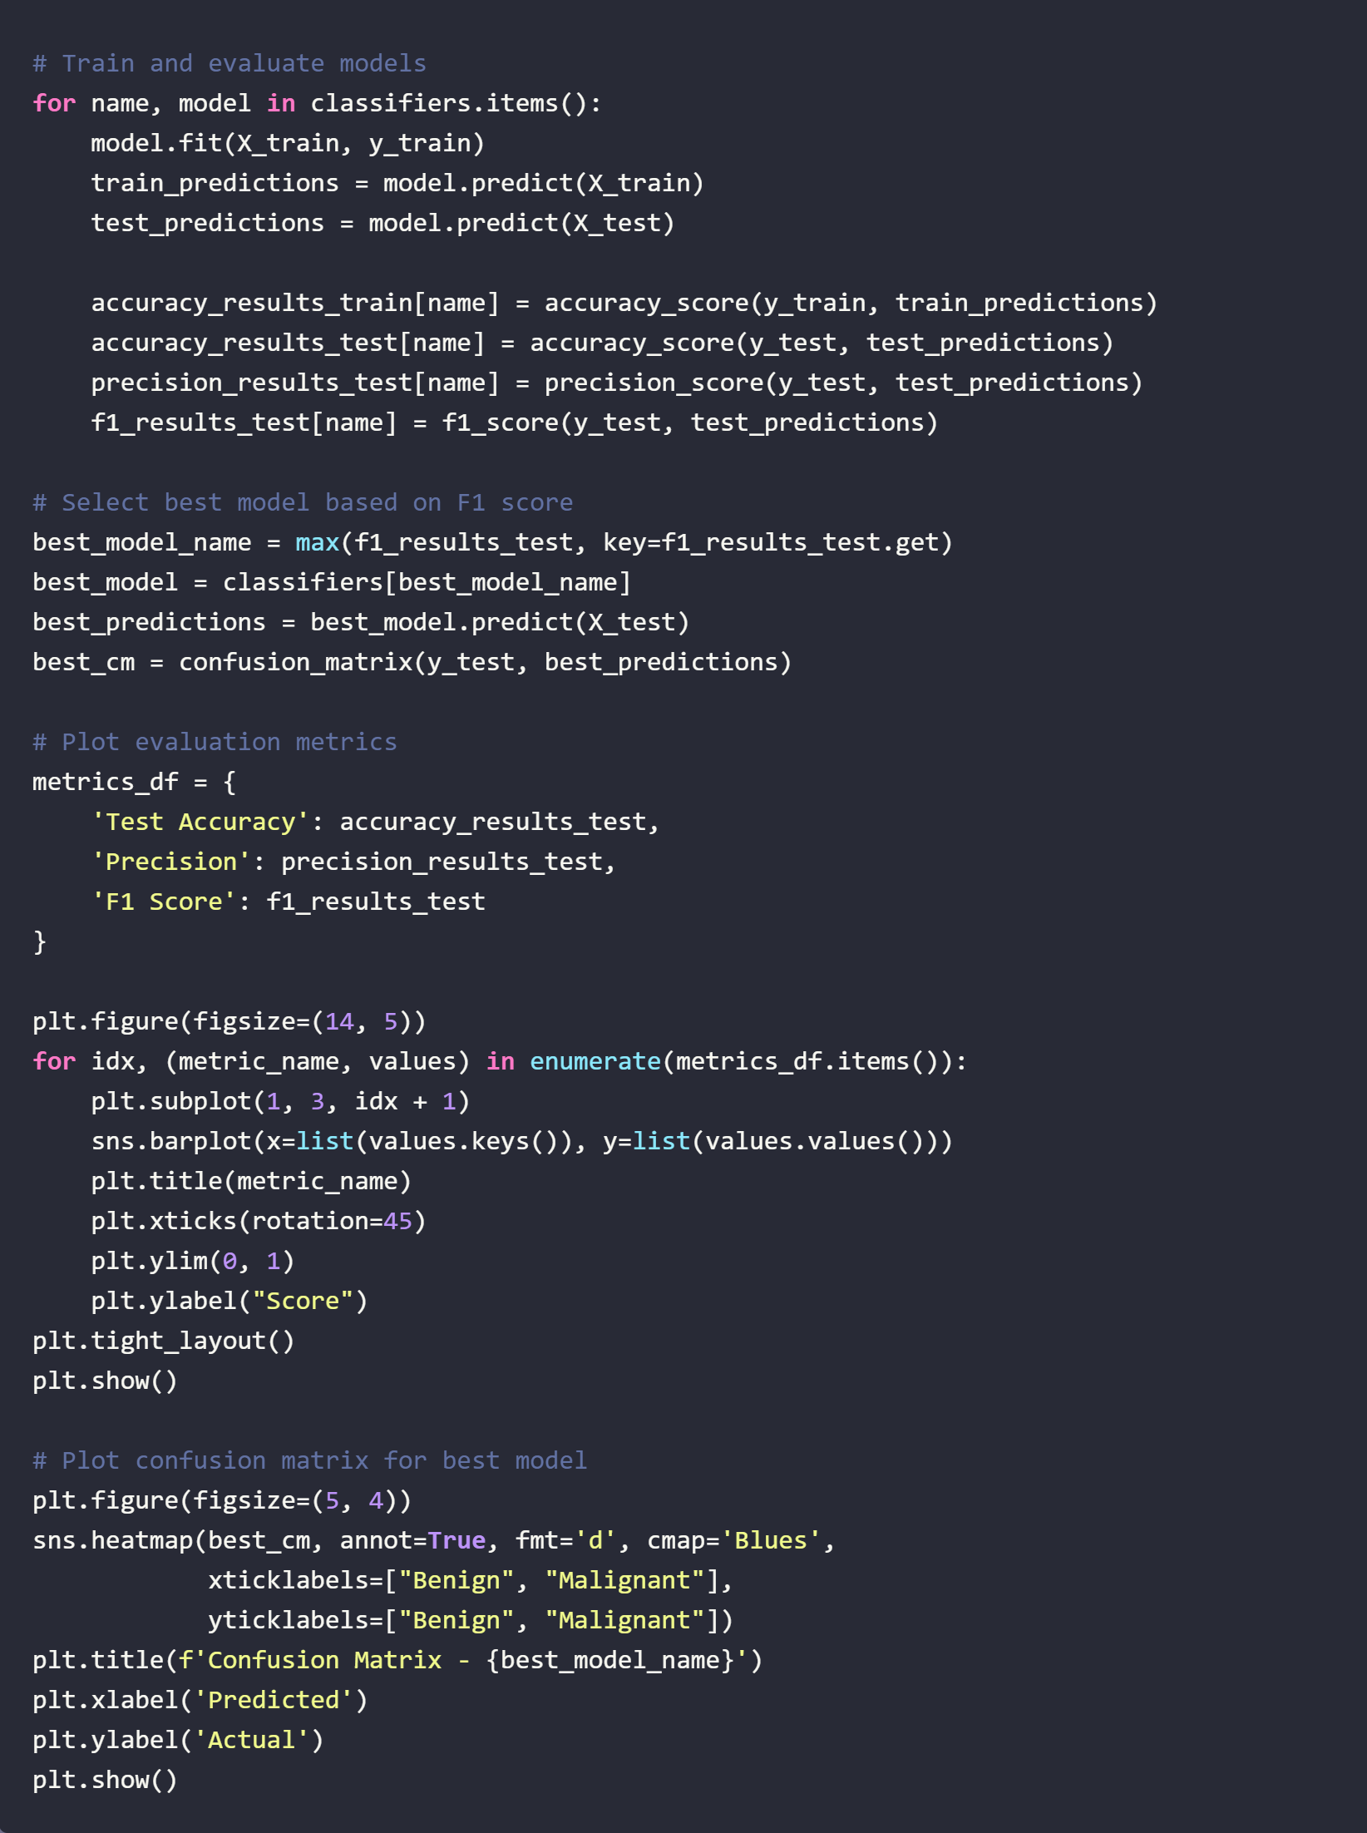
Code

Slide 13
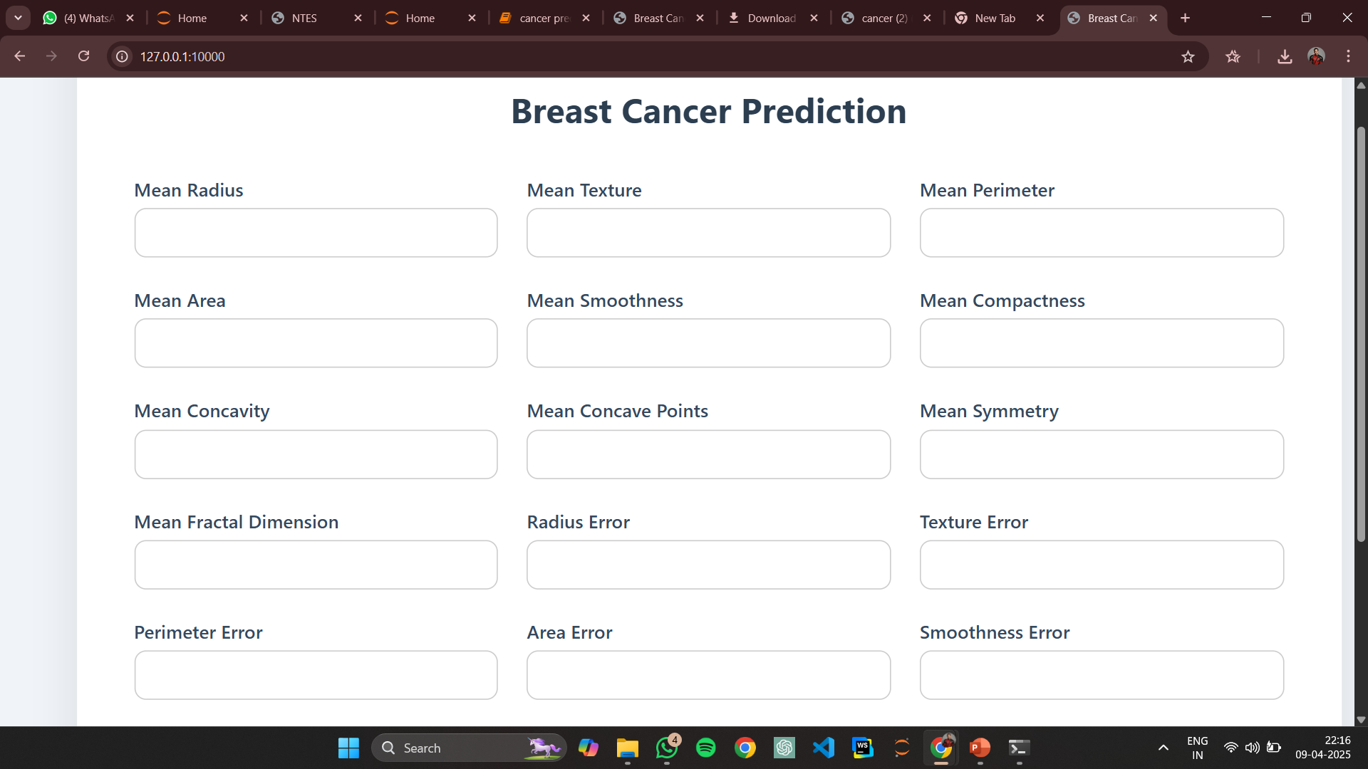
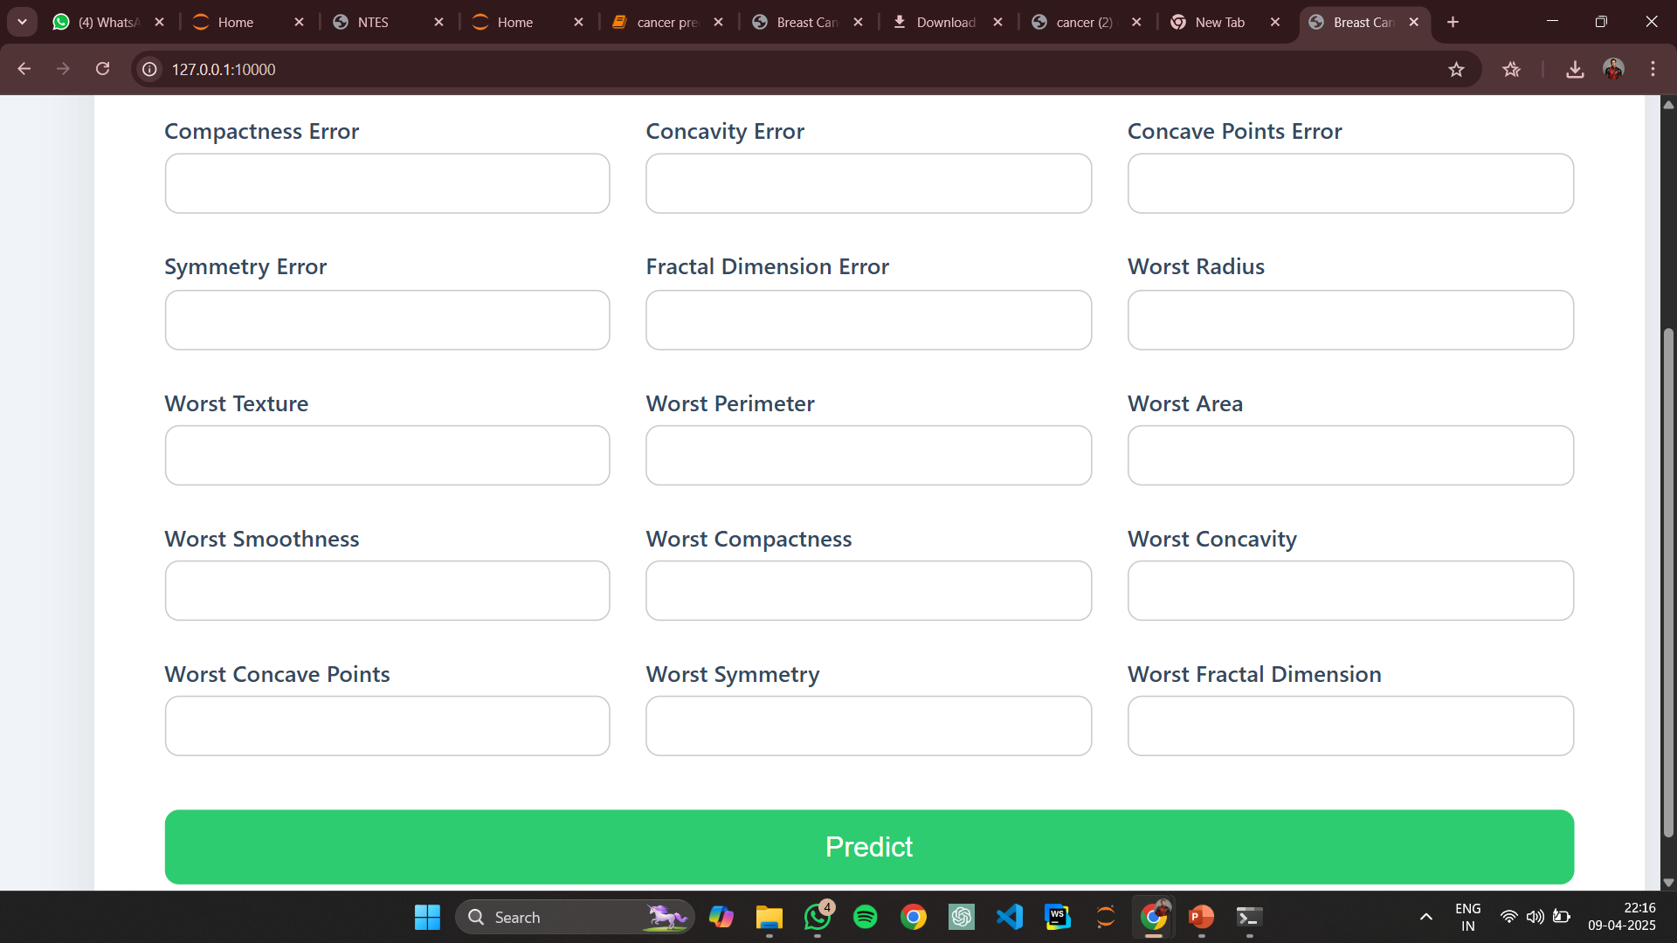
Before Entering Values

Slide 14
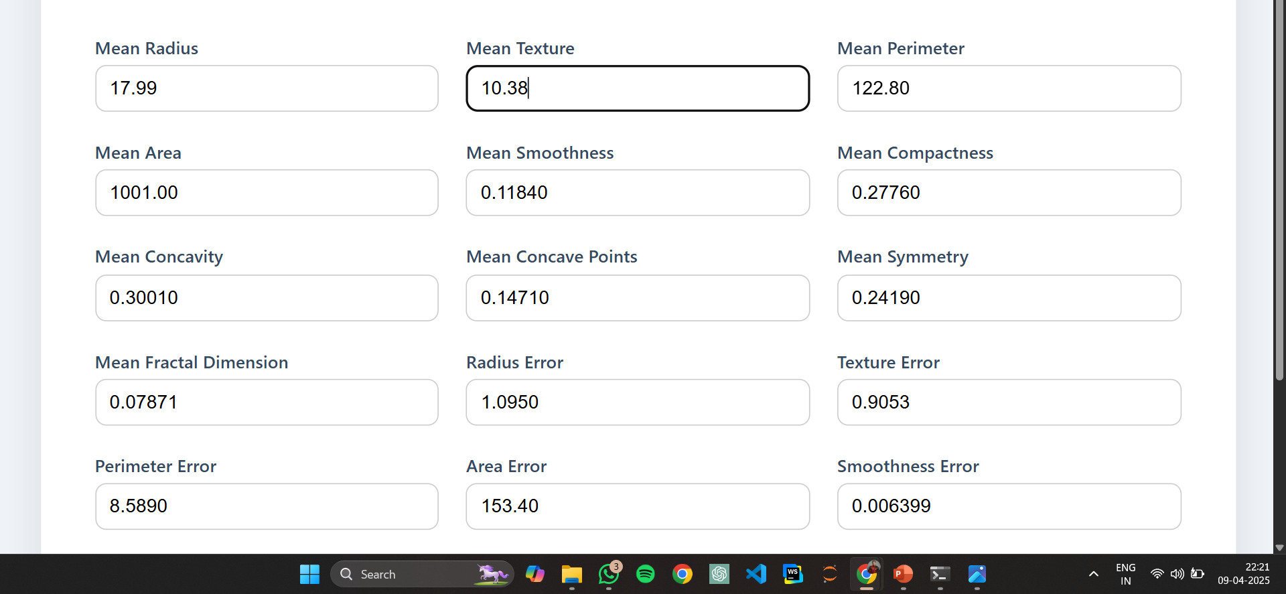
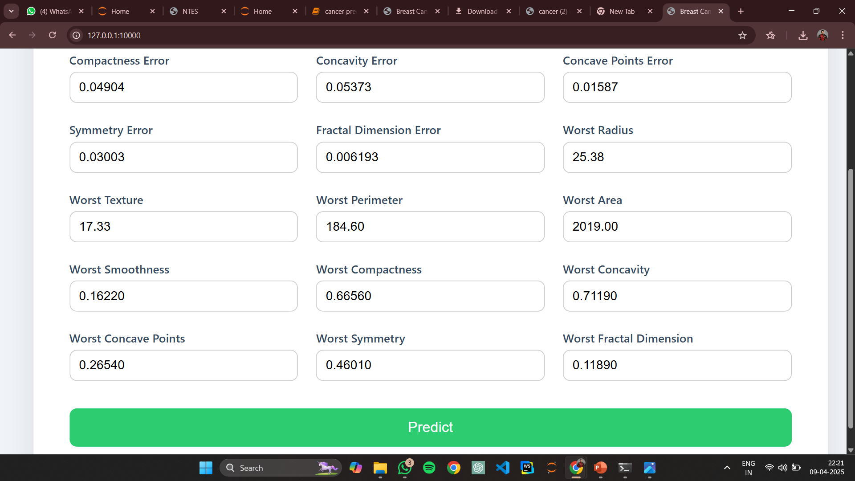
After Entering Values
The tumor is likely: Malignant

Slide 15
Conclusion
Machine learning offers a powerful solution for early breast cancer detection.
Among five classifiers tested, SVM achieved the best results with an F1 score of 0.98.
Future work includes using more data and exploring deep learning techniques.

Slide 16
References
- Cancer Wisconsin Dataset (UCI / sklearn.datasets)
- Scikit-learn: Machine Learning in Python
- Seaborn and Matplotlib for visualizations
- Python (pandas, numpy) for data preprocessing

Slide 17
Thank You
Questions and Feedback are Welcome!

