Slide 1
UPI Fraud Detection Using Machine Learning
SURYA P
MCA - A
RA2332241010055
SRM Institute of Science and Technology
GUIDE : Dr. G. MOTHILAL NEHRU M.C.A., Ph.D

Slide 2
Introduction
UPI transactions are growing rapidly, increasing the risk of fraudulent activities.
This project focuses on detecting fraud in UPI transactions using machine learning.
Machine learning models help in identifying suspicious activities automatically.

Slide 3
Problem Statement
UPI frauds are increasing and difficult to detect manually.
Need for real-time, accurate fraud detection mechanisms.
Objective:
Build a reliable ML model to predict fraud in transactions.

Slide 4
Dataset Overview
Dataset includes:
Transaction Type
Amount
Before and After Transaction Balances
Fraud Labels
Real-world transaction data used.

Slide 5
Data Preprocessing
Missing Value Treatment
Categorical Feature Encoding
Feature Engineering (e.g., Ratios, Thresholds)
Standardization for numerical stability

Slide 6
Machine Learning Models Used
Logistic Regression
Support Vector Classifier (SVC)
Random Forest
XGBoost

Slide 7
Logistic Regression
Binary Classification:
Ideal for distinguishing between fraudulent and non- fraudulent transactions.
Interpretability:
Coefficients reveal the impact of each feature on the prediction.
Efficiency:
Fast training time, suitable for large datasets with linear patterns.
Baseline Model:
Serves as a reference point for evaluating complex models.

Slide 8
Support Vector Classifier (SVC)
Constructs a hyperplane to separate fraud and non-fraud classes.
Effective in high-dimensional spaces.
Works well for small to medium datasets.

Slide 9
Random Forest
Ensemble Learning:
Combines multiple decision trees to improve prediction accuracy.
Feature Importance:
Provides insights into which features most influence fraud detection.
Overfitting Resistant:
Aggregation of trees reduces variance and boosts robustness.
Non-Linear Capabilities:
Captures complex patterns and interactions in the data.
High Accuracy:
Performs well across various fraud detection metrics.

Slide 10
XGBoost
Gradient Boosting Framework:
Builds trees sequentially to minimize errors from previous models.
High Performance:
Known for speed and efficiency, especially on large datasets.
Regularization:
Includes L1 and L2 to prevent overfitting.

Slide 11
Model Evaluation
Evaluation Metrics:
ROC-AUC Score
Confusion Matrix
Classification Report
Helps in understanding model performance and selecting the best one.

Slide 12
Feature Importance
Identify key factors influencing fraud predictions.
Random Forest used for analyzing feature importance.
Helps in understanding model decisions.

Slide 13
Best Model Selection
Random Forest selected as final model.
High accuracy and interpretability.
Suitable for production deployment.

Slide 14
Conclusion
Fraud detection in UPI is critical for financial security.
Machine learning provides accurate and scalable solutions.
Random Forest proved to be the most efficient model.
Future work includes real-time fraud detection systems.

Slide 15
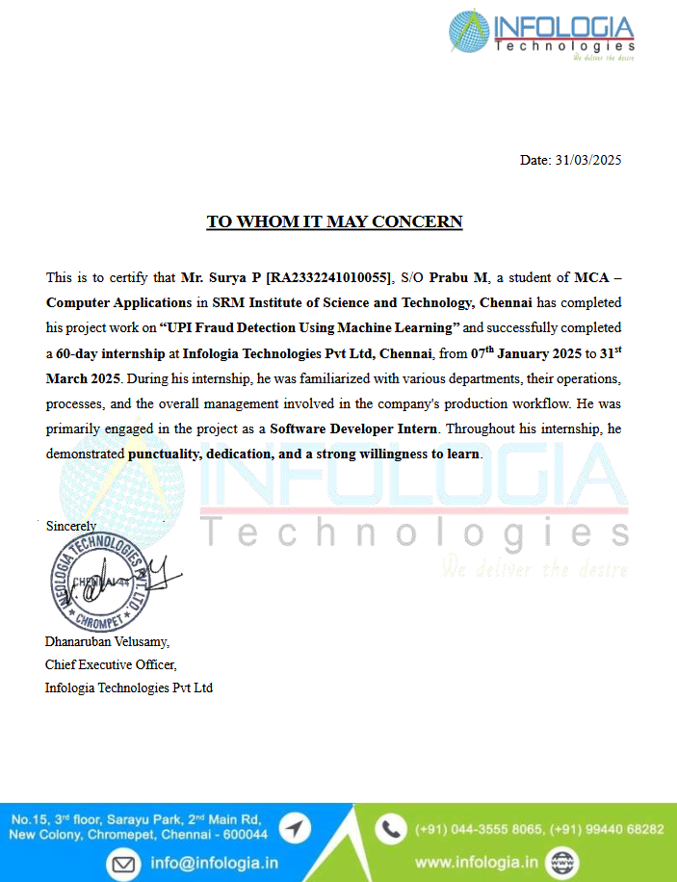

Slide 16


