Slide 1
Digital Transportation System (bd.Cab)
1)Mainuddin Russel ->1405032
2)Provakar Mondal ->1405034
3)Sajid ->1405047
4)Munif Musasim->1405058
5)Baki Billah Baki->1405059

Slide 2
Subsystems
1.Registration Subsystem.
2. Trip-Start subsystem.
3.Get Notification subsystem.
4.Trip-end subsystem.

Slide 3
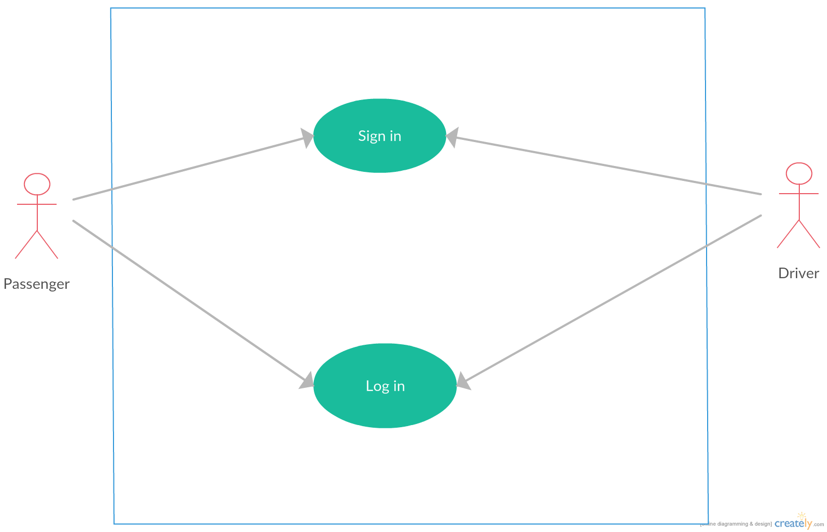
Registration subsystem.

Slide 4
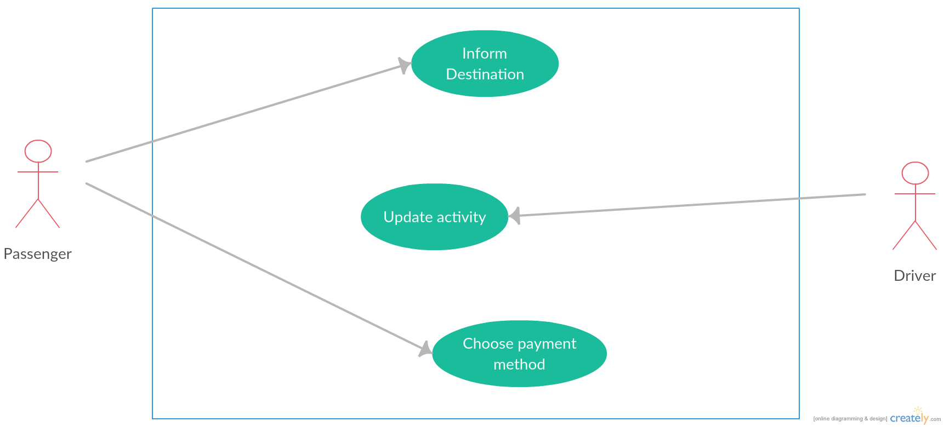
Trip-start subsystem

Slide 5
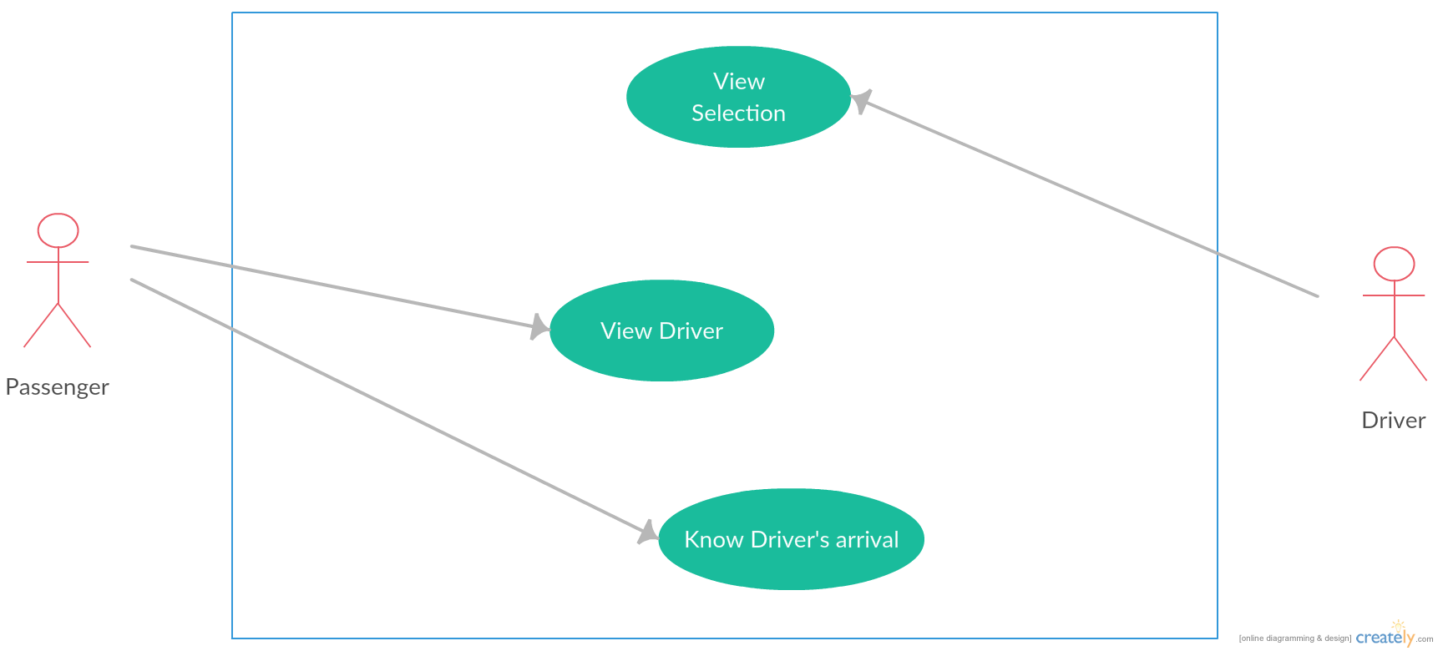
Get Notification subsystem

Slide 6
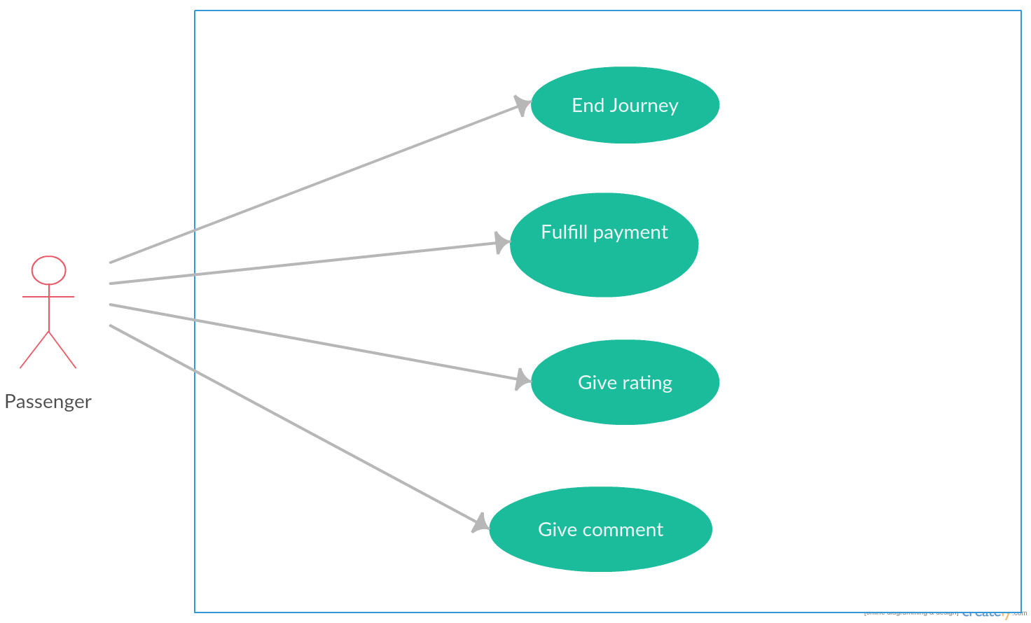
Trip-end subsystem

