Slide 1

Authors:
Mikołaj Pytlak
Maurycy Lenarczyk
Maciej Kwiatkowski
School & Class:
ZS Rataje, 4TIG
The Group’s Guardian:
Rafał Szymański

Slide 2
Our Goals
In our project we target these groups of people:
the elderly,
people with Alzheimers and other memory impairments,
disabled people.
We want to help them with their daily routine of taking pills and tablets, as it often requires the help of the other person in order to ensure that:
they will remember to take every pill they are supposed to,
they will not take any wrong pills,
the pills are safe for them regardless if they need or need not to take them.
With our project we hope to resolve all of the inconveniences when it comes to taking pills, up to the point people can safely take them without any help from others.

Slide 3


Cele Zrównoważonego Rozwoju
/
Sustainable Development Goals
Our project tackles the following SDG problems:
3.5 — by informing the person whether the pill (including drugs) is dangerous to take or not,
3.9 — also by informing the person whether the pill is dangerous to take or not, thus increasing the chance they will not consume any dangerous substances.
E.g. You have a headache and an individual gives you some “painkillers” — you can’t really trust they are safe to take.
Notes:
3.5, 3.9

Slide 4
Project Description
Currently, our project is separated into three main files:
NIH_PID.ipynb — used to download the training image data from National Library of Medicine (www.nlm.nih.gov) into the suitable dicrionaries,
model.ipynb — used to create the model designated to predict the types of pills from images,
predict.ipynb — used to predict the pill type from image.
Additionally, our project includes all the training data and example images for predicting pill types and an unused app made in HTML (due to PHP, which runs our Python script, requiring the usage of a server, which is incompatible with the project’s environment).

Slide 5
Current Results
The project is still in its early stages, so the results are not that impressive, but we positively look into the future and its new updates.
The end-user must manually choose the already-cropped image of a pill to be predicted (it does not currently support images of many pills). Although the model does not show high confidence at choosing which pills are what types, it really often assigns the highest probability to the correct pill (and all this in our little demo consisting only of ~800 images divided by 15 pill types).
Even though our project is not ready for production, the following changes might be useful in moving it closer to this desired state.

Slide 6
Potential Updates of SUS Pills
There is much to change. Starting with the non-AI stuff, we could improve the following:
Update the app from a simple HTML page to a real React.js app (our first intended tool to build an app),
Add the support for mobile (as it was supposed to be the intended platform to use for our app) with the help of React Native,
Improve the visuals with React-Bootstrap and add support for the disabled people,
Launch it on a server (even the localhost would do) so our script could run.
While these would be the main changes regarding our Python scripts:
Increase our training image database,
Use tools created for labeling images (e.g. labelimg), as we had to manually crop the images, which is not really convenient,
Add support for multiple pill detection (e.g. by basing our model on YOLO, using object_detection python library, using openvcv with Tensorflow 1, or creating our own multi-object detection),
And much, much more.

Slide 7
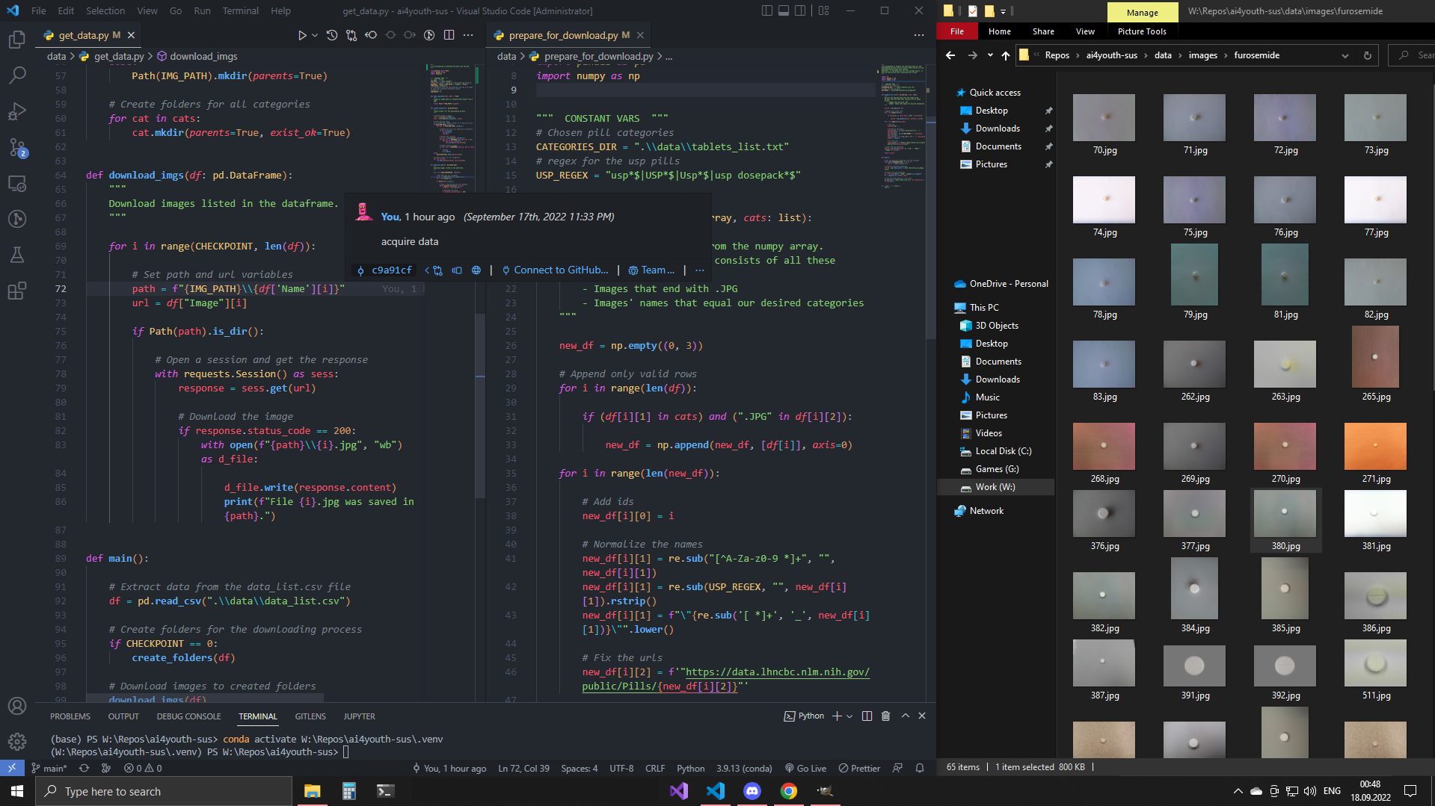

Slide 8
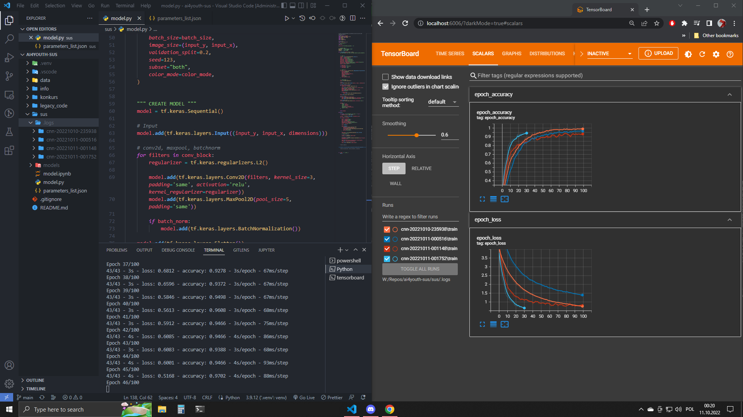
Interesting fact: SUS Pills is an abbreviation of Suspicious Pills.

