Slide 1
Top 10 Security Vulnerabilities
Susam Pal
Based on OWASP Top Ten Project (2006) http://www.owasp.org/index.php/OWASP_Top_Ten_Project
Content is available under Creative Commons Attribution-ShareAlike 2.5 License

Slide 2
Agenda
Unvalidated Input
Broken Access Control
Broken Authentication
Cross Site Scripting
Buffer Overflows
Injection Flaws
Improper Error Handling
Insecure Storage
Denial of Service
Insecure Configuration

Slide 3
Unvalidated Input
All input is evil ….
.... until proven otherwise.
Types of Input:
HTTP Requests
Commands
Network packets (TCP/IP, UDP, etc.)

Slide 4
Unvalidated Input
Common Input Tampering Attacks:
Forced Browsing
Command Insertion
Cross Site Scripting
Buffer Overflows
SQL Injection
Hidden Field Manipulation

Slide 5
Unvalidated Input
Microsoft IIS and PWS Extended Unicode Directory Traversal Vulnerability (BID 1806)
Web Root: C:\Inetpub\wwwroot\
Unsafe Procedure:
map [URL] to [path of the resource] on the hard disk;
if [path of the resource] starts with [C:\Inetpub\wwwroot]
then
allow access;
else
deny access;
Notes:
In a secure system

Slide 6
Unvalidated Input
Microsoft IIS and PWS Extended Unicode Directory Traversal Vulnerability (BID 1806)
Exploit:
http://www.example.com/../../windows/system32/cmd.exe
URL Mapped to Resource on Hard Disk:
C:\Inetpub\wwwroot\..\..\windows\system32\cmd.exe
What IIS/PWS forgot to check:
C:\Inetpub\wwwroot\..\..\windows\system32\cmd.exe
= C:\Inetpub\..\windows\system32\cmd.exe
= C:\windows\system32\cmd.exe

Slide 7
Unvalidated Input
Microsoft IIS and PWS Extended Unicode Directory Traversal Vulnerability (BID 1806)
Safe Procedure:
map [URL] to [path of the resource] on the hard disk;
canonicalize [path of the resource];
if [path of the resource] starts with [C:\Inetpub\wwwroot]
then
allow access;
else
deny access;
Reference:
http://www.securityfocus.com/bid/1806

Slide 8
Unvalidated Input
Prevention:
Canonicalization: Input should be converted to the simplest form before they are validated.
Server Side Validation: It is must. First code Server Side Validation, then code Client Side Validation.
Validate against a positive (not negative) specification.
Detailed code review for tainted parameters.

Slide 9
Broken Access Control
Access control, sometimes called authorization, is how a web application grants access to content and functions to some users and not others.
Features:
Access control is closely associated with the content and functions of the application.
Users are generally managed by putting them under various groups/roles with various priveleges.

Slide 10
Broken Access Control
Common Mistakes:
Administrative interfaces that allow site administrators to manage a site over the Internet.
Insertion of access control rules in various locations all over the code on an ad hoc basis.
Common Attacks:
Exploiting Insecure Id’s
Forced Browsing Past Access Control Checks
Path traversals
Exploiting browser cache

Slide 11
Broken Access Control
How to disable Browser Cache:
HTML <meta> Tag
<meta http-equiv="Pragma" content="no-cache">
<meta http-equiv="Expires" content="-1">
<meta http-equiv="Cache-control" content="no-cache">
<meta http-equiv="Cache" content="no-cache">
<meta http-equiv="Expires" content="thu, 01 Jan 1980 12:00:00 GMT">
ASP
<% Response.AddHeader "Pragma", "no-cache" %>
<% Response.Expires = -1 %>
<% Response.CacheControl="private" %>
<% Response.CacheControl = "no-cache" %>
<% Response.CacheControl = "no-store" %>

Slide 12
Broken Access Control
How to disable Browser Cache:
JSP
<% response.setHeader("Pragma","no-cache"); %>
<% response.setHeader("Cache-Control","no-cache"); %>
<% response.setDateHeader ("Expires", 0); %>
<% response.setHeader("Cache-Control","no-store"); %>
PHP
<?php
Header("Pragma: no-cache");
Header("Cache-control: private, no-cache, no-store");
Header("Expires: Mon, 26 Jul 1997 05:00:00 GMT");
?>

Slide 13
Broken Authentication
Types of Authentication:
User ID and Password
Software & Hardware based cryptographic tokens
Biometrics
Session Management:
Web applications must establish sessions to keep track of the stream of requests from each user.
HTTP doesn’t provide this capability, so web applications must create it themselves.
Generally developers create session tokens to manage sessions.

Slide 14
Broken Authentication
Common Attacks:
“Walk by” Attacks
Session Hijacking
Prevention:
Re-authentication for critical functionalities.
Use of SSL to protect authentication credentials and session identifiers.
Code review and penetration testing
POST method to submit authentication & session data.
Use autocomplete=“off” with <form> and <input> tags.
Avoid implicit trust between components.

Slide 15
Cross Site Scripting
XSS occurs when an attacker uses a web application to send malicious code, generally in the form of a script, to a different end user.
Types of XSS attacks:
Stored - Injected code is permanently stored on the target servers, such as in a database, forum, visitor log, comment field, etc.
Reflected – Injected code is reflected off the web server, such as in an error message, search result, or any other response that includes some or all of the input sent to the server as part of the request.

Slide 16
Cross Site Scripting
Common Attacks:
Annoyance to the end user.
Redirecting the user to some other page or site
Disclosure of the user’s session cookie.
Session hijacking.
Prevention:
Code review of all places where input from an HTTP request could possibly make its way into the HTML output.
Validate all headers, cookies, query strings, form fields and all such inputs against a rigorous positive specification.

Slide 17
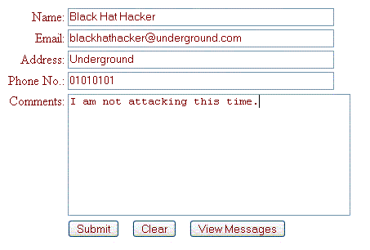
Cross Site Scripting
Community Architect Guestbook XSS (SA19742)
When the attacker is in a good mood:

Slide 18
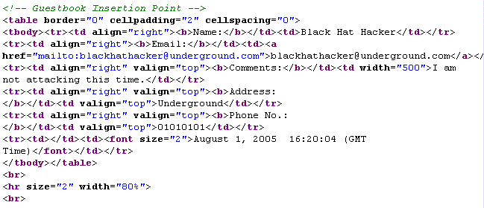
Cross Site Scripting
Community Architect Guestbook XSS (SA19742)
Where the input goes:

Slide 19
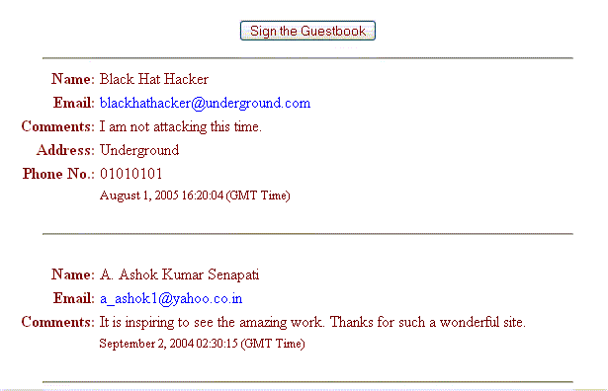
Cross Site Scripting
Community Architect Guestbook XSS (SA19742)
The Output:

Slide 20
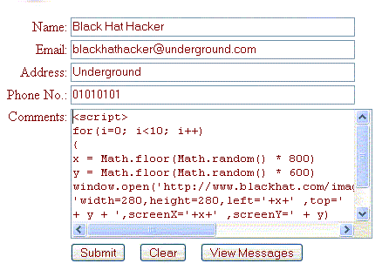
Cross Site Scripting
Community Architect Guestbook XSS (SA19742)
If the attacker attacks:

Slide 21
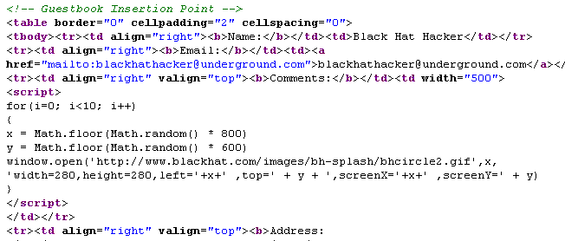
Cross Site Scripting
Community Architect Guestbook XSS (SA19742)
Where the input goes:

Slide 22
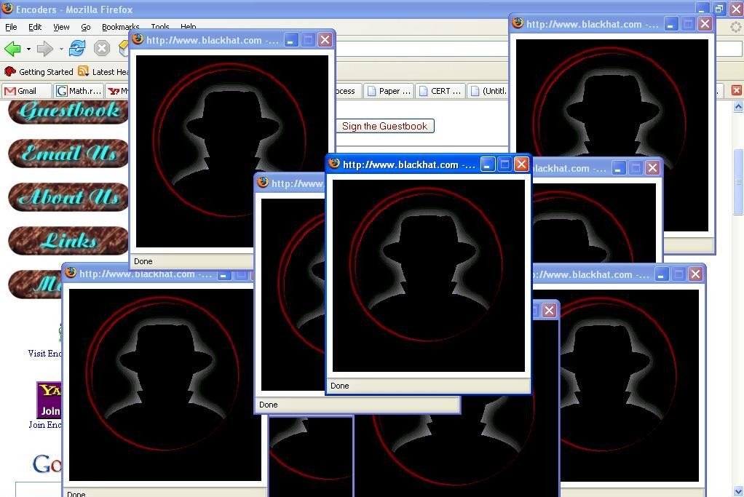
Cross Site Scripting
Community Architect Guestbook XSS (SA19742)
The
Output:
Reference:
http://cve.mitre.org/cgi-bin/cvename.cgi?name=CVE-2006-2003

Slide 23
Cross Site Scripting
Potential Harmful Tags:
<script>
<object>
<embed>
<applet>
<form>
Decision to be taken for XSS prevention:
Whether tags should appear in the output as a tags.
Whether tags should not appear in the output at all.
Whether text formatting is to be allowed.

Slide 24
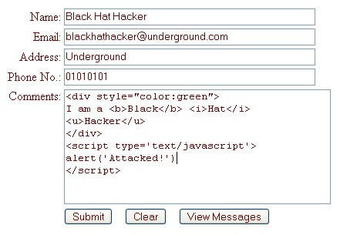
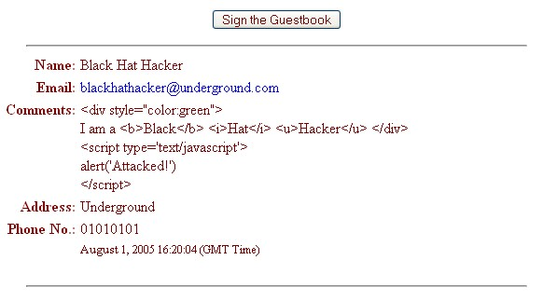
Cross Site Scripting
If tags should appear in the output.
Convert special characters to
HTML entities

Slide 25
Cross Site Scripting
If tags should appear in the output.
Convert special characters to HTML entities:
Special Character HTML Entity
< &lt;
> &rt;
“ &quot;
& &amp;
( &#40;
) &#41;
# &#35;

Slide 26
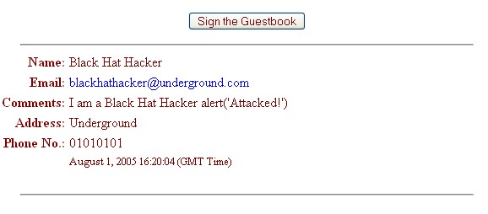
Cross Site Scripting
If tags should not appear in the output.
Filter out all tags

Slide 27
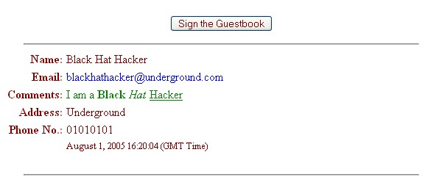
Cross Site Scripting
If text formatting should be allowed
Allow necessary tags only.

Slide 28
Cross Site Scripting
If text formatting should be allowed.
Tags that can be allowed:
<p>
<b>
<u>
<i>
<strike>
<h1>, <h2>, <h3>, <h4>, <h5>, <h6>

Slide 29
Buffer Overflows
Attackers use buffer overflows to corrupt the execution stack of an application.
Buffer overflows are easy to avoid, difficult to discover and extremely difficult to exploit.
Types of Attacks:
Attackers send carefully crafted input to a web application, an attacker can cause the application to execute arbitrary code.
When difficult to exploit, the attackers can crash the application thereby leading to DoS (Denial of Service).

Slide 30
Buffer Overflows
*str – 4th Byte
*str – 3rd Byte
*str – 2nd Byte
*str – 1st Byte
EIP – 4th Byte
EIP – 3rd Byte
EIP – 2nd Byte
EIP – 1st Byte
EBP – 4th Byte
EBP – 3rd Byte
EBP – 2nd Byte
EBP – 1st Byte
#include <string.h>
void function(char *str)
{
char buffer[4];
strcpy(buffer, str);
}
main()
{
char string[]="Hi!";
function(string);
}
Return Address
indicates what ESP is pointing to
indicates what EBP is pointing to

Slide 31
Buffer Overflows
*str – 4th Byte
*str – 3rd Byte
*str – 2nd Byte
*str – 1st Byte
EIP – 4th Byte
EIP – 3rd Byte
EIP – 2nd Byte
EIP – 1st Byte
EBP – 4th Byte
EBP – 3rd Byte
EBP – 2nd Byte
EBP – 1st Byte
buffer[3]
buffer[2]
buffer[1]
buffer[0]
#include <string.h>
void function(char *str)
{
char buffer[4];
strcpy(buffer, str);
}
main()
{
char string[]="Hi!";
function(string);
}
Return Address
indicates what ESP is pointing to
indicates what EBP is pointing to

Slide 32
Buffer Overflows
*str – 4th Byte
*str – 3rd Byte
*str – 2nd Byte
*str – 1st Byte
EIP – 4th Byte
EIP – 3rd Byte
EIP – 2nd Byte
EIP – 1st Byte
EBP – 4th Byte
EBP – 3rd Byte
EBP – 2nd Byte
EBP – 1st Byte
‘\0’
‘!’
‘i’
‘H’
#include <string.h>
void function(char *str)
{
char buffer[4];
strcpy(buffer, str);
}
main()
{
char string[]="Hi!";
function(string);
}
Return Address
indicates what ESP is pointing to
indicates what EBP is pointing to

Slide 33
Buffer Overflows
*str – 4th Byte
*str – 3rd Byte
*str – 2nd Byte
*str – 1st Byte
EIP – 4th Byte
EIP – 3rd Byte
EIP – 2nd Byte
EIP – 1st Byte
EBP – 4th Byte
EBP – 3rd Byte
EBP – 2nd Byte
EBP – 1st Byte
buffer[3]
buffer[2]
buffer[1]
buffer[0]
#include <string.h>
void function(char *str)
{
char buffer[4];
strcpy(buffer, str);
}
main()
{
char string[]="Good Morning!";
function(string);
}
Return Address
indicates what ESP is pointing to
indicates what EBP is pointing to

Slide 34
Buffer Overflows
*str – 4th byte
*str – 3rd byte
\0
!
g
n
i
n
r
o
M
d
o
o
G
#include <string.h>
void function(char *str)
{
char buffer[4];
strcpy(buffer, str);
}
main()
{
char string[]="Good Morning!";
function(string);
}
Return Address
indicates what ESP is pointing to
indicates what EBP is pointing to

Slide 35
Buffer Overflows
*str - | 4th byte
*str - | 3rd byte
\0 | 00H
! | 21H
g | 67H
n | 6EH
i | 69H
n | 6EH
r | 72H
o | 6FH
M | 4DH
 | 20H
d | 64H
o | 6FH
o | 6FH
G | 47H
#include <string.h>
void function(char *str)
{
char buffer[4];
strcpy(buffer, str);
}
main()
{
char string[]="Good Morning!";
function(string);
}
Return Address
Returns to offset
676E696EH
indicates what ESP is pointing to
indicates what EBP is pointing to

Slide 36
Buffer Overflows
Major Attacks:
Code Red Virus
Attacked a buffer overflow weakness in the Microsoft IIS Server API on July 19, 2001.
Damage: $2.6 billion
Sasser Worm
Attacked the Microsoft LSAS buffer overflow vulnerability on April 30, 2004.
Damage: $3.5 billion

Slide 37
Buffer Overflows
Prevention:
C Programmers now refrain from using strcpy(), strcat() in their programs. They use strncpy(), strncat() instead which perform bound checking. Never use gets().
Programmers now write their applications in languages like Java, Visual Basic which has better stack and memory management features.
Sun Microsystems is trying to make their Sparc processor immune to stack overflow attack by introducing new feature to protect the return address during a subroutine call.

Slide 38
Injection Flaws
Injection flaw lets you inject executable code at places where it is not allowed in a secure system which might lead to execution of the code and compromise of the system.
Common Attacks:
Relay malicious through a web application to another system.
Calls to operating system via system calls.
Use of external programs via shell commands.
Calls to backend databases via SQL.
Complete script injection into web applications.

Slide 39
Injection Flaws
SQL Injection:
SQL injection is particularly widespread and dangerous form of injection.
SQL Injection is possible if the value of any parameter is used in SQL queries and the parameter is not sanitised properly.
The attacker can retrieve, modify, corrupt or destroy database contents.

Slide 40
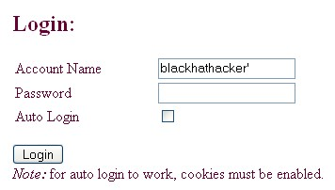
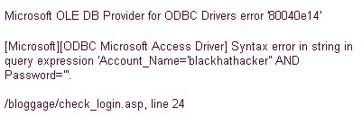
Injection Flaws
Bloggage SQL Injection:
SELECT <some_column> FROM <some_table> WHERE Account_Name = '<user>' AND Password ='<password>'
SELECT <some_column> FROM <some_table> WHERE Account_Name ='blackhathacker'' AND Password =''

Slide 41
Injection Flaws
Bloggage SQL Injection:
SELECT <some_column> FROM <some_table> WHERE Account_Name = '<user>' AND Password ='<password>'
SELECT <some_column> FROM <some_table> WHERE Account_Name = 'blackhathacker' AND
Password = 'a' OR 'a' = 'a'
(Always a true condition)
Account Name: blackhathacker
Password: a' OR 'a' = 'a

Slide 42
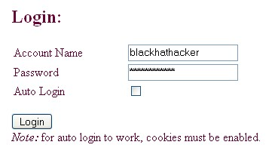
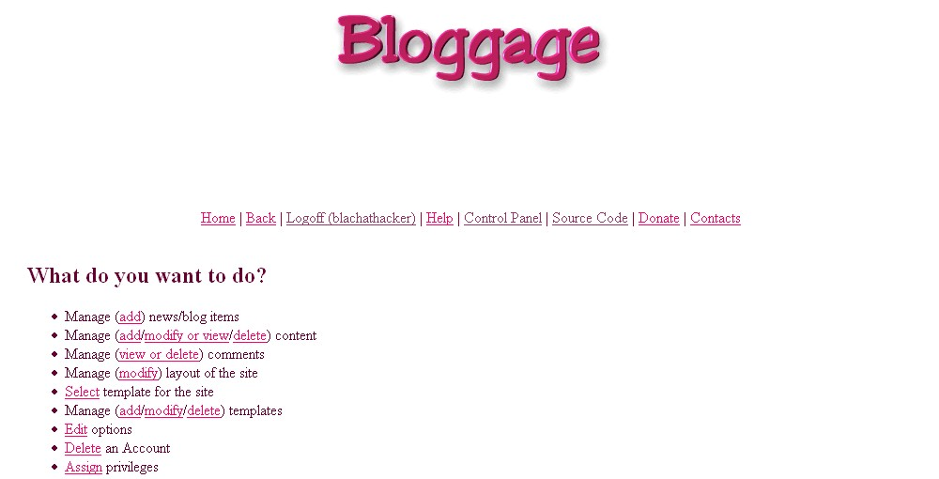
Injection Flaws
Bloggage SQL Injection:

Slide 43
Injection Flaws
Prevention:
Avoid accessing external interpreters wherever possible.
For calls to backend databases, carefully validate the data provided to ensure that it does not contain any malicious content.
Structure requests in a manner that ensures that all supplied parameters are treated as data, rather than potentially executable content.
Convert special characters to the correct form.
Run the application with minimum priveleges required.

Slide 44
Improper Error Handling
Improper handling of errors can introduce a variety of security problems.
Common Problems:
Inconsistencies in error messages which can reveal important clues on how the system works.
Stack traces, database dumps and error codes are displayed on error.
Syntax errors are displayed along with portions of the codes.

Slide 45

Improper Error Handling
A Bad Error Message

Slide 46

Improper Error Handling
An Ideal Error Message

Slide 47
Improper Error Handling
IncredibleIndia.org SQL Injection (WHID 2006-27)
A valid page: http://www.incredibleindia.org/newsite/cms_Page.asp?PageID=828
Trial 1:
http://www.incredibleindia.org/newsite/cms_Page.asp?PageID=828'
Error:
Unclosed quotation mark before the character string ' and mncpage.mnccategoryid = mnccategory.mnccategoryid'.
Conclusion:
Direct SQL Injection is possible. There are 2 tables, 'mncpage' and 'mnccategory'. Both of them have a column called 'mnccategoryid'.

Slide 48
Improper Error Handling
IncredibleIndia.org SQL Injection (WHID 2006-27)
Trial 2:
http://www.incredibleindia.org/newsite/cms_Page.asp?PageID=828 order by 1-- http://www.incredibleindia.org/newsite/cms_Page.asp?PageID=828 order by 2-- http://www.incredibleindia.org/newsite/cms_Page.asp?PageID=828 order by 3--
No error

Slide 49
Improper Error Handling
IncredibleIndia.org SQL Injection (WHID 2006-27)
Trial 3:
http://www.incredibleindia.org/newsite/cms_Page.asp?PageID=828 order by 4--
Error:
The ORDER BY position number 4 is out of range of the number of items in the select list.
Conclusion:
The table being used by the query selects 3 columns and one of them is an integer.

Slide 50
Improper Error Handling
IncredibleIndia.org SQL Injection (WHID 2006-27)
Trial 4:
http://www.incredibleindia.org/newsite/cms_Page.asp?PageID=828 union select 'varchar1', 'varchar2', 'varchar3' from mncpage --
Error:
Syntax error converting the varchar value 'varchar1' to a column of data type int.
Conclusion:
The 1st column in the select query is an integer.

Slide 51
Improper Error Handling
IncredibleIndia.org SQL Injection (WHID 2006-27)
Trial 5:
http://www.incredibleindia.org/newsite/cms_Page.asp?PageID=828 union select mnccategoryid, 'varchar2', 'varchar3' from mncpage--
No Error
Conclusion:
The column 'mnccategory' is of integer type.
Reference:
http://www.webappsec.org/projects/whid/list_id_2006-27.shtml

Slide 52
Insecure Storage
Most applications need to store sensitive information, either in a database or on a file system.
Types of Sensitive Information:
Passwords
Credit Card Numbers
Account Records
Proprietary Information

Slide 53
Insecure Storage
Common Mistakes:
Failure to encrypt critical data
Insecure storage of keys and passwords
Improper storage of secrets in memory
Poor sources of randomness
Poor choice of algorithm
Attempting to invent a new encryption algorithm
Types of Attacks:
Examining tokens, session IDs, cookies, etc. to see if they are obviously not random.
Finding cryptographic flaws.

Slide 54
Insecure Storage
Prevention:
Minimize encryption. Use it to keep information that is absolutely necessary.
Instead of storing encrypted passwords, use a one-way function, such as a SHA-1, to has the passwords
If cryptography must be done, choose a library that has been exposed to public scrutiny and makes sure that there are no open vulnerabilities.
Clear the clear-text sensitive information from the memory as soon as possible.

Slide 55
Denial of Service
Denial of Service (DoS) attack is an attempt to make a computer service unavailable to its intended users.
Common Attacks:
Consume bandwidth, database connections, disk storage, CPU, memory, threads, or application specific resources.
Locking out a legitimate user by sending invalid credentials until the system locks out the account.
Exploiting buffer overflows & injection flaws to inject code/commands to shut down or stall importand service.

Slide 56
Denial of Service
0verkill recv_packet() UDP Handling Overflow DoS
The vulnerability was an integer underflow error in a Linux based gaming daemon called 0verkill. It could be exploited to launch DoS attacks by sending UDP packets of size less than 12 bytes to the 0verkill daemon.
Prevention:
Load balancing makes these attacks more difficult.
Analyse each resource and check if there is a way to exhaust it.
Limit resources to any user to bare minimum.
Check error handling scheme and ensure that an error can not affect the overall operation of the system.

Slide 57
Insecure Configuration
Insecure configuration of a system can itself be a potential vulnerability.
Common Configuration Problems:
Unpatched security flaws in a software.
Server software flaws or misconfigurations that permit directory listing and directory traversal attacks
Improper file and directory permissions
Unnecessary services enabled
Default accounts with default passwords
Administrative or debugging functions that are enabled
Improper authentication with external systems

Slide 58
Insecure Configuration
Apache URL Validation Vulnerability (BID 19447)
# Sample Safe Configuration for Unix/Linux
DocumentRoot "/home/webmaster/site/docroot/"
ScriptAlias /cgi-bin/ "/home/webmaster/site/docroot/cgi-bin"
# Sample Unsafe Configuration for Windows
DocumentRoot "C:/webmaster/site/docroot"
ScriptAlias /cgi-bin/ "C:/webmaster/site/docroot/cgi-bin/"
Accessing a script in the cgi-bin directory:
http://www.example.com/cgi-bin/somescript
Exploit:
http://www.example.com/CGI-BIN/somescript

Slide 59
Insecure Configuration
Apache URL Validation Vulnerability (BID 19447)
# Sample Safe Configuration for Windows
DocumentRoot "C:/webmaster/site/docroot"
ScriptAlias /cgi-bin/ "C:/webmaster/site/cgi-bin/"
Accessing a script in the cgi-bin directory:
http://www.example.com/cgi-bin/somescript
Exploit URL is now invalid:
http://www.example.com/CGI-BIN/somescript
Reference:
http://www.securityfocus.com/bid/19447

Slide 60
Insecure Configuration
Prevention:
Configure all security mechanisms
Turn off all unused services
Set up roles, permissions and accounts
Disable all default accounts or change their passwords
Enable logging and alerts
Monitor the latest security vulnerabilities published
Apply the latest security patches
Update the security configuration guidelines
Scan for vulnerabilities with a vulnerability scanner regulary

Slide 61
Thank You!

