Slide 1
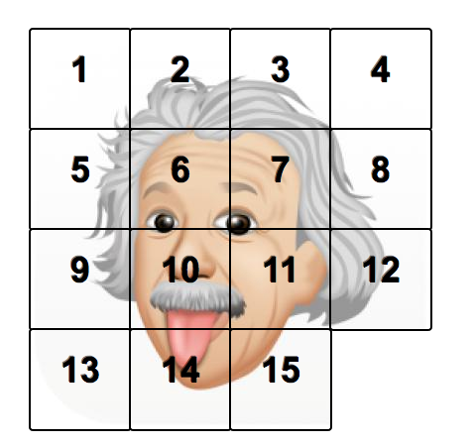
15 Puzzle
Created by:
Aleya
Susan Carrera

Slide 2
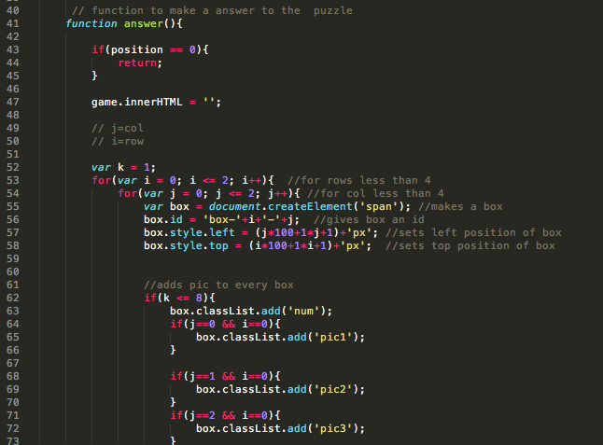
Function to create a solved puzzle

Slide 3
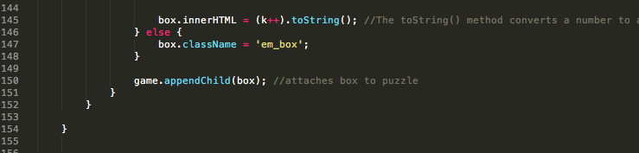
This function created a 2 dimensional array and gives each cell an
ID and a position. Gives each cell a picture associated with each
position

Slide 4
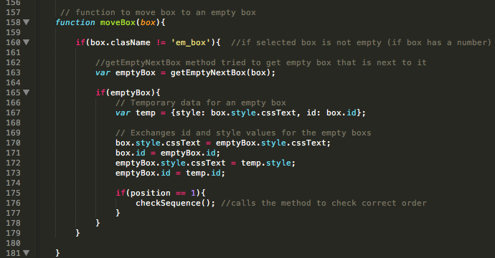

Slide 5
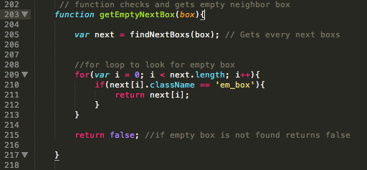

Slide 6
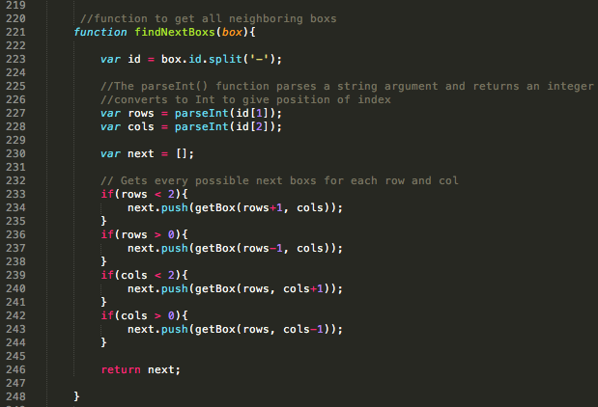

Slide 7
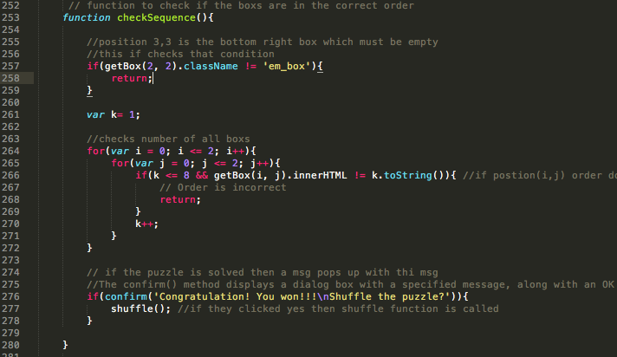

Slide 8
