Slide 1
Minesweeper
Susan Carrera
Aleya Chowdhury
Hyeun Kang
Web programming csc4370

Slide 2
Making the game
Format a table
Add contents to each cell
Match a radio button to each cell
ex<div class="button">
<input type="radio" id="b1_1" class="row1 column1 bomb">
<input type="radio" id="b1_2" class="row1 column2”>
Match each empty cell to radio
<div class="empty_space">
<input type="radio" id="em_b1">
<input type="radio" class="row2 column4">
<input type="radio" class="row2 column5">
<input type="radio" class="row2 column6">

Slide 3
Radio buttons let a user select ONLY ONE of a limited number of choice
Checkboxes let a user select ZERO or MORE options of a limited number of choices.

Slide 4
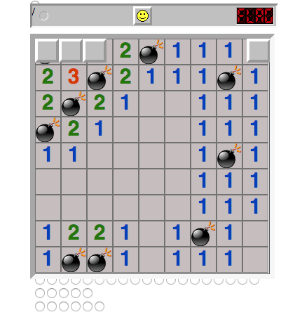

Slide 5
We match the table of radios to table of cells
Then we add buttons to cover each cell
Added a navigation bar
In the bar we added a flag option
A reset button (smiley)

Slide 6
Team Work
Our Team met every day on campus for an hour and a few hours on Friday
In addition we also communicated through the Slack app on through the weekend

