Slide 1
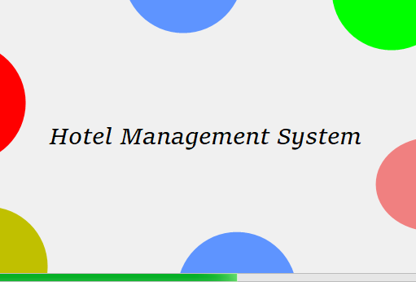
Name:Susan Abdullahi
Name:Najah Shuke
Welcome to Our
Hotel Management
System
We've created a powerful, yet easy to use system for managing hotels of all sizes. Our project utilizes C# and Microsoft Access for a seamless experience.

Slide 2
Project Overview
Project Description | Technology Stack Used | Features Offered
Our hotel management system makes it easy to keep track of guests, rooms, and staff all in one place. | We've utilized top of the line technology such as C# and Microsoft Access to create a powerful solution for hotel management. | Our system allows for seamless management of guests, staff, and room availability so you can focus on providing a top-notch experience for your guests.

Slide 3
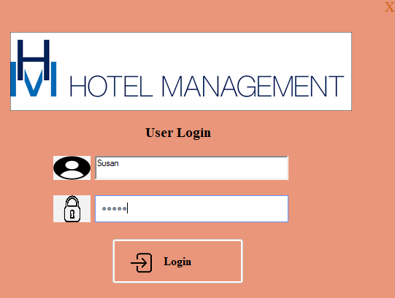
Admin Functionality
Login Mechanism
Admins can easily login to our system by entering their name and password. This ensures only authorized access to the dashboard.

Slide 4
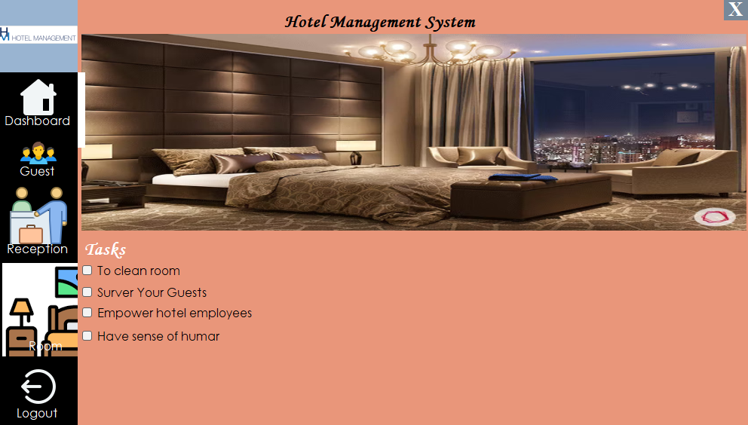
Dashboard Management
Once logged in, admins have complete control over the dashboard where they can manage guests, Reception and room availability.

Slide 5
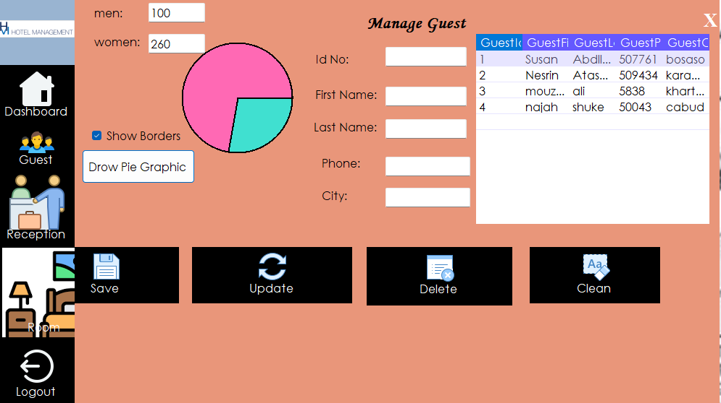
Guest Management
Furthermore, our system enables admins to effortlessly manage guests by name or ID.
This streamlined functionality facilitates the addition, deletion, and updating of guest information, ensuring that our records remain accurate and up-to-date with minimal effort.
In addition to our guest management system, we've implemented graphs that display the current breakdown of men and women staying in the hotel. Once the administrator inputs the guest numbers, these graphs provide a clear visual representation of the gender ratio among our guests, allowing for quick insights into our demographic distribution

Slide 6
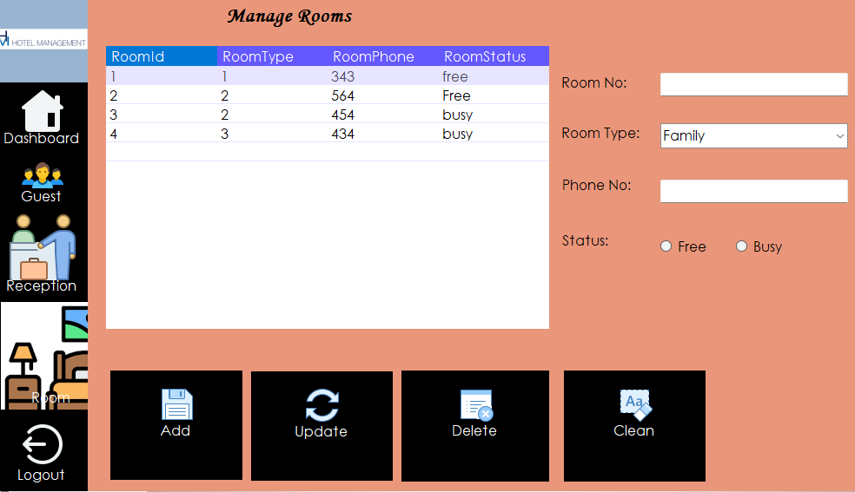
Room Management
Admins have the ability to delete, update, and add rooms as well as clear the form, allowing for effortless management of room information.
They can conveniently add rooms by selecting specific room types and entering relevant details, along with assigning phone numbers to each room for efficient communication with guests.
This comprehensive system ensures not only the smooth handling of room inventory but also facilitates guest interaction through designated room phone numbers.

Slide 7
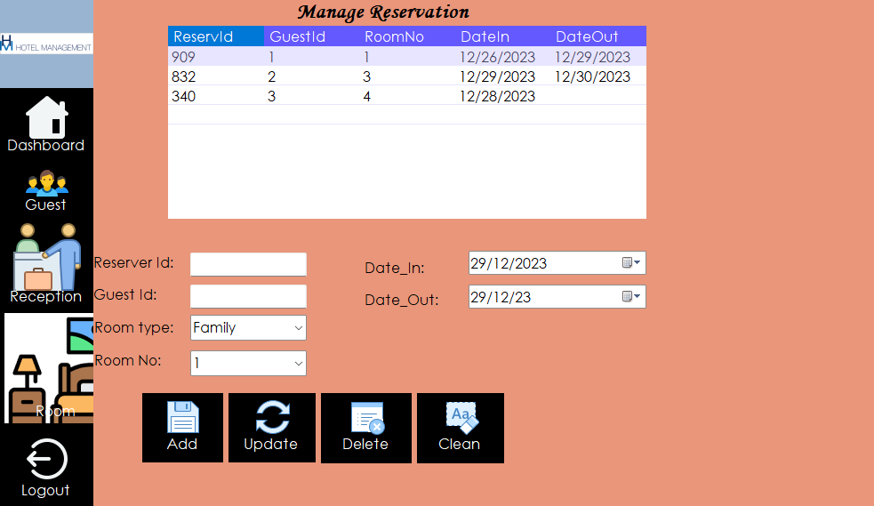
Reception Functionality
Room Status Display
In the reception portion of our system, staff can quickly see which rooms are free or busy.

Slide 8
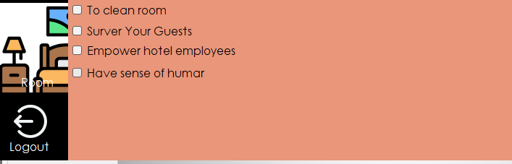
Log Out
At any time, admins or staff members can log out of our system, ensuring complete control over access to sensitive information.

Slide 9
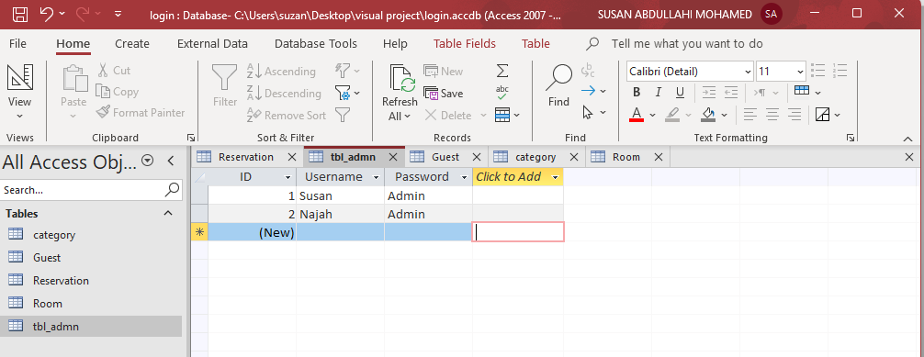
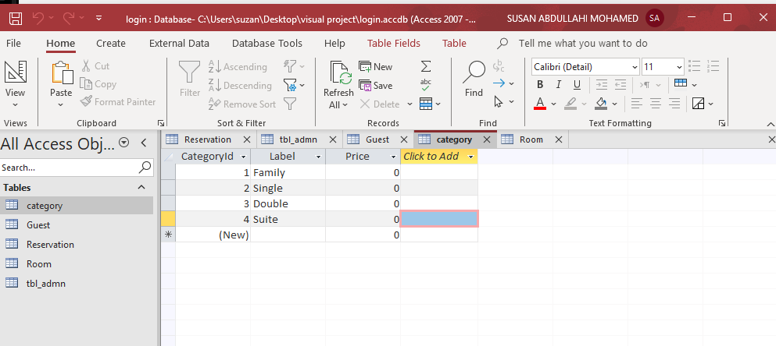
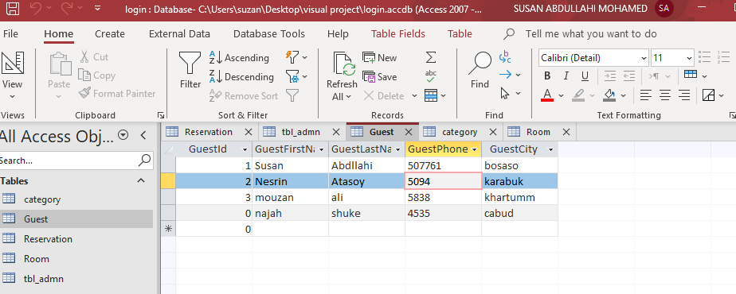
Screenshot of database

Slide 10
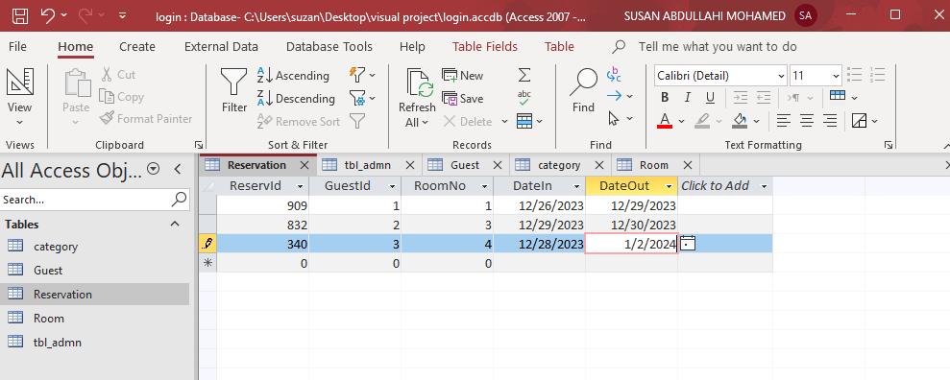
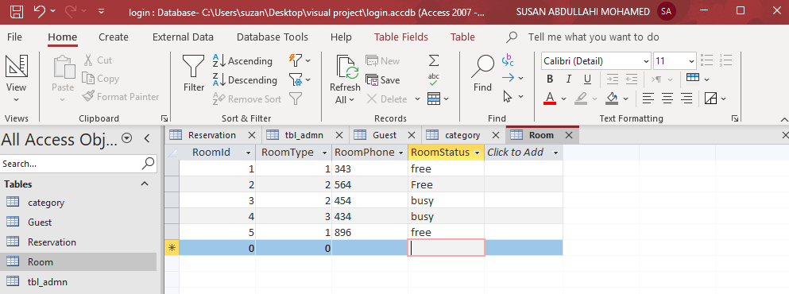
Screenshot of database

Slide 11
Conclusion
Effortless Management | Top of the Line Technology | Seamless Experience
Our hotel management system streamlines the process of managing guest, staff, and room information while also ensuring total control over access to sensitive data. | We've utilized top of the line technology to create a system that is both powerful and easy to use, making hotel management a breeze. | Thanks to seamless interconnectivity between all database components, our system ensures that all hotel information is effortlessly managed and accessible.

Slide 12
THANKS

