Slide 1
Marriage and Divorce in America
What has changed, and who divorces?
Susana Fernandez Rivera
DATA 201 Capstone | LaGuardia Community College | October 2026
Notes:
Hi, my name is Susana Fernandez Rivera. This is my DATA 201 capstone project. I looked at marriage and divorce in America: how the rates have changed over time, whether 2019 was any different, and what divorced people have in common. I used Python, pandas, matplotlib, and scipy for everything you are about to see.

Slide 2
Three research questions
How have marriage and divorce rates changed over time, and how does New York compare to the rest of the country?
1
Was 2019 different from the trend?
2
What do divorced people have in common?
3
Susana Fernandez Rivera | DATA 201 Capstone | 2
Notes:
I had three research questions. One: how have marriage and divorce rates changed over time, and how does New York compare to the rest of the country? Two: was 2019 different from the trend? And three: what do divorced people have in common? The first question uses national and state data over almost twenty years. The second and third use a survey of New Yorkers from 2019.

Slide 3
Two data sources
CDC / NCHS, 1990 to 2017
U.S. Census Bureau, ACS 2019
U.S. marriage and divorce rates, 2000 to 2017
Marriage and divorce rates for every state, 1990 to 2017
Rates are per 1,000 people
3 Excel files with messy layouts: footnotes, blank rows, missing values
American Community Survey, 1-year microdata, New York
198,788 people, one row per person
Age, sex, marital status, married or divorced in past year, education, income
Each person carries a weight, so the sample adds up to 19.5 million New Yorkers
Susana Fernandez Rivera | DATA 201 Capstone | 3
Notes:
I used two data sources. The first is from the CDC: national marriage and divorce rates from 2000 to 2017, and rates for every state going back to 1990. These came as Excel files with footnotes, blank rows, and missing values that I had to clean. The second is the Census Bureau's American Community Survey for 2019, for New York State. That file has one row per person, almost 200,000 people, with their age, sex, marital status, whether they married or divorced in the past year, their education, and their income. Each person has a weight, so when I add them up they represent the full 19.5 million people in New York.

Slide 4
How I did it
1
2
3
4
5
Load
Clean
Describe
Visualize
Test
pd.read_excel, pd.read_csv
cut tables out of sheets, strip footnotes, convert text to numbers, melt wide to long, merge
describe(), % change, weighted averages
line charts and bar charts with matplotlib
linear regression, paired t-test, chi-square test, Welch t-test (scipy)
Every step is in one Jupyter notebook: 34 code cells, 7 charts, all on GitHub.
Susana Fernandez Rivera | DATA 201 Capstone | 4
Notes:
My process had five steps. First I loaded the files with pandas. Then I cleaned them: I cut the tables out of the Excel sheets, stripped footnote numbers off the years and state names, converted text to numbers, reshaped the state data from wide to long, and merged everything into clean tables. Then I described the data with summary statistics and percent changes, and for the Census data I used the person weights. I visualized everything with matplotlib. And finally I tested whether the patterns were real using linear regression, a paired t-test, a chi-square test, and a two-sample t-test. All of it is in one Jupyter notebook on GitHub.

Slide 5
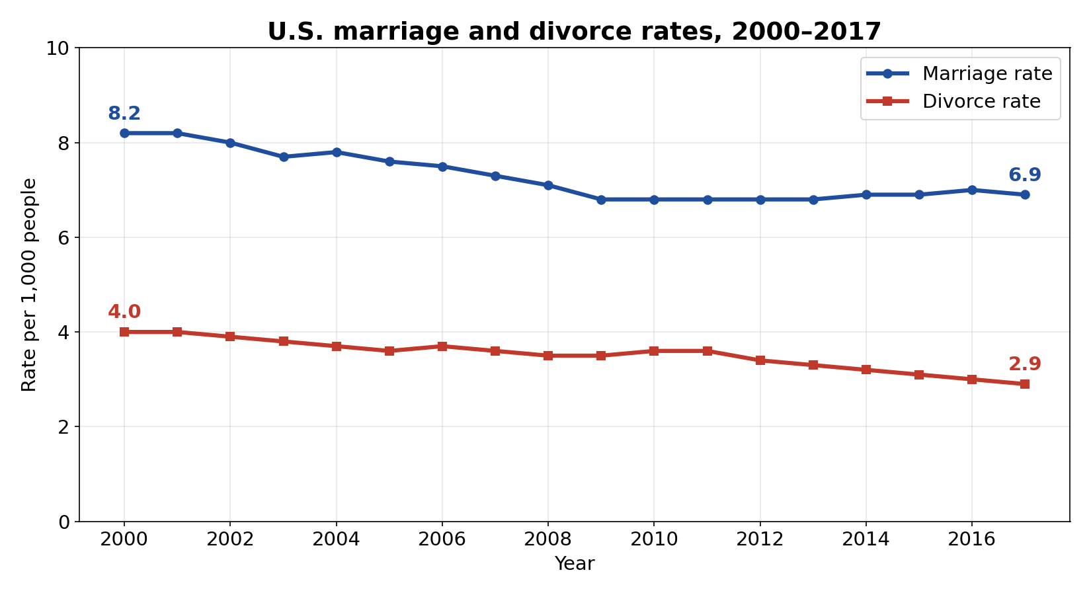
Q1: Both rates fell in the U.S., 2000 to 2017
8.2 → 6.9
Marriages per 1,000 people, down 16%
4.0 → 2.9
Divorces per 1,000 people, down 28%
p < 0.001
Both downward trends are statistically significant
Susana Fernandez Rivera | DATA 201 Capstone | 5
Notes:
For the first question: from 2000 to 2017, both the marriage rate and the divorce rate in the United States went down. Marriages dropped from 8.2 to 6.9 per thousand people, about 16 percent. Divorces dropped from 4.0 to 2.9, about 28 percent, so divorce actually fell faster than marriage. I ran a linear regression on each line, and both slopes are significant with p-values under 0.001. These are real trends, not random year-to-year noise.

Slide 6
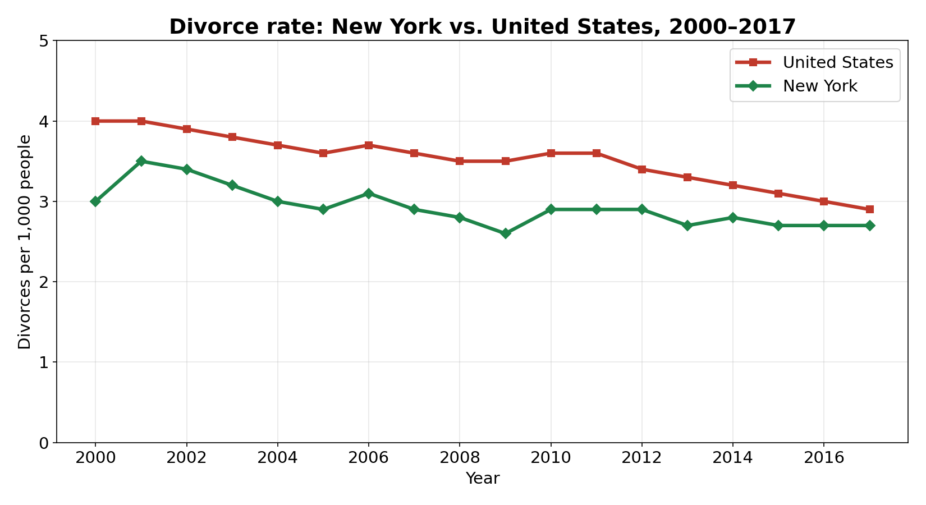
Q1: New York has fewer divorces than the U.S.
18 of 18
Years New York's divorce rate was below the U.S. rate (paired t-test, p < 0.001)
12th of 51
New York's marriage rate rank in 2017 (above the U.S. average)
32nd of 46
New York's divorce rate rank in 2017 (lower half)
Susana Fernandez Rivera | DATA 201 Capstone | 6
Notes:
New York followed the same downward path, but with consistently fewer divorces than the country. In every single one of the 18 years, New York's divorce rate was below the U.S. rate, by about 0.6 divorces per thousand on average. A paired t-test confirms that difference is significant. For marriage, New York started below the U.S. average in the early 2000s but moved above it around 2011. By 2017 New York ranked 12th out of 51 for marriage, and 32nd out of the 46 states that report divorces.

Slide 7
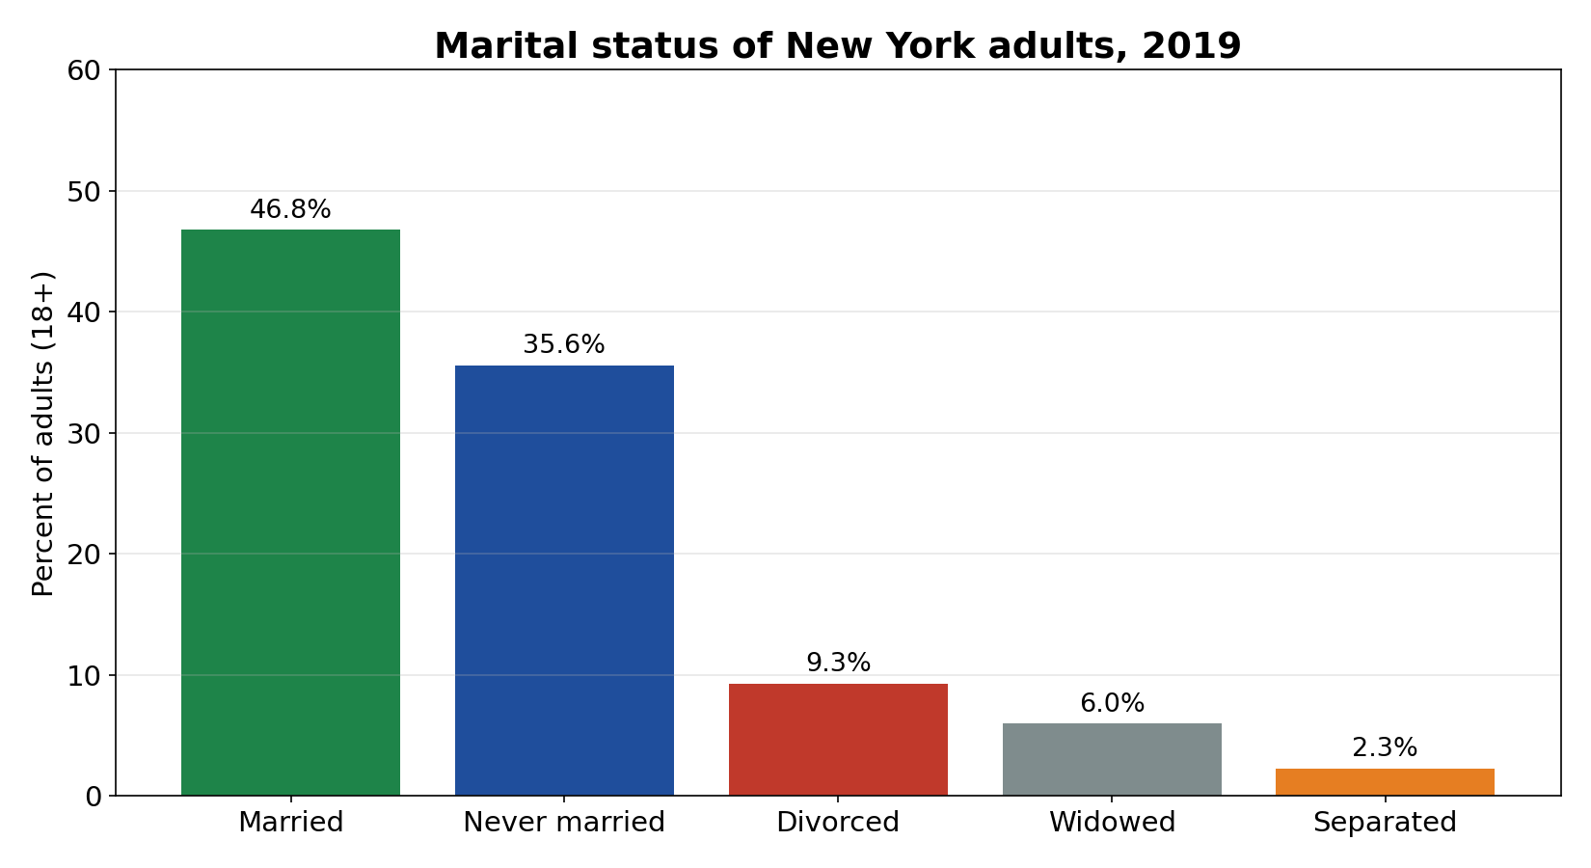
Q2: 2019 was right on the trend, not different
New York | Marriages per 1,000 | Divorces per 1,000
CDC, 2017 | 7.3 | 2.7
Census ACS, 2019 | 6.5 | 2.3
About 125,700 marriages and 44,700 divorces in New York in 2019
Roughly 3 marriages for every divorce
Slightly lower than 2017, exactly what the long slow decline predicts
Fewer than half of New York adults (46.8%) were married in 2019
Census counts people who married or divorced in the past 12 months. Two people per event, so counts are divided by 2 to match the CDC rates.
Susana Fernandez Rivera | DATA 201 Capstone | 7
Notes:
Second question: was 2019 different? No. The CDC data stops at 2017, so for 2019 I used the Census survey. The survey asks each person whether they got married or divorced in the past 12 months. Because every marriage or divorce involves two people, I divided the counts by two, and I used the whole population as the denominator, the same way the CDC does. That gives New York about 6.5 marriages and 2.3 divorces per thousand people in 2019, a small step down from 7.3 and 2.7 in 2017. That is exactly what the long, slow decline would predict. Nothing about 2019 stands out. One more fact from that year: fewer than half of New York adults, about 47 percent, were married, and about 9 percent were divorced.

Slide 8
Q3: Divorced vs. married New Yorkers
57.5 vs 52.5
60%
$14,000 less
Average age: 5 years older
Women (vs 50% of married adults)
Average yearly income: $52,900 vs $66,800
31% vs 41%
1 in 5
p < 0.001
Have a bachelor's degree or higher
Have been married more than once
Income gap is significant (Welch t-test)
New York adults 18+, ACS 2019, weighted
Susana Fernandez Rivera | DATA 201 Capstone | 8
Notes:
Third question: what do divorced people have in common? I compared adults who are currently divorced with adults who are currently married. Divorced New Yorkers are about five years older on average, 57 and a half versus 52 and a half. Sixty percent are women, compared with fifty percent of married adults. They earn about 14,000 dollars less per year on average, and a t-test shows that gap is statistically significant. They are less likely to have a bachelor's degree, 31 percent versus 41 percent. And one in five has been married more than once.

Slide 9
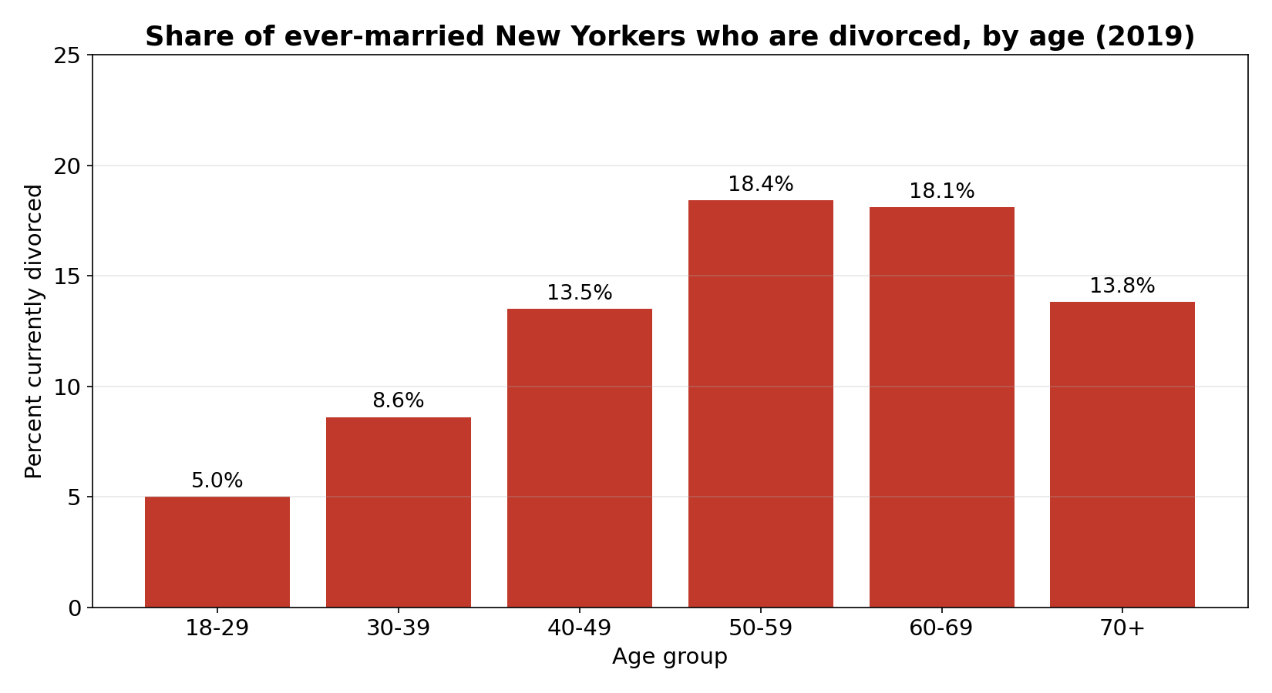
Q3: Divorce peaks in the 50s and 60s
Among ever-married adults, the share currently divorced climbs from 5% at ages 18 to 29 to about 18% at ages 50 to 69
It dips after 70, mostly because widowhood takes over at that age
Younger adults have simply had less time to marry and divorce
Susana Fernandez Rivera | DATA 201 Capstone | 9
Notes:
Looking at age: I limited this to people who have ever been married, so young adults who never married don't drag the numbers down. The share who are currently divorced climbs steadily: 5 percent in their twenties, about 9 percent in their thirties, 13 and a half in their forties, and about 18 percent in their fifties and sixties. It dips after 70, but that is mostly because widowhood takes over at that age, not because older people divorce less.

Slide 10
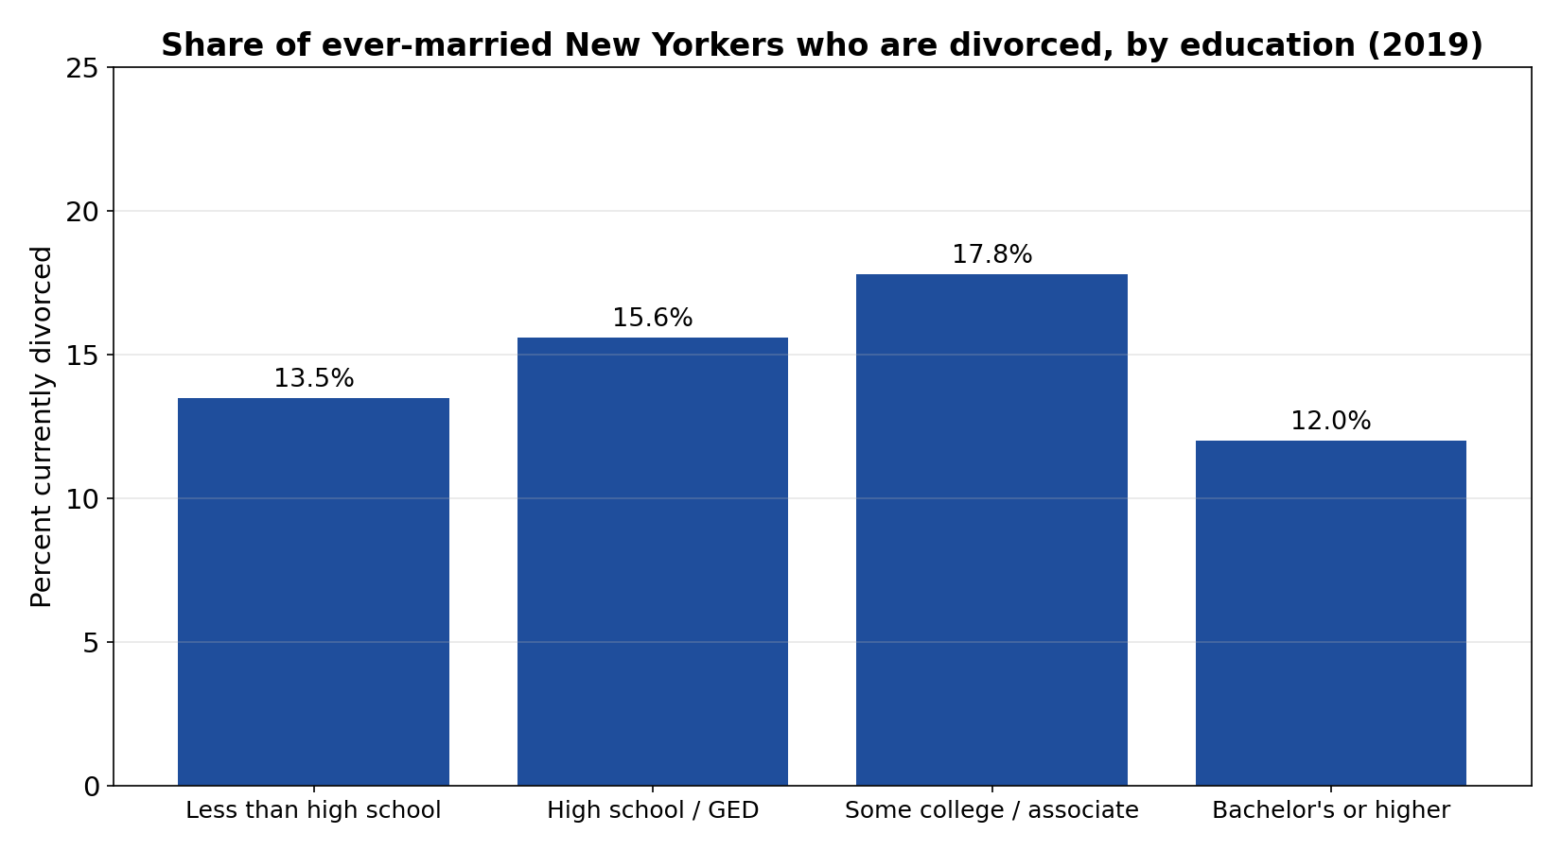
Q3: Education matters, but not in a straight line
17.8%
Highest divorce share: some college or associate degree
12.0%
Lowest divorce share: bachelor's degree or higher
p < 0.001
Chi-square test: education and divorce are related
Susana Fernandez Rivera | DATA 201 Capstone | 10
Notes:
Education: I expected a straight line, more education, less divorce, but that is not what the data shows. Adults with some college or an associate degree have the highest share currently divorced, almost 18 percent. Adults with a bachelor's degree or higher have the lowest, 12 percent. People with less than high school are in the middle. A chi-square test confirms that education and divorce are related, with a p-value under 0.001, so this pattern is not random.

Slide 11
What I found
Marriage and divorce both declined from 2000 to 2017, and divorce fell faster. New York had fewer divorces than the U.S. in every year.
1
2019 was not special. New York's 2019 rates sit right on the long downward trend.
2
Divorced New Yorkers are older, more often women, earn about $14,000 less, and are less likely to hold a bachelor's degree. Divorce peaks in the 50s and 60s.
3
Susana Fernandez Rivera | DATA 201 Capstone | 11
Notes:
So, to sum up. One: marriage and divorce both declined from 2000 to 2017, and divorce fell faster. New York had fewer divorces than the country in every year. Two: 2019 was not special. New York's 2019 numbers sit right on that downward trend. Three: in New York, divorced adults are older, more often women, earn about 14,000 dollars less, and are less likely to have a bachelor's degree. Divorce peaks in the fifties and sixties.

Slide 12
Limitations and next steps
Limitations
Next steps
CDC's national divorce rate leaves out states that don't report (like California)
CDC ends in 2017; Census covers 2019 only, so there is no single line through 2019
Census shows who is divorced now, not who got divorced. Divorced-then-remarried counts as married
These are patterns, not causes. Divorce can also cause lower income, especially for women
Add CDC data for 2018 to 2023 to see whether the pandemic years changed the trend
Use several years of Census data to follow the same age groups over time
Compare New York City with the rest of the state
Susana Fernandez Rivera | DATA 201 Capstone | 12
Notes:
A few limitations. The CDC's national divorce rate leaves out states that don't report divorces, like California. The CDC data ends in 2017 and the Census data is just 2019, so they measure slightly different things. The Census tells me who is divorced right now, not who got divorced, so someone who divorced and remarried counts as married. And these are patterns, not causes. Being older or earning less does not cause divorce; a divorce can also cause lower income, especially for women. If I kept going, I would add the CDC data through 2023 to see what the pandemic did to the trend, and use several years of Census data to follow the same age groups over time.

Slide 13
Data sources and references
National Center for Health Statistics (CDC). National Marriage and Divorce Rate Trends, 2000-2017. cdc.gov/nchs/nvss/marriage-divorce.htm
National Center for Health Statistics (CDC). Marriage Rates by State and Divorce Rates by State, 1990-2017. cdc.gov/nchs/nvss/marriage-divorce.htm
U.S. Census Bureau. American Community Survey 2019 1-Year Public Use Microdata Sample (PUMS), New York. census.gov/programs-surveys/acs/microdata.html
U.S. Census Bureau. 2019 ACS PUMS Data Dictionary. census.gov/programs-surveys/acs/microdata/documentation.html
pandas, NumPy, Matplotlib, and SciPy documentation
Code and notebook: github.com/susanaef0903-source
Susana Fernandez Rivera | DATA 201 Capstone | 13
Notes:
These are my data sources and references. The full notebook and all the code are on my GitHub. Thank you.

