Slide 1
Classically Verifiable Quantum Advantage from a Computational Bell Test
Submitted by:
Aadhithya Sankaranarayanan
Shyam Sunder Murugesan Sellammal
Susana Rivera Vergara
Team Name:Quanx

Slide 2

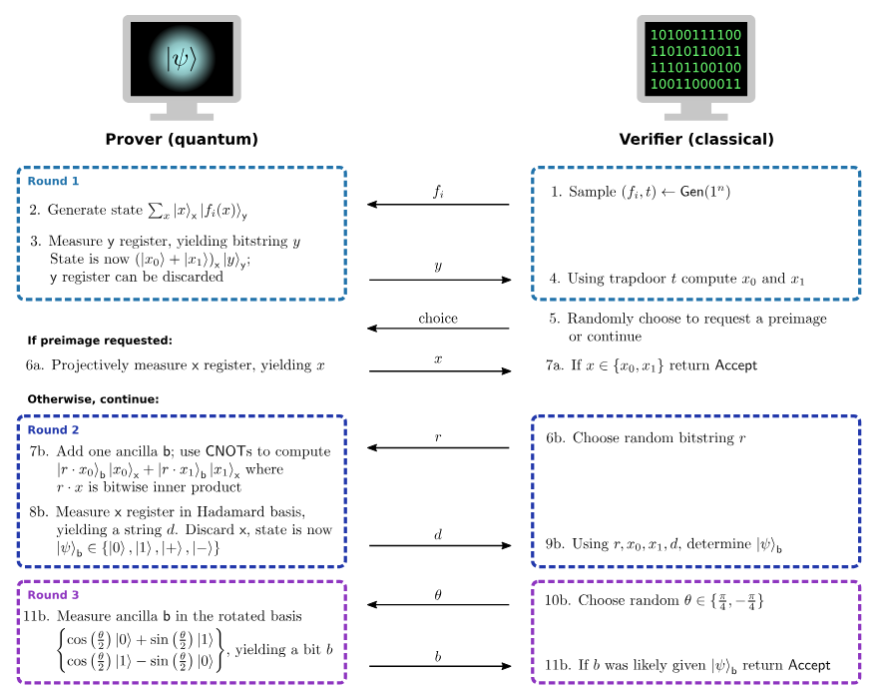
Problem Statement
Title: Classically Verifiable Quantum Advantage from a Computational Bell Test
Can quantum computers outperform classical ones for specific tasks?
This concept is termed quantum computational advantage.
We propose an interactive protocol for demonstrating quantum computational advantage, which is efficiently verifiable by classical means.
Kahanamoku-Meyer, G.D., Choi, S., Vazirani, U.V. and Yao, N.Y., 2022. Classically verifiable quantum advantage from a computational Bell test. Nature Physics, 18(8), pp.918-924.

Slide 3
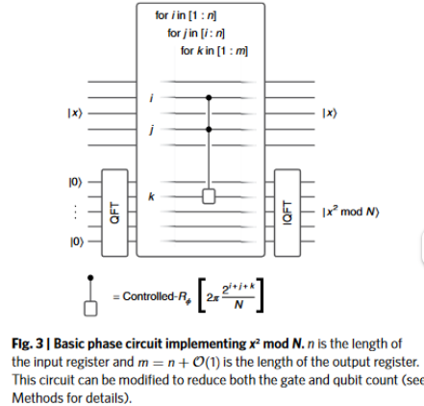
Project Solution
Objectives
1.The primary goal is to demonstrate quantum computational advantage using an interactive protocol that employs trapdoor claw-free functions (TCFs).
2.This approach links to Bell’s inequality, reducing the need for complex cryptographic properties while maintaining efficient verifiability.
Achieved by:
Discrete Logarithm is used to create TCF
Phase circuit to implement x^2 mod N using doubly-Controlled phase rotation gates of angle
Kahanamoku-Meyer, G.D., Choi, S., Vazirani, U.V. and Yao, N.Y., 2022. Classically verifiable quantum advantage from a computational Bell test. Nature Physics, 18(8), pp.918-924.

Slide 4
Result
Did you achieve your desired results? What were your success metrics? How did your project make an impact on the current field of Quantum Science?
Yes, we were able make the phase circuit for x^mod N.We managed to apply gate and qubit optimisation for the circuit. Our project will efficiently find the quantum advantage over classical computers. It will be helpful for polynomial or super-polynomial Quantum speed-ups.

Slide 5
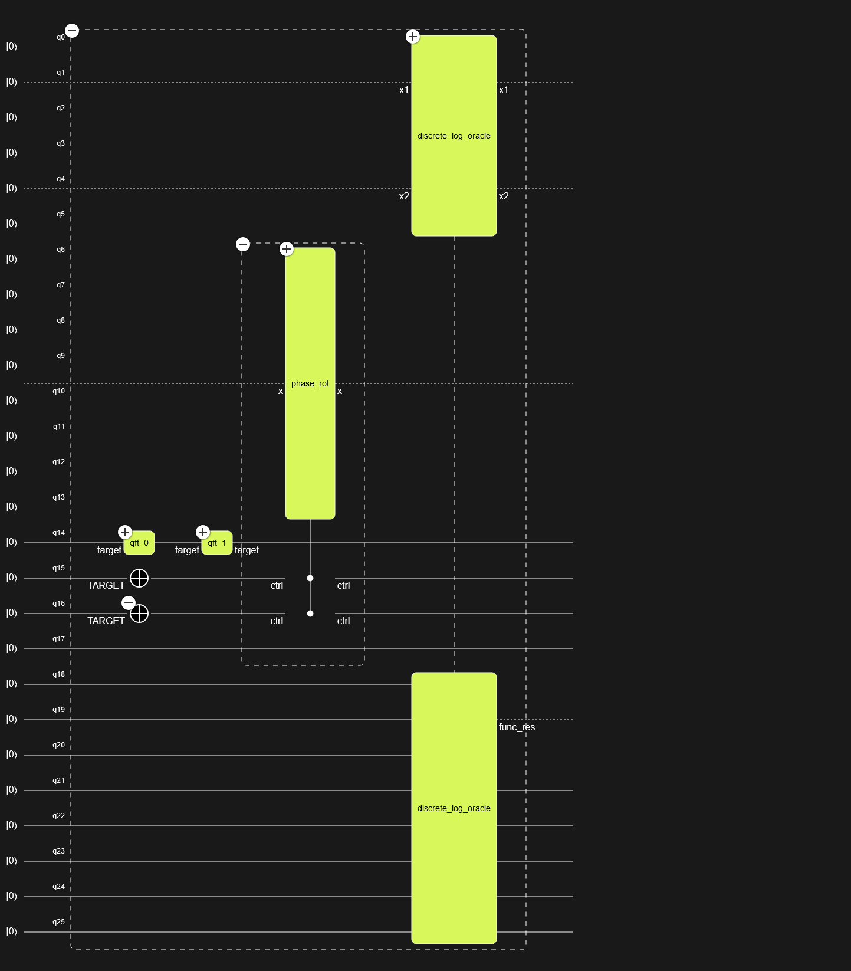
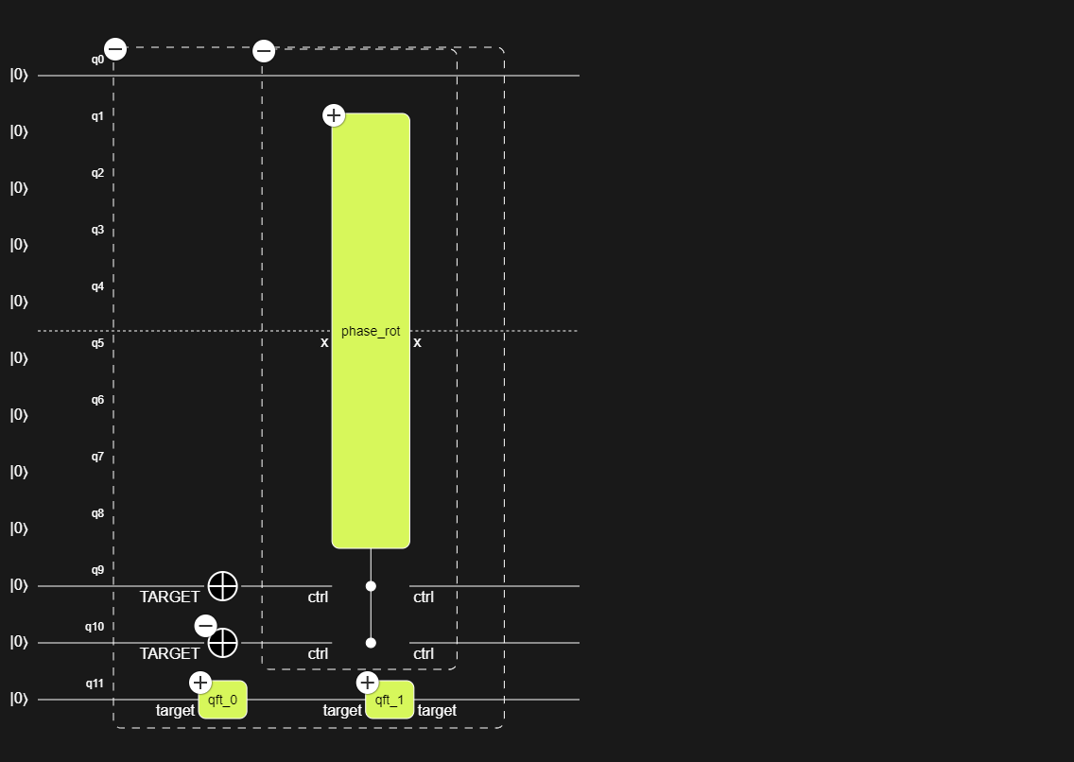
Result
Phase circuit for x^2 mod N
Discrete Log for TCF

Slide 6
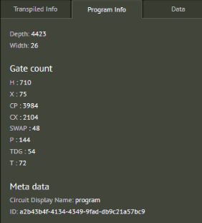
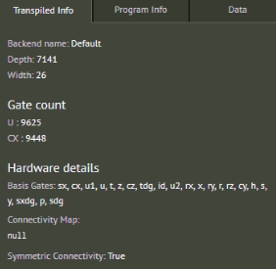
Description for Phase circuit

Slide 7
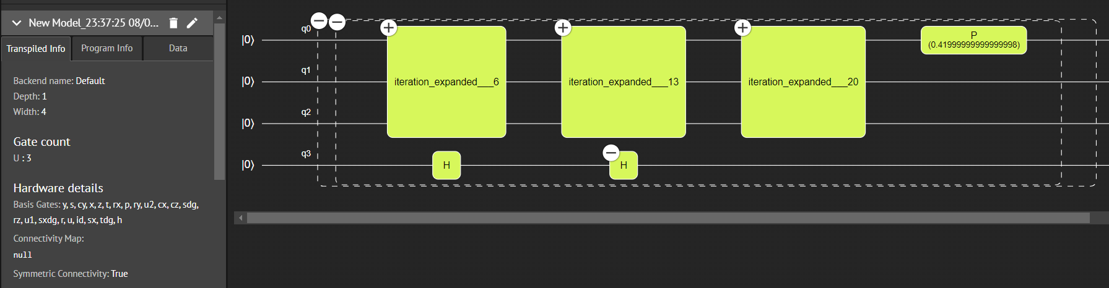
Qubit Number Optimized Circuit

Slide 8
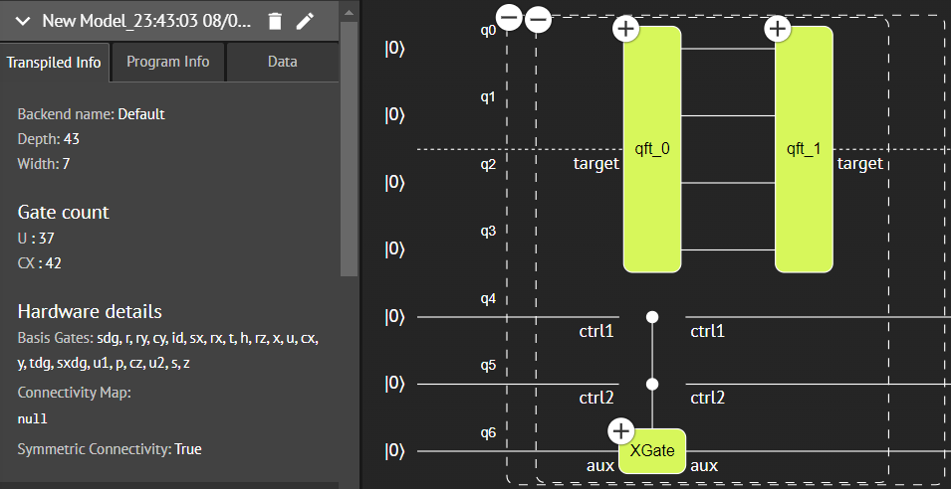
Gate Number Optimized Circuit

Slide 9
Future Scope
Karatsuba Algorithm( Classical multiplication algorithm) can be implemented in quantum circuits for increasing efficiency of model
Applying these method for application such as certifiable random number generation,
Limitation faced in current work are:
A. Time and hardware resources available
b.Calculation fidelity and plotting graph option were not available in native qmod
Reference
Kahanamoku-Meyer, G.D., Choi, S., Vazirani, U.V. and Yao, N.Y., 2022. Classically verifiable quantum advantage from a computational Bell test. Nature Physics, 18(8), pp.918-924.

