Slide 1
HOSPITAL BED DEMAND FORECASTING
Using Data and Artificial Intelligence to Plan Ahead
Summary Briefing for Hospital Leadership & Operations Stakeholders

Slide 2
BACKGROUND
Hospitals Are Under Growing Pressure
1
2
3
Limited Capacity
Resource Strain
Reactive Planning
Bed availability is finite, but patient demand is hard to predict day to day.
Under- or over-allocating beds, staff and equipment creates avoidable risk.
Without foresight, teams are left responding to pressure instead of preparing for it.
A reliable forecast lets leaders plan staffing and capacity before pressure peaks — not after.
Hospital Bed Demand Forecasting
2

Slide 3
METHOD
How We Built the Forecast
Combine
Hospital Data
Identify Key
Patterns
Train & Compare
AI Models
Recommend the
Best Approach
Data sources: bed occupancy, admissions & discharges, emergency arrivals, planned surgeries, and staffing levels — combined into one clean, connected dataset.
Models tested: a traditional statistical benchmark, three modern machine-learning methods, and a deep-learning model.
Hospital Bed Demand Forecasting
3

Slide 4
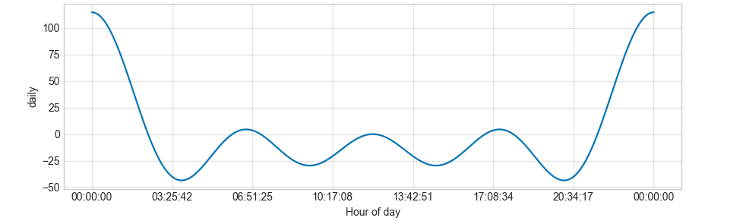
WHAT THE DATA SHOWED
A Predictable Daily Rhythm
Hospital activity consistently peaks around midnight and the early hours, then eases through the afternoon — a steady cycle that repeats every day.
Why it matters: Knowing exactly when demand peaks helps target staffing to the busiest hours rather than spreading resources evenly.
Hospital Bed Demand Forecasting
4

Slide 5
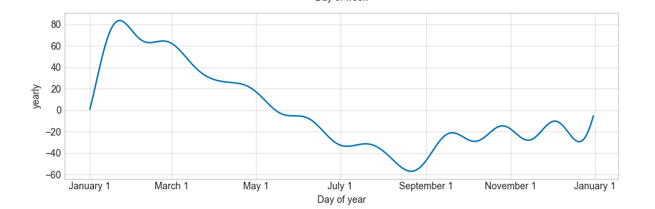
WHAT THE DATA SHOWED
A Seasonal Swing Across the Year
Demand runs noticeably higher in winter and early spring, and eases off over the summer months.
Why it matters: Building seasonality into the forecast lets leaders adjust staffing and capacity plans well ahead of the busiest time of year.
Hospital Bed Demand Forecasting
5

Slide 6
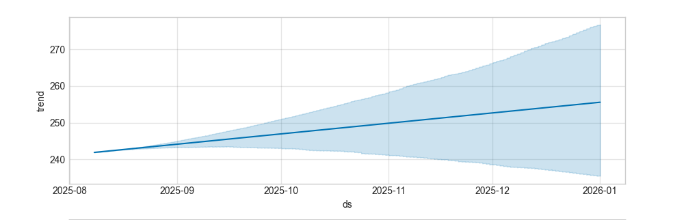
WHAT THE DATA SHOWED
Demand Is Trending Upward
Beyond daily and seasonal cycles, overall bed demand is gradually increasing over time — reinforcing the need for proactive, forward-looking planning.
The shaded band shows the range of forecast uncertainty — narrow near-term, widening further into the future.
Hospital Bed Demand Forecasting
6

Slide 7
RESULTS
Comparing the Forecasting Methods
“Typical error” shows how many beds, on average, each method's forecast was off by on a given day.
Forecasting Method | Accuracy | Typical Error | Best Used For
Deep Learning (LSTM) | Excellent | ~5 beds/day | Highest possible precision
XGBoost ★ Recommended | Excellent | ~6 beds/day | Best balance of accuracy & explainability
CatBoost | Very Good | ~8 beds/day | Strong alternative option
Random Forest | Good | ~13 beds/day | Reliable, less precise
Traditional Statistical Model | Fair | ~74 beds/day | Baseline comparison only
Hospital Bed Demand Forecasting
7

Slide 8
OUR RECOMMENDATION
Deploy XGBoost with Built-In Explainability
Accuracy
Performance nearly matches the most precise deep-learning model.
Transparency
Paired with an explainability tool that shows exactly why each forecast was made.
Practicality
Simpler to maintain and integrate into a live planning dashboard.
Hospital Bed Demand Forecasting
8

Slide 9
TRUST & TRANSPARENCY
Every Forecast Comes With a Reason Why
An explainability layer (SHAP) sits alongside the forecast, translating the model's reasoning into plain language planners can trust and act on.
Example: Why is tomorrow's forecast higher?
High occupancy over the last few days
A rise in emergency department arrivals
A higher-than-usual number of scheduled surgeries
Hospital Bed Demand Forecasting
9

Slide 10
DELIVERY
A Live Forecasting Dashboard
Forecasted bed demand for upcoming days and weeks
Live occupancy and admission/discharge trends
1
2
Early-warning indicators when capacity risk is rising
Interactive filtering by ward, time period or scenario
3
4
Hospital Bed Demand Forecasting
10

Slide 11
VALUE
What This Means for the Hospital
Smarter Allocation
Better Staffing
Beds and staff positioned ahead of demand spikes, not after.
Rota planning grounded in forecasted need, reducing last-minute pressure.
Lower Overcrowding Risk
Smoother Patient Flow
Early warning of rising pressure supports timely intervention.
From admission to discharge, capacity is planned rather than guessed.
Hospital Bed Demand Forecasting
11

Slide 12
NEXT STEPS
Moving From Insight to Action
1
Finalise integration of the forecasting model into the live dashboard
2
Pilot the system with operational teams and gather feedback
3
Establish a routine review cycle to monitor and retrain the model as new data arrives
Thank you
Hospital Bed Demand Forecasting
12

