Slide 1
DERMAI DIAGNOSTIC Skin Lesion Analysis for Cancer Risk Identification
Using Demographic, Diagnostic, and Environmental Data

Slide 2
INTRODUCTION
Skin cancer remains one of the most common forms of cancer globally, with early diagnosis significantly improving survival rates. However, misdiagnosis, environmental risk exposure, and limited dermatological access continue to challenge timely intervention.
DermAI Diagnostics aims to revolutionize skin cancer detection by merging clinical data analysis with AI-driven diagnostics. This project leverages real-world data from 1,088 patients, combining biopsied (42%) and non-biopsied (58%) lesion cases to identify hidden patterns, refine risk assessment, and enhance early-stage screening tools.

Slide 3
Project Objective
Identify diagnostic patterns of skin lesions
Compare benign, pre-malignant, and malignant characteristics
Explore environmental and demographic influences

Slide 4
Diagnostic Classification
Malignant - Basal Cell Carcinoma - BCC
Squamous Cell Carcinoma - SCC
Melanoma - MEL
Pre-Malignant - Actinic Keratosis - ACK
Benign - Seborrheic Keratosis - SEK
Nevi - NEV

Slide 5
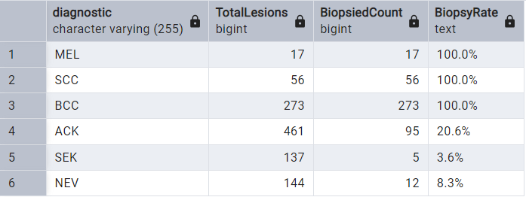
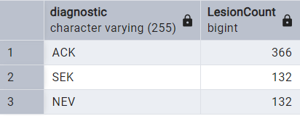
Biopsy Analysis
Unconfirmed Cases
Biopsy Confirmation Rate

Slide 6
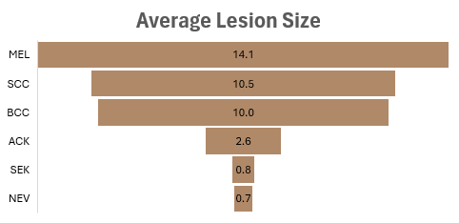
Lesion Classifications
Fair-skinned individuals (Fitzpatrick types 1–3) appear to have higher lesion counts across most cancerous and pre-cancerous conditions. This aligns with clinical knowledge that lighter skin offers less melanin protection against UV radiation.
According to ABCDE rule, diameter > 6mm is a red flag and malignant diagnoses (MEL, SCC, BCC) are clearly associated with larger diameters.
Benign lesions are much smaller on average, which could assist early triaging and screening.

Slide 7
Symptomatic Patterns by Lesion Categorization
Malignant lesions tend to grow, bleed, itch, hurt, and elevate more frequently than benign ones.
Benign lesions may be elevated but rarely bleed or change.
Pre-malignant (e.g., ACK) lesions show high itching but lower critical changes like bleeding or pain.

Slide 8
Environmental Risk Factors
No Sewage & No Piped Water
Highest for Pre-malignant (93%/92%) and Benign (81%/80%), suggesting lower sanitation correlates with early lesion development, but not necessarily malignancy.
Pesticide Exposure
Highest in Malignant lesions (45%), strongly linking toxic environmental exposure to cancerous transformation.
Drink & Smoke Exposure
Malignant lesions show higher exposure (28%/13%) than other types, indicating lifestyle risk factors.

Slide 9
Demographic Risk Factors
Our findings indicate that 47% of patients above 30 years of age with malignant lesions have a history of skin cancer, and about 53% have broader cancer history.
This suggests that possible genetic (hereditary) or shared environmental predisposition play a significant role in malignant lesion development

Slide 10
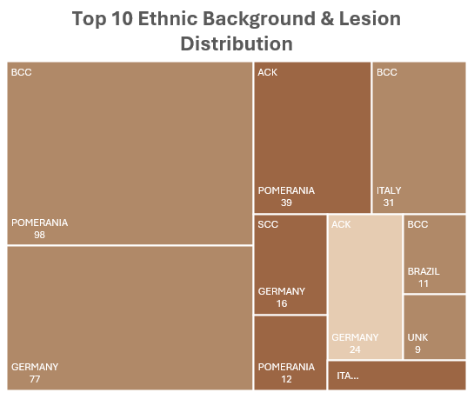
Demographic Risk Factors
Individuals with Pomeranian and German backgrounds have a higher count of malignant lesions like BCC and SCC.
Implication: Ethnic/genetic predisposition may influence lesion development. This warrants targeted education and early intervention strategies for high-risk backgrounds.

Slide 11
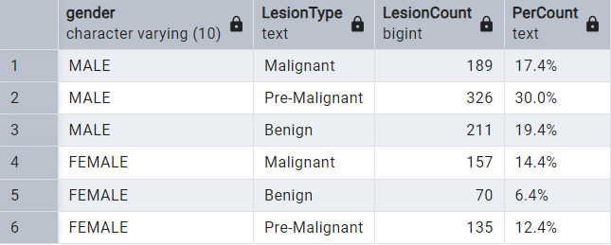
Demographic Risk Factors - Gender Distribution
Men show a higher susceptibility because they are more affected by all lesion types compared to females accounting for about 66.8%

Slide 12
Lesion Frequency by Body Area
The top 3 regions (Face, Forearm, Chest) account for nearly 58% of all lesions, reinforcing that UV-exposed regions are at higher risk.
Cumulative trend:
Top 5 (Face - Arm): approximately 75% of lesions.
Bottom 5 (Neck - Foot): approximately 7%.

Slide 13
Recommendation
Prioritize Biopsy in Key Subgroups by flagging high-risk patients for early biopsy:
Family cancer history
High-risk ethnic backgrounds
Middle-aged and aged patients with recent lesion changes
Fitzpatrick types with larger lesions
Public Health Interventions by increasing awareness and screening in:
Rural areas with poor water/sewage infrastructure
Populations exposed to pesticides
Communities with hereditary cancer patterns
AI Model Training with Critical Factors Utilizing features such as:
Demographics (age group, gender)
Environmental exposures (pesticide, smoking, water access)
Family history
Lesion characteristics (symptoms, location, size, Fitzpatrick type)
Diagnostic label (e.g., BCC, MEL, SCC)

