Slide 1



Retrieving Skills from Job Description: A Language Model Based Extreme Multi-label Classification Framework
Akshay Bhola, Kishaloy Halder, Animesh Prasad and Min-Yen Kan
December 9, 2020

Slide 2





Job Search in the Digital-era
70% of the global workforce is made up of passive talent who aren’t actively job searching, and the remaining 30% are active job seekers
87% of active and passive candidates are open to new job opportunities
Online job boards (60%) are one of the most popular channel amongst job seekers to find desired jobs
Reference: business.linkedin.com
Image Reference: wsj.com
2

Slide 3




Online job portals
These portals receive thousands of applications, among which fewer than 10% candidates have appropriate skills
Crucial task is matching suitable candidates with jobs
Popular approach: matching the candidate’s associated set of skills by the job descriptions (JDs)
Issue arises due to the inconsistencies in job descriptions
Bhola et al.

Slide 4
Sample Job Description
Job description
Required skills
Looking for a dynamic individual keen to join a growing organization in the fast-paced and expanding Supply Chain Software Industry. As Singapore goes through the digital revolution, the individual will play a paramount role in developing and upgrading our SaaS tools and valued added services for our clients. Responsibilities:
Work with Architect, Framework Designer to develop the next generation of Cloud base Micro Services Suite
Design and implement Micro Service modules primary for Supply Chain systems. Design must be flexible and scalable for any future expansion or upgrade.
….
1. .NET
2. Agile Methodologies
3. AJAX
4. ASP.NET
5. C#
Incomplete skill set (individually)
6. C++
7. HTML
8. Java
…
Bhola et al.

Slide 5
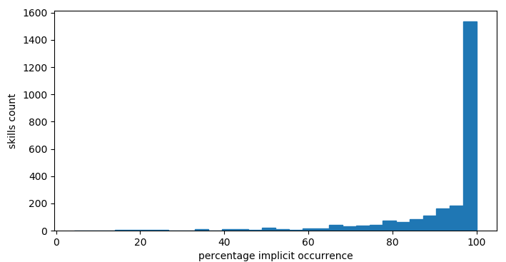
How to mitigate the issue?
Notice: The job descriptions might connotate the skill requirement for job which aren’t explicitly mentioned in the textual descriptions
Simple string-matching algorithm can’t extract implicit skills
The task requires more complex algorithms that can infer implicit skills from the job descriptions
Distribution of the count of skills from mycareersfuture dataset with their corresponding implicit occurrence
Bhola et al.

Slide 6

Proposed Method
We approach this task as a multi-label classification problem
Job description
Predicted skills
BERT-XMLC
Requirements performing end end software development cycle coding using Java j2ee spring framework Oracle pl SQL Multithreading angular js hibernate rest soap api oracle databases shell scripting degree Information Technology Engineering background minimum 5 9 years experience information technology software development must proven experience ……
1. SQL
2. Java
σ
3. XML
BERT Encoder
Probability vector
4. JavaScript
5. Software Development
6. Web Services
Bhola et al.

Slide 7
Mycareersfuture Dataset
No large-scale job description dataset was available
We have collected data from Singaporean government website, mycareersfuture.sg of over 20,000 richly structured job posts
Dataset contains 16 different fields of information
Number of job posts | 20,298
Number of distinct skills | 2,548
Number of skills with 20 or more mentions | 1,209
Average skill tags per job post | 19.98
Average token count per job post | 162.27
Bhola et al.

Slide 8
Performance Comparison
Table 1: Mean Reciprocal Rank (MRR) comparison
Model | MRR
CNN-Kim ¹ | 0.8195
LSTM ² | 0.8417
BiLSTM ³ | 0.8565
BiGRU ⁴ | 0.8716
BiGRU w/ CSA ⁴ | 0.8840
BERT-XMLC | 0.9019
Bhola et al.

Slide 9
Performance Comparison
Table 2: Recall Comparison (Recall@M for various M)
Model | Recall
 | @5 | @10 | @30 | @50 | @100
CNN-Kim ¹ | 16.38 | 29.59 | 59.60 | 70.40 | 82.47
LSTM ² | 16.83 | 29.35 | 57.09 | 68.65 | 81.46
BiLSTM ³ | 17.51 | 31.19 | 61.77 | 73.25 | 84.89
BiGRU ⁴ | 17.73 | 31.27 | 60.84 | 72.80 | 84.88
BiGRU w/ CSA ⁴ | 18.34 | 32.52 | 64.19 | 75.75 | 87.02
BERT-XMLC | 19.60 | 35.58 | 70.10 | 80.91 | 90.26
Bhola et al.

Slide 10
Performance Comparison
Table 3: Normalized Discounted Cumulative Gain Comparison (nDGC@M for various M)
Model | nDGC
 | @5 | @10 | @30 | @50 | @100
CNN-Kim ¹ | 28.21 | 40.23 | 60.60 | 66.37 | 71.96
LSTM ² | 29.27 | 40.68 | 59.43 | 65.61 | 71.53
BiLSTM ³ | 30.32 | 42.77 | 63.50 | 69.64 | 75.04
BiGRU ⁴ | 30.80 | 43.11 | 63.09 | 69.49 | 75.09
BiGRU w/ CSA ⁴ | 31.71 | 44.62 | 66.04 | 72.23 | 77.46
BERT-XMLC | 33.64 | 48.18 | 71.66 | 77.45 | 81.79
Bhola et al.

Slide 11
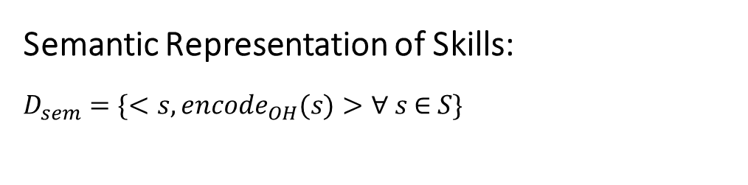
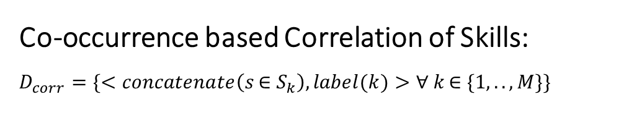
Collaboration Aware Bootstrapping
We proposed Correlation Aware Bootstrapping process to further enhance the performance of ML models by taking into the structured representation of skills and their co-occurrences
Semantic representation of skills
Java
0
1
0
0
0
0
Semantic Representation of Skills:
$$D_{sem}=\{<s,encode_{OH}(s)>\text{∀} s \text{∈} S\}$$
Text description
One-hot vector
Co-occurrence based correlation of skills
Co-occurrence based Correlation of Skills:
$$D_{corr}=\{<concatenate\left(s \text{∈}{ S}_{k}\right), label(k)>\text{∀} k \text{∈} \{1,..,M\}\}$$
JavaScript C XML SQL
0
1
1
0
1
0
Text description
Binary vector
Bhola et al.

Slide 12
Added boost with CAB
Table 4: Performance comparison with added CAB
Model | MRR | Recall | nDGC
 |  | @5 |  | @10 |  | @30 |  | @50 |  | @100
CNN-Kim ¹ | 0.8195 | 16.38 | 28.21 | 29.59 | 40.23 | 59.60 | 60.60 | 70.40 | 66.37 | 82.47 | 71.96
LSTM ² | 0.8417 | 16.83 | 29.27 | 29.35 | 40.68 | 57.09 | 59.43 | 68.65 | 65.61 | 81.46 | 71.53
BiLSTM ³ | 0.8565 | 17.51 | 30.32 | 31.19 | 42.77 | 61.77 | 63.50 | 73.25 | 69.64 | 84.89 | 75.04
BiGRU ⁴ | 0.8716 | 17.73 | 30.80 | 31.27 | 43.11 | 60.84 | 63.09 | 72.80 | 69.49 | 84.88 | 75.09
BiGRU w/ CSA ⁴ | 0.8840 | 18.34 | 31.71 | 32.52 | 44.62 | 64.19 | 66.04 | 75.75 | 72.23 | 87.02 | 77.46
BERT-XMLC | 0.9019 | 19.60 | 33.64 | 35.58 | 48.18 | 70.10 | 71.66 | 80.91 | 77.45 | 90.26 | 81.79
BIGRU w/ CSA + CAB | 0.8995 | 18.93 | 32.72 | 33.84 | 46.28 | 66.36 | 68.33 | 77.66 | 74.38 | 88.28 | 79.30
BERT-XMLC + CAB | 0.9049 | 21.67 | 35.93 | 40.49 | 52.84 | 79.59 | 79.32 | 86.60 | 82.96 | 92.24 | 85.41
Bhola et al.

Slide 13
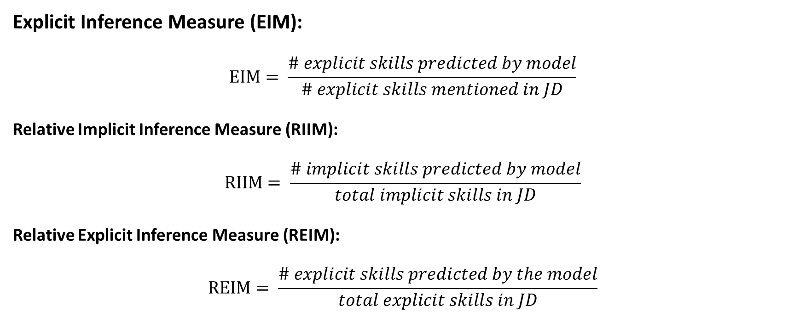
Micro-evaluation metrics
Explicit Inference Measure (EIM):
$$EIM= \frac{\# explicit skills predicted by model}{\# explicit skills mentioned in JD}$$
Relative Implicit Inference Measure (RIIM):
$$RIIM= \frac{\# implicit skills predicted by model}{total implicit skills in JD}$$
Relative Explicit Inference Measure (REIM):
$$REIM= \frac{\# explicit skills predicted by the model}{total explicit skills in JD}$$
Bhola et al.

Slide 14
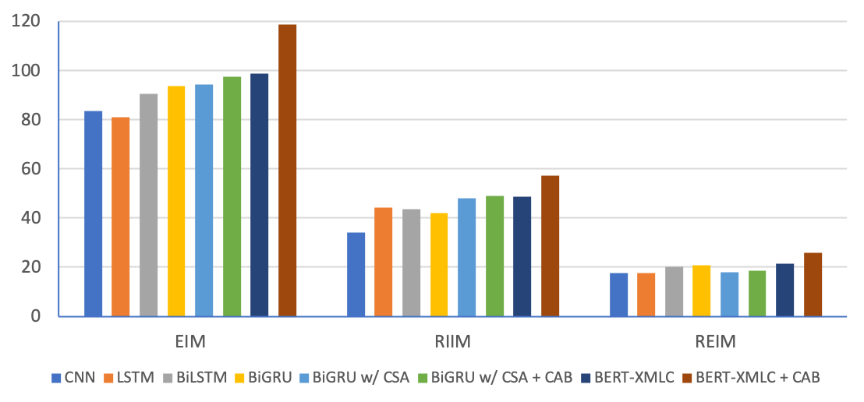
Performance Comparison
Performance comparison of different models over EIM, RIIM, REIM metrics
Bhola et al.

Slide 15
Conclusion
Online job portals are popular platform amongst job seekers, having its own set of limitations in matching jobs with suitable candidates
Collected a large-scale job description dataset - mycareersfuture
Proposed a novel transformer based model to handle the XMLC task
Proposed model outperforms all other state-of-the-art XMLC models on the mycareersfuture dataset
Proposed Collaboration Aware Bootstrapping technique to boost the performance of Machine learning models in multilabel classification task involving common linguistic signature of labels in textual input
Bhola et al.

Slide 16

Thank you for your attention
Akshay Bhola
Email ID: akbhola.bhola@gmail.com
For any query, feel free to contact me.

Slide 17
References
Yoon Kim. 2014. Convolutional neural networks for sentence classification. In Proceedings of the 2014 Conference on Empirical Methods in Natural Language Processing (EMNLP), pages 1746–1751, Doha, Qatar, October. Association for Computational Linguistics
Tim Rocktaschel, Edward Grefenstette, Karl Moritz Hermann, Tomas Kocisky, and Phil Blunsom. 2015. Reason- ` ing about entailment with neural attention. arXiv preprint arXiv:1509.06664
Chengjie Sun, Yang Liu, Chang’e Jia, Bingquan Liu, and Lei Lin. 2017. Recognizing text entailment via bidirectional lstm model with inner-attention. In International Conference on Intelligent Computing, pages 448–457. Springer
Kishaloy Halder, Lahari Poddar, and Min-Yen Kan. 2018. Cold start thread recommendation as extreme multilabel classification. In Companion of the The Web Conference 2018 on The Web Conference 2018, pages 1911–1918. International World Wide Web Conferences Steering Committee
Bhola et al.

