Slide 1
Text Mining Project
Topic modeling and Text summarization
Susanna Maugeri 839365
Veronica Grazia Morelli 839257

Slide 2
The dataset
CNN-Daily Mail News dataset from Kaggle.
It contains 311,971 documents in English.
It is designed for text summarization: for each article, a target bullet-point summary is given.

Slide 3
Topic modeling

Slide 4
Topic modeling - step 1: Preprocessing the documents
Removal of what doesn’t apport additional meaning to the texts: punctuation and stopwords;
Tokenization: text is broken down in smaller units, the tokens;
Lemmatization: words are reduced to their lemma;
Lowercasing the texts: it improves uniformity and matching;
NA removal: empty documents are dropped.

Slide 5
Topic modeling - step 2: Fit of different models I
LSA - Latent Semantic Analysis
How does it work?
Building the term-document matrix
Dimensionality reduction
Topic extraction
Pros:
Dimensionality reduction allows for efficient processing
Capture semantic similarity
Cons:
Bag of Words representation of text: doesn’t consider word order or context
Struggles with polysemy
May not capture domain-specific distinctions
The mathematical procedure works, but it doesn’t have an interpretable meaning
Number of topics must be set beforehand

Slide 6
Topic modeling - step 2: Fit of different models II
LDA - Latent Dirichlet Allocation
How does it work?
Building the term-document matrix
Model training
Topic inference and interpretation
Pros:
Produces interpretable topics
Flexible topic allocation (it is also a con: results may overlap)
Probabilistic framework
Cons:
Bag of Words representation of text: doesn’t consider word order or context
Sensitive to preprocessing and to hyperparameters
Struggles with polysemy
Number of topics must be set beforehand

Slide 7
Topic modeling - step 2: Fit of different models III
BERTopic
What is it?
Open-source library for topic analysis based on BERT
BERT is a pre-trained language model developed by Google
Pros:
Contextual understanding: it uses embeddings
Automatically finds the number of topics
High versatility and stability
Cons:
Computationally intensive
Dependency on pre-trained models
Limited support for non-English text
Objective evaluation metrics are missing

Slide 8
Topic modeling - step 2: Fit of different models IV
Top2Vec
What is it?
Machine learning algorithm
uses document embeddings and clustering to generate meaningful topics
Pros:
Contextual understanding: it uses embeddings
Automatically finds the number of topics
Allows for multilingual analysis
Interpretability
Cons:
Computationally intensive
Not suitable for small datasets
Dependency of embeddings quality
Each document is assigned to one topic
Objective evaluation metrics are missing

Slide 9
Topic modeling - step 3: Evaluation and comparison
Tested sample sizes: 100, 1k, 10k, 100k documents.
Metric: coherence c_v
Problem of lack of computational resources in Google Colab.
 | 100 | 1,000 | 10,000 | 100,000
LSA | 0.28 | 0.30 | 0.30 | 0.45
LDA - sklearn | 0.75 | 0.75 | Too big | Too big
LDA - gensim | 0.23 | 0.28 | 0.42 | 0.59
BERTopic | 0.44 | 0.76 | 0.83 | Too big
Top2Vec | Too small | 0.65 | 0.85 | Too big

Slide 10
Results: topic examples by LSA
'-0.567*"apple" + -0.236*"watch" + 0.179*"per" + 0.166*"cent" + -0.132*"software" + -0.129*"user" + -0.127*"ipod" + 0.123*"people" + 0.120*"child" + -0.118*"music"'
'-0.377*"hospital" + -0.266*"nurse" + -0.259*"ebola" + -0.221*"duncan" + -0.166*"health" + -0.156*"patient" + 0.145*"woman" + -0.135*"per" + -0.124*"cent" + -0.117*"texas"'
'0.298*"woman" + 0.220*"people" + -0.200*"obama" + -0.184*"president" + 0.158*"minister" + -0.157*"child" + -0.151*"say" + -0.150*"state" + 0.145*"school" + -0.138*"per"'
'-0.249*"family" + 0.219*"car" + 0.218*"time" + 0.209*"royal" + 0.190*"people" + 0.184*"prince" + -0.174*"million" + -0.160*"show" + 0.150*"say" + 0.116*"found"'

Slide 11
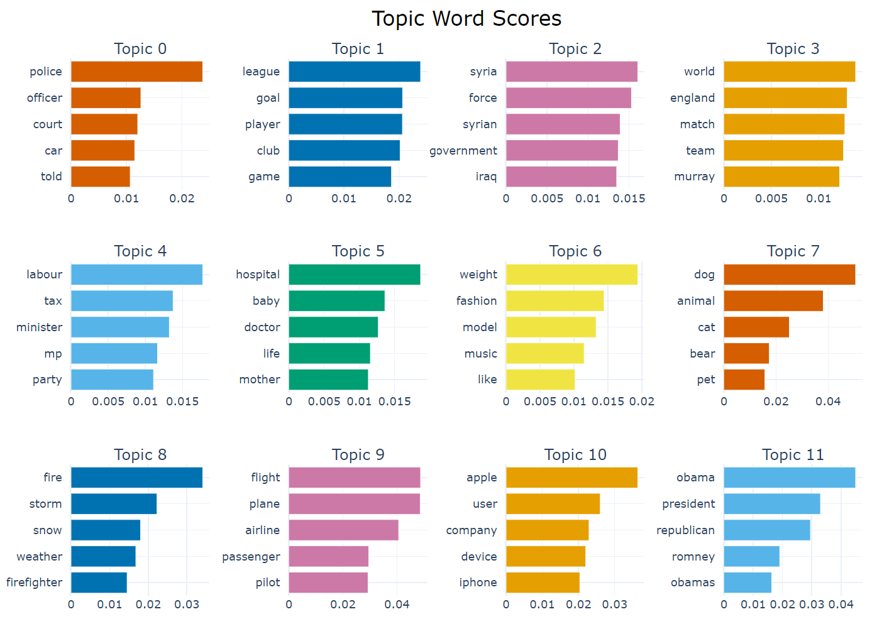
Results: topic examples by BERTopic

Slide 12
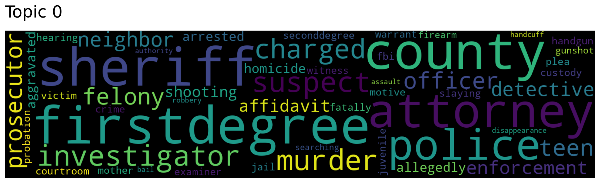
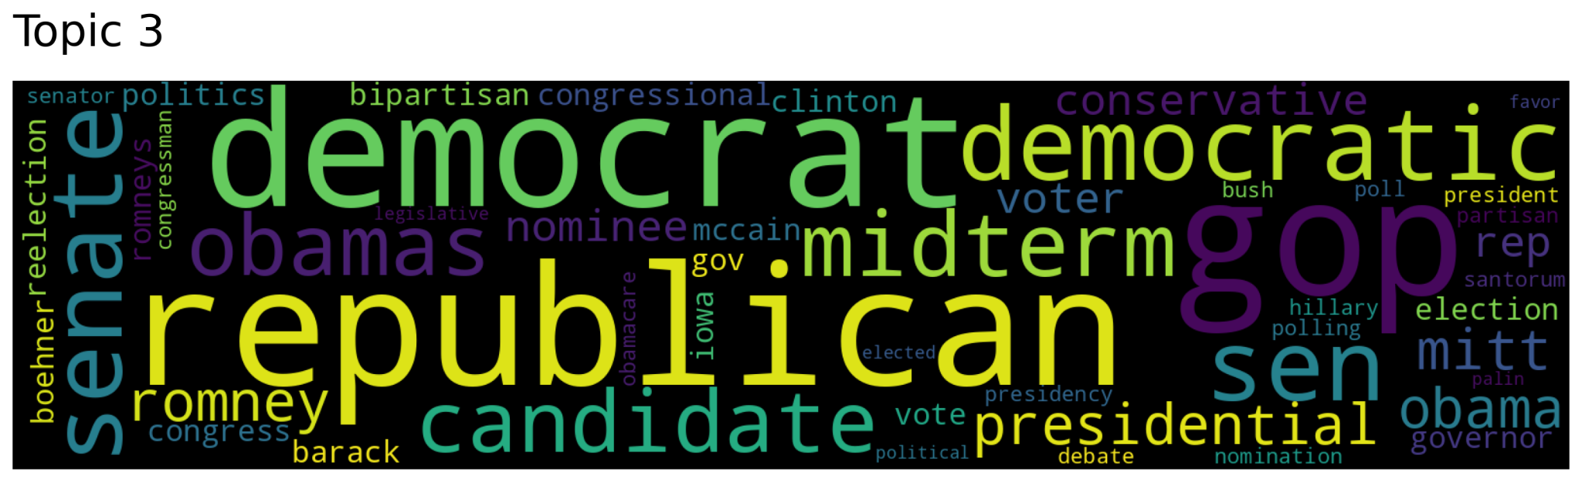
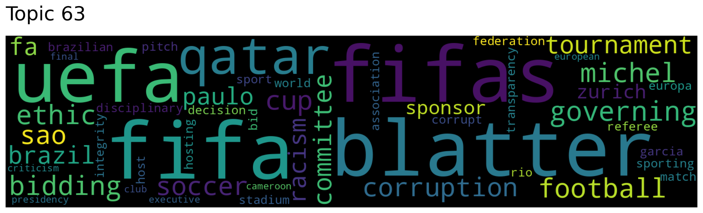
Results: wordclouds by Top2Vec
Top2Vec implements some functions which make easy to visualize the result of the topic model, for example creating the wordcloud.
The first picture - topic 0 - is the wordcloud of the topic words associated with the word “police”.
The second one - topic 3 - with the word “Obama”.
The third - topic 63 - with the word “football”.

Slide 13
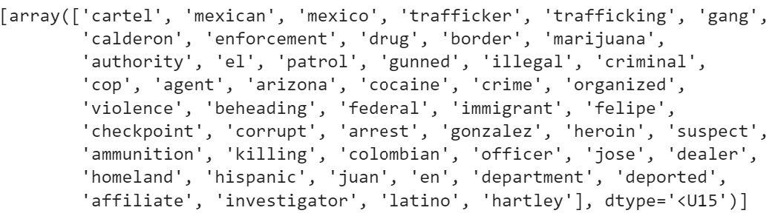
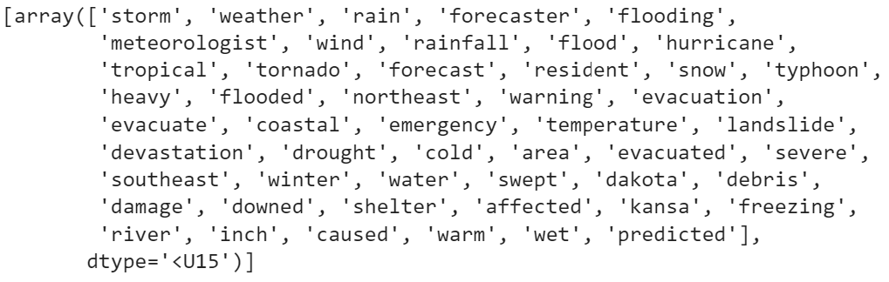
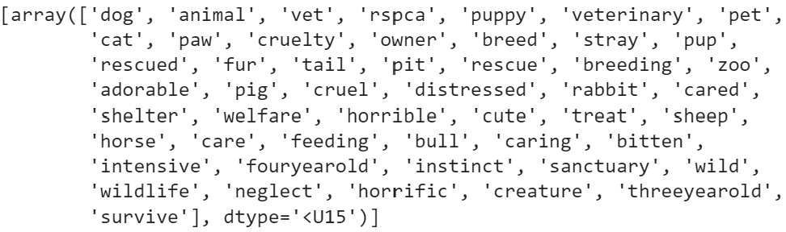
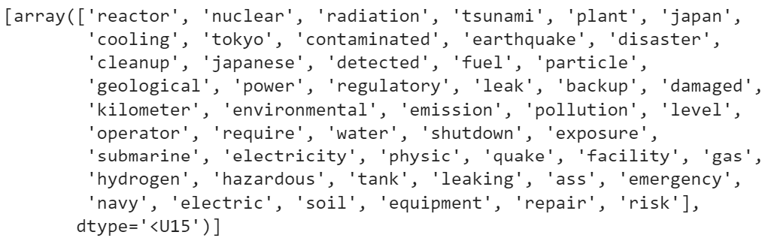
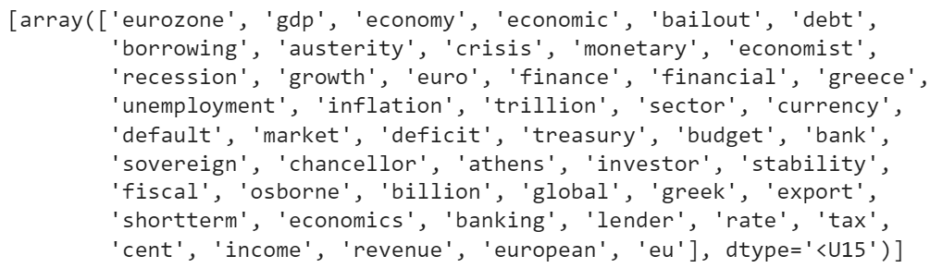
Results: topic examples by Top2Vec
Mexico
Canada
Puppy
Nuclear
Statistic

Slide 14
Text summarization

Slide 15
Text Summarization Task
Text Summarization is the process of condensing a longer text while retaining its meaning.
Automatic Text Summarization involves using algorithms or AI to automate the summarization task.
There are two types of Automatic Text Summarization: Extractive and Abstractive.
Extractive Summarization selects important sentences from the text to form the summary based on their relevance.
Abstractive Summarization generates summaries in a more human-like way, creating concise and richer summaries, but it is more challenging to implement.

Slide 16
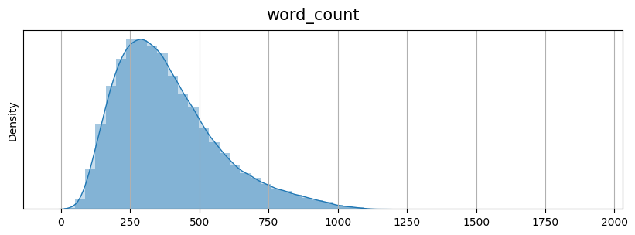
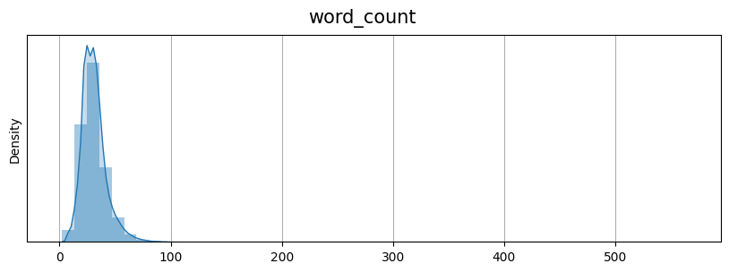
Exploratory Analysis
Training: 287113 samples.
Validation: 13368 samples.
Test set: 11490 samples.
No missing values
Source Text word count distribution
Target Text word count distribution

Slide 17
Extractive Summarization
Topic representation approaches are used to identify representative words for the main topic of a document, employing frequency thresholds.
Examples: Latent Semantic Analysis (LSA), Bayesian topic models such as Latent Dirichlet Allocation (LDA)
Indicator representation approaches represent sentences using features like length or position within the document.
Examples: Graph methods, such as TextRank, LexRank. Machine learning approaches, like Naive Bayes.

Slide 18
Extractive Summarization methods
Unsupervised summarization techniques.
Preprocessing by Sumy library: stopwords removal + stemming
Luhn Summarizer
Latent Semantic Analysis (LSA)
Kullback-Lieber (KL) Summarizer: it involves comparing the distribution of words in each sentence to the distribution of words in the entire document. Sentences with higher divergence values, indicating a greater deviation from the overall document distribution, are considered more informative and selected for the summa
Text Rank: unsupervised graph-based ranking algorithm that assigns importance scores to sentences in a text document based on their structural position and co-occurrence patterns,

Slide 19
Evaluation - ROUGE Score
ROUGE (Recall-Oriented Understudy for Gisting Evaluation): set of metrics used to evaluate the quality of text summarization systems.
It measures the overlap between the generated summary and the reference summary based on n-gram matching and other criteria.
ROUGE scores include ROUGE-1, ROUGE-2, and ROUGE-L, which respectively focus on unigram, bigram, and longest common subsequence matching between the summaries.
ROUGE scores range from 0 to 1, with higher values indicating better summarization performance.
By incorporating ROUGE scores into the evaluation process, we can objectively assess the effectiveness our summarization system and make informed decisions for further improvements.

Slide 20
Abstractive Summarization: Pegasus
Pegasus
Pegasus is a state-of-the-art transformer-based model specifically designed for text summarization tasks. It is built upon the encoder-decoder architecture.
Pre-training with Gap Sentences: Pegasus utilizes a unique pre-training approach called "gap sentences" that involves randomly removing certain sentences from the input text and training the model to predict those missing sentences. This method encourages the model to learn the underlying structure and semantics of the text, enabling it to generate coherent and informative summaries during fine-tuning.
Fine-tuning with Reinforcement Learning: Pegasus employs a reinforcement learning-based approach to further enhance the summarization performance. During fine-tuning, the model generates summaries and receives rewards based on their quality, encouraging the model to optimize its generation process to produce more accurate and readable summaries.
Pre-processing included in HuggingFace model fine-tuning process.

Slide 21
Abstractive Summarization: T5
T5 (Text-to-Text Transfer Transformer)
It is a versatile model that can be fine-tuned for specific tasks by framing them as text-to-text problems.
Pre-training and Fine-tuning: The T5 transformer is initially pre-trained on a large corpus of text data using unsupervised learning. During pre-training, it learns to understand the structure and semantics of text. After pre-training, the model is fine-tuned on a specific task, such as text summarization, using supervised learning with task-specific datasets.
Encoder-Decoder Architecture: The T5 transformer consists of an encoder-decoder architecture. The encoder takes the input text and processes it, capturing contextual information and encoding it into a representation. The decoder then uses this representation to generate a summary by decoding it into a concise form. The attention mechanism in the transformer allows the model to capture dependencies and relationships between words, enabling high-quality summarization.
Pre-processing included in HuggingFace model fine-tuning process.

Slide 22
Results
Original Text
A Russian father who fed parrots, guinea pigs, cats and puppies to his pet snake and filmed the gruesome footage is being hunted by police. Father-of-two Andrei Generalov, 32, from St. Petersburg in north-western Russia, started uploading videos of his Boa Constrictor 'King' devouring rats and hamsters. But as the videos rose in popularity, he began taking suggestions from viewers who demanded more 'blood and gore'. With this in mind, he started feeding 'King' larger animals in the sickening videos, which included terrified puppies. In the videos, he tells his audience: 'Why these senseless sacrifices? It's for the sake of food (ha ha). 'I like to film the way the animals fight for their lives, suffer and eventually die.' Scroll down for video . Andrei Generalov, 32, from St. Petersburg, feeds animals to his pet snake 'King' and uploads the video online . In this video, the Boa Constrictor curls round a petrified guinea pig with its muscular body before suffocating it . An excited Mr Generalov says: 'I like to film the way the animals fight for their lives, suffer and eventually die' The guinea pig tries to wriggle free but the snake has jaws lined with small hooked teeth, for holding their prey . A petition has started in St Petersburg, Russia, by those appalled by the suffering of the animals . But furious campaigners - outraged at the appalling suffering - began a petition to take Mr Generalov to court. After collecting more than 4,000 signatures, they handed it to the prosecutors office who ordered police to arrest him. Chief Prosecutor Sergey Litvinenko said: 'An arrest warrant has been put out for this man but he has now disappeared. 'Anyone with information of his whereabouts should contact us or the police directly.' Local petition signer Tigran Evdokimov, 28, said: 'What this man did was sickening beyond belief. 'To film such cruelty and to enjoy it is the work of a very sick and dangerous man.' But his friend, Leopold Polyakov, 35, defended Mr Generalov describing him as a 'good, family man'. He said: 'Andrei is a very good man, a family man. He has three cats at home and has never shown any sign of cruelty towards people or animals. 'I find it just incomprehensible that he would do this.' Boa Constrictors will eat almost anything they can catch, including birds, monkeys and wild pigs . In the videos, the Russian father tells his audience: 'Why these senseless sacrifices? It's for the sake of food' He started feeding his snake, 'King', hamsters and rats but moved on to bigger animals, including puppies . The boa constrictor is a species of large, non-poisonous snake. It is a member of the Boidae family and is found in the wild in North, Central and South America, as well as some islands in the Caribbean. They live for between 20 and 30 years, reach up to 13ft in length and can weigh up to 60lbs or 27kgs. Like their cousins, Anacondas, Boas are excellent swimmers but prefer to stay on dry land. In the wild they tend to live in hollow logs and mammals burrows. Their jaws are lined with small hooked teeth, for grabbing and holding their prey, while wrapping their muscular bodies around their victim, squeezing it until it suffocates. Boas will eat almost anything they can catch, including birds, monkeys and wild pigs. Their jaws can stretch to allow them to swallow their prey whole. Female boas incubate their eggs outside their bodies and can give birth to up to 60 babies during their lives. Some boa constrictors are hunted for their fine, ornate skin and as such, many of the species are endangered.

Slide 23
Results
Original Summary
Andrei Generalov, 32, uploads videos of his Boa Constrictor eating animals. \nFeeds his snake called ’King’ parrots, guinea pigs, cats and even puppies. \nBoas have jaws lined with hooked teeth for grabbing and holding prey. \nThey wrap their bodies around their victim, squeezing it until it suffocates. \nPetition started to take him to court and he is now being hunted by police.
Translation in Italian
Andrei Generalov, 32 anni, carica video del suo Boa Constrictor che mangia animali. \Il serpente, chiamato "King", nutre pappagalli, porcellini d'India, gatti e persino cuccioli. \I boa hanno mascelle rivestite di denti uncinati per afferrare e trattenere le prede. \Avvolgono il corpo intorno alla vittima, stringendola fino a farla soffocare. \Il boa è stato portato in tribunale con una petizione e ora è braccato dalla polizia.

Slide 24
Results
Predicted Summaries
Summarizer | Predicted Summary | ROUGE
Text Rank | Excited Mr. Generalov says like a film, where animals fight, live, suffer, and eventually die. A guinea pig tries to wriggle free from a snake’s jaws lined with small hooked teeth holding its prey. The three cats at home have never shown any signs of cruelty towards people or animals. It’s like a film, where animals fight, live, suffer, and eventually die. In his mind, he started feeding a king, which included larger animals and sickening videos, including terrified puppies. For the sake of food, he started feeding the snake like a king, with hamsters, rats, and even larger animals, including puppies. | rouge1: 0.33 rouge2: 0.06 rougeL: 0.06 avg rouge: 0.22
LSA | A Russian father who fed parrots, guinea pigs, cats and puppies to his pet snake and filmed the gruesome footage is being hunted by police. Father-of-two Andrei Generalov, 32, from St. Petersburg in north-western Russia, started uploading videos of his Boa Constrictor ’King’ devouring rats and hamsters. An excited Mr Generalov says: ’I like to film the way the animals fight for their lives, suffer and eventually die’ The guinea pig tries to wriggle free but the snake has jaws lined with small hooked teeth, for holding their prey. Their jaws are lined with small hooked teeth, for grabbing and holding their prey, while wrapping their muscular bodies around their victim, squeezing it until it suffocates. | rouge1: 0.55 rouge2: 0.31 rougeL: 0.31 avg rouge: 0.47

Slide 25
Results
Predicted Summaries
Summarizer | Predicted Summary | ROUGE
Luhn | Father-of-two Andrei Generalov, 32, from St. Petersburg in north-western Russia, started uploading videos of his Boa Constrictor ’King’ devouring rats and hamsters. An excited Mr Generalov says: ’I like to film the way the animals fight for their lives, suffer and eventually die’. The guinea pig tries to wriggle free but the snake has jaws lined with small hooked teeth, for holding their prey. Boa Constrictors will eat almost anything they can catch, including birds, monkeys and wild pigs. Boas will eat almost anything they can catch, including birds, monkeys and wild pigs. | rouge1: 0.37 rouge2: 0.11 rougeL: 0.11 avg rouge: 0.28
KL | A Russian father who fed parrots, guinea pigs, cats and puppies to his pet snake and filmed the gruesome footage is being hunted by police. ’I like to film the way the animals fight for their lives, suffer and eventually die.’ An excited Mr Generalov says: ’I like to film the way the animals fight for their lives, suffer and eventually die’. The guinea pig tries to wriggle free but the snake has jaws lined with small hooked teeth, for holding their prey . It’s for the sake of food’. He started feeding his snake, ’King’, hamsters and rats but moved on to bigger animals, including puppies. | rouge1: 0.38 rouge2: 0.12 rougeL: 0.12 avg rouge: 0.29

Slide 26
Results
Predicted Summaries
Summarizer | Predicted Summary | ROUGE
Pegasus | Andrei Generalov, 32, from St. Petersburg uploads videos of his Boa Constrictor ’King’ devouring rats and hamsters. As the videos rose in popularity, he began taking suggestions from viewers who demanded more ’blood and gore’ He started feeding ’King’ larger animals in the sickening videos, which included terrified puppies. A petition has started in St Petersburg, Russia, by those appalled by the suffering of the animals. | rouge1: 0.30 rouge2: 0.11 rougeL: 0.11 avg rouge: 0.23
T5 small | A Russian father who fed parrots, guinea pigs, cats and puppies to his pet snake and filmed the gruesome footage is being hunted by police. ’I like to film the way the animals fight for their lives, suffer and eventually die.’ An excited Mr Generalov says: ’I like to film the way the animals fight for their lives, suffer and eventually die’. The guinea pig tries to wriggle free but the snake has jaws lined with small hooked teeth, for holding their prey . It’s for the sake of food’. He started feeding his snake, ’King’, hamsters and rats but moved on to bigger animals, including puppies. | rouge1: 0.11 rouge2: 0.01 rougeL: 0.01 avg rouge: 0.07

Slide 27
Thanks for your attention!

