Slide 1

Austin Transportation Department Signs Work Orders
Created By: Susanne Gov Created Date: 2020-08-10 Location Name: ENFIELD RD / HARTFORD RD Intersection ID: 5154281 Cardinal Direction: N Work Order ID: SG-20213
Sign Type | Install/Remove

Slide 2
Austin Transportation Department Signs Work Orders
Created By: Susanne Gov Created Date: 2020-08-10 Location Name: ENFIELD RD / HARTFORD RD Intersection ID: 5154281 Cardinal Direction: S Work Order ID: SG-20213
Sign Type | Install/Remove

Slide 3
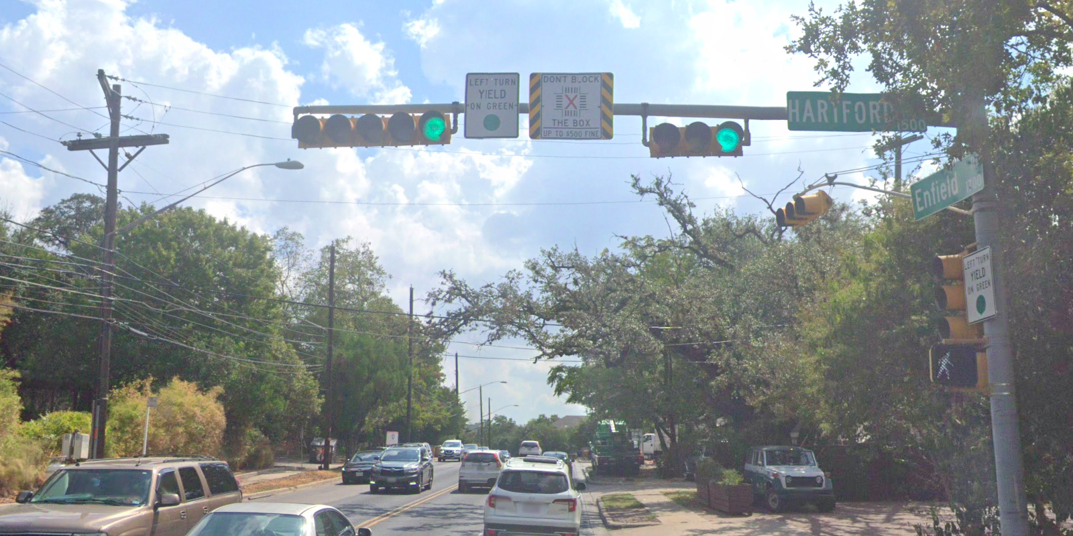
Austin Transportation Department Signs Work Orders
Created By: Susanne Gov Created Date: 2020-08-10 Location Name: ENFIELD RD / HARTFORD RD Intersection ID: 5154281 Cardinal Direction: E Work Order ID: SG-20213
Sign Type | Install/Remove
Left Turn Yield On Green | Install
Street Name Sign | Install
Don’t Block the Box | Install

Slide 4
Austin Transportation Department Signs Work Orders
Created By: Susanne Gov Created Date: 2020-08-10 Location Name: ENFIELD RD / HARTFORD RD Intersection ID: 5154281 Cardinal Direction: W Work Order ID: SG-20213
Sign Type | Install/Remove

