Slide 1

Austin Transportation Department Signs Work Orders
Created By: Susanne Gov Created Date: 2020-08-10 Location Name: 7TH ST / PROSPECT AVE Intersection ID: 5160282 Cardinal Direction: N Work Order ID: SG-20353
Sign Type | Install/Remove

Slide 2
Austin Transportation Department Signs Work Orders
Created By: Susanne Gov Created Date: 2020-08-10 Location Name: 7TH ST / PROSPECT AVE Intersection ID: 5160282 Cardinal Direction: S Work Order ID: SG-20353
Sign Type | Install/Remove

Slide 3
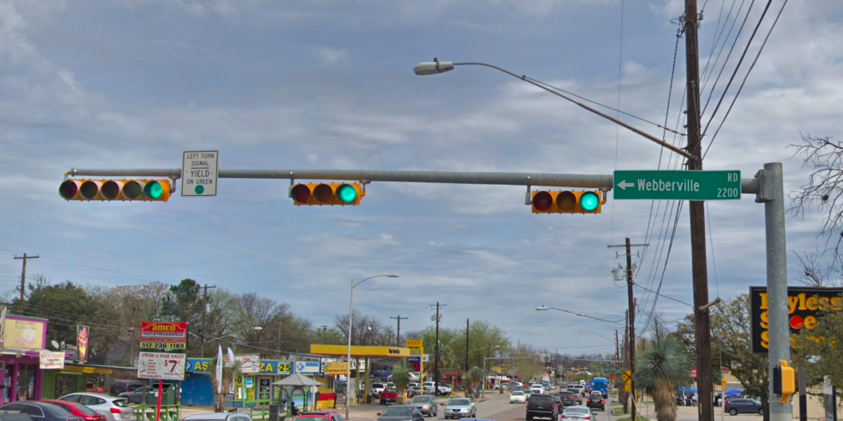
Austin Transportation Department Signs Work Orders
Created By: Susanne Gov Created Date: 2020-08-10 Location Name: 7TH ST / PROSPECT AVE Intersection ID: 5160282 Cardinal Direction: E Work Order ID: SG-20353
Sign Type | Install/Remove
No Right Turn On Red | Install
Street Name Sign | Install

Slide 4
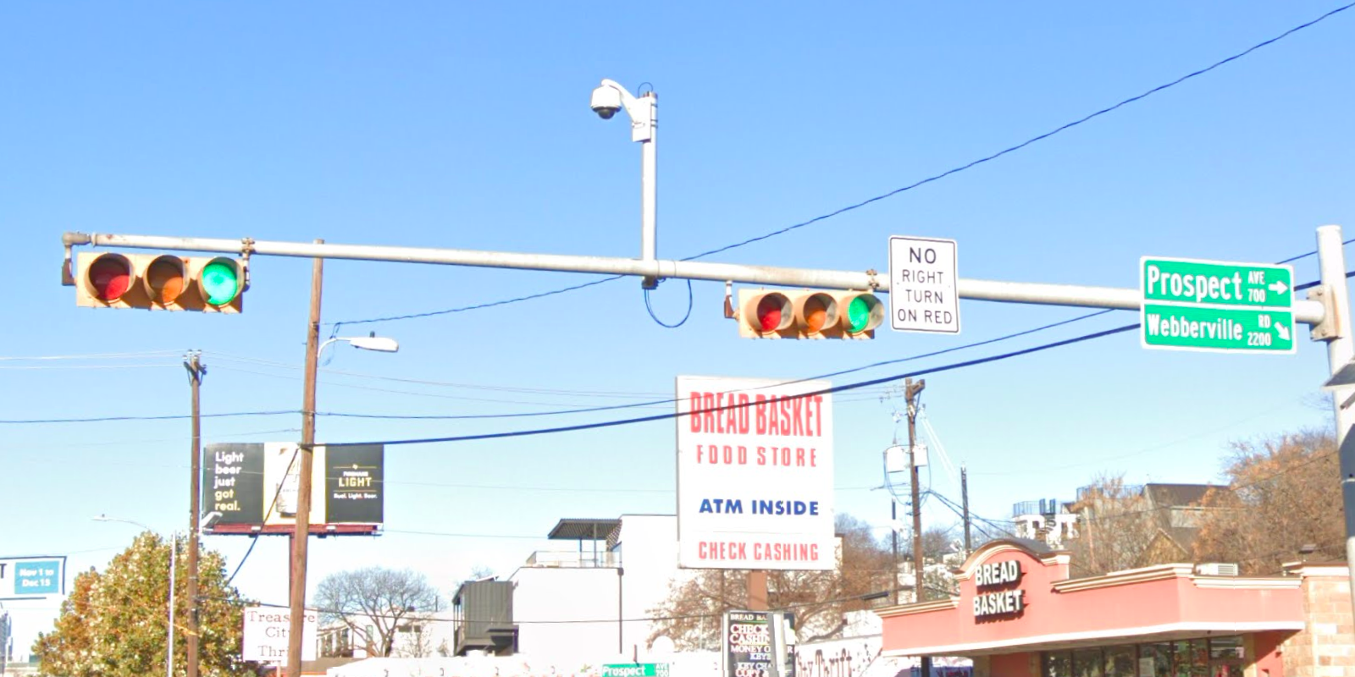
Austin Transportation Department Signs Work Orders
Created By: Susanne Gov Created Date: 2020-08-10 Location Name: 7TH ST / PROSPECT AVE Intersection ID: 5160282 Cardinal Direction: W Work Order ID: SG-20353
Sign Type | Install/Remove
Left Turn Yield Flashing Yellow | Install
Street Name Sign | Install

