Slide 1

Austin Transportation Department Signs Work Orders
Created By: Susanne Gov Created Date: 2020-08-10 Location Name: 7TH ST / CALLES ST Intersection ID: 5160920 Cardinal Direction: N Work Order ID: SG-204016
Sign Type | Install/Remove

Slide 2
Austin Transportation Department Signs Work Orders
Created By: Susanne Gov Created Date: 2020-08-10 Location Name: 7TH ST / CALLES ST Intersection ID: 5160920 Cardinal Direction: S Work Order ID: SG-204016
Sign Type | Install/Remove

Slide 3
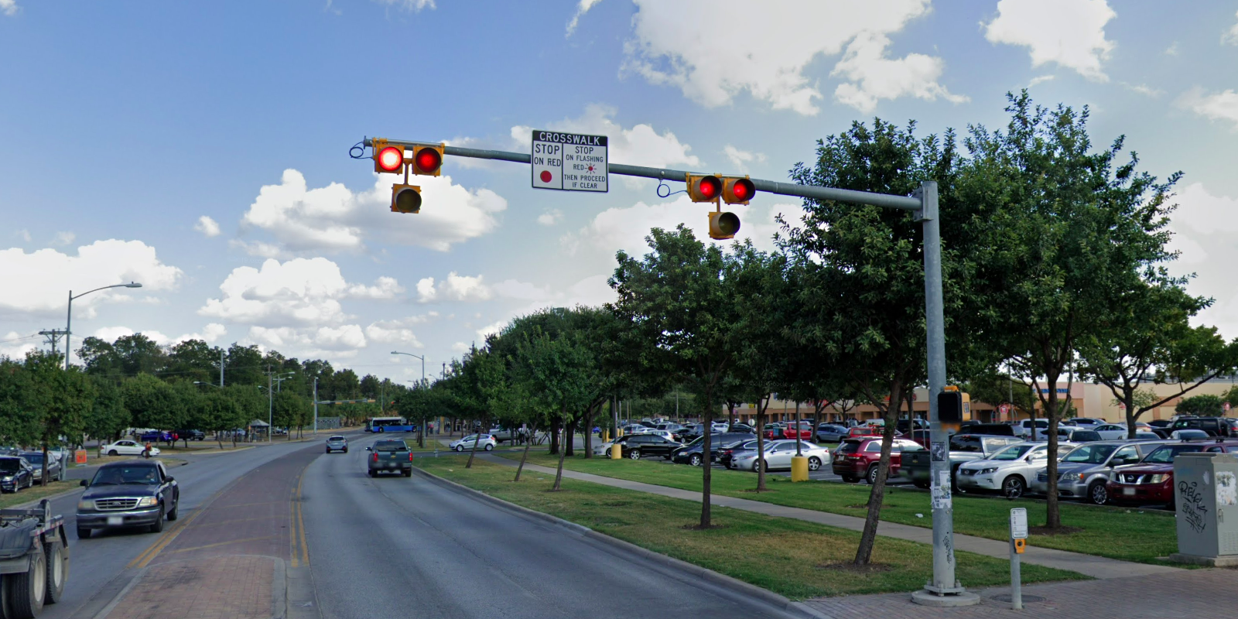
Austin Transportation Department Signs Work Orders
Created By: Susanne Gov Created Date: 2020-08-10 Location Name: 7TH ST / CALLES ST Intersection ID: 5160920 Cardinal Direction: E Work Order ID: SG-204016
Sign Type | Install/Remove
Crosswalk Stop On Red | Install

Slide 4
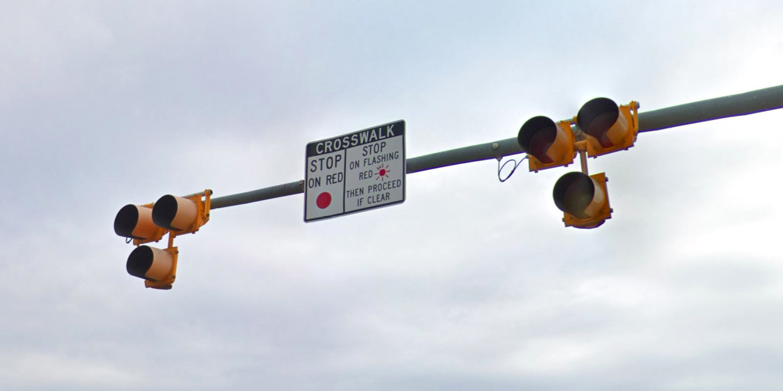
Austin Transportation Department Signs Work Orders
Created By: Susanne Gov Created Date: 2020-08-10 Location Name: 7TH ST / CALLES ST Intersection ID: 5160920 Cardinal Direction: W Work Order ID: SG-204016
Sign Type | Install/Remove
Crosswalk Stop On Red | Install

