Slide 1

Austin Transportation Department Signs Work Orders
Created By: Susanne Gov Created Date: 2020-08-10 Location Name: PARMER LN / 35 SVRD Intersection ID: 5164455 Cardinal Direction: N Work Order ID: SG-20538
Sign Type | Install/Remove

Slide 2
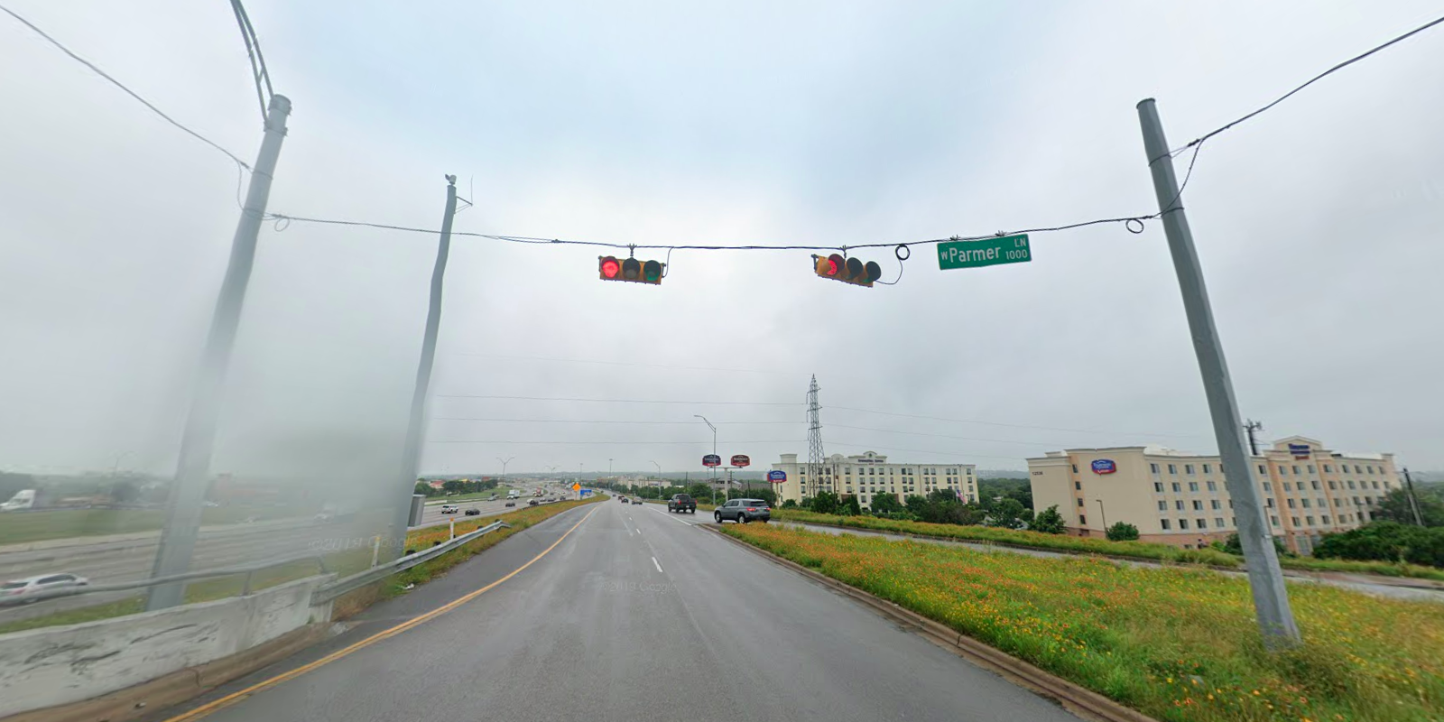
Austin Transportation Department Signs Work Orders
Created By: Susanne Gov Created Date: 2020-08-10 Location Name: PARMER LN / 35 SVRD Intersection ID: 5164455 Cardinal Direction: S Work Order ID: SG-20538
Sign Type | Install/Remove
Street Name Sign | Install

Slide 3
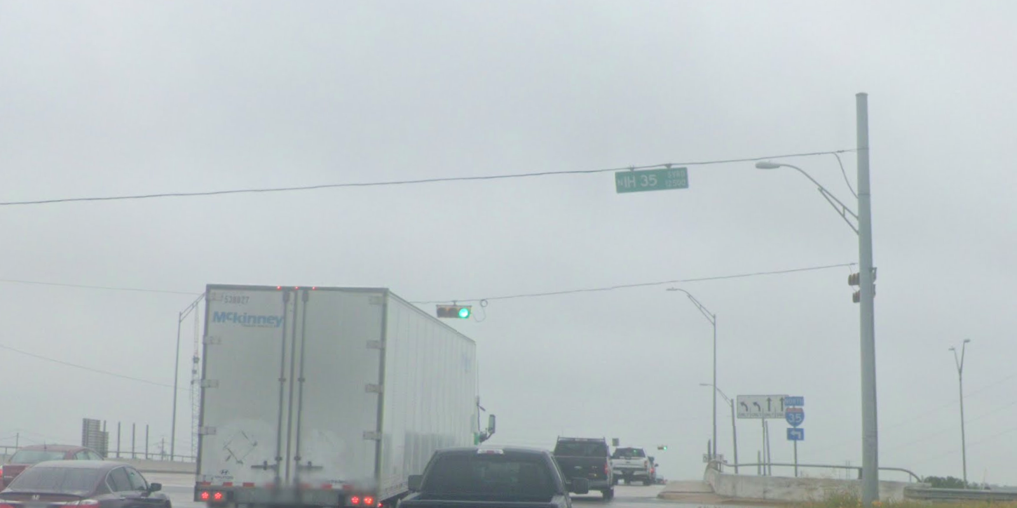
Austin Transportation Department Signs Work Orders
Created By: Susanne Gov Created Date: 2020-08-10 Location Name: PARMER LN / 35 SVRD Intersection ID: 5164455 Cardinal Direction: E Work Order ID: SG-20538
Sign Type | Install/Remove
Street Name Sign | Install

Slide 4
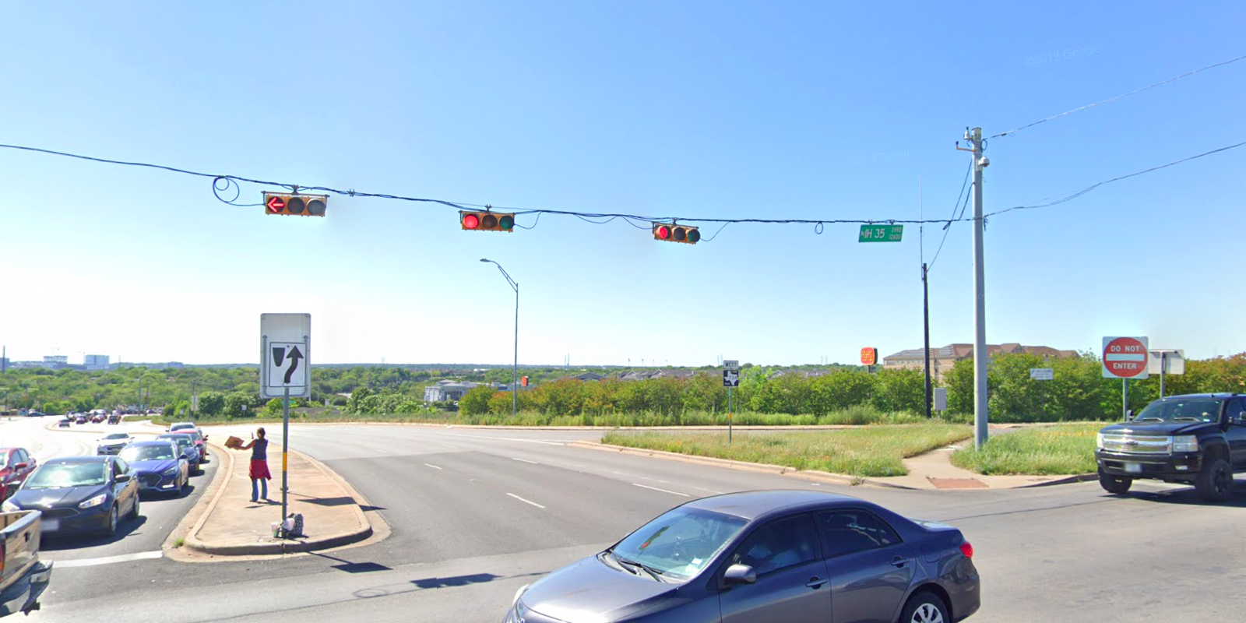
Austin Transportation Department Signs Work Orders
Created By: Susanne Gov Created Date: 2020-08-10 Location Name: PARMER LN / 35 SVRD Intersection ID: 5164455 Cardinal Direction: W Work Order ID: SG-20538
Sign Type | Install/Remove
Street Name Sign | Install

