Slide 1

Austin Transportation Department Signs Work Orders
Created By: Susanne Gov Created Date: 2020-08-10 Location Name: SH 71 / 290 HWY Intersection ID: 5144363 Cardinal Direction: N Work Order ID: SG-20709
Sign Type | Install/Remove

Slide 2
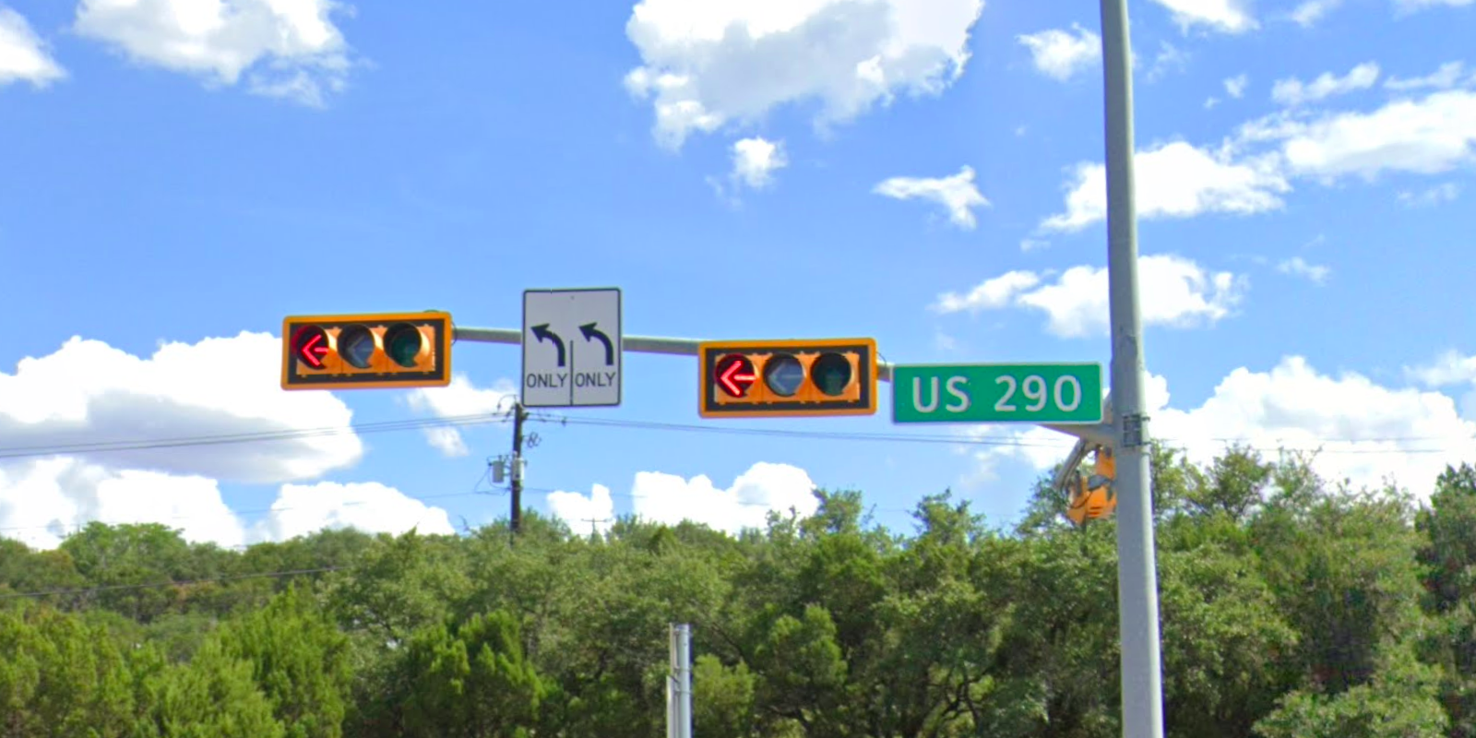
Austin Transportation Department Signs Work Orders
Created By: Susanne Gov Created Date: 2020-08-10 Location Name: SH 71 / 290 HWY Intersection ID: 5144363 Cardinal Direction: S Work Order ID: SG-20709
Sign Type | Install/Remove
Left Turn Arrow Only | Install
Street Name Sign | Install
Left Turn Arrow Only | Install

Slide 3
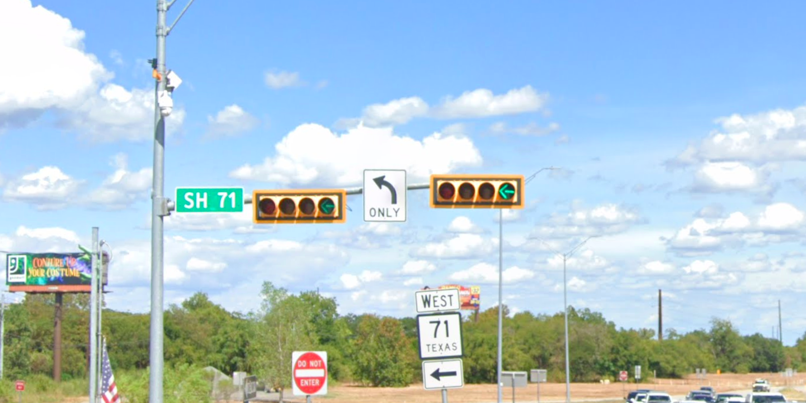
Austin Transportation Department Signs Work Orders
Created By: Susanne Gov Created Date: 2020-08-10 Location Name: SH 71 / 290 HWY Intersection ID: 5144363 Cardinal Direction: E Work Order ID: SG-20709
Sign Type | Install/Remove
Street Name Sign | Install
Left Turn Arrow Only | Install

Slide 4
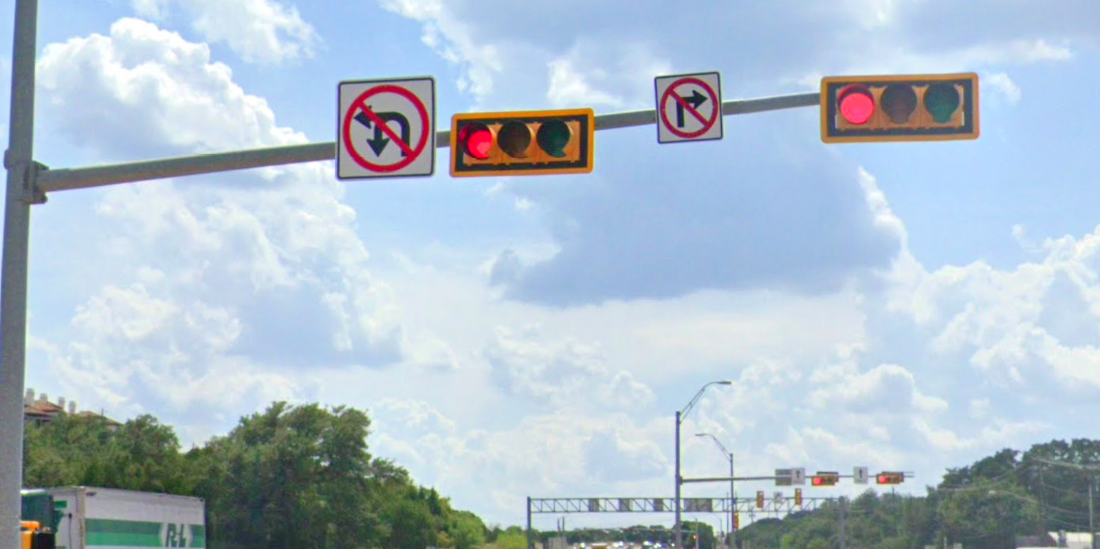
Austin Transportation Department Signs Work Orders
Created By: Susanne Gov Created Date: 2020-08-10 Location Name: SH 71 / 290 HWY Intersection ID: 5144363 Cardinal Direction: W Work Order ID: SG-20709
Sign Type | Install/Remove
No Left U Turn Arrow | Install
No Right Turn Arrow | Install

