Slide 1

Austin Transportation Department Signs Work Orders
Created By: Susanne Gov Created Date: 2020-08-10 Location Name: 2000 BLK W SLAUGHTER LN (HEB) Intersection ID: 0 Cardinal Direction: N Work Order ID: SG-20730
Sign Type | Install/Remove

Slide 2
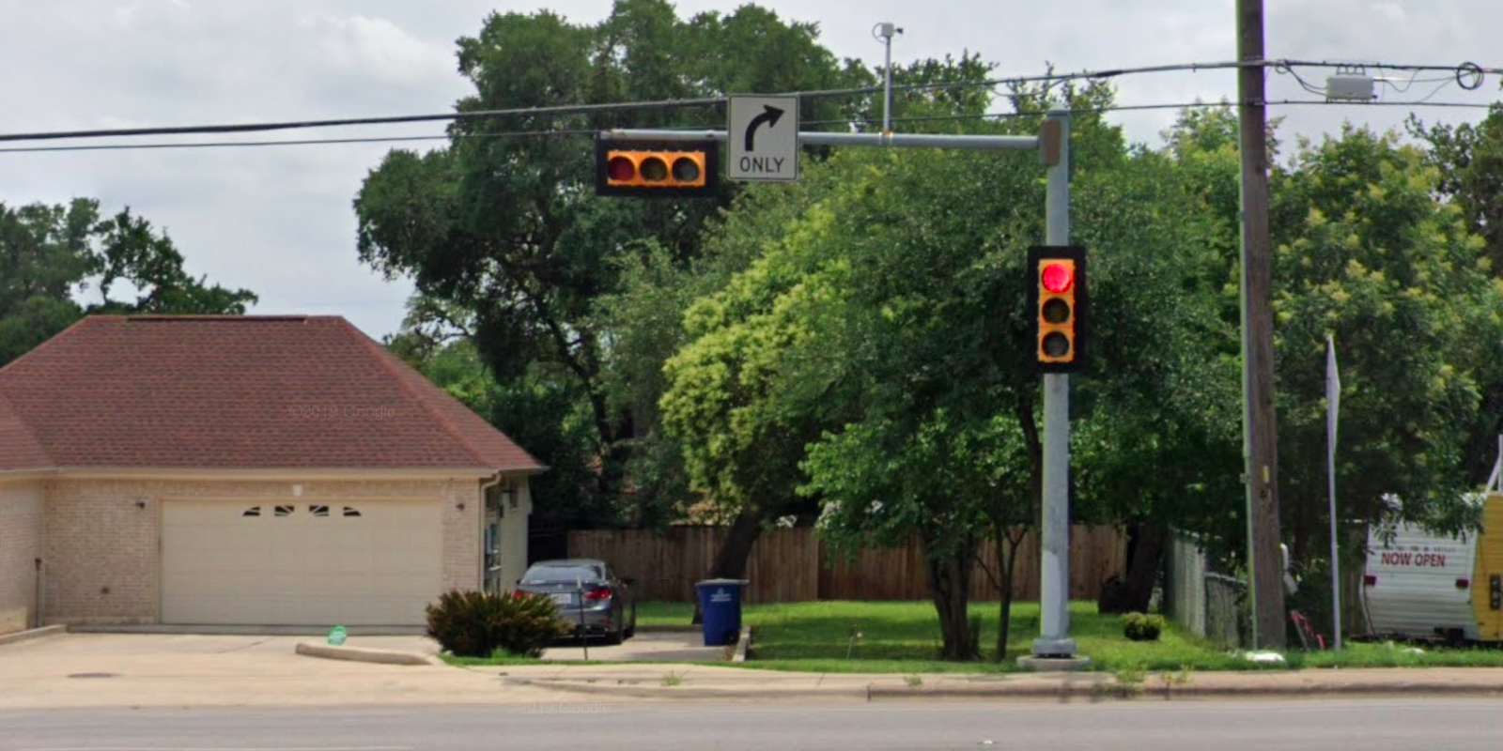
Austin Transportation Department Signs Work Orders
Created By: Susanne Gov Created Date: 2020-08-10 Location Name: 2000 BLK W SLAUGHTER LN (HEB) Intersection ID: 0 Cardinal Direction: S Work Order ID: SG-20730
Sign Type | Install/Remove
Right Arrow Only | Install

Slide 3
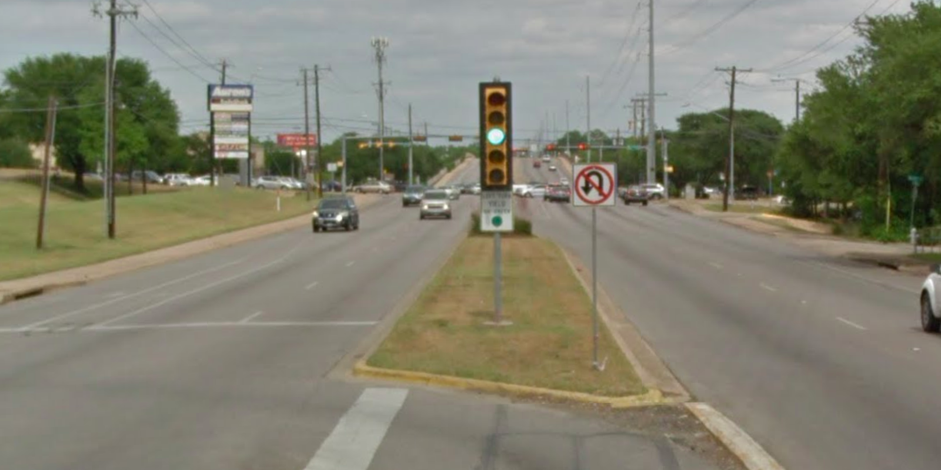
Austin Transportation Department Signs Work Orders
Created By: Susanne Gov Created Date: 2020-08-10 Location Name: 2000 BLK W SLAUGHTER LN (HEB) Intersection ID: 0 Cardinal Direction: E Work Order ID: SG-20730
Sign Type | Install/Remove
Left Turn Yield On Green | Install

Slide 4
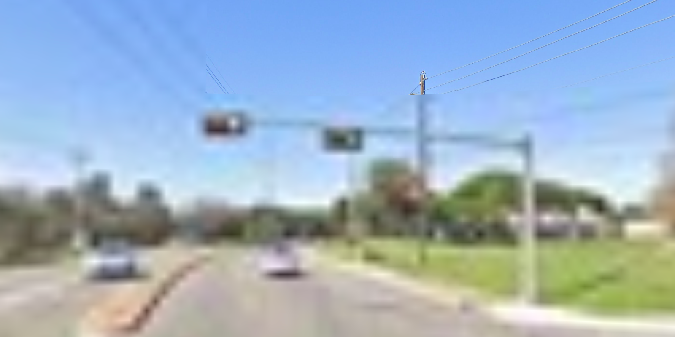
Austin Transportation Department Signs Work Orders
Created By: Susanne Gov Created Date: 2020-08-10 Location Name: 2000 BLK W SLAUGHTER LN (HEB) Intersection ID: 0 Cardinal Direction: W Work Order ID: SG-20730
Sign Type | Install/Remove
 | Install

