Slide 1

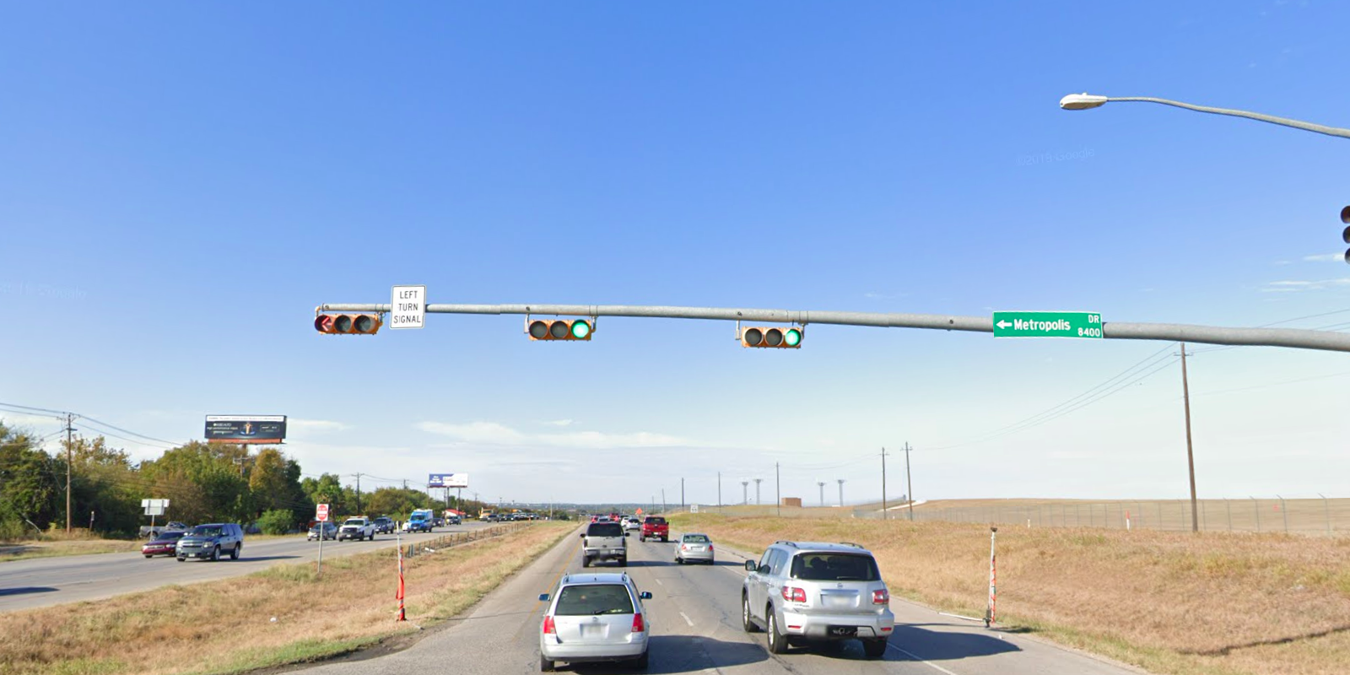
Austin Transportation Department Signs Work Orders
Created By: Susanne Gov Created Date: 2020-08-10 Location Name: US 183 HWY / METROPOLIS DR Intersection ID: 5164191 Cardinal Direction: N Work Order ID: SG-20860
Sign Type | Install/Remove
Left Turn Signal | Install
Street Name Sign | Install

Slide 2
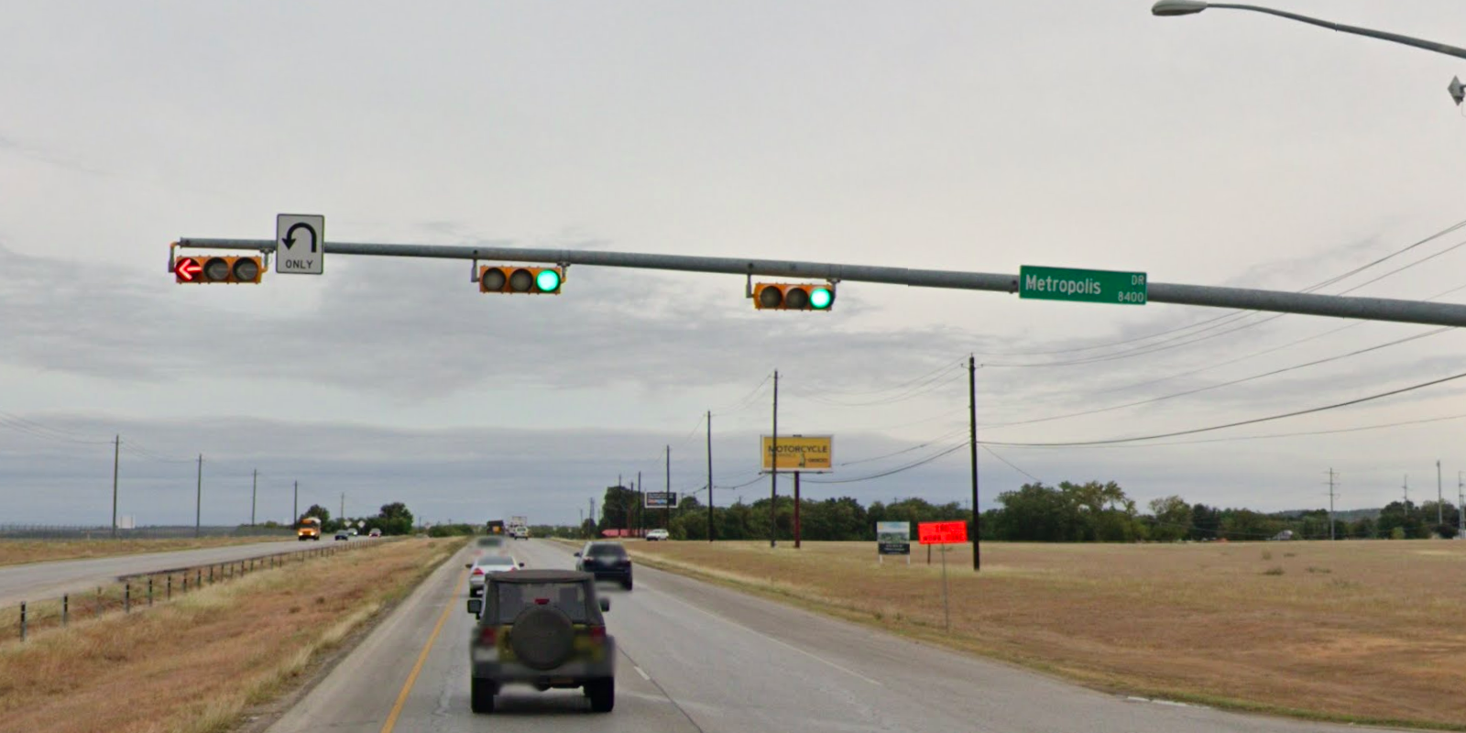
Austin Transportation Department Signs Work Orders
Created By: Susanne Gov Created Date: 2020-08-10 Location Name: US 183 HWY / METROPOLIS DR Intersection ID: 5164191 Cardinal Direction: S Work Order ID: SG-20860
Sign Type | Install/Remove
U Turn Arrow Only | Install
Street Name Sign | Install

Slide 3
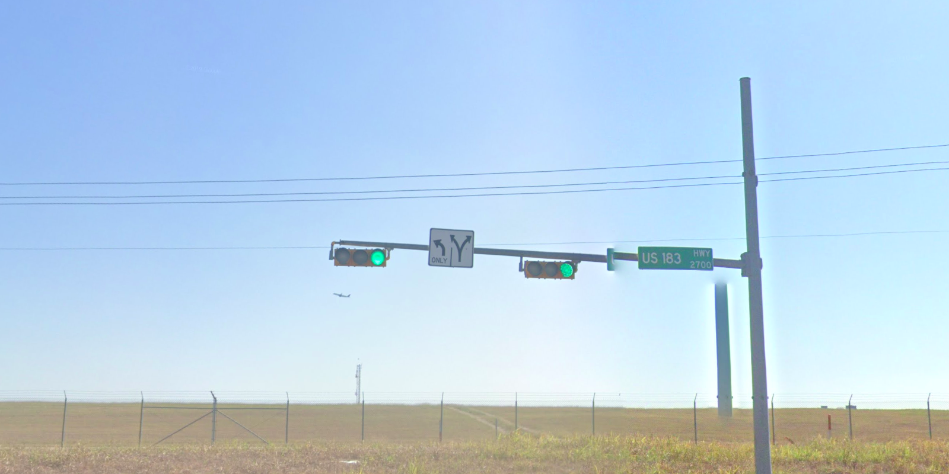
Austin Transportation Department Signs Work Orders
Created By: Susanne Gov Created Date: 2020-08-10 Location Name: US 183 HWY / METROPOLIS DR Intersection ID: 5164191 Cardinal Direction: E Work Order ID: SG-20860
Sign Type | Install/Remove
Left Turn Arrow Only | Install
Street Name Sign | Install
Left Right Turn Arrow | Install

Slide 4
Austin Transportation Department Signs Work Orders
Created By: Susanne Gov Created Date: 2020-08-10 Location Name: US 183 HWY / METROPOLIS DR Intersection ID: 5164191 Cardinal Direction: W Work Order ID: SG-20860
Sign Type | Install/Remove

