Slide 1
58th Annual Councils’
Awards Ceremony
Richard E. Fairfax, CIH
Director, Enforcement Programs

Slide 2
Directorate of Enforcement Programs
Office of General Industry Enforcement
Office of Health Enforcement
Office of Investigative Assistance
Office of Maritime Assistance
Office of Federal Agency Programs

Slide 3
Office of Federal Agency Programs
Agency Support:
Presentations
Technical Assistance
Outreach
Training

Slide 4
Office of Federal Agency Programs
Council Activities:
Manual
Charters
Website
Training Conference

Slide 5
Federal Agency Inspection
Data

Slide 6
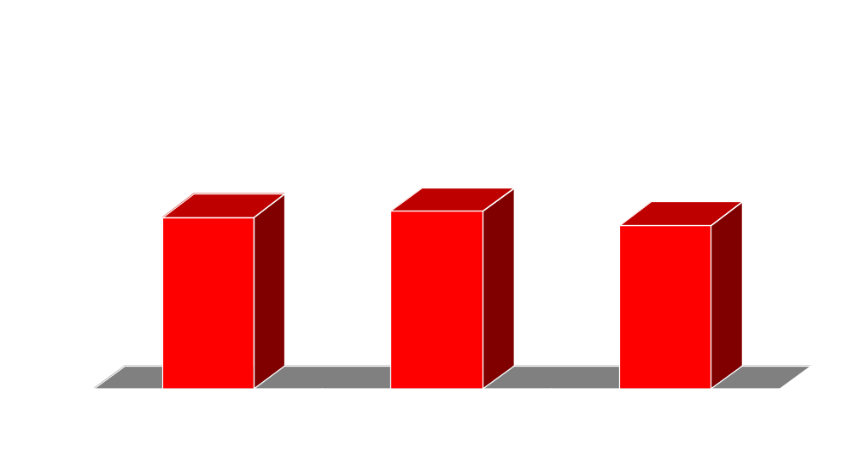
Inspections Conducted

Slide 7
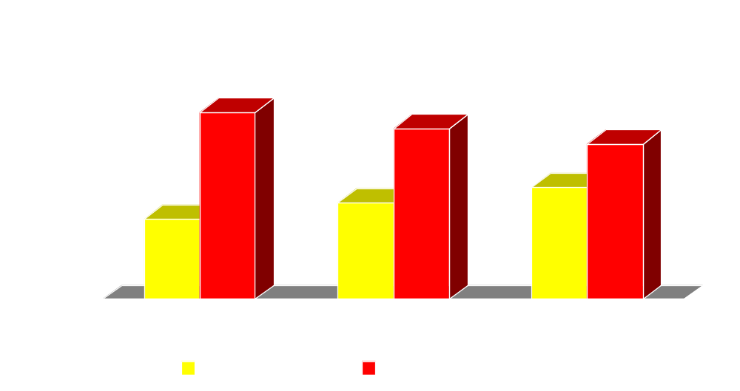
Inspection By Type
% Programmed vs. % Unprogrammed

Slide 8
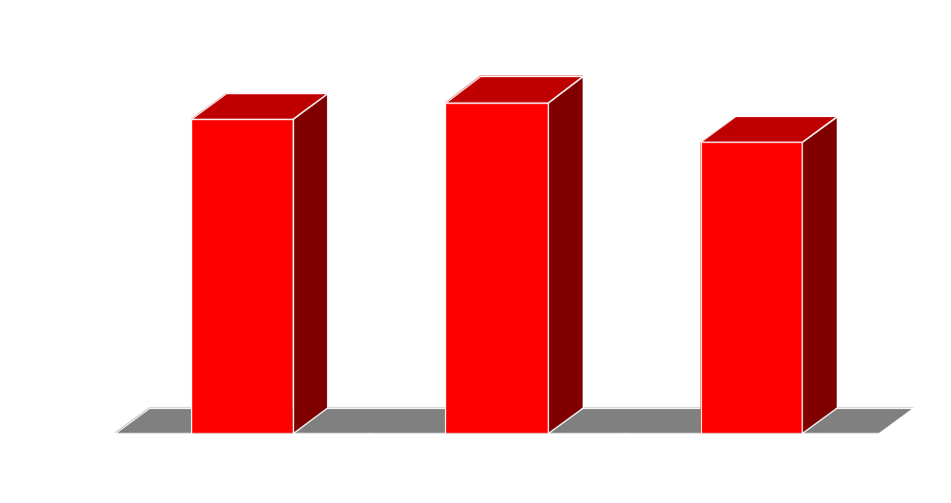
Total Violations Issued

Slide 9

% Violations Issued As Serious,Willful, Repeat, FTA

Slide 10
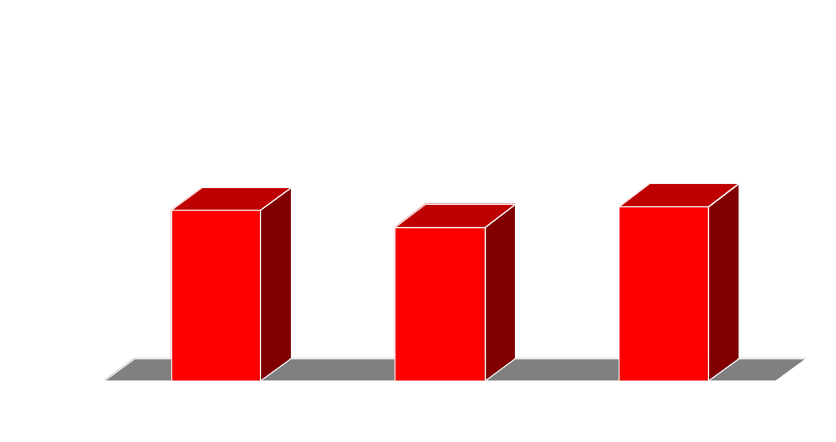
% Inspections With Violations

Slide 11
FY 2000 - FY 2003 (Combined)
Most Frequently Cited Standards
1. | Electrical, Wiring Methods
2. | Hazard Communication
3. | Electrical, Systems Design
4. | Means of Egress
5. | Bloodborne Pathogens
6. | Portable Fire Extinguishers
7. | Walking-Working Surfaces
8. | Respiratory Protection
9. | Machine Guarding
10. | Guarding Floor & Wall Openings

Slide 12
Federal Worker 2000
Presidential Initiative

Slide 13
FED 2000 Goals
Reduce injuries by 3% per year & improve timeliness by 5% per year
Reduce injuries by 10% at sites with highest incidence rates
Reduce lost production day rates by 2% per year

Slide 14
Federal Initiatives
SHARE ’04
Recordkeeping Changes

Slide 15
58th Annual Councils’
Awards Ceremony

