Slide 1
Suspensions & Expulsions
Project EASIER Data Conference
April 12, 2006

Slide 2
Suspensions and Expulsions
Overview
  Data Elements
  Common Errors
  Previous Results
  Safe and Drug Free Schools
  Special Education

Slide 3
Suspensions and Expulsions
Data Elements
  Removal Type – type of removal from the classroom
    Out of School Suspension
    Expulsion
    Removal to an Interim Educational Setting

Slide 4
Suspensions and Expulsions
Data Elements
  Reason for Removal – primary reason the student was removed from the classroom
    Drug related
    Alcohol related
    Both drug and alcohol related
    Weapons related
    Administrative law judge, court action, or hearing officer determination
    Physical fighting
    Non-drug and non-weapon related, other than those already listed

Slide 5
Suspensions and Expulsions
  Data Elements
  Violence-Related Indicator
    student was determined by the local school board to have physically injured or threatened to injure another student at school or at a school-sponsored activity in one of the following crimes;
      Forcible felony
      Physical assault with injury
      Sexual assault
      Extortion
      Use of bomb/explosive device
      Gang activity
      Carrying or using weapon

Slide 6
Suspensions and Expulsions
Data Elements
  Length of removal – full school days removed from the classroom
  Date of removal – date the removal began

Slide 7
Suspensions and Expulsions
  Common Errors
  Data elements missing
  Length of removal
    Use of partial days
      ½ day suspension = 1 day
      Must round up
    Use of days other than school days
      Do not count weekends, other school breaks
    Use of more days than in one school year
      Maximum length is equal to number of days in one school year according to the district’s school calendar

Slide 8
Suspensions and Expulsions
Common Errors
  How to handle suspension then expulsion for the same incident?

Slide 9
Suspensions and Expulsions
Previous Results
  03-04 and 04-05 school year aggregate results available in Condition of Education Report
  04-05 school year available by district on DE web-site:
  http://www.state.ia.us/educate/fis/pre/eddata/ied05/index.html

Slide 10
Suspensions and Expulsions
Previous Results
  04-05 suspensions + expulsions by incident
Incident Type | Total | Per 100 Students
Physical Fighting | 9,354 | 1.98
Weapons | 649 | 0.14
Alcohol | 558 | 0.12
Drugs | 824 | 0.17
Total | 11,385 | 2.41

Slide 11
Suspensions and Expulsions
Previous Results
  04-05 suspensions + expulsions by school level
School Level | Total | Per 100 Students
High School | 4,803 | 3.07
Junior High | 457 | 3.53
Middle School | 3,964 | 4.76
Elementary School | 1,854 | 0.87
Other | 307 | 4.00
Total | 11,385 | 2.41

Slide 12
Suspensions and Expulsions
Previous Results
  04-05 suspensions + expulsions by enrollment category
Enrollment Category | Total | Per 100 Students
<250 | 47 | 0.87
250-399 | 207 | 1.19
400-599 | 319 | 0.87
600-999 | 809 | 1.14
1,000-2,499 | 1,647 | 1.36
2,500-7,499 | 1,858 | 0.19
7,500 + | 6,498 | 5.15
Total | 11,385 | 2.41

Slide 13
Suspensions and Expulsions
Safe and Drug Free Schools
  requirement to gather and report this information to the federal government under NCLB
  In the future we will gather more detailed information
  Data should also be helpful with CSIP, SDFSC budgets and annual reports, and drug and violence prevention planning

Slide 14
Talking Points
SPP
Suspension and Expulsion Specifics
    Priority (Essential Question)
    Indicator
  Measurement
  Overview
  Baseline
  Target
  Improvement Activities
Future Data Collection Activities

Slide 15
IDEA 2004
Must develop a State Performance Plan (SPP).
Focus on improving educational results and functional outcomes—e.g., “results.”
Are still required to meeting compliance requirements, particularly those most closely related to results.

Slide 16
Suspension and Expulsion Specifics

Slide 17
Indicators
Percent of districts identified by the State as having a significant discrepancy in the rates of suspensions and expulsions of children with disabilities for greater than 10 days in a school year; and
Percent of districts identified by the State as having a significant discrepancy in the rates of suspensions and expulsions of greater than 10 days in a school year of children with disabilities by race and ethnicity. [New Indicator]

Slide 18
Measurement
  Percent = # of districts identified by the State as having significant discrepancies in the rates of suspensions and expulsions of children with disabilities for greater than 10 days in a school year divided by # of districts in the State times 100.
  Percent = # of districts identified by the State as having significant discrepancies in the rates of suspensions and expulsions for greater than 10 days in a school year of children with disabilities by race ethnicity divided by # of districts in the State times 100. Include State’s definition of “significant discrepancy.”

Slide 19
Overview of Issue/Description of System or Process
Prior Data Collection Efforts
Past Methodology
Past Analysis and Results

Slide 20
Methodology
(a) rate of suspensions > 10 days for =
students with disabilities
# of students with disabilities suspended
divided by
# of students with disabilities enrolled in school year
(b) rate of suspensions > 10 days for =
students without disabilities
# of students without disabilities suspended
divided by
# of students without enrolled in school year
Difference in the rates of suspension =
between (a) and (b)
(a) – (b)

Slide 21
Baseline Data for FFY 2004 (2004-05)
Five districts, or 1.36% of Iowa’s districts, were identified as having a significant discrepancy of 2% above the State average of .56% in the rates of suspensions and expulsions of children with disabilities for greater than 10 days in a school year.

Slide 22
Measurable and Rigorous Targets
For the 2005-06 School Year
  A. 1.5% or less of districts are identified as having a significant discrepancy of 2% above the State average in the rates of suspensions and expulsions of children with disabilities for greater than 10 days in a school year.
  B. To be provided in the February 2007 APR

Slide 23
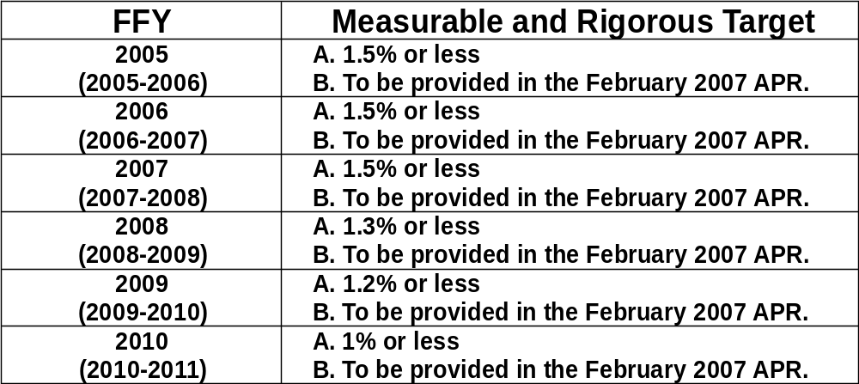

Slide 24
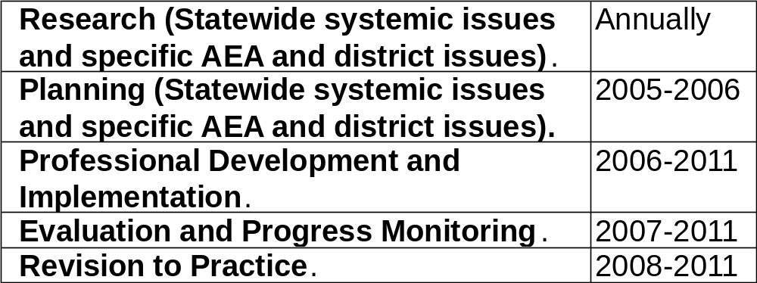
Improvement Activities and Timelines

Slide 25
Resources
Special Education Advisory Panel, SEA Staff (Special Education), University of Iowa Child Psychiatry, Iowa Behavioral Alliance, and Area Education Agencies
Part B Funding
ESEA Funding
SIG

Slide 26
Future Data Collection Activities
Federal Changes in Definitions and Requirements
In-School Suspension
Summer Project EASIER Training
Timelines and Compliance

Slide 27
Contact Information
Iowa Department of Education
Janell Brandhorst, Project EASIER Consultant
515-281-5288
janell.brandhorst@iowa.gov
Mary Sullivan, Consultant
515-281-5471
mary.sullivan@iowa.gov

