Slide 1

CDC’s Framework for Program Evaluation in
Public Health
Step 4. Gather Credible Evidence
Using surveillance data in your evaluation
Linda Leary
Field Services Evaluation Branch
Lori Armstrong
Surveillance, Epidemiology, and Outbreak Investigations Branch
Surveillance Team

Slide 2
Evaluation is an Essential Organizational Practice
Program evaluation is not practiced consistently across program
areas, nor is it well-integrated into the day-to-day management of
most programs.
Program evaluation is necessary to fulfill CDC’s operating
principles for public health, which include:
  Using science as a basis for decision-making and action;
  Expanding the quest for social equity;
  Performing effectively as a service agency;
  Making efforts outcome-oriented; and
  Being accountable

Slide 3
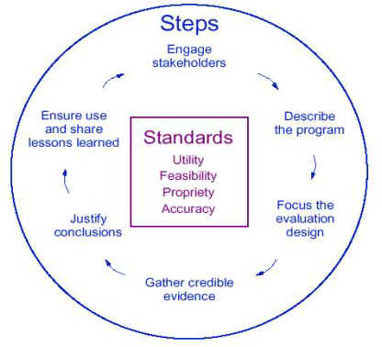
Framework for program evaluation in public health
http://www.cdc.gov/eval/framework.htm

Slide 4
Six Steps in Program Evaluation
Engage stakeholders
Describe the program
Focus the evaluation design
Gather credible evidence
Justify conclusions
Ensure use and share lessons learned
webinar site:
http://www.cdc.gov/nchstp/tb/Program_Evaluation/default.htm

Slide 5
Overview
Define surveillance data and their use
Using surveillance data to determine evaluation focus and develop evaluation questions
Using surveillance data as a source of credible evidence
Issues and concerns on data quality and completeness, and what you can do about it

Slide 6
How can a local TB program use surveillance data to conduct evaluations?
The national TB program requires each grantee to write an evaluation plan by Dec. 16, 2005.
  Surveillance data can help ensure the right evaluation questions are identified, and
  Surveillance data can be used to set meaningful benchmarks for progress.

Slide 7
How can a local TB program use surveillance data to conduct evaluations?
TB surveillance data can also be used as one source of credible evidence to compare:
  Local objectives against national objectives;
  Local area objectives within a state; and
  Look at the trend of data over a period of time.

Slide 8
Surveillance Definition
Ongoing systematic collection, analysis, and interpretation of outcome-specific data.
For use in planning, implementation, and evaluation of public health practice.

Slide 9
Uses of Surveillance Data
Public health surveillance is an important part of the information
feedback loop that links the public, health care providers, and
health care agencies. These data can be useful in posing
questions for your evaluation design, such as:
  How to identify people and groups of people at risk for disease?
  How to prioritize health needs in persons at higher risk for disease exposure or infection accompanied by a plan for follow-up?
  How to incorporate surveillance data as a source of information for program planning and evaluation?
  How to use indicators to determine if a condition exists or certain results have been achieved?

Slide 10
Indicators
Indicators are at the heart of a performance
monitoring system.
  They provide a basis for collecting credible evidence that is valid and reliable for evaluation.
  Describes progress in achieving its objectives.
  Tells us what to measure to determine whether the objective has been achieved.

Slide 11
National TB Program Objectives | National TB Program Indicators
Increase % of TB pts who complete TB treatment within 12 mos. Increase % of TB pts with initial positive cultures who also are tested and receive drug susceptibility results Decrease the TB case rate in reporting areas At least 90% of core RVCT data are complete. | Completion of therapy rates Percent of cultured confirmed drug cases with susceptibility results TB case rate Completeness of RVCT reporting

Slide 12
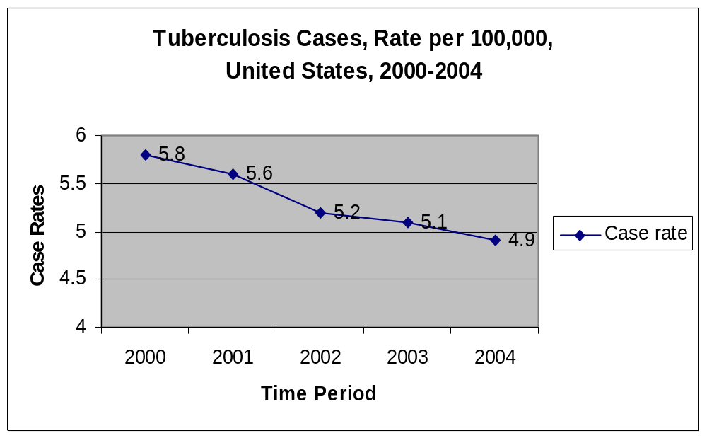

Slide 13
Race/Ethnicity – Year 2002
 | State A |  | State B
 | No. Cases | Rate | No. Cases | Rate | US Rate**
Hispanic | 2 | 2 | 16 | 23 | 10
Black, Non-Hispanic (NH) | 1 | 4 | 16 | 5 | 13
Asian, Pacific Islander, Native Hawaiian, NH | 137 | 22 | 14 | 39 | 28
White, NH | 6 | 2 | 100 | 3 | 2
Other | 2 |  | 0
Total | 148 | 11.9 | 146 | 3.6 | 5.2
* Rate per 100,000

Slide 14
How do you calculate the
TB Case Rate?
RVCT variable item #6 – month year counted
  Data is obtained from the RVCT.
      [The health department is responsible for: counting TB case by month year, verifying the case as TB, and including it in the official case count.]
  The national annual surveillance report publishes the total number of TB cases by state.
Population estimates from the US Census Bureau
  http://www.census.gov/popest

Slide 15
Calculation of TB Case Rate
Year 2000 – State X
Population of State X = 554,817
# of TB Cases for Year 2000 State X = 42
  42 / 554,817 x 100,000 = 7.6 per 100,000

Slide 16
How do you calculate the
TB Case Rate?
RVCT variable item #6 – month year counted
  Data is obtained from the RVCT.
      [The health department is responsible for: counting TB case by month year, verifying the case as TB, and including it in the official case count.]
  The national annual surveillance report publishes the total number of TB cases by state.
Population estimates from the US Census Bureau
  http://www.census.gov/popest

Slide 17
Guidance documents in measuring outcomes
Using the RVCT as an Evaluation Tool
Exercises from the Program Manager’s Course.
Request copies of draft documents: lsl1@cdc.gov

Slide 18
Who is OTIS?

Slide 19
The Online TB Information System
(OTIS)
A query-based public use data set of national TB surveillance data from 1993 through 2003
It includes the 50 states, District of Columbia, and Puerto Rico
Maintains confidentiality by de-identifying, aggregating, or suppressing data
Performs queries and ad hoc cross-tabulations on 22 variables from the RVCT
Supplements annual surveillance report
“Housed” on WONDER server
http://wonder.cdc.gov/tb

Slide 20
OTIS: current status
Each state signed a data release agreement form to accept or refuse participation in OTIS.
States reviewed OTIS for several months
Data were checked and changes made based on your suggestions
Release date: November 2005
Anticipate 2004 data will be available March 2006

Slide 21
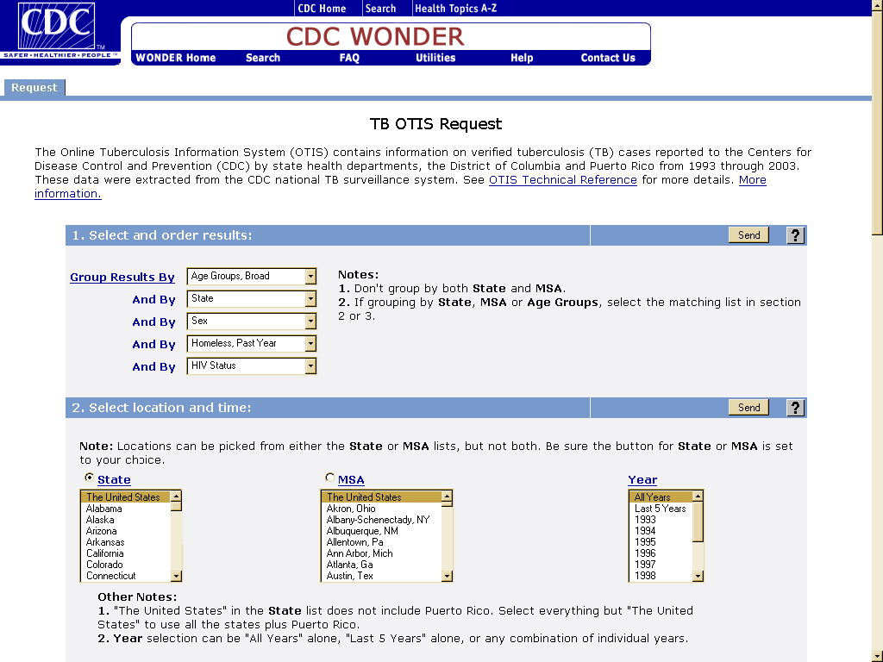

Slide 22
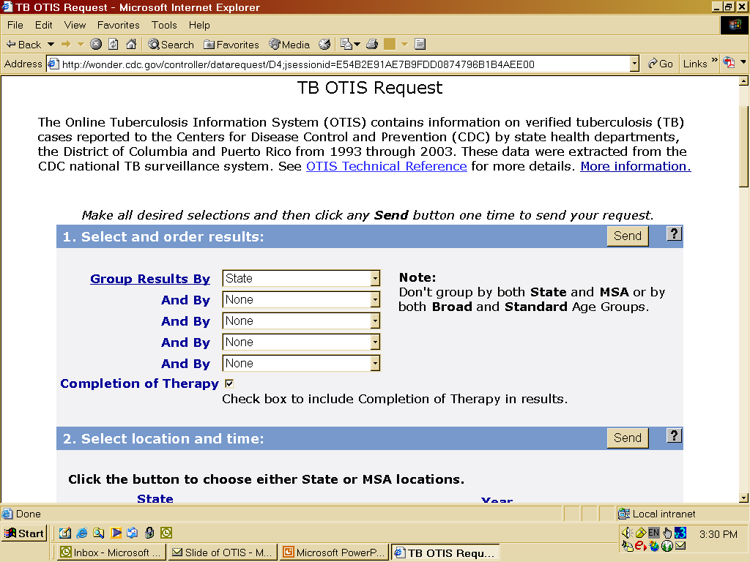

Slide 23
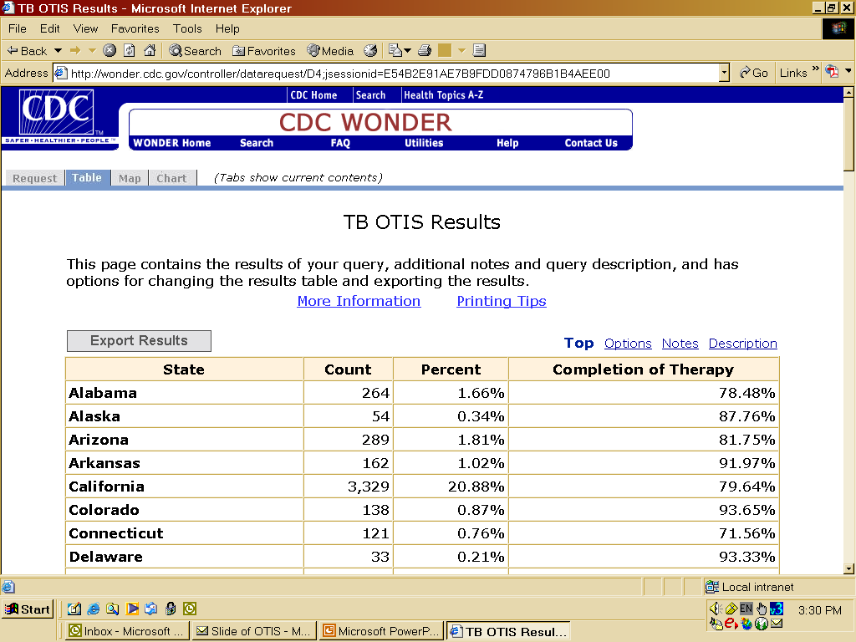

Slide 24
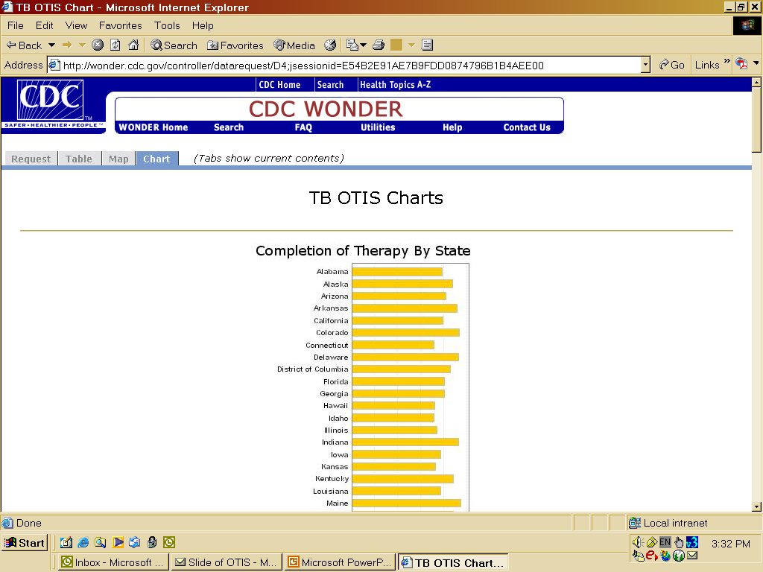

Slide 25
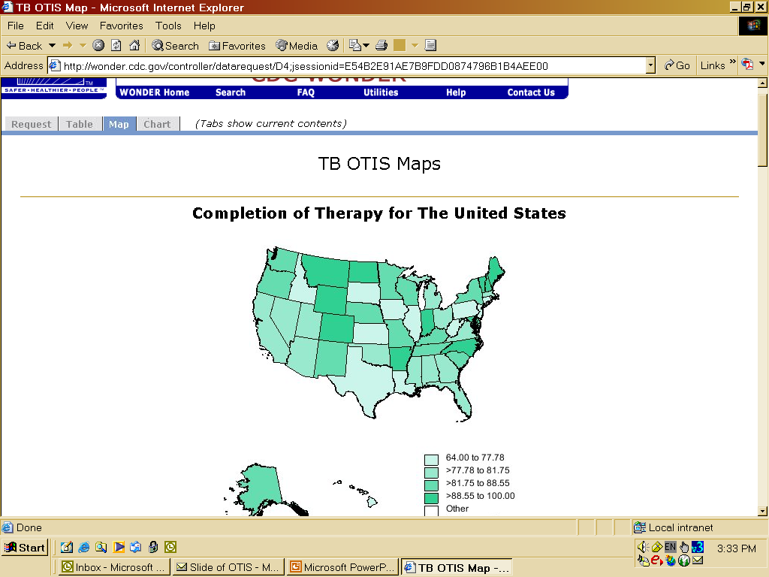

Slide 26
Issues of Data Completeness and Quality

Slide 27
Data Completeness
TIMS data are evaluated for overall completeness each month
The goal for percent completeness of each RVCT (TIMS) variable is based on GPRA goals or on tradition
Each RVCT variable has a completeness goal, usually 95% to 99%
Missing and Unknown Reports (MUNK)
MUNK Reports provide information on RVCT (TIMS) variables that are below the completeness goal
MUNK reports are sent to each TB program or recording area 1 to 3 times/year and to the FSEB Consultant for that area.

Slide 28
Missing and Unknown Variables
2004 RVCT Data
RVCT Variable | Completeness Goal (%) | Average % completeness among all reporting areas (%)
TB skin test | 95 | 93.1
Year of previous TB | 99 | 98
Month/year arrived in US (FB) | 95 | 86.3
Excess alcohol use | 99 | 96.6
injecting drug use | 99 | 96.5
non-injecting drug use | 99 | 96.1

Slide 29
Data Quality
High quality RVCT data are essential for proper interpretation of data for TB control programs
Inconsistent or inaccurate data can lead to inappropriate associations and unrecognized biases in research
Examples of miscoded information
  People from India were coded as American Indian - (reclassified to Native American/Alaskan Native in 2003)
  Young children were coded as alcoholics or IDUs - (Children born to IDUs and alcoholics are not drug abusers or alcoholics)
  People born in the Philippines or Japan were coded as “Native Hawaiian and Other Pacific Islander”

Slide 30
Native Hawaiian and Other Pacific Islander
Miscoded information
In preparation for the 2005 World TB Day MMWR
article, we found 37 foreign-born TB cases who
were incorrectly coded as “Native Hawaiian and Other
Pacific Islander”
Incorrect NH/OPI cases were coded in TIMS as foreign
born and from other countries such as Philippines,
Japan, Laos, Vietnam, India, Somalia, Iran, Ecuador,
Brazil

Slide 31
TB cases by Asian, NH/OPI race, United States, 2004 (provisional data)
 | Uncorrected |  | Corrected*
Race | N | Rate/100,000 | N | Rate/100,000
Asian | 3,222 | 26.7 | 3,235 | 26.9
Native Hawaiian and Other Pacific Islander | 103 | 25.9 | 66 | 16.6
Native Hawaiian and Other Pacific Islander rate was not reported in the World TB Day MMWR. The count was included in the category “Other/Unknown”

Slide 32
Native Hawaiian and Other Pacific Islander: Correct Definition
First introduced as a race code in 2003
TIMS Race and Ethnicity Classification (9/4/2002) lists all the islands classified as Other Pacific Islands and countries that are considered Asian.
Examples
  NH/OPI: Carolinian, Chamorro, Fijian, Guamanian, Kiribati, Papua New Guinean, Polynesian, Saipanese, Samoan, Solomon Islander, Hawaiian Islands
  Asian: Filipino, Bhutanese, Asian Indian, Singaporean, Taiwanese, Okinawan, Nepalese, Hmong, Iwo Jiman

Slide 33
Summary
Follow the six steps in the CDC Framework in conducting your evaluation.
Use surveillance data as one source of credible evidence to use in evaluation. Also, consider using OTIS as another source of gathering information.
Strive for data quality. Quality refers to the appropriateness and integrity of information used. Good decisions are based on accurate data.

Slide 34
Contacts
Linda Leary 404.639.8342 lsl1@cdc.gov
Lori Armstrong 404.639.8860 lra0@cdc.gov

Slide 35
QUESTIONS
? ? ? ? ? ? ? ? ?

