Slide 1
Government Enterprise Architecture Framework (GEAF) Meeting
Coordination with Other
Governance Subcommittee Goal 3 Tasks
Brand Niemann, US EPA, and Susan Turnbull, GSA, Emerging Technology Subcommittee, October 27, 2003
and
OASIS eGOV Technical Committee Meeting: Registries & Repositories Workshop, October 30, 2003

Slide 2
Overview
1. CIO Council’s Architecture and Infrastructure Committee (AIC).
2. Governance Subcommittee.
3. Governance Subcommittee FY 2003 Work Plan.
4. Governance Subcommittee, Goal 3 Tasks.
5. Goal 3 Task Deliverables.
6. Goal 3 Architecture
7. Collaboration Environment and Work on Multiple Registries and Repositories.
8. Some Next Steps.

Slide 3
1. CIO Council’s Architecture and Infrastructure Committee (AIC)
Co-Chairs:
  John Gilligan, CIO, Air Force, and Kim Nelson, CIO, EPA.
Three Subcommittees:
  Governance: Policy guidance and assistance in design and implementation of the Enterprise Architecture discipline and practice.
    Robert Haycock, OMB, and TBA.
  Components: Identify, mature and facilitate use/reuse of Component-based Architectures.
    Reynolds Cahoon, CIO, NARA, and Robert Haycock, OMB.
  Emerging Technology: Identify technologies with the potential to improve the value and quality of the FEA.
    Mark Day, DCIO, EPA, and John McManus, NASA.

Slide 4
2. Governance Subcommittee
Vision: Institutionalize the Federal Enterprise Architecture.
Mission: Develop policy, direction, and guidance by which the FEA is a driver of business process improvement, investment management, and technical decisions, in order to institutionalize the FEA throughout government. Assist in implementing the FEA and other Enterprise Architectures throughout government.
Goal: Develop a set of FEA principles and accomplish three activities (see next slide).
Definition: The “range of business and information technology decision-making structures and processes used to create, apply, and evolve the Federal Enterprise Architecture (FEA).”

Slide 5
3. Governance Subcommittee FY 2003 Work Plan
Mission Statement/Task 1: Develop FEA Principles.
  Lead: TBA.
Goal 1. Integrate Enterprise Architectures (EAs) Into Management Processes of Government.
  Gerry Stoopman, Department of Homeland Security, and Linda Ibrahim, Federal Aviation Agency (two of three tasks).
Goal 2. Define the Alignment of Department/Agency EAs with the FEA.
  Roy Mabry, Department of Defense (all three tasks).
Goal 3. Describe How the FEA will Facilitate the Connection of State and Local EAs to Federal Business Lines and Agency Architectures (see next slide).
  Patrick Mullen, US AID, Arthur Graham, Department of Education, and Brand Niemann, US EPA.

Slide 6
4. Governance Subcommittee, Goal 3 Tasks
1. Government Enterprise Architecture Framework (GEAF).
2. Joint Architecture Integration Pilot (JAIP).
3. Joint Component Registry/Repository Pilot (JCRP).
  Use Component Subcommittee “Quick Win” Task Components.
4. Joint Government Data and Information Reference Model (GDIRM).
  Note: Announced April 10th at FOSE 2003 by Bob Haycock:
    http://www.gcn.com/vol1_no1/daily-updates/21691-1.html
5. Enterprise Software Licensing.
  On hold because of GSA “Smart Buy”
6. More Joint Pilots.
Note: The focus of Goal 3 Tasks goes beyond FY 2005 budget needs to working with states, the Data Reference Model (DRM), and the 6 priority lines of business and enterprise software licensing. Tasks 1-4 are short-term (3/03-4/04).

Slide 7
5. Goal 3 Task Deliverables
Six deliverables in spite of several impediments:
  Input to the Draft FEA Data and Information Reference Model (DRM) for the past 10 months (18 revisions)!
    Posted at http://web-services.gov
  IAC Business Line Integration and Federated Data Reference Model White Paper produced:
    Included XML Web Services Working Group Pilot as Example Scenario Using MOF Models and XML-Based Web Services.
  Contributed to Tasks 1-4 of the Components Subcommittee and Emerging Technology Life Cycle Task of the Emerging Technology Subcommittee:
    Populating “Matrix Framework” (Eight stages of life cycle versus 5 basic types of components in the FEA SCRM).
    See http://componenttechnology.org
  Several pilots delivered to DHS, the Global Justice Programs, etc.
  Established a Collaboration Environment and Work on Multiple Registries and Repositories (see next slide).
  Working with major collaboration communities with authoritative governance on sustainable intergovernmental exchange networks with semantic interoperability and Services Oriented Architectures (SOA):
    Global, National Environmental Information Exchange Network, Health IT Sharing Program, Intelligence Community Metadata Working Group, etc.

Slide 8
6. Goal 3 Architecture
Three Basic Architectures:
  Federal Enterprise Architecture:
    A Set of Reference Models Backed by Law and Administrative Rule.
      “Not a roadmap, but a guide to getting there”. (Gartner)
  National Association of State CIO’s Architecture Toolkit:
    Business Architecture (TBD), IT Domains (10), and Temporal Context (Emerging, Current, Twilight, and Sunset).
  Other:
    Gartner EA:
      Business Relationships Grid:
        Styles, Patterns, and Bricks Versus Seven Domains (Data, Application, Integration, Point of Access, Security, Systems Management, and Infrastructure).

Slide 9
6. Goal 3 Architecture
eGov requires multiple interfaces for the:
  Citizen, portfolio manager, developer, etc.
To the Government Enterprise Architecture Framework (GEAF):
  Federal Enterprise Architecture plus the National Association of State CIOs Architecture Toolkit, etc.
Which consists of multiple Reference Models (RM):
  Performance, Business, Services, Technical, Data, Security, etc.
Which provide multiple views for implementing a Component-based Architecture (CBA):
  Requiring multiple registries/repositories to cover the matrix framework of at least eight life-cycle stages and five basic types of components.

Slide 10
6. Goal 3 Architecture
Life Cycle Stages(1):
  Identification
  Subscription
  Stewardship
  Graduation
  Budgeting
  Acquisition
  Maintenance
  Retirement /Replacement
Basic Component Types (2):
  Federated
  Business System
  Business
  Distributed
  Language Class
Managing the IT Innovation Life-Cycle: Proposed Stages/Schemas, Draft, May 27, 2003, with minor edit on July 2, 2003 at http://xml.gov/draft/etLifeCycle.htm
FEA Service Components Reference Model, http://www.feapmo.gov

Slide 11
6. Goal 3 Architecture
GRANULARITY | DEFINITION | SCRM REFERENCE MODEL FOCUS?
Federated Component | A set of cooperating system-level components federated to resolve the business need of multiple end users often belonging to different organizations. | Yes
Business Component System | A set of cooperating business components assembled together to deliver a solution to a business problem. | Yes
Business Component | Represents the implementation of an autonomous business concept or business process. It consists of all the technology elements (i.e., software, hardware, data) necessary to express, implement, and deploy a given business concept as an autonomous, reusable element of a large information system. It is a unifying concept across the development lifecycle and the distribution tiers. | Yes
Distributed Component | The lowest level of component granularity. It is a software element that can be called at run-time with a clear interface and a clear separation between interface and implementation. It is autonomously deployable. | Yes
Language Class | A class in an object-oriented programming language to build distributed components. This is NOT considered an SCRM component. | No

Slide 12
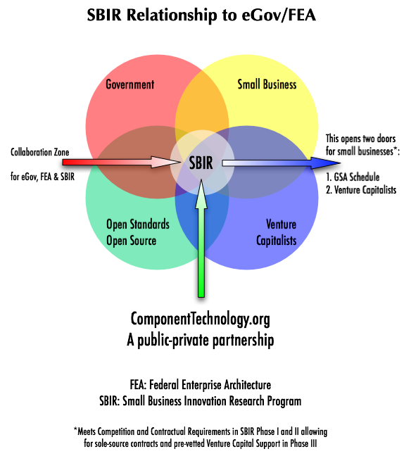
6. Goal 3 Architecture
Emerging Components Collaboration Registry/Repository (ECCRR) (“esir”):
http://componenttechnology.org

Slide 13
6. Goal 3 Architecture
Mapping Emerging Technology Activities to the FEA Reference Models
Emerging Components Quarterly Conference, October 20, 2003:
Identify early successes and set 1% goal for new funding.
Quarterly Conferences:
  October 20, 2003.
  January 26, 2004.
  March 2004 as part of FOSE 2004.
Collaboration Web Site with Directory, Registry and Repository:
  http://componenttechnology.org
  http://web-services.gov
Open Standards and Interoperability Demonstrations.
  W3C, OASIS, WS-I, etc.
Shareable Content Object Reference Model (SCORM) Compliant:
  Support XML Metadata and Export Standards.
Web Services Security (WS*) and Related Standards.
FEA Reference Models, October 7, 2003:
Performance:
  Metrics & Indicators:
    Measures.
Business:
  Context & Conditions:
    Workflow.
Service Component:
  Directory, Repository, & Registry.
    Applications.
Technical:
  Standards and Specifications:
    Interoperability.
Data:
  Subjects & Schema:
    Information Exchange.
Security & Privacy:
  TBD.

Slide 14
6. Goal 3 Architecture
Taxonomies with the FEA Reference Models
Example: Show me all the data structures that have been classified as part of the Business Compliance One-Stop Initiative and as a work product of the IRS:
  DRM – the data structures themselves (e.g. data dictionary)…
  SRM – expressed as a reusable component (e.g. XML Schema) …
  TRM – provided in an interoperable way (e.g. an XML Web Service) ….
  BRM – classified according to a taxonomy (e.g. Business Reference Model Version 2).
  PRM – Doing all this demonstrates performance!
Source: Kevin Williams, Creating Taxonomies in XML Collaborator,
Presentation to the XML Web Services Working Group, April 15, 2003.

Slide 15
7. Collaboration Environment and Work on Multiple Registries and Repositories
Name | Origin | Destination (s)
BlueOxide’s XML Collaborator | XML Web Services WG | Business Gateway, IC MWG, etc.
CollabNet’s Source Cast | XML Web Services WG | DISA, US PTMO, Business Gateway, etc.
Software AG’s Tamino Native XML Server | XML Web Services WG | EPA, Global, Business Gateway, etc.
BAH’s “Web Services and Registries” | XML Web Services WG | XML.Gov Registry Team
GEAF | XML Web Services WG | Governance SC, etc.
Open Source for eGov Reference Architecture | GSA-Emerging Components | Componenttechnology.org
WorkForce Connections –Shareable Content Object Reference Model | Department of Labor and DevIS – Emerging Components | Componenttechnology.org
Components (Reusable Asset Specification-OMG) | Flashline/Noblestar – Emerging Components | Componenttechnology.org

Slide 16
8. Some Next Steps
November 3rd:
  Sustainability of Intergovernmental Information Networks.
November 10th:
  Global Service-Oriented Architecture Meeting.
December 9th:
  Collaboration Expedition Workshop #30.
January 26, 2004:
  Second Quarterly Emerging Components Conference (possibly with OASIS eGov TC Meeting).
January 27, 2004:
  Collaboration Expedition Workshop #31.

