Slide 1

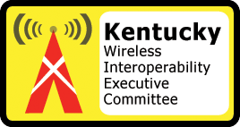
Kentucky’s Public Safety Awareness Initiative Program
Coordination and Partnerships
August 23, 2005

Slide 2


Course Objectives
To educate public safety officials with coordination and partnership strategies to support public safety radio communication systems.
To identify partnerships and develop common approaches to improve radio communications interoperability among public safety agencies.
To foster relationship building and information sharing among public safety agencies.

Slide 3

Lesson Plan
Current Environment
Purpose
Strategy
Barriers
Foster Partnerships
Memorandum of Understanding
Benefits
Class Exercise

Slide 4
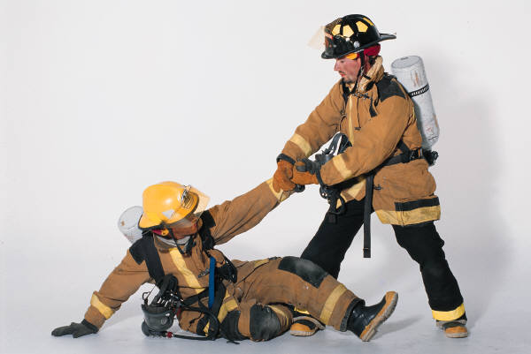
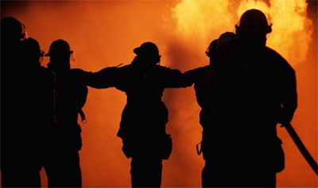
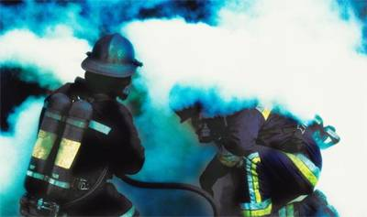
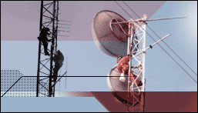
Coordination and Partnerships

Slide 5

Current Environment
A multitude of autonomous radio communications systems serving individual public safety agencies using different protocols and technologies without switching channels to each others systems.
“Most public safety agencies cannot directly communicate with other public safety agencies in their region, even when numerous agencies collectively respond to an emergency”*
*National Task Force on Interoperability – Why Can’t We Talk

Slide 6




New Focus - Interoperability
Public Safety personnel must be able to communicate with each other to provide immediate and coordinated assistance in times of emergencies.
Otherwise, lives and properties may be lost unnecessarily.

Slide 7
Purpose
“Promote the efficient use of resources and the development of long-term interoperability solutions through improved coordination and partnerships with and among public safety agencies.”*
To identify opportunities and coordinate plan activities and support efforts to improved radio communication interoperability.
*PSWN – Program and FLEWUG Status Report

Slide 8

Strategy
Cultivate political and stakeholder support at all levels of government.
  Kentucky Wireless Interoperability Executive Committee (KWIEC)
  Legislature
Build partnerships with stakeholders.
Perform an assessment to help identify and locate resources for collaboration opportunities.
  Current radio communication capabilities
  Commonalities across public safety agencies
  Future needs assessment
Develop the Commonwealth of Kentucky’s Public Safety Wireless Communications Plan.

Slide 9

Barriers
Organizational
  Operational Approaches
  Cultural
  Individual Perspectives
Physical/Technical
  Hardware and Software
“Turf Issues”
  Management and Control
Geographic
  Rivers, Mountains, Lakes, etc…
Jurisdictional
  Regulatory

Slide 10

Foster Partnerships
All Levels of Government
Engender Trust
Open Communications
Information Sharing
Patience with the Process
Respect for Differences
Make Decisions through Consensus

Slide 11

Memorandum of Understanding
An agreement of cooperation between organizations defining the roles and responsibilities of each organization in relation to the other with respect to an issue over which the organizations have concurrent jurisdiction.”*
*National Task Force on Interoperability – Why Can’t We Talk

Slide 12

Components of MOU
Purpose
Scope
Background
Principles of Agreement
Resources
Authority and Agreement Signatures

Slide 13

Benefits
Coordination and Partnerships are necessary:
  To discuss and facilitate planning and policy development for wireless communications interoperability.
  To provide immediate and coordinated wireless communications among first responders.
  To developed shared systems that contribute to a lower total cost of ownership while optimizing support, maintenance, training, reusability, and economies of scale in purchasing.

Slide 14

Review Areas of Study
Lesson Plan
  Current Environment
  Purpose
  Strategy
  Barriers
  Foster Partnerships
  Memoranda of Understanding
  Benefits

Slide 15
Class Exercise
Working Group Assignment
  This lesson focuses on the importance to solve problems as a team.
  The instructor will place individuals into working groups and all groups will be assigned an identical problem.
  Group members are encourage to interact with other members and participate in the process to solve the problem presented to them.

Slide 16
Exercise One
Using your tiles, work with other members to construct the blue image.

Slide 17
Exercise One - Solution
How successful was your group?
How successful was your group to coordinate and partner with other groups to exchange information in order to solve the puzzle?
After the solution was known, was this information disseminated to other groups?

Slide 18
Exercise Two
Using your tiles, work with other members to construct the blue image.

Slide 19
Exercise Two - Solution
How successful was your group?
How successful was your group to establish a Memorandum of Understanding to exchange tiles to solve the puzzle?
After the solution was known, was this information disseminated to other groups?

Slide 20

Action Plan / Wrap Up
Coordination and Partnership are necessary for the efficient use of resources and the development of long-term wireless communication interoperability solutions.
Public safety agencies need to overcome barriers and foster partnerships.
Memorandum of Understanding needs to be established.

Slide 21
Recommended Readings
Coordination and Partnerships Guide
Statewide Communications Interoperability Planning Methodology (SCIP)
Statewide Strategy Best Practices Report
Post Symposium Report – Kentucky
Role of the Local Public Safety Community in Wireless Interoperability
Role of the State Public Safety Community in Wireless Interoperability

Slide 22

Additional Resources
Internet Links
  www.dhs.gov
  www.fema.gov
  www.publicsafetywins.gov
  www.agileprogram.org
Kentucky Office of Homeland Security
  www.homelandsecurity.gov
Commonwealth Office of Technology
  www.cot.ky.gov
Kentucky Wireless Interoperability Executive Committee (KWIEC)

Slide 23
Kentucky’s Public Safety Awareness Initiative Program
Discussions?
Coordination and Partnerships
August 23, 2005

