Slide 1

PhRMA Presentation to FDA:
Bar Codes to Reduce Medication Errors
August 19, 2002

Slide 2
Topics of Discussion
NDC Numbers Within the EAN/UCC System
Current Use of Bar Codes on Pharmaceuticals
A Solution from EAN/UCC: RSS
Another Solution: Datamatrix Symbology
Camera Readers
Preprinting a GTIN in RSS or Datamatrix
Difficulties of Lot and Expiry Coding

Slide 3
NDC numbers within the EAN/UCC system
EAN/UCC regulates a global unique product number:
0009 1234 01 NDC (National Drug Code)
30009 123401 6 UPC (Universal Product Code)
030009 123401 6 EAN (International Article Number)
5030009 123401 6 GTIN (Global Trade Item Number)

Slide 4
NDC numbers within the EAN/UCC system, cont.
NDC, 10 digits formatted label code, product family, package (4-4-2, 5-3-2, 5-4-1)
UPC , 12 digits formatted Manufactures Number, Product, Ck digit. The label code 0009 is converted to a manufacturing number by adding “3”
EAN, 13 digits formatted Manufactures Number, Product, Ck digit. To convert from UPC to EAN add a “0”
GTIN, 14 digits formatted Packing level, Manufactures Number, Product, Ck digit. To convert from EAN to GTIN add a digit to designate package level (0-9).
RSS, Reduced Space Symbology created to encode the GTIN

Slide 5
NDC numbers within the EAN/UCC system, cont.
Products that have bar coded UPC, EAN or GTIN are uniquely identified. A separate NDC bar code would not be necessary.
NDC numbers and UPC codes are not always related. Databases may be used to link them.
  OTC products that have gone through improvements may have many NDC numbers associated with one UPC because retailers don’t change the UPC.
  Global products with many languages may have one NDC number related to many UPCs.

Slide 6
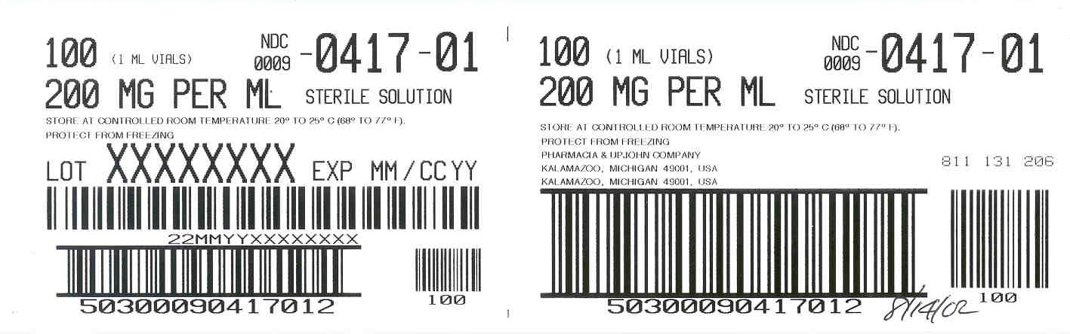
Current Use of Bar Codes on Pharmaceuticals
Case labels use GTIN. It may be coded either in ITF-14 or UCC/EAN 128 with AI “01”

Slide 7
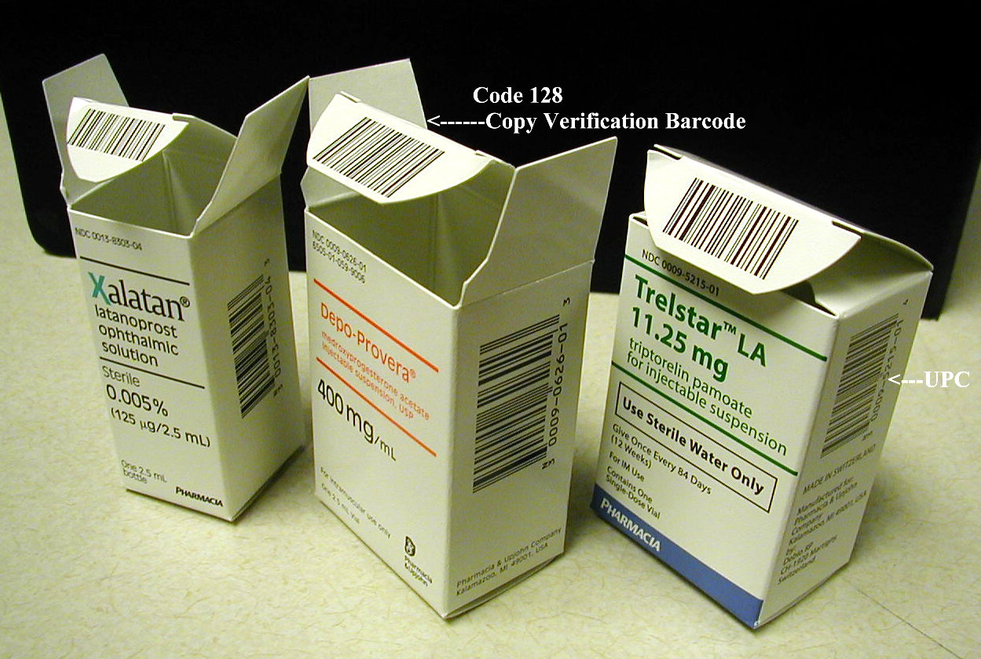
Current Use of Bar Codes on Pharmaceuticals, cont.
SKU’s including OTC products use UPC or EAN
Sometimes a second bar code may be on a container for internal label identification. This can’t be used for product tracking.

Slide 8
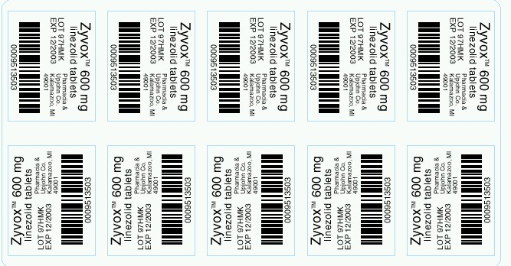
Current Use of Bar Codes on Pharmaceuticals, cont.
Some manufacturers encode the NDC in Code 128 on Blisters.

Slide 9
Current Use of Bar Codes on Pharmaceuticals, cont.
Many products don’t have space available for a UPC or a Code 128 NDC
  Samples

Slide 10
A Solution from EAN/UCC: RSS - Reduced Space Symbology
RSS is designed to encode the GTIN to fit on small labels.
GTIN, with its package application identifier, could uniquely identify different package sizes instead of different NDC numbers.
  Any database built on the 10 digit NDC number will have to be expanded to accommodate the extra digits.

Slide 11
Standard Product ID vs. Symbology
Symbology
(Bars /Spaces) data carrier
7
12345
12345
9
Standard Product ID Number-Data Content
Notes:
A visual representation symbology versus standard id

Slide 12
GTIN Assignment Methods
Item reference for higher levels of packaging
Indicator for higher levels of packaging
2880 ampoules
2880 ampoules
0 0314141 10996 C
7 0314141 12345 C
144 ampoules
0 0314141 10959 C
144 ampoules
5 0314141 12345 C
12 ampoules
0 0314141 10990 C
12 ampoules
2 0314141 12345 C
ampoule
0 0314141 10923 C
ampoule
0 0314141 12345 C
Change NDC
Indicator
Same National Drug Code
(NDC)

Slide 13
GTIN Assignment Methods, cont.
Combination of Indicator and Item reference for higher levels of packaging
2880 ampoules
4 0314141 10988 C
144 ampoules
2 0314141 10988 C
12 ampoules
0 0314141 10988 C
ampoule
0 03141 41 10923 C

Slide 14
Retail Unit and Case Must
Have A Unique GTIN
Retail Unit
Product A 18 oz.
Case
12 x Product A 18 oz.
CORRECT
3 14141 45324 C
1 03 14141 45324 C
INCORRECT
3 14141 45324 C
0 03 14141 45324 C

Slide 15
Another Solution:
Datamatrix Symbology
Because of its size it may be necessary for the smallest labels.
We would need to agree on a data format for this because it is not part of the EAN/UCC system.
Vaccine manufactures are examining Datamatrix.
It is a code that is used successfully in other industries.
It is also used for label verification.

Slide 16
Camera Readers
Camera readers are required for Datamatrix.
Many camera readers being developed now can read both RSS and Datamatrix. All of them can read the linear codes of UPC and Code 128.
Linear readers won’t read Datamatrix and only the newest ones will read RSS.
Most development has been in the hand held devices. The on-line equipment is lagging, vision systems are likely necessary.

Slide 17
Preprinting a GTIN in
RSS or Datamatrix
For preprinting a GTIN in RSS or Datamatrix the logistics are similar to preprinting a UPC.
Manufactures need the capability to produce the artwork, and to scan it for print quality.
The bar widths allowed for these codes are smaller and more difficult than UPC.
To put these codes on unit of use labels manufactures will have to phase them in to their production schedules.

Slide 18
Preprinting a GTIN in RSS or Datamatrix – Phase In
Copy changes will need to be approved.
Logistics people and printing suppliers need to be trained.
Film software needs to be integrated.
Scanners and verifiers need to be purchased.
Packaging sizes may need to be altered.
These changes may take 2-3 years.

Slide 19
Copy Change Experiences
Explanation of Complete Logo Changes
Explanation of Label Modifications
Explanation of “Rx Only” Copy Changes industry wide

Slide 20
Difficulties of Lot and Expiration Date Coding
The lot and expiration date are variable information that is printed on line.
The resolution of on-line printers does not compare with printing presses.
  Hot stamp printers can’t print bar codes.
  Thermal transfer printers are slow and may require rerouting labels.
  Ink jet and laser printers have capabilities but most of the current installations would have to be upgraded.
  Some flexographic printers have the capability on blister lines.

Slide 21
Difficulties of Lot and Expiration Date Coding, cont.
There may be line space constraints when replacing printers.
Any added on-line operation increases down time potential.
A data structure for the lot and expiration date needs to be agreed upon.
If the barcode is printed on-line, companies will need to verify correctness of each barcode printing. There are few high speed scanners available currently.

Slide 22
Difficulties of Lot and Expiration Date Coding, cont.
With these difficulties it would likely be 5 years before significant number of the bar codes could contain lot and expiration dates.
Around the table samples and explanations from Pharma members.

