Slide 1

History of Preclinical Data: Anesthetic-induced Neuroapoptosis
Anesthetics and Life Support Drugs
Advisory Committee Meeting
March 29, 2007
R. Daniel Mellon, Ph.D.
Supervisory Pharmacologist
Division of Anesthesia, Analgesia and Rheumatology Products
Center for Drug Evaluation and Research

Slide 2
Objective
Summarize published in vivo preclinical data characterizing the effects of anesthetic drugs on the developing brain.
Outline the steps taken by the Agency to further characterize the potential clinical significance of these findings.

Slide 3
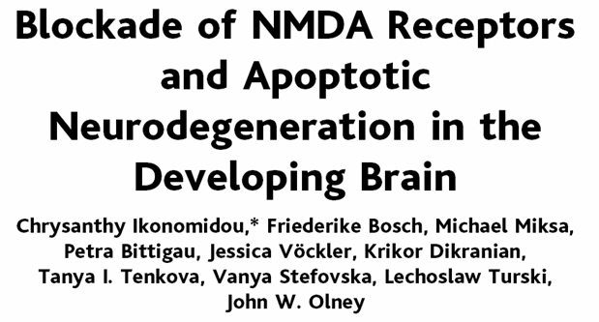
Ikonomidou et al. (1999)
Model: 7-day old rat
MK-801 (0.5 mg/kg, i.p.)
Reported findings with Ketamine (20 mg/kg, s.c. x 7 over 9 h)
Science 283: 70-74

Slide 4
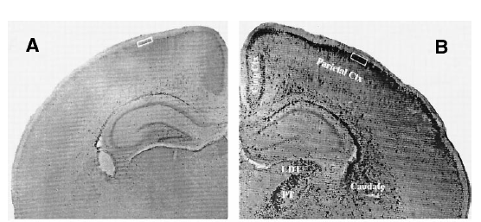
Ikonomidou et al. (1999)
Saline Treatment
MK-801 Treatment
Stained with TUNEL Method (Apoptosis)
8-Day old rats treated with (A) Vehicle or (B) MK-801 24 hours previously.
IP Injection 0.5 mg/kg single dose.
NOTED: Ketamine (20 mg/kg, sc), injected every 90 minutes, 7 injections produced similar results.

Slide 5
Origin of the FDA Investigations
In 2000, FDA raises concerns regarding proposed NIH clinical trial to study ketamine in children based on a preclinical study published in 1999 by Dr. Olney and colleagues.
Formation of an FDA-wide Expert Working Group: FDA neurotoxicologists CDER and NCTR.
Rapid Response Team: CDER’s Office of Pharmaceutical Sciences.
Research Subcommittee of the Pharmacology Toxicology Coordinating Committee (PTCC)

Slide 6
FDA Investigations (continued)
Reviewed literature on NMDA receptor system and susceptibility to neurotoxicity (Haberny et al., 2002).
Duplicated and extended the findings reported by Dr. Olney’s group in the 7-day old rat (Scallet et al., 2004).
Recommendations:
  Duplication of Dr. Olney’s findings in the rat brain support the need for studies in the nonhuman primate model.
  The rat model could be used to pursue mechanistic studies.
  CDER/NCTR would nominate ketamine to the National Toxicology Program to obtain funds to support the nonhuman primate studies.

Slide 7
Ketamine Nomination
National Toxicology Program
FDA’s nomination proposed the following general studies:
  Studies to characterize potential for ketamine to produce neurodegeneration in developing nonhuman primate.
  Behavioral assessments of nonhuman primate infants exposed to ketamine during development.
Studies unanimously approved by NTP but not funded.
These studies are currently being completed by NCTR.

Slide 8
Time Windows of Vulnerability to the Neurotoxic Effects of NMDA Receptor Antagonists for Rat
(Postulated for Monkey and Human)
Conception
Birth
Source: William Slikker, NCTR
Rats
1.5 mo
14 d
Rhesus
Monkeys
3 yr
2 mo
Humans
11 yr
3 yr
Apoptotic Neurodegeneration
No Neurodegeneration
Excitotoxic Neurodegeneration

Slide 9
Two Types of NMDA-Receptor Mediated Neurotoxicity
Neuroapoptotic Degeneration | Excitotoxic Degeneration
Developing brain | Adult brain
Cell death without necrosis | Neuronal vacuoles and eventual necrosis
Widespread in brain | Distinct brain regions
Can be physiological (example: synaptogenesis) | Always pathological (example: ischemia)

Slide 10
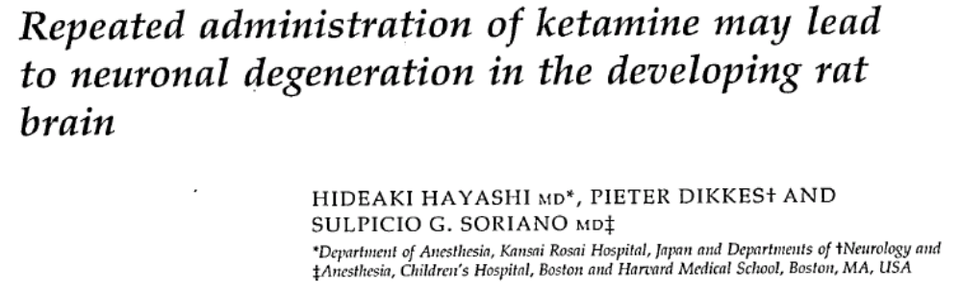
Hayashi et al. (2002)
Model: Neonatal Rat (PND 7), intraperitoneal injections, histology at 24 hours post last injection
  Saline injection
  Single dose ketamine (25, 50, 75 mg/kg, i.p.) → No neurodegeneration
  Repeated Doses (7) once every 90 minutes, 25 mg/kg Ketamine → Neurodegeneration
Paediatric Anaesthesia 12:770-774

Slide 11
Hayashi et al. (2002)
Single doses of ketamine did not produce evidence of neurodegeneration.
Confirmed that repeated doses of ketamine can produce evidence of neurodegeneration in the rat model.
Suggests that there are exposure conditions that do not produce neurodegeneration.

Slide 12
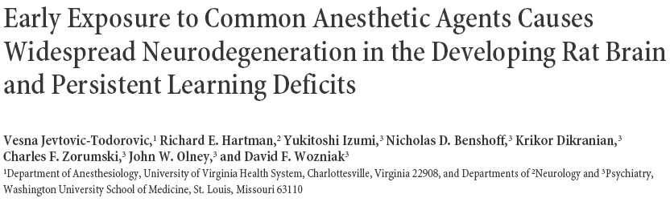
Jevtovic-Todorovic et al. (2003)
Model: Neonatal Rat (PND 7), 6 hours of anesthesia.
Anesthetic Regimen: cocktail of nitrous oxide, oxygen, isoflurane and midazolam.
Endpoints: Histopathology, behavioral testing over 160 days, and electrophysiology testing in hippocampal slices (P29-p33)
J. Neuroscience 23(3): 876-882

Slide 13
Jevtovic-Todorovic et al. (2003)
First published report to suggest that both nitrous oxide, isoflurane and midazolam can also produce neuroapoptosis in rat model.
First study to attempt to mimic the clinical anesthetic setting.
Exposure of neonatal rats to 6 hrs of “mock anesthesia” (nitrous oxide, oxygen, isoflurane, midazolam) caused:
  widespread apoptotic neurodegeneration in the developing brain,
  deficits in hippocampal synaptic function, and
  persistent memory/learning impairments.

Slide 14
The Challenge of Animal Models:
How to Extrapolate Risk to Humans?
Species Differences:
  Most sensitive species vs. most appropriate species
  Metabolism Differences
  Developmental Differences
Technical Study Design Challenges:
  How to mimic the clinical setting as closely as possible
    Concurrent medications, blood gases, nutritional support, hemodynamic stability
  How to extrapolate dose administered to clinical setting.
    Body Surface Area, pharmacokinetic comparison vs.
    Pharmacodynamic effect

Slide 15
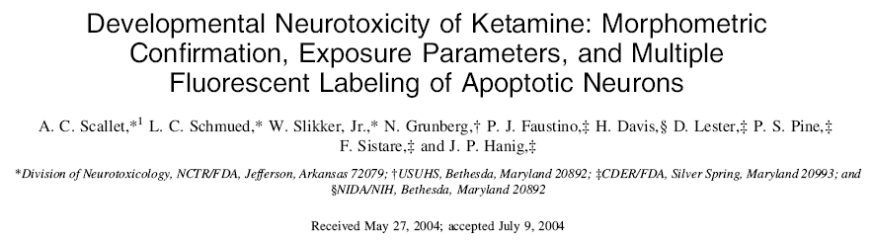
Scallet et al. (2004)
Objective: Confirm and extend results of Ikonomidou 1999 Science Paper
Model: Neonatal Rat Model (PND 7), subcutaneous injections, histology at 24 hours post last injection
    Saline injection
    Repeated Doses (7) once every 90 minutes, 10 mg/kg Ketamine
    Repeated Doses (7) once every 90 minutes, 20 mg/kg Ketamine
    Single Dose Ketamine 20 mg/kg
Toxicological Sciences 81: 364-370

Slide 16
Approximate Exposure Margin for Ketamine-induced Neuroapoptosis
Treatment | Evidence of Neuro-apoptosis | Exposure Margin¹
Ketamine 10 mg/kg x 7 | No  | ~1
Ketamine 20 mg/kg x 1 | No  | ~2.7
Ketamine 20 mg/kg x 7 | Yes  | ~7
¹ Based on reported concentrations in humans that are adequate for major surgery (2 ug/mL = “worst case scenario”).
Notes:
NCTR/FDA measured ketamine levels in the rats 2 minutes after the last dose (subcutaneous dosing)

Slide 17
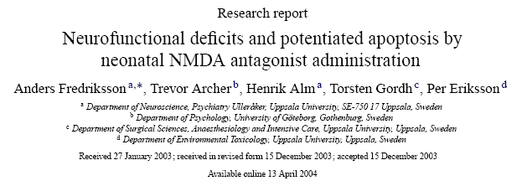
Fredriksson et al. (2004)
Model: Mouse pups, Neonatal day 10
  Ketamine (50 mg/kg, s.c.)
  Diazepam (5 mg/kg, s.c.)
  Ketamine (50 mg/kg, s.c.) + Diazepam (5 mg/kg, s.c.)
  Vehicle (0.9% Saline)
Behavior. Brain Res. 153:367-376

Slide 18
Fredriksson et al. (2004)
First report of neuroapoptosis in a second rodent species.
Ketamine and diazepam alone produced neurodegeneration in the mouse model.
Ketamine and diazepam produced different neuroanatomical patterns of neurodegeneration.
The combination of both ketamine and diazepam produced a greater degree of neurodegeneration than either drug alone.
Functional deficits noted at 2 months of age in motor activity and learning performance (ketamine and ketamine + diazepam groups).

Slide 19
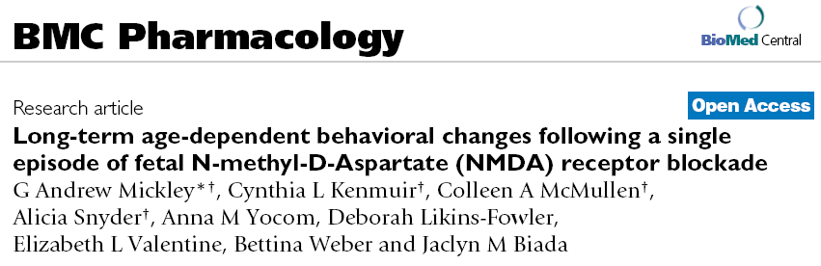
Mickley et al. (2004)
Model: Embryonic rat fetuses treated through the maternal circulation
Conditioned taste aversion (CTA) model for learning and memory.
BMC Pharm 4:28

Slide 20
Mickley et al. (2004)
E18 rat fetuses pretreated with ketamine (100 mg/kg, i.p. through maternal circulation) and taught a conditioned taste aversion (CTA) learn and remember the CTA, whereas treated of E19 fetuses with ketamine do not.
Exposure of rat fetus to ketamine in utero results in long-term behavioral deficits in the adult animal.
Data suggest that there are critical periods of gestational development in which the rat is susceptible to long-term behavioral neurotoxicity.

Slide 21
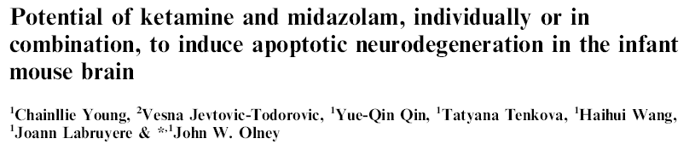
Young et al. (2005)
Model: 7-day old mouse
Ketamine 10, 20, 30, 40 mg/kg, s.c.
Midazolam 9 mg/kg, s.c.
Ketamine 40 mg/kg + Midazolam 9 mg/kg
Br. J Pharmacol. 146:189-197

Slide 22
Young et al. (2005)
Ketamine 10 mg/kg produced a slight, nonsignificant, increase in neuroapoptosis.
Ketamine at ≥ 20 mg/kg produced significant increase in neuroapoptosis and at doses between 30 mg/kg and 40 mg/kg sharp increase in neuroapoptosis.
Midazolam produced a dose-dependent increase in neuroapoptosis.
Ketamine plus midazolam produced a greater increase in neuroapoptosis than either drug alone.

Slide 23
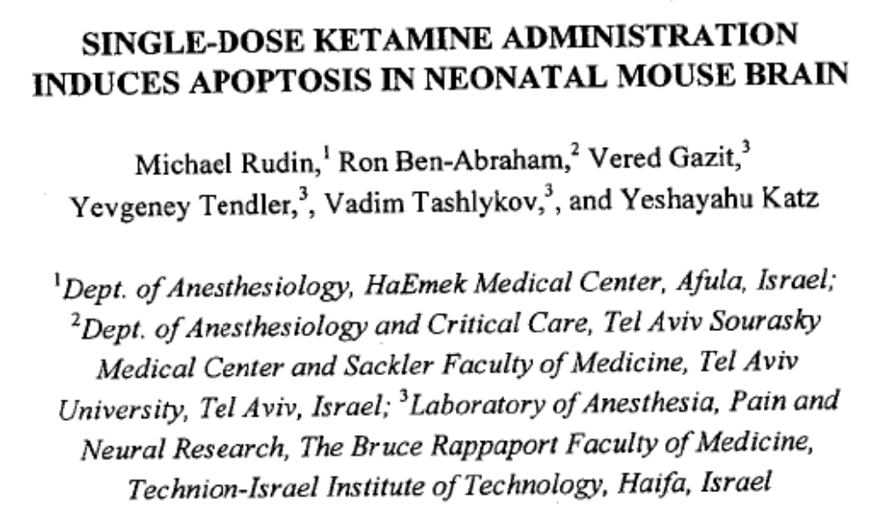
Rudin et al. (2005)
Model: 7-day old ICR mice
Ketamine (1.25, 2.5, 5, 10, 20, 40 mg/kg, s.c.)
J Basic & Clin Physiol & Pharm 16(4): 231-243

Slide 24
Rudin et al. (2005)
Ketamine produced neuroapoptosis at 5 mg/kg and above.
Neuroapoptotic neurons peaked at 72 hours after dosing but were still evident out to day 7 post treatment.
No gross neurobehavioral effects noted at day 7.

Slide 25
Slikker et al. (in press)
Ketamine-induced neurodegeneration in the perinatal rhesus monkey
  Model: Rhesus monkey (Gestational day 122 and postnatal day 5 and 35)
  Ketamine i.v. 24 hours, 6 hour withdrawal period.
  Ketamine i.v. 3 hours in postnatal day 5 animals.

Slide 26
Nonclinical Summary
Multiple anesthetic drugs:
  NMDA receptor antagonists
  GABA-ergic drugs
Multiple species
Long-term behavioral changes
Combinations of drugs
Potential means to block these effects

