Slide 1
All Experimenter’s Meeting
All Experimenter’s Meeting
Jim Morgan,
Salah Chaurize
November 21, 2005

Slide 2
Stores Summary
Store | Initial Lum. (E30) | Deliv’d Lum. (nb⁻¹) | Termination | Time (hr) | Total Pbars (E10) | Comments
4501 | 124.5 | 3,560 | Planned | 24.3 | 174.7
4506 | 64.1 | 1,765 | Planned | 15.2 | 155.0 | Large pbar losses in Main Injector
4508 | 126.4 | 2,055 | Loss of store | 6.3 | 188.9 | B11H separator spark
4514 | 124.0 | 4,220 | Planned | 26.2 | 177.6

Slide 3
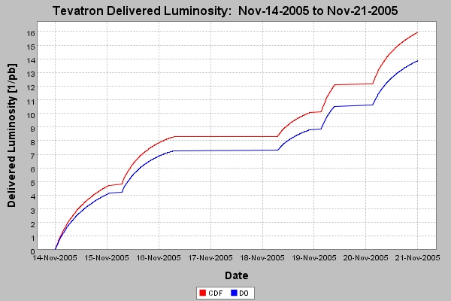
Integrated Luminosity for the week
Integrated Luminosity for the week
Safety system testing
4514
Tevatrom p.s. problems
B11H separator vacuum
Recycler RF
B1 vacuum valve
124.0E30
4508
D0 access
4506
126.4E30
64.1E30
4501
B11H separator spark
124.5E30
Tev studies
Tev studies
D0 access

Slide 4
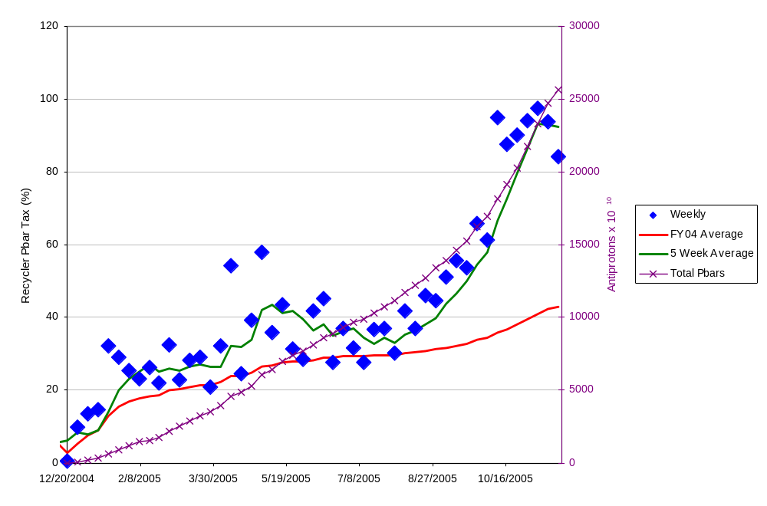
Recycler Pbar “Tax”
Recycler Pbar “Tax”

Slide 5
Pbar and Tevatron Studies
Pbar and Tevatron Studies
Pbar Studies
11/14 | 1.1 | Beamline orbit steering program
11/14 | 4.0 | Rings access to repair Debuncher BPM’s
11/17 | 0.3 | 120 GeV beamline aperture and orbit drift
11/20 | 7.0 | Reverse protons, Debuncher TBT
Tevatron Studies
11/18 | 2.6 | Driving term measurements
11/19 | 7.2 | Protons tunes above 7/12 at 150 GeV

Slide 6
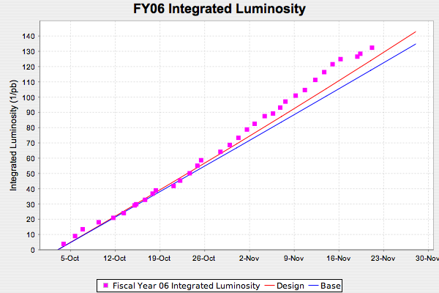
FY06 Integrated Luminosity

Slide 7
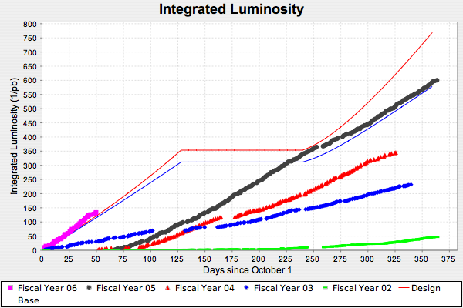
Integrated Luminosity Design

Slide 8
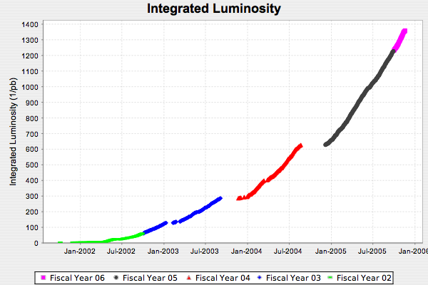
Integrated Luminosity Sequential

Slide 9
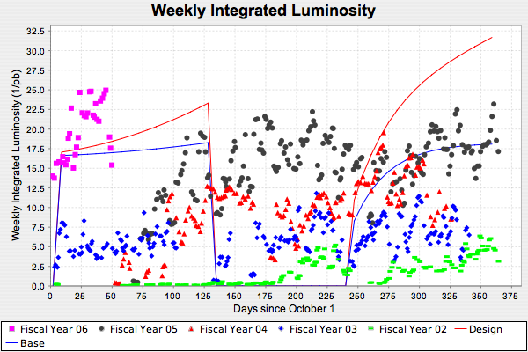
Weekly Integrated Luminosity

Slide 10
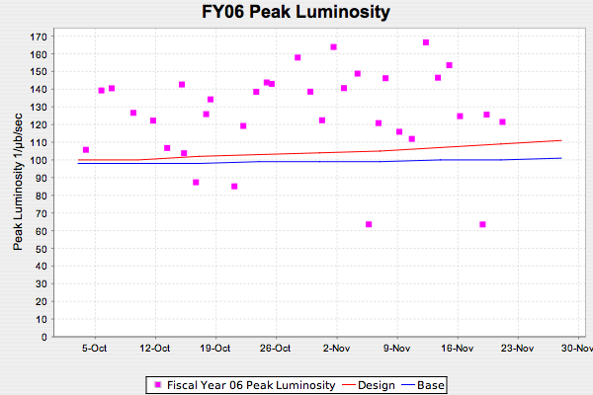
FY06 Peak Luminosity

Slide 11
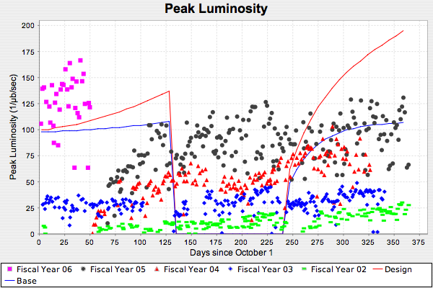
Peak Luminosity

Slide 12
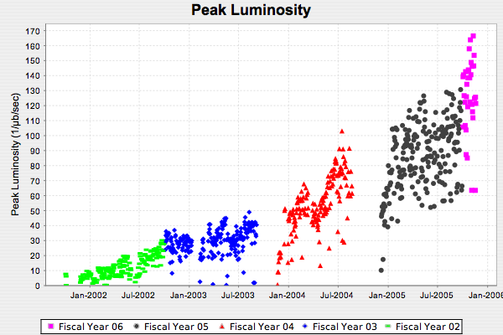
Peak Luminosity Sequential

Slide 13
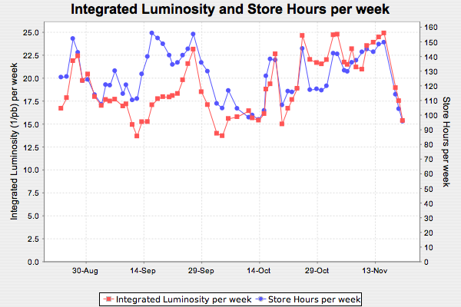
Integrated Lum Store hours/week

Slide 14
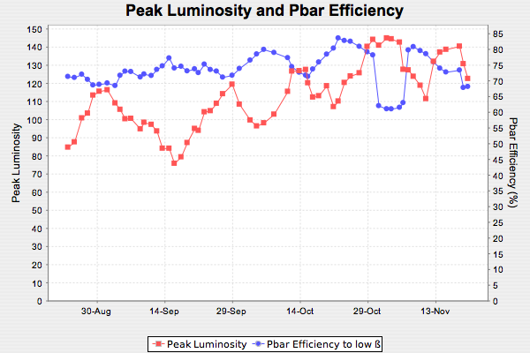
Peak luminosity and Pbar Efficiency

Slide 15
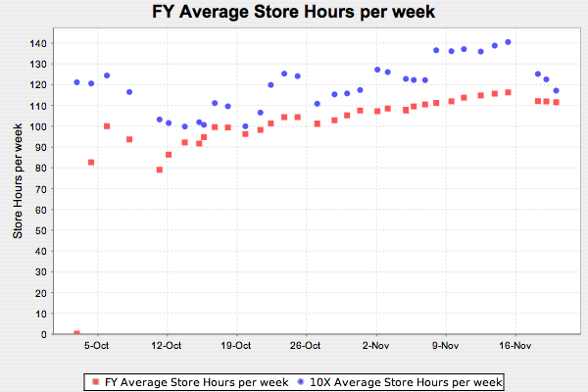
FY AvgStore Hrs/week

Slide 16
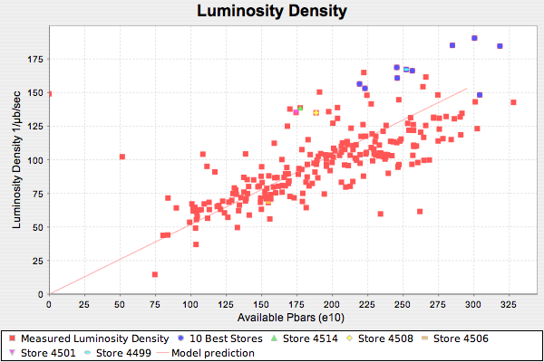
Luminosity Density

Slide 17
Plan for the week
Pbar
  Prepare plan for “1-week” study period in December
  Increase intensity on target
  AP-2 line orbits and aperture
  Debuncher lattice measurements
  Reverse proton Debuncher TBT
Recycler
  Increase typical stash size
Tevatron
  Working point above 7/12 at 150 GeV and during ramp
  Finish crystal collimator studies
  Luminosity lifetime
  D0 losses during squeeze
Proton Source
  Support slip-stacking and work on cogging
Main Injector
  2.5 MHz Dampers (pbar)
  NuMI
    Multi-batch slip-stacking
  Slip-stacking studies
    Reduce bunch length and losses
    Improve bunch rotation
  2.5MHz slow acceleration
  Mid-level RF upgrade
NuMI
  Resume stable operation
    Target station issues

