Slide 1
TIME AND ATTENDANCE
1LT Walter Wade
SSG Albert Kennedy

Slide 2
Overview
Objective & Introduction
Supervisor’s Responsibilities
Employee’s Responsibilities
Timekeeper’s Responsibilities
Recording and Reporting
Adjustments and Corrections
Questions

Slide 3
Objective & Introduction
As a supervisor, you are to understand all functionalities of time and attendance (T&A) for technician employee payroll.
The purpose for time and attendance is to ensure that the attendance (either presence or absence) of employees is accurate and reported for pay, leave, and allowances.
Notes:
The supervisor is to understand and comply with all rules and responsibilities for the employee’s pay.
The purpose of T&A is to make sure all time and attendance is true and accurate pay, whether the employee was absence on leave or working, is reported to the payroll office.

Slide 4
Supervisor’s Responsibilities
Each employee’s T&A report shall be certified correct by the supervisor or other designated authorized official.
Supervisor’s will ensure that exclusions to the employee’s normal duty hours are recorded timely and accurately.
Notes:
Each supervisor has the responsibility as the authorizing official of certifying T&A.
Any exclusion (e.g. time not work) must be known and properly recorded on the T&A report.
Approvals shall be made individually for each employee, and a handwritten or automated signature shall be provided for each time and attendance report.

Slide 5
Supervisor’s Responsibilities (cont.)
Approves or disapproves leave applications (OPM 71) in writing.
  make sure all leave taken in conjunction with TDY is recorded.
When military leave is used, ensure a copy of orders and statement of duty (performance certificate) are forwarded to the Timekeeper.
Notes:
Any advance leave granted, supervisor must be aware of the amount of advance leave to request. Employee must be in a duty status long enough to earn back leave.

Slide 6
Supervisor’s Responsibilities (cont.)
All compensatory time is approved on NGB Form 46-14 and the hours reported on the T&A report do not exceed the hours authorized.
Employees must use compensatory time within 26 pay periods after it is earned or it will be lost!
Notes:
Compensatory time is only approved for time WORKED outside the employee’s normal duty hours.

Slide 7
Supervisor’s Responsibilities (cont.)
Always be aware of the employee’s available leave balances prior to approving T&A.
- if leave is not available, this can result in loss of pay!

Slide 8
Employee’s Responsibilities
Employees will initial and/or sign on indicated areas of the T&A reports, including leave applications and other supporting documentations.
Submit all leave requests and acquiring leave approval prior to taking or earning leave.
Notes:
Make sure all leave requests and acquires are approved prior to taking leave.

Slide 9
Employee’s Responsibilities (cont.)
For every leave year, schedule all “use or lose” leave prior to the end of November.

Slide 10
Timekeeper’s Responsibilities
The timekeeping function requires the accurate and timely recording of T&A data and the maintenance of related documentation.
Timekeepers may be appointed as civilian, military or contractor personnel.
- a DD577 form is required and submitted to USPFO.
Notes:
A DD 577 forms is required

Slide 11
Timekeeper’s Responsibilities (cont.)
Normally, timekeeping accountability should not be assigned to individuals who cannot actually observe technician’s attendance and absence each day.
Maintains files of T&A documents for six years to include compensatory time requests, military leave certifications and orders, and any other relevant leave information.

Slide 12
Recording and Reporting
The time period shown on T&A reports shall correspond to the length of a pay period.
Any charges of leave or accrues (comp time) shall indicate clearly the actual day and time on the T&A report.
Notes:
If a payment is made for a 2-week period, the T&A report shall cover a 2-week period of days.
A scheduled shall be established and recorded showing start and end times of the days for each employee.

Slide 13
Recording and Reporting (cont.)
Ensure daily entries for leave charges using the correct code in the TYPE HOUR field and record number of hours in the HOURS field.
When coding T&A reports in increments of quarter hours, code as:
      15 Minutes = .25
      30 Minutes = .50
      45 Minutes = .75

Slide 14
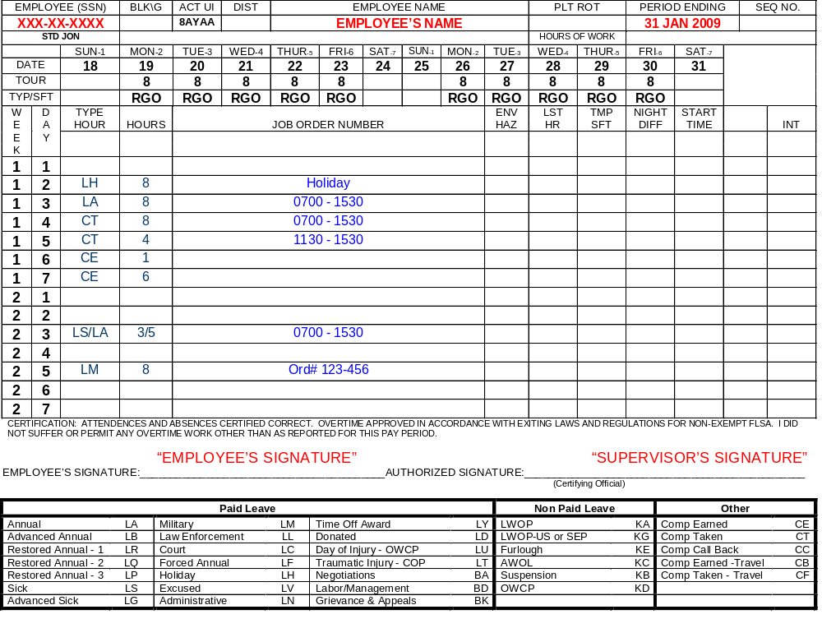
UPDATE CALENDAR DATES EVERY PAY PERIOD
Default work schedule DO NOT CHANGE!
If no comp time was earned or leave was taken for the pay period, DO NOT FILL IN.

Slide 15
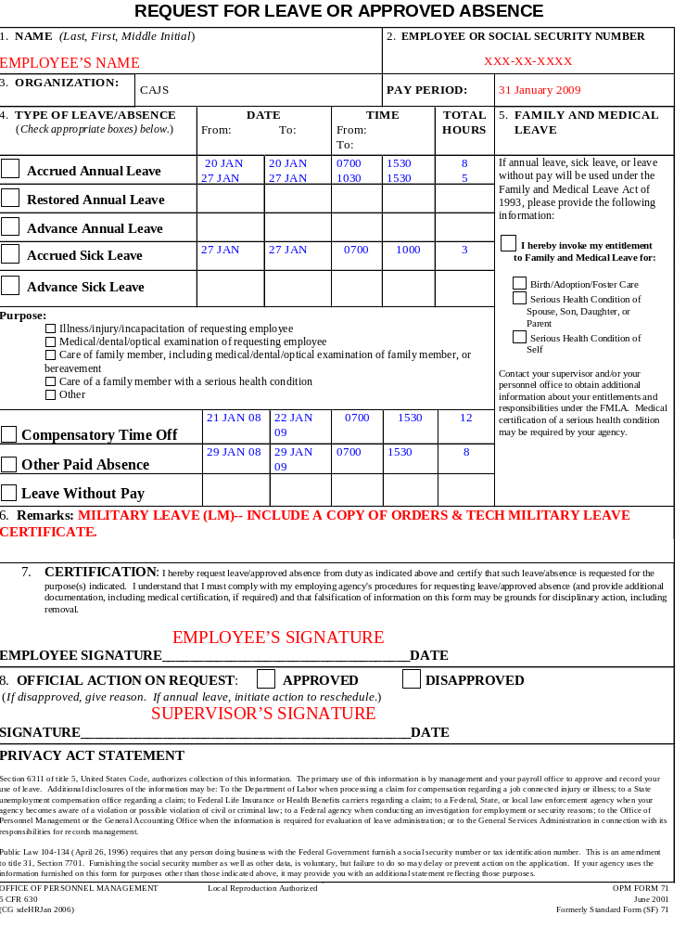

Slide 16
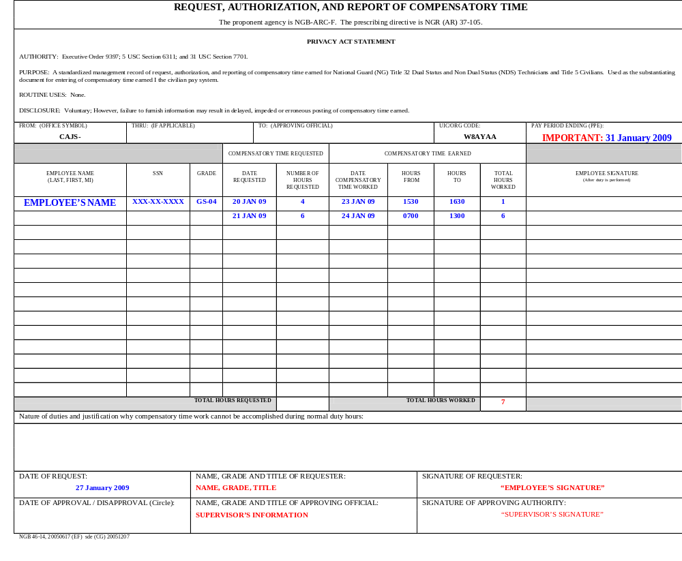
ORIGINAL REQUEST WAS 4 HOURS, BUT ONLY 1 HOUR WAS WORKED
6 HOURS WERE REQUESTED, AND 6 HOURS WERE WORKED
TOTAL HOURS WORKED

Slide 17
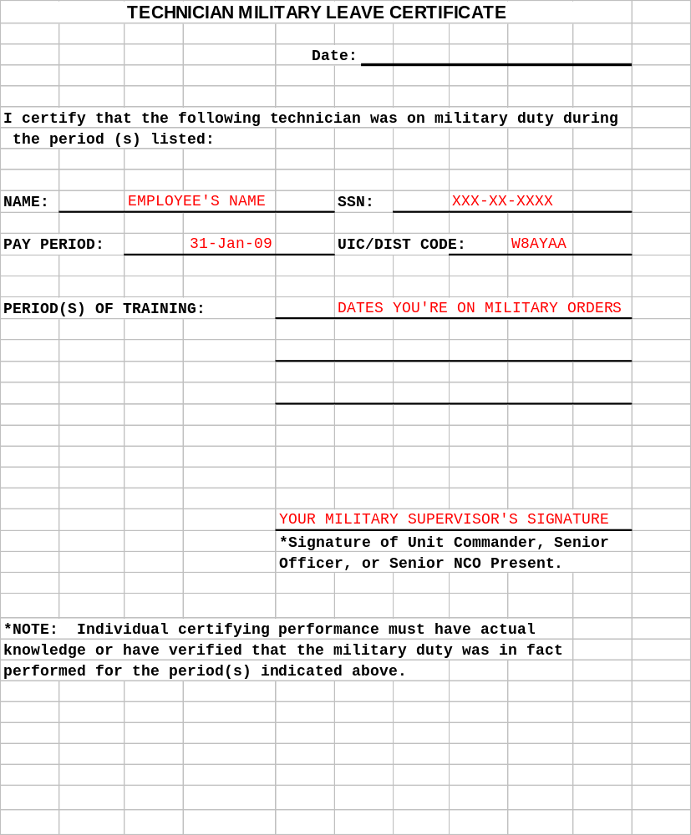
This is a required document when in military duty status

Slide 18
Adjustments and Corrections
If the T&A for the current pay period has been processed and a change is required, then the supervisor shall certify an adjusted T&A report to submit to timekeeper with corrections.

Slide 19
Adjustments and Corrections (cont.)
Any adjustments made after payroll has been process, will reflect on the next following pay period.

Slide 20
QUESTIONS?

