Slide 1
Regional Goods Movement Study for the San Francisco Bay Area
  presented by
  Cambridge Systematics, Inc.
  with
  Hausrath Economics Group
  The Tioga Group
  Dowling Associates
  February 25, 2003

Slide 2
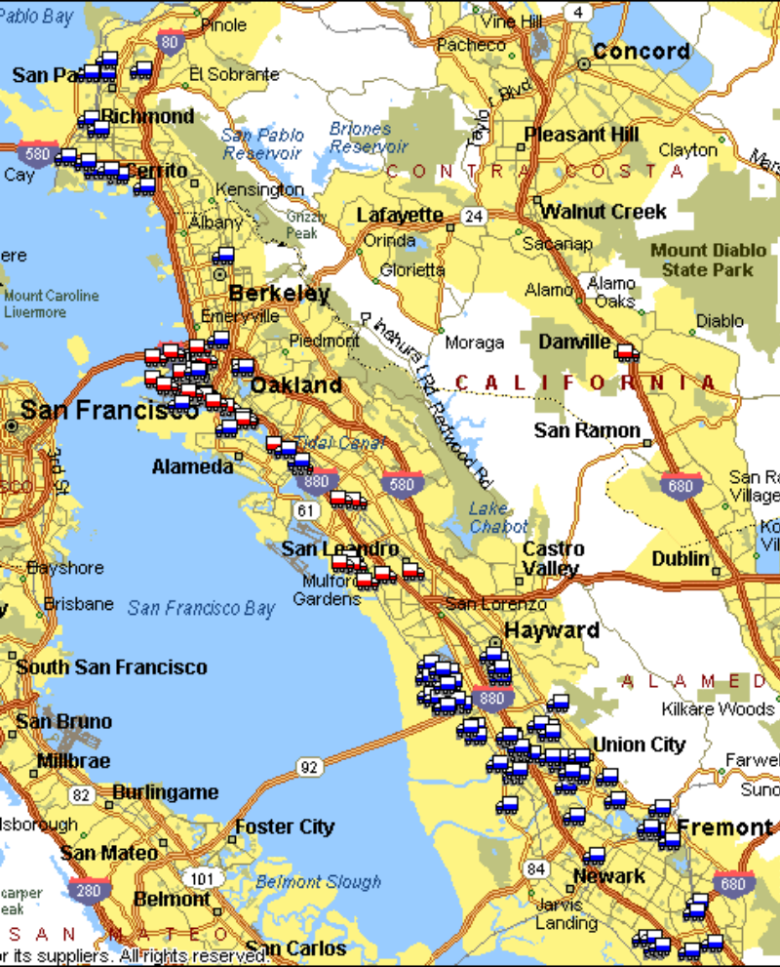
All Businesses/Consumers Rely on Goods Movement, But What are Economic Hot Buttons?
Goods movement businesses (carriers, warehouse/DC, logistics services)
  Jobs/communities impacted
  (880 corridor, South SF)
  Trends affecting location (Safeway example)
  Opportunities for value and job growth (value-added distribution)
Significant industries where transportation affects location

Slide 3
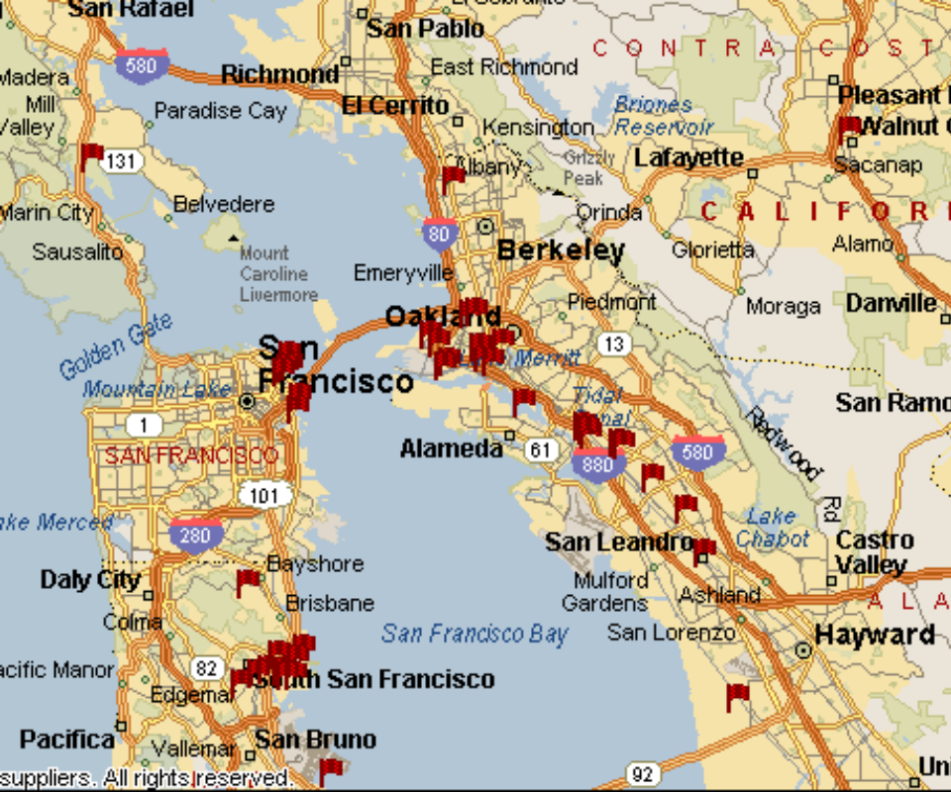
All Businesses/Consumers Rely on Goods Movement, But What are Economic Hot Buttons?
Trade
  Unique features of Bay Area Ports
  Competitive issues
  Growth in air cargo

Slide 4
How Should MTC Allocate Funds to Goods Movement?
Most RTP funds are already planned or programmed
  How do freight needs overlap with passenger needs?
  New revenue opportunities
RTP emphasizes maintenance and operations
  Traffic operations for freight (I-880 Corridor example)
  Private sector solutions (FedEx staging in South SF)
  Public/private ITS solutions (Synchro Met example)
  Innovative modal services (CIRIS, Napa/Solano rail)
Look at goods movement system through eyes of the users
  Market segments (long haul, parcel, construction, drayage, etc.)
  Customer requirements (timing, equipment choices)
Notes:
There is very little discretionary money left. On the highway side, many of the freight hot spots are same as passenger. An important part of the process is identifying the overlap in order to impact priorities.
Many people look to freight as a source of new revenue for improvements. Need to develop B/C techniques in order to examine the real opportunities (e.g., the truck lane example in Southern California)
RTP emphasize operations. There are some significant operations problems in and around major freight centers. The private sector is already doing a lot. There are ITS option and innovative multi-modal solutions
Need to describe the different segments of the freight industry and point out that there choice of routes, time of day, types of equipment are customer driven. Some of the solutions that people think about don’t mesh well with the customer drivers.

Slide 5
Reauthorization and Statewide Policy Issues
Freight funding
  User fees
  Gateway funding
Funding for rail investments (e.g., rail shuttle projects, public-private)
  AASHTO Rail Freight Bottom Line, Mid-Atlantic Rail
Project earmarking – Where is the competition?
Global Gateways and ITIP Funding
Notes:
This slide summarizes just a few of the key issues coming up at the federal and state level. Emphasize our roles in reauthorization (both public and private sector)

Slide 6
Overview of the Team
Cambridge Systematics, Inc.
Project Management
Freight Data
Freight and Economic Development
Freight Policy
Key Staff: Michael Fischer, Project Manager
Christopher Wornum, Principal-in-Charge
The Tioga Group
Hausrath Economics Group
Dowling Associates
Industry Knowledge
Trucking, Ports and Rail
Logistics Trends
Land Use
Economic and Community Development
Traffic Operations
Transportation Engineering
Key Staff: Dan Smith,
Steve Nieman
Key Staff: Linda Hausrath
Key Staff: Mark Bowman

Slide 7
Overview of Approach
Phase I
Phase II
Task 1. Develop Detailed Work Plan
Task 1. Stakeholder Interviews and Issue Identification
Task 3. Cluster and
Economic Impact Analysis
Task 2. Data
Reconnaissance
and Trend Analysis
Task 6. Initial Stakeholder Interviews
Task 2. Assessment of Issues and Strategies
Task 4. Land Use
and Community Impact Analysis
Task 5. TEA-21 Reauthorization
Task 3.
Final Report
Task 7. Phase 1
Report

Slide 8
Freight Transportation System Data and Trends
Traffic Flows
Trucks, Planes, Rail Cars . . .
Freight Infrastructure
Highways, Rail Lines, Ports, Access Roads . . .
Ownership, Regulation, Pricing . . .
Organization and Public Policy
Industry Logistics Patterns
Supply Chains, Distribution Networks
Economic Structure
Type of Businesses, Number of Households
Notes:
Economic Structure – Key trade relationships. Both their economic and geographic dimension. What are the local, national, and international economic factors that will drive demand for goods movement.
Industry Logistics Patterns –How do supply chains and distribution patterns work for the key industries. How do they create customer requirements that drive decisions. Factors such as location of DCs, order rates and time sensitivity, transport/inventory cost tradeoffs. What are the key technology trends.
Goods Movement Infrastructure -- Gather the maps and data on all the key elements and those characteristics that affect service.
Traffic Flows – Commodity data, traffic data, trips

Slide 9
The Goods Movement Industry
Highway Infrastructure and Truck Operations
Warehousing
and Distribution
Air Freight and
Parcel/Express
Manufacturing
Truck Fleet
Operations and
Support Industries
Commercial
Trucking
Containerized
Ocean Shipping
Railroad and
Intermodal Transportation
Notes:
I want to try to describe the types of industries and sub-regional importance of the goods movement cluster. I’d also like to describe our overall approach to cluster analysis since it may not have been clear in the prop.

Slide 10
Economic Impacts and Clusters – Goods Movement Dependent Industries
Supporting Infrastructure
Industry
Clusters
Supporting
Industries
Supporting
Industries
Supporting Industries
Notes:
Here I want to introduce the idea that we are going to screen for economically significant industries that use a lot of transportation. Again, need to flesh out our approach.

Slide 11
Infrastructure and Business Environment
Tax and Regulatory
Environment
Other
Infrastructure
Water and Sewer
Education
Power
Transportation
Investments
Transit
Freight
Highways
Housing and
Quality of Life
Affordability
Crime
Public Amenities
Labor Force
Wage Rates
Skill Level
Activism
Collateral
Activities
Business Attraction
Private Investment
Job Training

Slide 12


Interregional, Interstate, and International Transportation Needs for Key Industries
Agriculture/Forestry
Manufacturing
Distribution
High-Tech
Construction
Health Care
Tourism
Military
Less Important
More Important
Notes:
I want to try to describe the types of industries and sub-regional importance of the goods movement cluster. I’d also like to describe our overall approach to cluster analysis since it may not have been clear in the prop.

Slide 13
Land Use and Community Impacts
Impacts of economy and real estate market on location of goods movement industry
Community attitudes and local land use policy
Tax base advantages from switching land out of transportation uses
Future development patterns and goods movement industry
Notes:
Just want to describe a few of the key issues that have already emerged in other studies. Some anecdotes from the Port Services Location Study would be helpful

Slide 14
Stakeholder Interviews and Issues
Stakeholder groups
  CTA, commercial truckers, private fleet owners
  Port/airport, ocean carriers, terminal operators, air cargo operators
  Class I and shortline railroads
  Local electeds and planners
  Shippers
  Warehousing and distribution industry
Issue areas
  Infrastructure needs
  Operational problems
  Land use and regulatory issues
  Institutional/Governance
  Funding and Finance
Notes:
The main point I want to make here is that we know the stakeholders and can engage them and that we have a good idea of what some of the key issues are. This would be a good place to put in some technical nuggets about operational problems in specific Bay Area corridors. Ideas from anyone on the team will be helpful.

Slide 15
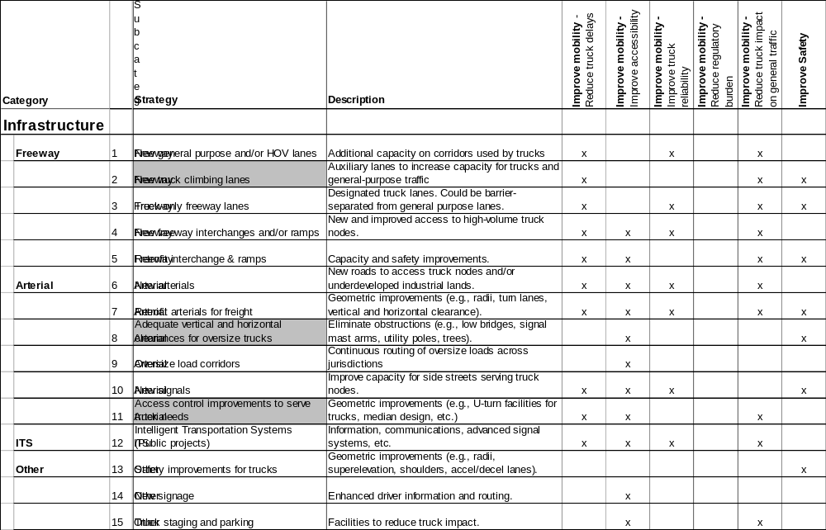
Assessing Issues and Strategies/Solutions
Develop solutions and compile evaluative information
Relate solutions to implementation issues and likelihood of success
Construct performance measures where possible
Conduct workshop/charette
Notes:
I’d like to describe the method and show how we used it effectively in Puget Sound Region. I’d also like to use this slide to emphasize that many of the critical roadway capacity issues are well documented and the solutions are already in the TIP.
This study can maybe bring the national implications of some of these to the forefront for use in reauthorization lobbying.
Start focusing on some non-traditional strategies that are multi-modal

Slide 16
Related Goods Movement Studies

Slide 17
National Efforts with Regional Significance
National Cooperative Highway Research Projects
  8-39 – Financing and Improving Land Access to U.S. Cargo Hubs
  8-42 – Freight Movement by Rail, Impacts and Opportunities
  8-43 – Methods for Forecasting Statewide Freight Movements and Related Performance Measures
  8-36(A), Task 33 – Best Practices for Statewide Freight Planning
AASHTO Freight Rail Bottom Line Report
U.S. Chamber of Commerce, Port and Intermodal Access Needs

Slide 18
National Efforts with Regional Significance (cont.)
FHWA
  Freight Analysis Framework
  Freight Professional Capacity Building
  NHS Connector Study
Transportation Security Agency, Operation Safe Commerce
TEA-21 Reauthorization

Slide 19
Statewide Studies/Programs
Global Gateways Development Program
State Rail Plan
  Freight Rail Plan
Freight Movement Cost Benefit Study
ITMS Statewide Freight Forecast

Slide 20
Northern California – Representative Completed Studies
MTC/BCDC Cargo Forecast Update
MTC I-880 Corridor Truck Access Study
Port of Oakland CIRIS White Paper
San Joaquin Valley Goods Movement Study, Phase I
Central Stanislaus Freight Study
BCDC Bulk Cargo Forecast
Oakland Port Services Location Study

Slide 21
Northern California – Representative Ongoing Studies
San Joaquin Valley Goods Movement Study, Phase II
Port of Oakland/Caltrans/SJ Valley COGs CIRIS Market Feasibility Study
Port of Stockton Rail Shuttle Study
SJ COG Inland Port Study
Napa/Solano County Passenger and Freight Rail Study
Alameda CMA North I-880 Operations and Safety Study

Slide 22
Southern California Goods Movement Studies
Alameda Corridor
SCAG Goods Movement White Paper
MTA/SCAG/Caltrans/FHWA Southern California Goods Movement Case Study
SCAG Heavy Duty Truck Model
Sub-Regional Goods Movement Studies
Rail Capacity/Truck-Rail Diversion Studies

Slide 23
Southern California Goods Movement Studies (cont.)
Truck Lanes/Corridor Studies
  SR-60 Truck Lane Feasibility Study
  I-710 Major Corridor Study
  I-15 Corridor Study

Slide 24
TEA-21 Reauthorization

Slide 25
The $64 Million Question – What Will the New Surface Transportation Bill Hold in Store for Ports and Freight Transportation?
Some themes are emerging
  Freight transportation will see increased emphasis
  The effort to create options for public-private partnerships will require creative approaches to financing
  Multimodal freight interests will still be viewed with suspicion by traditional highway lobbies – but there is hope!

Slide 26
What Stakeholders Said in FHWA Outreach
Solutions will involve new capacity coupled with improved operation
Improve intermodal connections to enhance connectivity, interoperability
Improve state and MPO planning and financing mechanisms for freight
Support multi-state coalitions to deal with corridor and regional trade/transportation issues
Better enable public/private financing and other innovative finance approaches for freight
More federal leadership needed given multiple modes, jurisdictions, private stakeholders, international considerations, and national security implications

Slide 27
Some Perspectives on Funding
Basic funding categories/revenue sources and funding structure unlikely to change
  Highway Trust Fund
  Apportionment categories
  Discretionary earmarks

Slide 28
Some Perspectives on Funding (cont.)
Some new funding sources may be proposed by stakeholders
  Indexing gas tax
  Recovery of ethanol tax exemptions
  National Transportation Finance Corporation
How will freight projects get more money?
  Discretionary projects
  New funding categories (e.g., set asides) – Affects existing apportionments
  Changing eligibility rules (e.g., broaden STP eligibility, modify TIFIA, add gateways to Sec. 1118/1119)
  Changes in planning process – More effectively compete for existing funds

Slide 29
Freight Reauthorization Ideas
Improve Freight Financing
  Flexibility for intermodal freight in existing Fed-aid programs (e.g., CMAQ, STP)
  Innovative Finance (e.g., TIFIA for freight)
  More emphasis on NHS intermodal connectors
  Expand Borders/Corridors to include Gateways/Hubs
Improve State/MPO freight planning, including public/private collaboration
Improve data and analytical tools
Need freight professional capacity building
Focus on Operations/Technology/Security
Notes:
As the results from our conferences become available, here is a summary of the Freight Finance meeting.
Freight Finance is a large challenge. The first DOT freight outreach conference was conducted in St. Louis Apr. 29-May 1 resulted in a number of recommendations for possible funding mechanisms for freight projects in the future. They include both changes in eligibility of existing programs and new programs or revenue sources.
The conference materials are being posted to our website.

