Slide 1
Building a World-Class Project Management Organization
Michael G. Martin, PMP

Slide 2
Purpose
To help you better understand the perception organizations currently have towards the value of project management and to identify the key elements required to build a “world-class” project management organization.

Slide 3
What is meant by “world-class”?
According to Webster’s Dictionary “world-class” is defined as:
  “Of the highest class, as in international competition.”

Slide 4
Elements of a “world-class” organization
Right Resources
Standard Tools and Templates
Methodology
Training

Slide 5
PM Survey - Background
135 respondents
Survey consisted of 51 questions, organized into the following sections: 1/
    Company
    General scope
    Organization
    PMO maturity
    Training & certification
    Results
    Methodology
    Compliance & Monitoring
    Portfolio Management & Reporting
    Costs & Activity
    Future
    1/ KPMG Annual Program/Project Management Survey - 2002

Slide 6
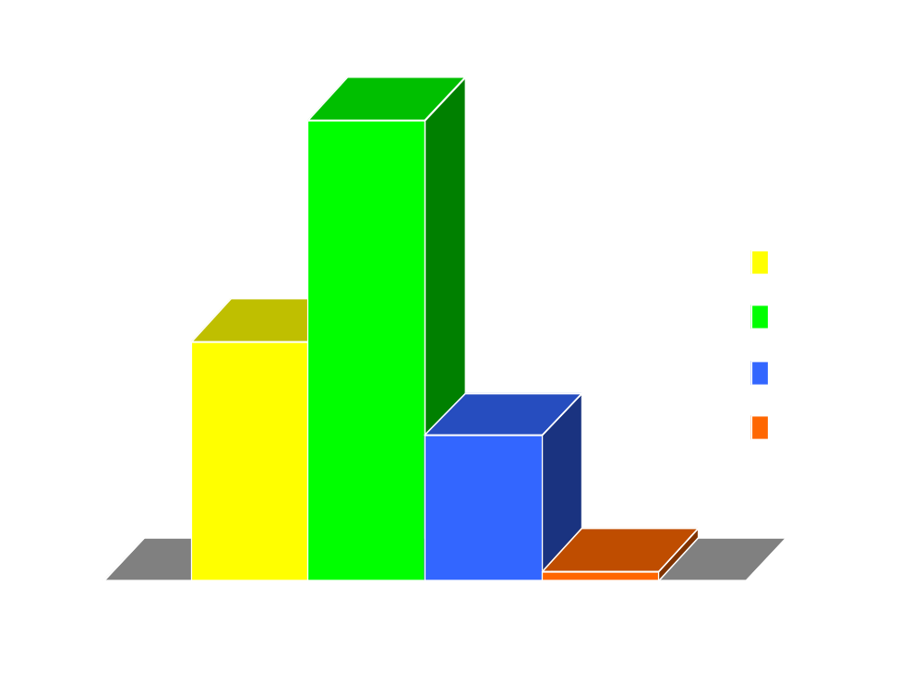
PM Survey - Background
Global Participation: 1/
  54% of respondents were from Europe
  28% were from the Americas
  17% were from Africa
  1% were from Australia
Notes:
Organization Size:
54% had less than $1B in annual revenues;
46% had $1B or more in annual revenues;
13% had $10B or more in annual revenues.
FS: Financial Services
CM: Consumer Markets
ICE: Information, Communications, & Electronics
IM: Industrial Markets
PS: Public Services
HC: Health Care

Slide 7

PM Survey - Background
Response by Industry: 1/
  52% or respondents were Financial Service organizations
  14% were from Consumer Market organizations
  12% were from Information, Communications & Electronics organizations
  11% were from Industrial Markets organizations
  9% were from Public Service organizations
  2% represented Health Care

Slide 8
One Consistent Theme
Disciplined Program/Project Management is the next wave of untapped productivity gain for organizations. Better tools, methodologies, accountability, tracking, training, and enterprise wide communication are critical to achieving the expected benefits of our business initiatives. Real maturity and its inherent competitive edge will come from moving these disciplines from the project office to the hearts, minds and desktops of every employee.

Slide 9
Key Elements of Building a “world-class” PM Organization
  Project/Program Management Office (PMO)
    Right Resources - Passion
    Baseline current state
Notes:
81% of respondents used a homegrown methodology
70% use MS Project® and 34% use web based tools
Web tool users rated their tools more effective than non-web tool users

Slide 10
Program/Project Management Office
Baseline the current state in order to measure success
Findings on the value of the PMO: 1/
  Having a PMO in place was critical to project success
  Average PMO managed 83 projects, with a total value of $101 million
  Average cost of mature PMO’s (8 or more years) was 2% of the total project portfolio versus 3% for immature
  90% stated most important function was tracking & reporting – communications and standards a close second
Notes:
PMOs report to:
20% reported to the CEO or equivalent;
37% reported to the Executive VP;
23% reported to a Vice President;
20% reported lower in their organization.
PMOs staff size:
Organizations larger than $10B had an average of 44 personnel;
Organizations > $1B and < $10B had an average of 39 personnel;
Organizations smaller than $1B had an average of 12 personnel.

Slide 11
Program/Project Management Office (Cont’d.)
  98% of mature PMO’s reported all successful projects
  60% of PMO staffs had > 5 years PM experience
  PMO Staff Size:
    >$10 Billion – avg. 44 personnel
    >$1 Billion and <$10 Billion – avg. 39 personnel
    <$1 Billion – avg. 12 personnel
  80% of successful projects occurred in PMO’s with stringent compliance
  56% of the PMO’s had failed projects within the past 12 months, with an average loss of $11.6 million

Slide 12
Key Elements of Building a “world-class” PM Organization
  Project/Program Management Office (PMO)
    Right Resources - Passion
    Baseline current state
  Senior Executive Support
Notes:
81% of respondents used a homegrown methodology
70% use MS Project® and 34% use web based tools
Web tool users rated their tools more effective than non-web tool users

Slide 13
Senior Executive Support
  Mature PMO’s (8 or more years) predominately reported to CEO, rather than to an executive or oversight committee
  80% of the PMO’s reported to a Vice President or higher
  87% stated that senior management valued the PMO 1/
Notes:
PMOs report to:
20% reported to the CEO or equivalent;
37% reported to the Executive VP;
23% reported to a Vice President;
20% reported lower in their organization.
PMOs staff size:
Organizations larger than $10B had an average of 44 personnel;
Organizations > $1B and < $10B had an average of 39 personnel;
Organizations smaller than $1B had an average of 12 personnel.

Slide 14
Key Elements of Building a “world-class” PM Organization
  Project/Program Management Office (PMO)
    Passion
    Baseline current state
  Senior Executive Support
  PM Methodology
    K.I.S.S
Notes:
81% of respondents used a homegrown methodology
70% use MS Project® and 34% use web based tools
Web tool users rated their tools more effective than non-web tool users

Slide 15
Methodology
Keep it simple and straight forward
Provides a roadmap or framework for managing projects
Builds consistency throughout the organization
Supported by standard tools and templates
Methodology used by PMO’s: 1/
  81% used a homegrown methodology
  15% used a PMBOK® based methodology
  4% used other methodologies

Slide 16
Martin’s Cone of Team Cohesion™
Common
Understanding
/ Clearly
Defined
Team
Unity
Maximum
P
T
R
E
O
A
J
M
E
C
C
T
O
O
H
B
E
J
S
E
I
C
V
T
E
I
N
V
E
E
S
S
S
TM
TM
TM
TM
TM
Unclear /
Loosely Defined
TM
TM
Minimal
(Individualism)
TM
TM
TM
TM
TM: Team Members

Slide 17
Key Elements of Building a “world-class” PM Organization
  Project/Program Management Office (PMO)
    Passion
    Baseline current state
  Senior Executive Support
  PM Methodology
    K.I.S.S
  PM Competency Model and Training
Notes:
81% of respondents used a homegrown methodology
70% use MS Project® and 34% use web based tools
Web tool users rated their tools more effective than non-web tool users

Slide 18
Training
Develop a competency model or career path to support the training curriculum
Customize training specific to the methodology and organization
PMO Training: 1/
  Only 65% reported being trained in their discipline
  49% had a curriculum to follow to achieve training goals
  PMO personnel averaged 40 hours of training per year

Slide 19
Value of Certification
Value of PMP Certification in the PMO: 1/
  2% reported all personnel within the PMO were certified
  4% reported most personnel were certified
  22% reported some personnel certified
  72% said no personnel were certified
  Only 39% Valued PMI Certification
Other valuable professional organizations/certifications: 1/
    Prince2
    IEEE
    Six Sigma

Slide 20
Key Elements of Building a “world-class” PM Organization
  Project/Program Management Office (PMO)
    Passion
    Baseline current state
  Senior Executive Support
  PM Methodology
    K.I.S.S
  PM Competency Model and Training
  Supporting Tools
Notes:
81% of respondents used a homegrown methodology
70% use MS Project® and 34% use web based tools
Web tool users rated their tools more effective than non-web tool users

Slide 21
Supporting Tools
Tools should be used to support the methodology and make it more efficient and productive
Most important tools used by the PMO: 1/
  MS Office Suite
  MS Project
  Time recording applications
Value of technology tools: 1/
  21% said high, very effective
  73% said o.k., fairly effective
  6% said poor, not effective

Slide 22
Summary of Findings
Reasons for Failure: 1/
  Lack of sponsor’s involvement
  Poor scope management
  Poor planning
  Poor change management – compliance with the process, lack of understanding
  Ambitious commitment to deliver in restricted timescale

Slide 23
Summary of Findings
Reasons for Failure (cont’d.):
  Contention over resources
  Poor communication between IT & the business
  Misalignment of strategy
  Quality of code delivered by software vendor

Slide 24
Summary of Findings
Most Important Measure of Success: 1/
  21% said On-time projects
  9% said On-budget projects
  46% said projects meeting business case expectations
  24% gave all three measures equal weighting

Slide 25
Summary of Findings
Reasons for Success: 1/
  Clarity of scope
  Clear understanding of requirements at start
  Executive sponsorship and commitment
  Management of shareholders expectations
  Project transparency and regular reporting
  Issues resolution

Slide 26
Summary of Findings
Reasons for Success (cont’d.):
  Small controllable projects
  Teamwork and leadership
  Experienced / capable staff
  Quality control
  Common goals

Slide 27
Questions & Answers

Slide 28
Thank You!
Michael G. Martin, PMP
President
M2 Consulting Group, Ltd.
(404) 915-0671
E-Mail: MGM@M2ConsultingGroup.com

Slide 29
Michael G. Martin, PMP
  Michael is a Senior Manager with KPMG, LLP’s Project Risk Management (PRM) group and author of the recently released book titled Delivering Project Excellence with The Statement of Work [Management Concepts, Inc. - 2003]. He has over 18 years of program and project management experience in the information technology and construction industries. During his career he has been instrumental in helping organizations in both the public and private sector achieve excellence in program and project management worldwide.
  A certified project management professional (PMP), he has authored numerous articles and papers on project management and is a frequent speaker to professional organizations, companies, and universities on the topic. He is past chair of the Project Management Institute’s (PMI’s) Georgia Chapter and past member of the PMI Research Membership Advisory Group. Michael holds an MBA from the University of North Florida and a BS in Civil Engineering from West Virginia Tech.

