Slide 1
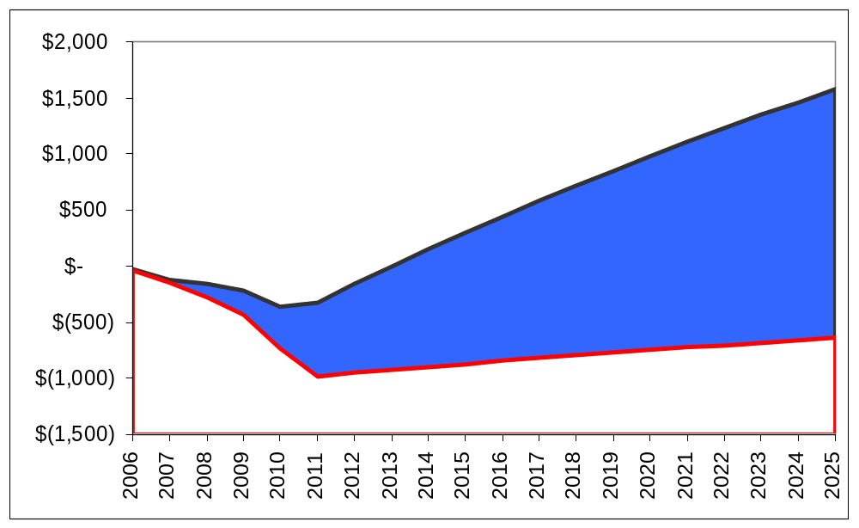
COBRA NPV Comparison
The Navy’s COBRA run for Scenario DON-0033B understates one-time costs by $441.8 million and overstates total savings by $2.2 billion through 2025. The Connecticut corrected COBRA run shows that the NPV for DON-0033B is actually a cost of $641 million, not the savings of $1.6 billion proposed by the Navy. Recurring savings are an immaterial $35 million a year rather than the Navy’s $193 million. The corrected COBRA run shows that scenario DON-0033B does not break even for “100+ years.”
Overstated Savings
$1.6 Billion
Navy COBRA
= $2.2
Billion
(Cost) / Savings
Understated Costs - $641 Million
Connecticut COBRA
COBRA
Break-Even
“100+ years”

