Slide 1
Furan: Mechanisms of Formation and Levels in Food
Don S. Forsyth, Adam Becalski, Valerie Casey, Steve Seaman,Karen Pepper and Samuel Ben Rejeb, Food Research Division, Bureau of Chemical Safety, Food Directorate, Health Canada

Slide 2
Background
Late March, 2004- Health Canada informed of US FDA investigation of furan in canned and bottled food commodities
Furan has been shown to be carcinogenic in mice and rats, classified as “possibly carcinogenic to humans” (Group 2B) by IARC in 1995
Although furan is used in industrial processes the likely source was considered to be formation during food processing
April, 2004- Health Canada commenced method development for study of mechanism(s) of formation and survey of Canadian food products

Slide 3
Furans in Foods
Furan derivatives have been reported in a wide variety of foods and are a significant flavour and odour component in coffee, cocoa, and various cooked meat products
Furan has been found in coffee, canned beef, sodium caseinate, soy and rapeseed protein and caramel

Slide 4
Possible Mechanisms of Formation
Thermal degradation of carbohydrates (Maillard reaction)
Thermal oxidation of lipid
Decomposition of ascorbic acid or its derivatives

Slide 5
Effect of Canned Beef Formulation and Processing Time on Furan Levels (Persson and von Sydow 1974)
Formulation | Processing Time (min at 121°C) |  | Furan (ng/g)
79.3% beef, 20% H₂O, 0.7% NaCl |  | 15 | 930
 |  | 30 | 750
 |  | 45 | 760
 |  | 60 | 960
 |  | 75 | 870
66.3% beef, 13% fat, 20% H₂O, 0.7% NaCl |  | 30 | 3700
74.3% beef, 5% carbohydrate, 20% H₂O, 0.7% NaCl |  | 30 | 670
61.3% beef, 13% fat, 5% carbohydrate, 20% H₂O, 0.7% NaCl |  | 15 | 2800
 |  | 30 | 3900
 |  | 45 | 3700
 |  | 60 | 980
 |  | 75 | 1400

Slide 6
Analytical Methods
Two methods were used:
Static Headspace Analysis
  Mechanism(s) of formation and food survey
MicroExtraction Technique (MET)- A SPME related method developed at Health Canada
  Food survey
Both methods are based on isotope dilution (d₄-furan) gas chromatography-mass spectrometry

Slide 7
Mechanism of Formation Studies
10 mg of test compound was added to a 1.5 mL vial containing 0.5 mL water
Vials were heated 30 min at 118 ± 1°C
Cooled to 4°C
D₄-furan added

Slide 8
Formation of furan from ascorbic acid and derivatives
Reagents | Furan (ng/g)ª | SD
Ascorbic acid | 35 | 11.9
Ascorbic acid + Fe⁺³ | 38 | 9.6
Sodium ascorbate | 3.4 | 0.7
Sodium ascorbate + Fe⁺³ | 29 | 8.5
Dehydroascorbic acid | 338 | 44.5
Dehydroascorbic acid + Fe⁺³ | 381 | 99
Isoascorbic acid | 379 | 101
Sodium isoascorbate | 15 | 0.8
Sodium isoascorbate + Fe⁺³ | 144 | 3.7
Ascorbyl palmitate | 6.8 | 0.7
Ascorbyl palmitate + Fe⁺³ | 4.3 | 0.4
ªConcentration of furan in 0.5 mL of reaction mixture
Reagent – 10 mg
Fe⁺³ – 100 µg
Each value is an average of 4 experiments

Slide 9
Formation of furan from fatty acids
Reagents | Furan (ng/g)ª | N^{b} | SD
Linoleic | 125 | 4 | 26
Linoleic + Fe⁺³ | 498 | 4 | 185
Linolenic | 625 | 4 | 96
Linolenic + Fe⁺³ | 985 | 3 | 2
Trilinoleate | 78 | 4 | 16
Trilinoleate + Fe⁺³ | 136 | 4 | 20
Trilinolenate | 570 | 4 | 96
Trilinolenate +Fe⁺³ | 463 | 4 | 4
ªConcentration of furan in 0.5 mL of reaction mixture
Reagent – 10 mg
Fe⁺³ – 100 µg
^{b} number of experiments

Slide 10
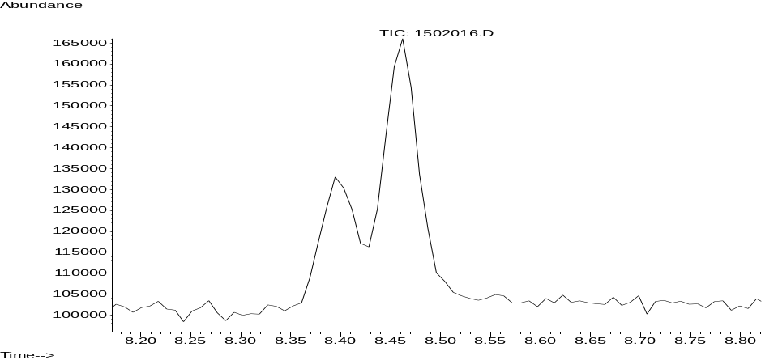
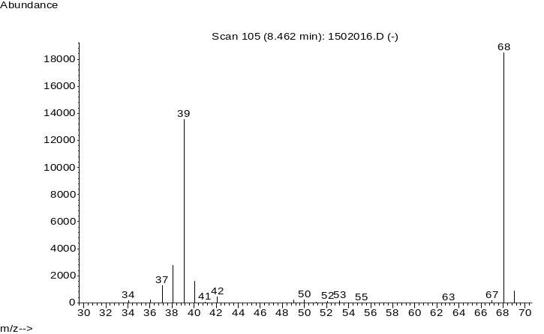
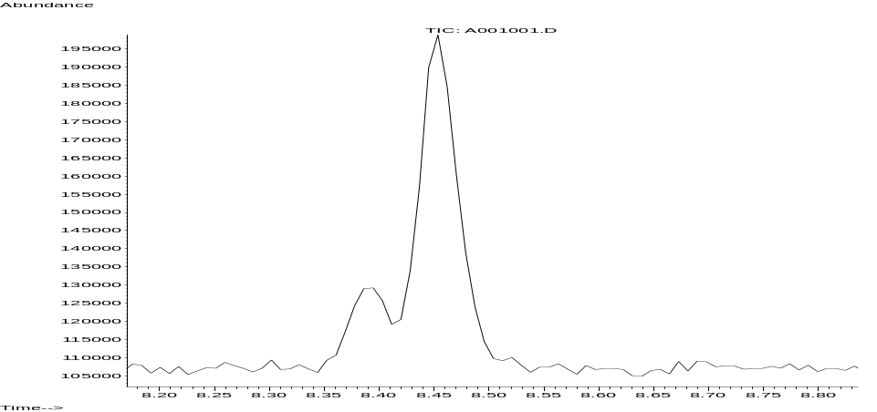
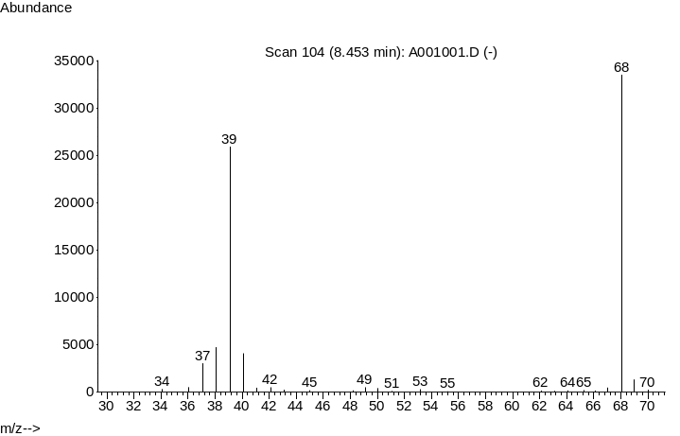
Chromatograms of: a) linolenic acid reaction and b) furan standard (1 ppm native, 0.25 ppm d₄)
a
b

Slide 11
Conclusions
Two pathways of furan formation were identified in the model systems:
Polyunsaturated fatty acids (linoleic, linolenic) via peroxidation and ring closure
2. Decomposition of ascorbic acid derivatives particularly dehydroascorbic acid and isoascorbic acid

Slide 12
Preliminary Survey Results

Slide 13
Furan in Baby Foods
Sample | Furan Concentration (ng/g)
 | METª | Headspaceª
Beef with Broth | 6 | 6
Banana | 7 | 8
Carrot | 54 | 56
Vegetable and Chicken | 18 | 19
Apple Sauce | 5 | 5
Mixed Vegetable | 146 | 154
Alphabet Beef | 62 | 66
Beef Stroganoff | 98 | 103
Chicken and Stars | 25 | 26
ªAverage of two determinations

Slide 14
Furan in Adult Foods
Sample | Furan Concentration (ng/g)
 | METª | Headspaceª
Soups | 35-117 | 34-117
Chili | 152-227 | 157-236
Stew | 82 | 83
Bean products | 14 | 14
Canned luncheon meat | 7-31 | 4-28
Coffee, fresh brewed | 14-52 | 14-51
ªAverage of two determinations

Slide 15
Next Steps?
Further studies on mechanism(s) of formation using model systems and precursor fortified food matrices
Losses of furan during food processing and cooking
Further surveys of canned and bottled products
Participate in round robin method validation study
Update health risk assessment as new data becomes available

Slide 16

Thank-you !

