Slide 1

2007 Diversity Assessment
NASA Ames Research Center
Presentation to the DEOB
Westat Research Corporation
February 26, 2008
Notes:
-- For those of you who don’t know me, my name is Brett Vu. I attended the 5-month long workshop in the Diversity Leadership Course.
-- As one of the action of the DLG was to meet with the DEOB and have a outline of how we can improve diversity here at Ames.
-- In the October, I presented a 15 minute presentation, introducing what we learned in the class, and asking for a hour-long meeting to present our “PROPOSAL.”
-- So here we are, and this is what we would like to present to you.
NEXT SLIDE

Slide 2
Agenda
Introduction
Presentation of Survey Findings
Question and Answer
Action Team Recommendations
Conclusion

Slide 3
Assessment Team Goals
Establish baseline and review of “where we are at the Center”
Conduct periodic assessments of Ames workforce’s:
  1. Understanding and definition of Diversity
  2. Awareness of Diversity
  3. Support for the Center’s Diversity Program
  4. Workplace climate / culture
  5. Perception of the Center and/or co-worker support of diversity

Slide 4
Assessment Team
Lead – Brett Vu (Code C)
Westat POC – David Morse (Code D)
Ames Assessment Team Members
  Darlene Gross (Code C)
  Barbara Miller (Code D)
  Jeff Berlin (Code H)
  Sandy Olliges (Code Q)
  Christine Munroe (Code J)
  Mike Liu (Code Q)

Slide 5
Westat Research Corporation
Company Profile
  An Employee-owned Research Corporation
  Leading Survey Research Organization - Established in 1961
  Headquarters in Rockville, Maryland (more than 1,900 headquarters
  employees)
  Areas of Expertise: Survey, statistical, and analytical methods, program
  evaluation, qualitative studies (e.g., cognitive pretests of surveys, focus
  groups, in-depth interviews, and website usability studies), clinical trials,
  and custom research
  Clients: Federal agencies, businesses, foundations, and state and local
  governments
Westat Presenters
  Michele Harmon, Ph.D. – Project Director, NASA Ames Diversity Study
  Marty Franklin, M.A. – Graduate Certificate in Survey Methodology –
  Project Manager of the NASA Ames Diversity Study

Slide 6
Research Methodology

Slide 7
Research Methodology
Questionnaire
  75 close-ended items
    65 content area items
      5 items: Understanding diversity and its benefits
      19 items: Perceptions regarding the culture of diversity
      at NASA Ames
      29 items: Employees’ perceptions about their own experiences
      at NASA Ames
      6 items: Awareness of NASA Ames policies and initiatives to
      promote diversity
      8 items: Effectiveness in creating an inclusive work
      environment
    10 demographic items
  2 open-ended items
  Estimated completion time = 10 to15 minutes

Slide 8
Research Methodology
Survey Administration
Administered electronically (email with web link and strong password)
  October 18, 2007 – December 7, 2007
Each respondent was contacted up to seven times
  Pre-notification email
  Email survey invitation
  Up to 5 reminder emails

Slide 9
Research Methodology
Sample and Response Rate
Sample
  Census of all full-time and part-time NASA Ames civil service employees in mid-October 2007
  N = 1,260 employees
Response Rate
  Of the 1,259 eligible employees, 637 responded to the survey for a response rate of 50.6%

Slide 10
Respondent Profile
Figure 1a. Comparison of Survey Respondents with NASA Ames Population
Survey Respondent
NASA Ames Population
Characteristics
Characteristics
37%
32%
Gender
Male
Female
63%
68%
16%
17%
Supervisory
Non-Supervisor
Status
Supervisor
84%
83%
13%
13%
Length of
36%
5 years or less
Service with
21%
40%
21%
6 to 10 years
NASA Ames
11 to 20 years
Research
Center
More than 20
30%
26%
years

Slide 11
Respondent Profile (continued)
Figure 1b. Comparison of Survey Respondents with NASA Ames Population (continued)
Survey Respondent
NASA Ames Population
Characteristics
Characteristics
5%
11%
5%
11%
29 years or less
Age
49%
30 to 39 years
50%
40 to 49 years
35%
34%
50 years or more
5%
7%
0.4%
0.1%
31%
34%
Non-White
White
Race/Ethnicity
Multiracial
Unspecified
66%
57%
3%
20%
3%
15%
Black
Hispanic
Non-White
19%
22%
Asian/Pacific
Breakout
58%
60%
Islander
Native American

Slide 12
Organization of Findings
  Research Question 1: Do employees at NASA Ames understand diversity and its benefits?
  Research Question 2: What are employees’ perceptions regarding the culture of diversity at NASA Ames?
  Research Question 3: How do employees perceive their own experiences at NASA Ames?
  Research Question 4: How aware are employees of NASA Ames policies and initiatives to promote diversity?
  Research Question 5: How effective do employees think NASA Ames has been, overall, in creating an inclusive work environment?
  Selected Findings and Possible Follow-up Actions
  Action Planning

Slide 13
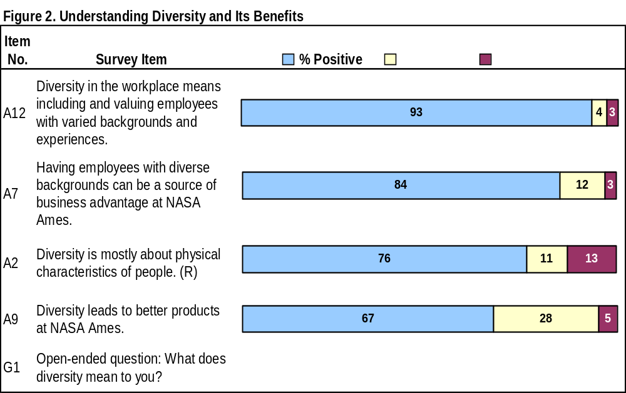
Sample Research Question (Actual Survey Question # 1):
Do employees at NASA Ames understand diversity and its benefits?

Slide 14
Survey Findings
• Ames’ Strengths
• Areas of Concern
• Follow-Up Actions
Notes:
Notable Subgroup differences
Notable Subgroup Differences

Slide 15
Understanding of Workplace Diversity
Ames’ Strengths
  Most respondents understand the NASA Ames Diversity message
  75 percent agree that diversity is not just about physical characteristics
Areas of Concern
  Some respondents define workplace diversity somewhat narrowly in terms of equal opportunity, affirmative action, and quotas
Possible Actions
  Promote better understanding of the broad meaning of workplace diversity
  Consider using the widely read Astrogram as a promotion tool

Slide 16
Benefits of Workplace Diversity
Ames’ Strengths
  More than 80% of Ames respondents believe that diversity can be a source of business advantage, and many cited its importance to the Center’s mission
Areas of Concern
  A minority do not see a link between a diverse workplace and better products, increased workforce productivity, and creativity and innovation
Possible Actions
  Provide more concrete examples of the relationship between workplace diversity and workplace benefits in diversity training classes and promotional activities
  Consider offering Myers-Briggs training to managers and supervisors

Slide 17
Organizational Culture: General Perceptions
Ames’ Strengths
  Overall, respondents have positive general perceptions about the organizational culture: About 80% believe Ames policies promote fair treatment of employees, and 84% agree that employees have a responsibility to encourage diversity
Areas of Concern
  Only 29% of respondents disagree with the statement that workplace diversity sometimes leads to workplace problems
  Only two thirds of employees believe their coworkers actually encourage and promote workforce inclusion
Possible Actions
  Address the first area of concern by:
    Exploring the topic in employee focus groups. To reduce reticence in sharing honest feelings, keep the groups homogeneous in terms of gender (e.g., females in one group and males in another), supervisory status, and race/ethnicity
    Incorporating this topic into diversity training courses
  Guide all employees in practical ways to implement diversity principles in their work units and teams

Slide 18
Diversity Training
Ames’ Strengths
  Less than 10% of respondents have a negative opinion about Ames’ efforts to encourage employees to participate in diversity training
Area of Concern
  About 50% of respondents indicated a need to improve diversity training at Ames, citing:
    Too much focus on physical differences
    Passive “lecturing” on compliance with equal opportunity (EEO) laws and agency policies
Possible Actions
  Develop training that is more interactive
  Align content with the agency’s diversity mission statement and principles
  Differentiate diversity mission from EEO compliance
  Consider conducting a focus group or interviews with former trainees to gather their ideas for improving the training
  Monitor training effectiveness; revise training in response to participants’ evaluations and progress in meeting identified training goals
  Be realistic about the purpose and goals of diversity training. The diversity literature indicates that diversity training, in and of itself, is insufficient as the primary mechanism for achieving a diverse workforce

Slide 19
Manager and Supervisors
Ames’ Strengths
  60% to 70% of respondents believe that managers and supervisors value employees of diverse backgrounds and viewpoints and encourage them to share their opinions
Area of Concern
  However, respondents generally give managers and supervisors higher marks for what they say than for what they actually do to ensure effective workplace diversity, with the perceived difference between words and action being in the 10% to 20% range
Possible Actions
  Review existing responsibilities of managers and supervisors for promoting and implementing diversity principles
  If necessary, clarify the responsibilities so that they can be measured and monitored
  Communicate and discuss the goals with managers and supervisors. Share best practices with them for achieving the goals. Provide them with the support they need to perform effectively
  Incorporate the goals into their performance appraisals and hold them accountable for progress in meeting them
  Recognize and reward managers and supervisors for outstanding achievements in improving workplace diversity

Slide 20
Personal Perceptions: Fair Treatment and Possible Reprisals
Ames’ Strengths
  Very low percentages of respondents (from 1% to 5%) indicated they are treated unfairly because of assumptions about their personal characteristics
Areas of Concern
  Non-Whites and women are less positive about experiencing unfair treatment
  Only 57% of respondents disagree with the statement that there will be negative consequences for them if they report unfair treatment at work, with notable differences between Whites and Non-Whites, men and women, supervisors and non-supervisors, and younger and older employees
Possible Actions
  If focus groups or interviews are held with various employee subgroups, include these topics for discussion
  In all training for managers and supervisors, discuss employee perceptions about possible reprisals for reports of unfair treatment
  Assure employees that Ames will not tolerate reprisals for any reports of unfair treatment

Slide 21
Opportunities for Advancement
Ames’ Strengths
  Approximately 70% of respondents believe that Ames gives them adequate opportunities to use their skills and advance in their careers
Area of Concern
  Many respondents would like more mentoring and more opportunities for professional development
  Many respondents think assumptions made about them by supervisors and coworkers limit their opportunities for professional development
  Perceptions about these topics are notably less positive among women, Non- Whites, non-supervisors, respondents 40 years and over, and respondents working at NASA Ames for more than 10 years

Slide 22
Opportunities for Advancement (continued)
Possible Actions
  Have agency leaders review both their formal and informal procedures for identifying employees with supervisory and managerial potential. Make sure no one is inadvertently overlooked - broaden the pool beyond “the usual suspects.” Inform all employees of professional growth opportunities and job openings for supervisors and managers
  Consider using formal and informal mentoring programs to promote diversity in the upper ranks
  Adopt industry best practice - Set specific diversity goals and treat each like any other major organizational goal. That is, senior leaders champion the goal and:
    • Assign responsibility to an individual or group for achieving the goal
    • Provide the necessary resources to accomplish the goal
    • Establish a reasonable timeline
    • Hold the responsible person or group members accountable for their performance

Slide 23
Awareness of Ames’ Diversity Policies and Initiatives
Ames’ Strengths
  Nearly all respondents are very familiar with the Astrogram, and many are somewhat familiar with the Ames policy statement on non-harassment in the workplace
Areas of Concern
  The survey findings indicate low awareness of various diversity initiatives and information sources, particularly the:
    NASA Ames Office of Diversity and Equal Opportunity website
    Diversity Implementation Plan
    Diversity Leadership Course
    NASA Ames Diversity Policy
Possible Action
  Highlight the website, plan, course, and policy in the widely read Astrogram

Slide 24
Ames’ Effectiveness in Creating an Inclusive Work Environment
Ames’ Strengths
  About 70% of respondents have positive perceptions about Ames’ overall effectiveness in promoting professional growth, fostering mutual trust and respect, and valuing individual contributions
Areas of Concern
  Positive perceptions are somewhat less common about Ames’ overall effectiveness in creating a supportive environment for all employees and creating a strong teamwork culture
  Again, for some of the overall effectiveness items, positive perceptions are less common among Non-Whites, women, non-supervisors, respondents working at Ames for more than 10 years, and those 40 years old and over
Possible Actions
  Assign a high priority to investigating the causes of differences in positive perceptions within subgroups
  Meet with employees individually, other than during performance appraisals, to discuss the support needed to achieve their potential at NASA Ames
  Identify specific actions for strengthening teamwork

Slide 25
Action Planning

Slide 26
Recommendations for Action Planning
First Step
Review and discuss findings and supplementary information
Consider conducting focus groups, interviews, town-hall meetings to identify strengths and weaknesses
Second Step
Develop an action plan
  Invite input from employees representing diverse groups
  Establish short- and long-term goals
  Set priorities
  Establish measures for evaluating plan components
Secure top-level management endorsement and support and secure appropriate resources to carry out the plan
Establish a timeframe for achieving priority goals

Slide 27
Recommendations for Action Planning (continued)
Third Step
Effectively communicate the action plan goals and priorities to managers and others who will likely serve as frontline agents for disseminating information about the plan to employees
Draw on existing resources and initiatives, such as the Astrogram, to reinforce efforts to advertise the plan
Fourth Step
Implement the plan and monitor and evaluate the effectiveness of activities to achieve priority goals
Use, as appropriate, evaluation tools such as progress reports on achieving specific goals, benchmark data, employee evaluations of activities such as training courses and special observance day events, and employee surveys
Use performance reports to decide:
  (1) which initiatives have been successful and should be either continued or ended because they are no longer necessary
  (2) which initiatives have not been successful and may need to be modified or discontinued

Slide 28
Ames Action Team Recommendations

Slide 29
DEOB Action Subcommittee Approach
Key survey findings include:
  EEO vs. Diversity is not clear; equating Diversity with quotas, affirmative action, and minority preferences
  Lack of familiarity of ODEO website, Diversity Leadership Training, Diversity Plan
  Unclear usefulness of Diversity training
  Diversity and the business case – not clear to staff how Diversity leads to better products, addresses workforce productivity, fosters creativity and innovation
  Achieving Diversity leads to workplace problems
  Managers are viewed as not practicing diversity
  Supervisor/coworker assumptions limit opportunities for professional development
  Lack of mentoring
  Negative perception of consequences for reporting unfair treatment
  Employees feel they have to change things about themselves to fit into NASA Ames
  Lack of freedom to express alternate solutions

Slide 30
DEOB Action Subcommittee Approach
Create a prioritized list of actions based on key survey findings
Solicit volunteers from DEOB to form teams
Align with existing center committees
Make available survey findings to all civil servants
Open further participation to staff via centerwide announcement
Track actions being taken via all-hands meetings, ODEO website, Astrogram

Slide 31
Conclusion – Next Step
Request DEOB for archival approval of Assessment Survey Findings
  Action Team to prioritize and present list in next meeting
DEOB to implement list of action items based on Action Team recommendation

Slide 32
Backup Slides

Slide 33
Research Question 1:
Do employees at NASA Ames understand diversity and its benefits?

Slide 34
Research Question 1:
Findings: Understanding of Workplace Diversity and Its Benefits
Understanding Workplace Diversity
Many Respondents:
  Perceived workplace diversity quite broadly
  Agreed that workplace diversity involves including, supporting, and valuing employees with varied backgrounds, experiences, and viewpoints
  Understand workplace diversity is not just about differences in physical characteristics
Some respondents:
  Defined workplace diversity more narrowly in terms of fair treatment, equal opportunity, acceptance of differences, or quotas when responding to the open-ended question “What does workplace diversity mean to you?”
Benefits
Many Respondents:
  Linked workplace diversity with business advantages
  Reported workplace diversity facilitates the goals and mission of NASA Ames
  Were uncertain how workplace diversity actually leads to better products and want to see examples

Slide 35
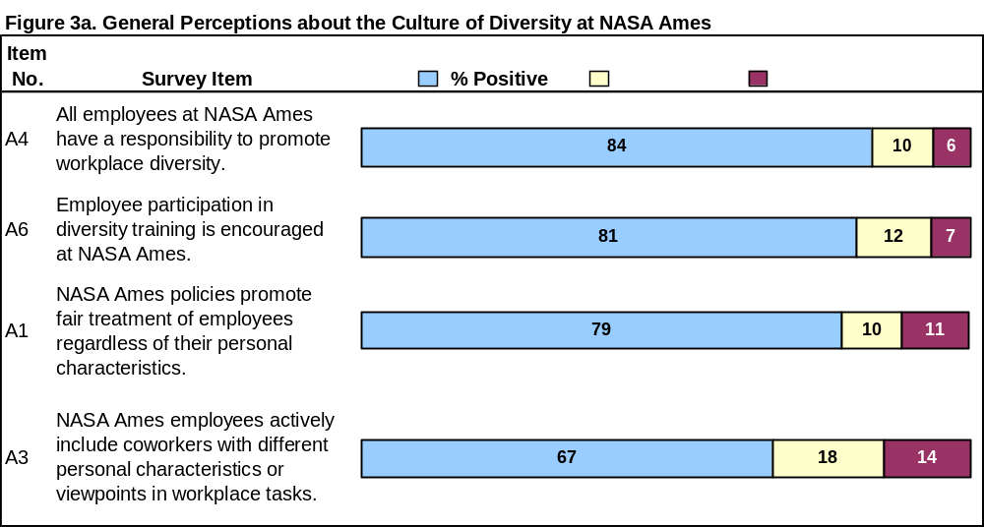
Research Question 2:
What are employees’ perceptions regarding the culture of diversity at NASA Ames?
Part 1: General Perceptions about the Organizational Culture

Slide 36
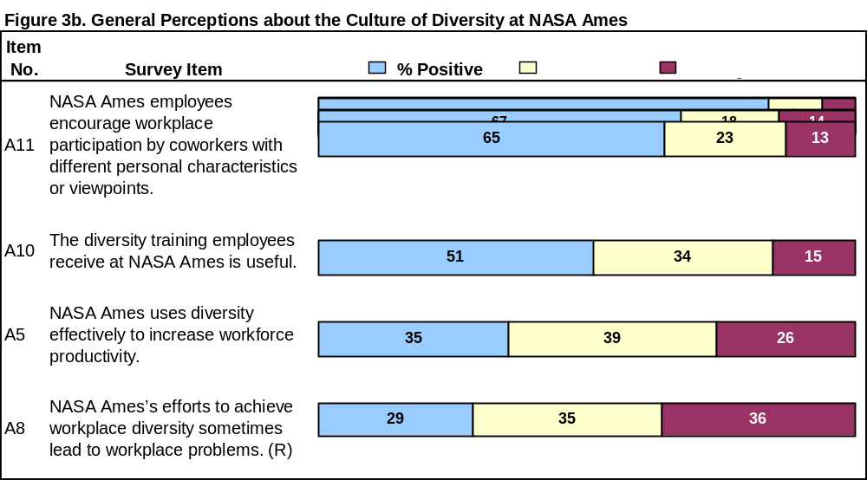
Research Question 2:
What are employees’ perceptions regarding the culture of diversity at NASA Ames?
Part 1: General Perceptions about the Organizational Culture

Slide 37
Research Question 2:
Findings Part 1: General Perceptions about the Organizational Culture
Some Strong Positive Findings, But They Come With Qualifications
About 80% of respondents agreed that NASA Ames promotes fair treatment of all employees, although only 72.6% of Non-White respondents agreed.
83.7% agreed that all employees have a responsibility to promote workplace diversity, but only about 65% said employees actually encourage workplace participation by coworkers with different characteristics or viewpoints.
81.2% of respondents said diversity training is encouraged, but only about 50% agreed that the training is useful.
Challenges
Only 35.3% of respondents report NASA Ames uses diversity effectively to increase workforce productivity and only about 30% disagreed that workplace diversity sometimes leads to workplace problems.

Slide 38
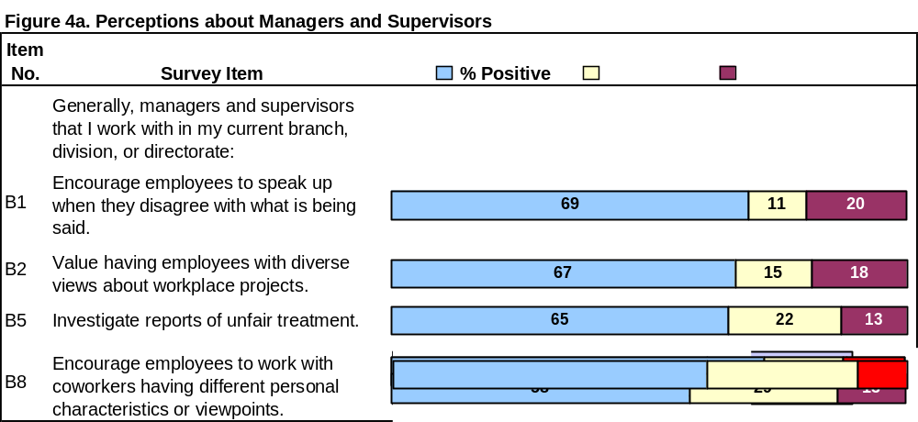
Research Question 2:
What are employees’ perceptions regarding the culture of diversity at NASA Ames?
Part 2: Perceptions about Managers and Supervisors

Slide 39
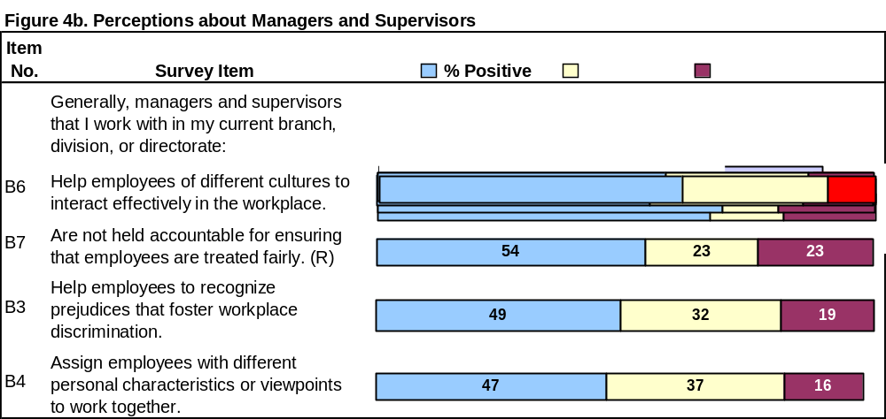
Research Question 2:
What are employees’ perceptions regarding the culture of diversity at NASA Ames?
Part 2: Perceptions about Managers and Supervisors (continued)

Slide 40
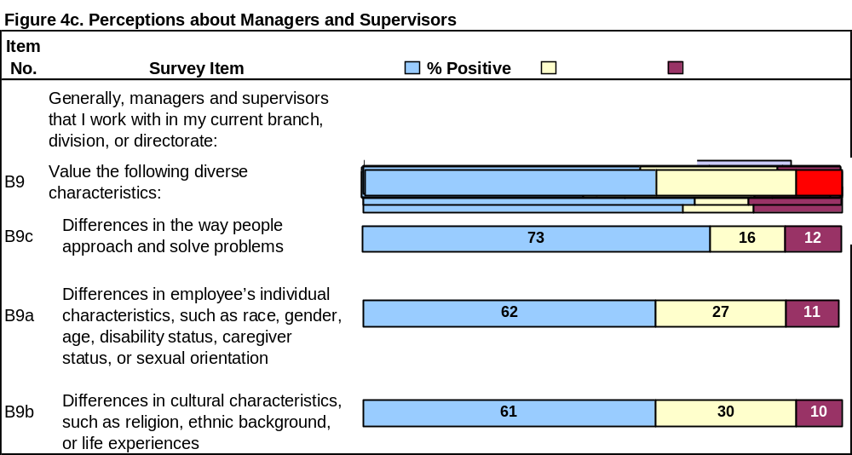
Research Question 2:
What are employees’ perceptions regarding the culture of diversity at NASA Ames?
Part 2: Perceptions about Managers and Supervisors (continued)

Slide 41
Research Question 2:
Findings Part 2: Perceptions about Managers and Supervisors
Some Positive Perceptions Were Stronger Than Others
Positive perceptions were highest (65% to 73%) regarding:
  Valuing diverse viewpoints
  Valuing differences in approaches and solutions to problems
  Encouraging employees to speak up
  Investigating reports of unfair treatment
Positive perceptions about managers and supervisors declined (47% to 62%) regarding:
  What they actually do to promote a diverse workplace
  Valuing of differences in individual and cultural characteristics
  Their being held accountable for ensuring fair treatment

Slide 42
Research Question 2:
Findings Part 2: Perceptions about Managers and Supervisors (continued)
Many Notable Subgroup Differences
Positive perceptions differed notably most often between supervisors and non-supervisors and between Whites and Non-Whites. For example:
White Non-White
Managers and supervisors they work with
investigate reports of unfair treatment 72.2% 54.7%
Males, respondents with less tenure, and respondents younger than 40 years old tended to be proportionately more positive. For example: Male Female
Managers and supervisors are held
accountable for ensuring fair treatment 58.0% 46.9%

Slide 43
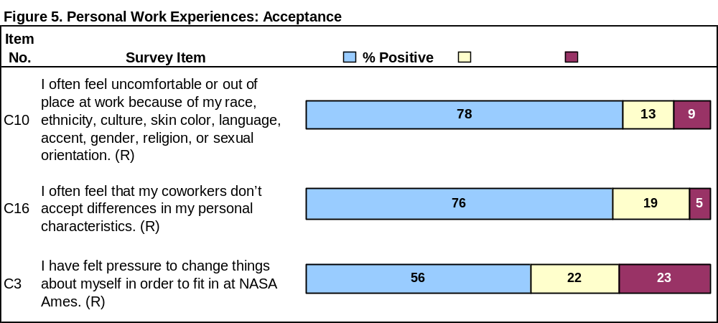
Research Question 3:
How do employees perceive their own experiences at NASA Ames?
Acceptance

Slide 44
Research Question 3:
Findings: Perceptions about Acceptance
Mixed Perceptions
Positive findings:
  About 76% of respondents disagreed that coworkers don’t accept differences in their personal characteristics
  78.3% disagreed that they often feel uncomfortable or out of place at work because of physical or cultural characteristics.
However:
  Only about 56% report they have not felt pressure to change things about themselves in order to fit in; 21.9% responded neutrally to that statement, and 22.7% indicated they have felt such pressure.
What these mixed perceptions may mean:
  Some of those feeling pressured to change things about themselves were thinking about differences in viewpoints and approaches to work tasks.

Slide 45
Research Question 3:
Findings: Perceptions about Acceptance (continued)
Notable Differences
Positive Perceptions about Acceptance between Whites and Non-Whites:
Disagreement with the following statements:
Whites Non-Whites
Have felt pressure to change in order to fit in: 61.3% 47.9%
Often feel uncomfortable or out of place
because of various cultural or physical characteristics 85.8% 68.2%
Often feel that coworkers’ don’t accept
differences in personal characteristics 82.0% 66.3%

Slide 46
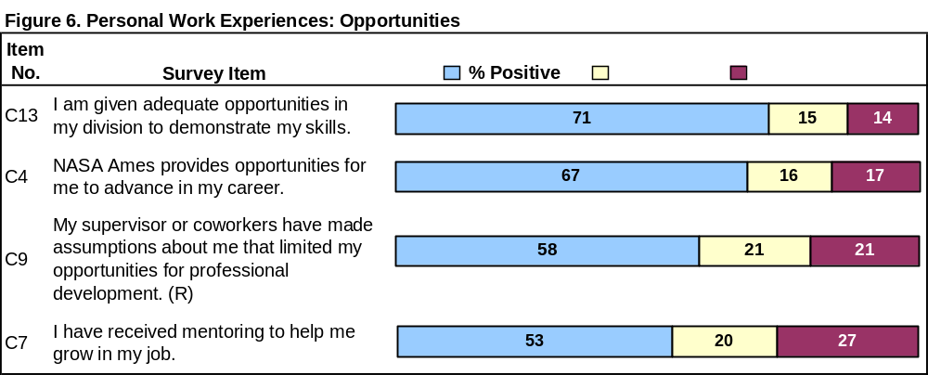
Research Question 3:
How do employees perceive their own experiences at NASA Ames?
Opportunities

Slide 47
Research Question 3:
Findings: Perceptions about Opportunities
Use of Skills
Many respondents (71.3%) reported positive perceptions about use of their skills.
Opportunities for Growth and Advancement
Respondents were somewhat less positive about having:
  opportunities for professional development (disagreed that they were limited by supervisor/coworker assumptions) – 58.2%
  opportunities for advancement – 67.1%
Mentoring
52.8% said they have received mentoring to help them grow in their jobs.

Slide 48
Research Question 3:
Findings: Perceptions about Opportunities (continued)
Same Pattern for Subgroup Differences
Non-Whites, non-supervisors, females, older respondents, and respondents employed at NASA Ames for more than 10 years were less positive
Examples of Subgroup Differences in Positive Perceptions
Opportunities for advancement:
  72.9% for Whites, 59.8% for Non-Whites
Adequate opportunities to demonstrate skills:
  90.0% for supervisors, 68.1% for non-supervisors
Assumptions made that limited opportunities for professional development
  61.3% of males disagreed, 52.6% of females disagreed
  65.1% of respondents employed at NASA Ames for 10 years or less vs. 54.5% of those with at least 10 years’ tenure
Mentoring:
  65.3% of respondents younger than 40, 50.8% for older respondents

Slide 49
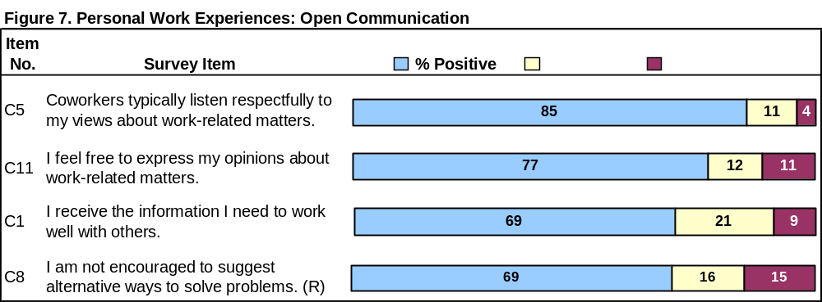
Research Question 3:
How do employees perceive their own experiences at NASA Ames?
Open Communication

Slide 50
Research Question 3:
Findings: Perceptions about Open Communication
Overall, Positive Experiences with Communication
Many respondents had positive perceptions about being able to express their opinions about work-related matters (76.9%) and said coworkers listen respectfully to them (85.0%).
69.1% disagreed with the statement, “I am not encouraged to suggest alternative ways to solve problems”.
Nearly 70% said they receive the information they need to work well
with others.
Subgroup Differences by Supervisory Status and Gender
Examples:
Positive perceptions for “I feel free to express my opinion about work-related matters”:
    80.9% for males vs. 70.6% for females
    85.0% for supervisors vs. 75.7% for non-supervisors

Slide 51
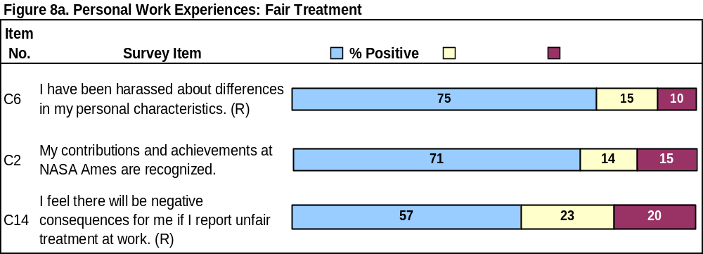
Research Question 3:
How do employees perceive their own experiences at NASA Ames?
Fair Treatment

Slide 52
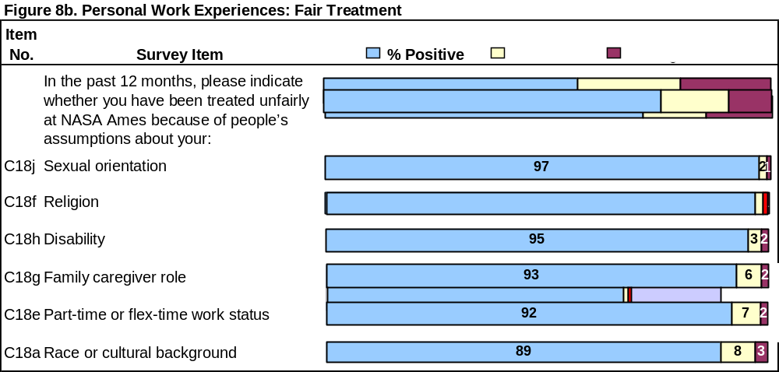
Research Question 3:
How do employees perceive their own experiences at NASA Ames?
Fair Treatment (continued)

Slide 53
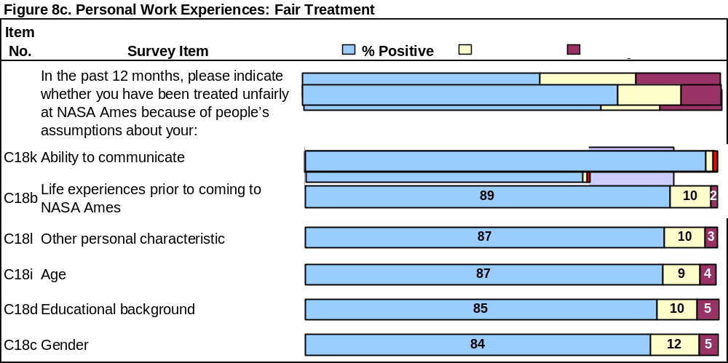
Research Question 3:
How do employees perceive their own experiences at NASA Ames?
Fair Treatment (continued)

Slide 54
Research Question 3:
Findings: Perceptions about Fair Treatment
Mixed Findings Overall on Harassment, Recognition for Contributions, and
Consequences for Reporting Unfair Treatment
About 75% of respondents said they had never been harassed about differences in their personal characteristics (9.5% disagreed and 15.2% responded neutrally).
About 71% said their contributions and achievement were recognized.
Only about 57% disagreed that there will be negative consequences if they report unfair treatment at work.

Slide 55
Research Question 3:
Findings: Perceptions about Fair Treatment (continued)
Notable Subgroup Differences in Respondents’ Positive Perceptions for
All Three Fair Treatment Items
Example:
Disagreed that there will be negative consequences for reporting unfair treatment:
  63.4% of Whites vs. 48.4% of Non-Whites
  74.0% of supervisors vs. 53.6% of non-supervisors
  60.9% of males vs. 50.4% of females
  62.8% of respondents working at NASA Ames 10 years or less vs. 53.8% of respondents working there more than 10 years
  64.6% of respondents younger than 40 years vs. 56.0% of those 40 years and over

Slide 56
Research Question 3:
Findings: Perceptions about Fair Treatment (continued)
Very Positive Findings for “Unfair Treatment” Items (C18a-l) but Some Notable
Subgroup Differences
Positive perceptions overall ranged from 83.7% to 97.3%
Proportionately more males than females reported they were never or seldom treated unfairly because of people’s assumptions about:
    Gender (92.2% vs. 69.3%)
    Educational background (89.6% vs. 78.0%)
    Part-time or flex-time work status (95.2% vs. 86.7%)
    Family caregiver role (96.4% vs. 86.6%)
    Other personal characteristics (91.6% vs. 81.0%)
Proportionately more Whites than Non-Whites reported they were never or seldom treated unfairly because of people’s assumptions about:
    Race or cultural background (96.2% vs. 79.8%)
    Life experiences prior to coming to NASA Ames (92.9% vs. 82.7%)
    Ability to communicate (93.2% vs. 82.7%)
    Educational background (89.1% vs. 80.2%)

Slide 57
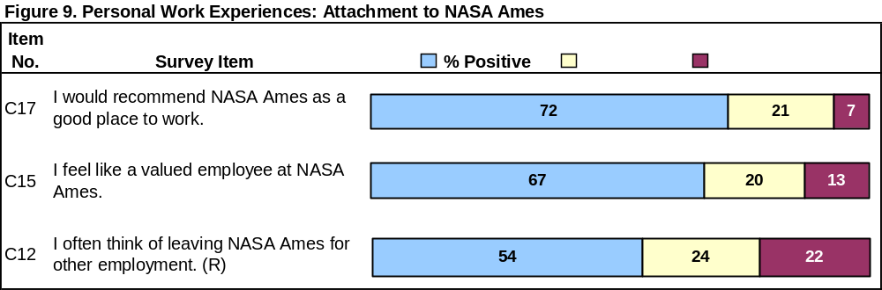
Research Question 3:
How do employees perceive their own experiences at NASA Ames?
Attachment to NASA Ames

Slide 58
Research Question 3:
Findings: Perceptions about Attachment to NASA Ames
Attachment Strongest Among Supervisors
Many respondents (71.7%) said they would recommend NASA Ames as a good place to work.
    81.8% of supervisors vs. 69.9% of non-supervisors
    80.2% of younger respondents vs. 70.3% of older respondents
66.9% of respondents feel like valued employees.
    81.8% of supervisors vs. 64.4% of non-supervisors
    70.6% of males vs. 61.4% of older respondents
    71.5% of Whites vs. 60.5% of Non-Whites
54.3% said they often think of leaving NASA Ames for employment elsewhere.
    47.2% of supervisors vs. 38.0% of non-supervisors

Slide 59
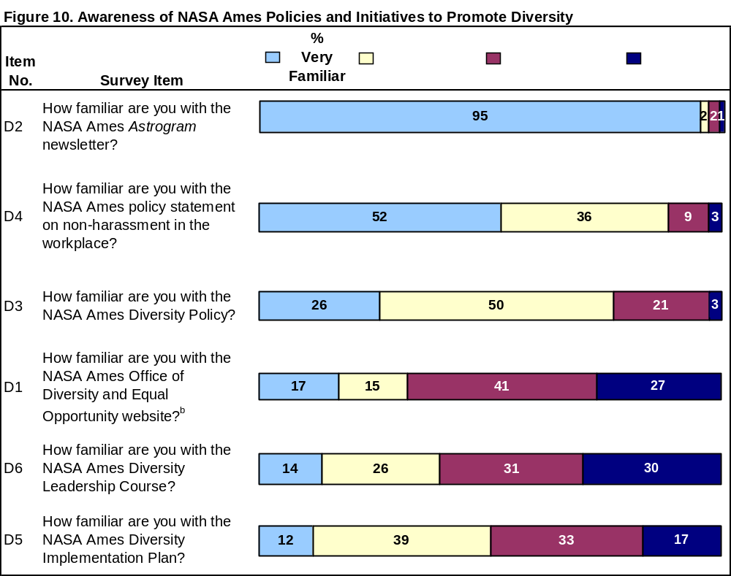
Research Question 4:
How aware are employees of NASA Ames policies and initiatives?

Slide 60
Research Question 4:
Findings: Awareness of NASA Ames Policies and Initiatives to Promote Diversity
Percentages of Respondents Who Are Very Familiar or Somewhat Familiar
with the:
Astrogram (have read it at least once) – 96.6%
NASA Ames policy statement on non-harassment in the workplace - 88.3%
NASA Ames Diversity Policy - 76.5%
NASA Ames Diversity Implementation Plan - 50.2%
NASA Ames Diversity Leadership Course – 39.2%
NASA Ames Office of Diversity and Equal Opportunity website (have visited it at least once) – 32.1%

Slide 61
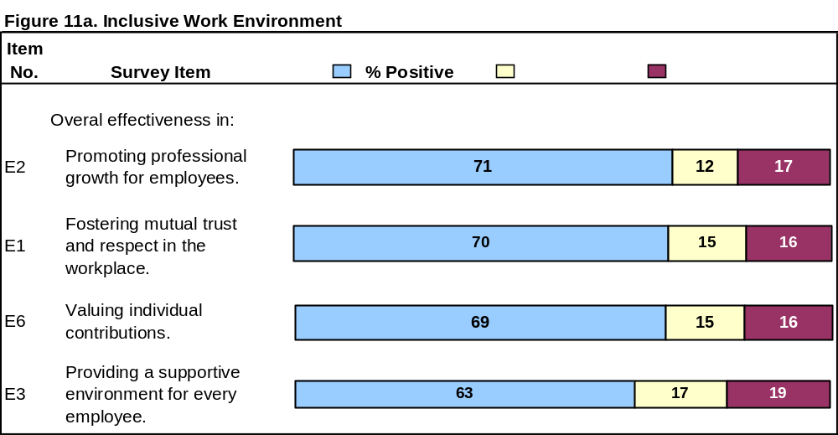
Research Question 5:
How effective do employees think NASA Ames has been, overall, in creating an inclusive work environment?

Slide 62
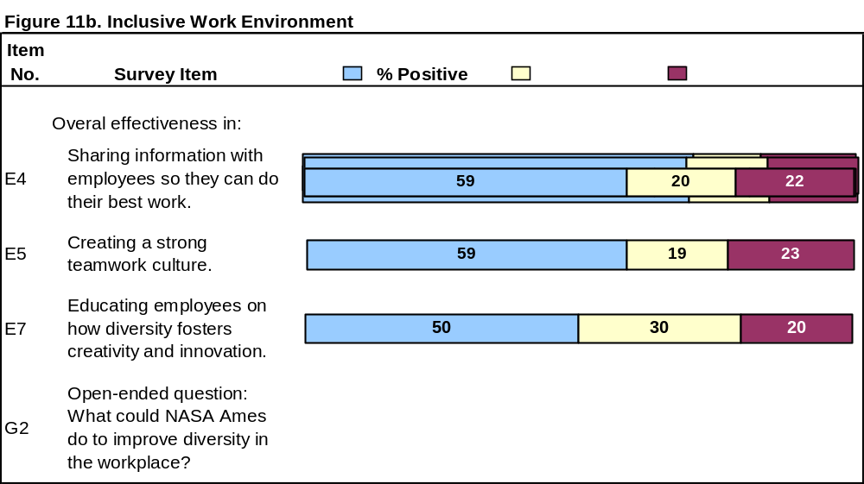
Research Question 5:
How effective do employees think NASA Ames has been, overall, in creating an inclusive work environment? (continued)

Slide 63
Research Question 5:
Findings: Overall Effectiveness in Creating an Inclusive Work Environment
Positive Perceptions Clustered into Three Groups
Group 1
  Promoting professional growth – 70.7%
  Fostering mutual trust and respect – 69.7%
  Valuing individual contributions – 69.0%
Group 2
  Providing a supportive environment for every employee – 63.3%
  Sharing information with employees so they can do their best work – 58.7%
  Creating a strong teamwork culture – 58.5%
Group 3
  Educating employees on how diversity fosters creativity and innovation – 49.9%
Subgroup Differences in Positive Perceptions for All 7 Items about Overall Effectiveness in Creating an Inclusive Work Environment

Slide 64
Research Question 5:
Findings: Overall Effectiveness in Creating an Inclusive Work Environment (continued)
Effectiveness Score
Represents the respondent’s average response to Items E1 through E7
Created by adding the respondent’s score for each of the E items and dividing by the number of items the respondent answered
Effectiveness scores range from 1 to 5:
  1 = Ineffective
  2 = Somewhat Ineffective
  3 = Neither Ineffective nor Effective
  4 = Somewhat Effective
  5 = Effective
Respondent scores ranged from 1.0 to 5.0
Overall average respondent score = 3.63

Slide 65
Research Question 5:
Findings: Overall Effectiveness in Creating an Inclusive Work Environment (continued)
Effectiveness Score by Subgroup
Subgroup | Effectiveness Score
Supervisor | 3.83
Non-supervisor | 3.60
Male | 3.71
Female | 3.52
American Indian/Alaska Native | 4.08
White | 3.75
Asian/Pacific Islander | 3.71
Other race | 3.60
Multiracial | 3.55
Black/African American | 3.19
Hispanic/Latino American | 2.92
Less than 40 years old | 3.66
40 years or older | 3.64
10 years or less tenure | 3.68
More than 10 years’ tenure | 3.61

Slide 66
Research Question 5:
Findings: Overall Effectiveness in Creating an Inclusive Work Environment (continued)
What could NASA Ames do to improve workplace diversity?
Common Themes in Respondents’ Answers to this Open-ended Question
  Improve diversity training
  Improve recruiting
  Promote diversity awareness more effectively
  Increase the number of female, Asian/Pacific Islander, Hispanic/Latino, and Black/African American managers
  Hold managers accountable / Assist managers / Reward best practice
  Focus on teamwork and collaboration
  Focus on similarities, not differences
  Focus on individual merit to achieve Center success

