Slide 1
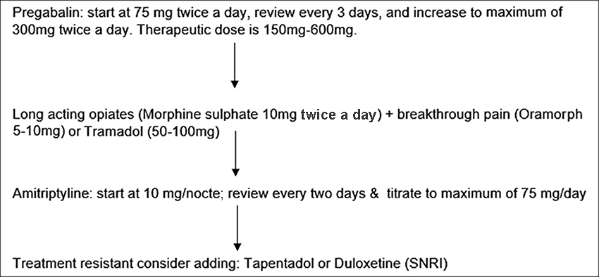

Figure 1. Medication dosage procedure. SNRI = serotonin-norepinephrine reuptake inhibitors.
Rafferty M, Bennett Britton TM, Drew BT, Phillip RD. Cross-sectional study of alteration of phantom limb pain with visceral stimulation in military personnel with amputation. J Rehabil Res Dev. 2015;52(4):441–48.
http://dx.doi.org/10.1682/JRRD.2014.04.0114
Notes:
Figure 1.
Medication dosage procedure. SNRI = serotonin-norepinephrine reuptake inhibitors.

