Slide 1
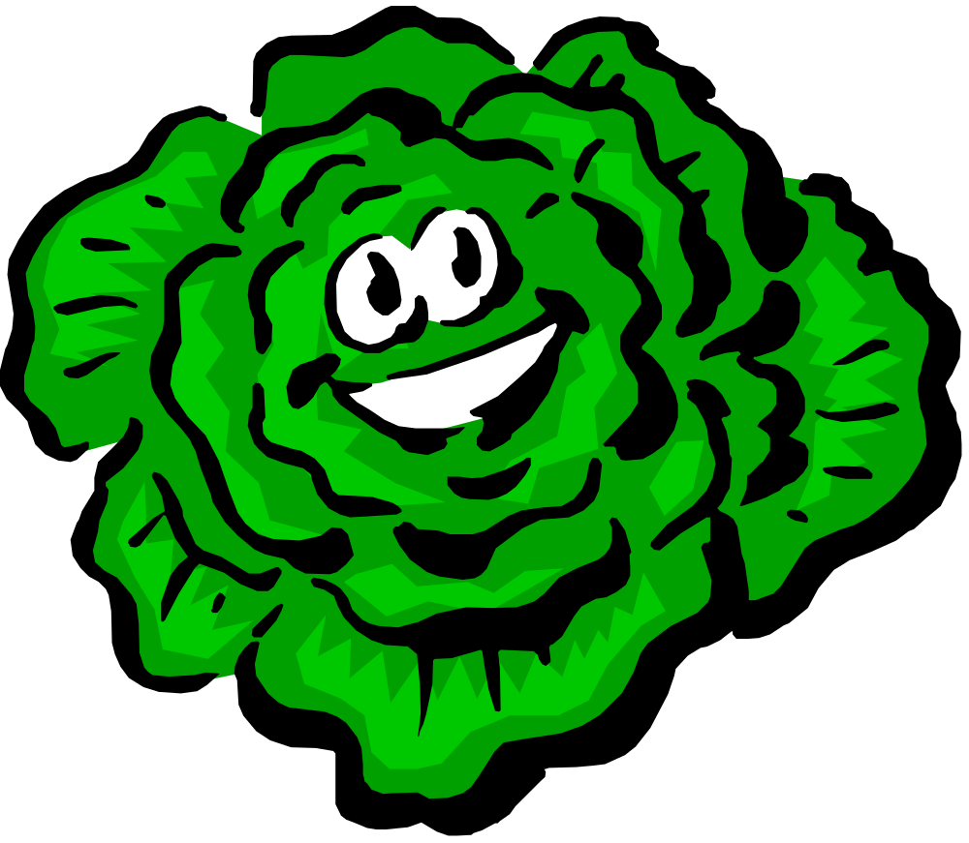
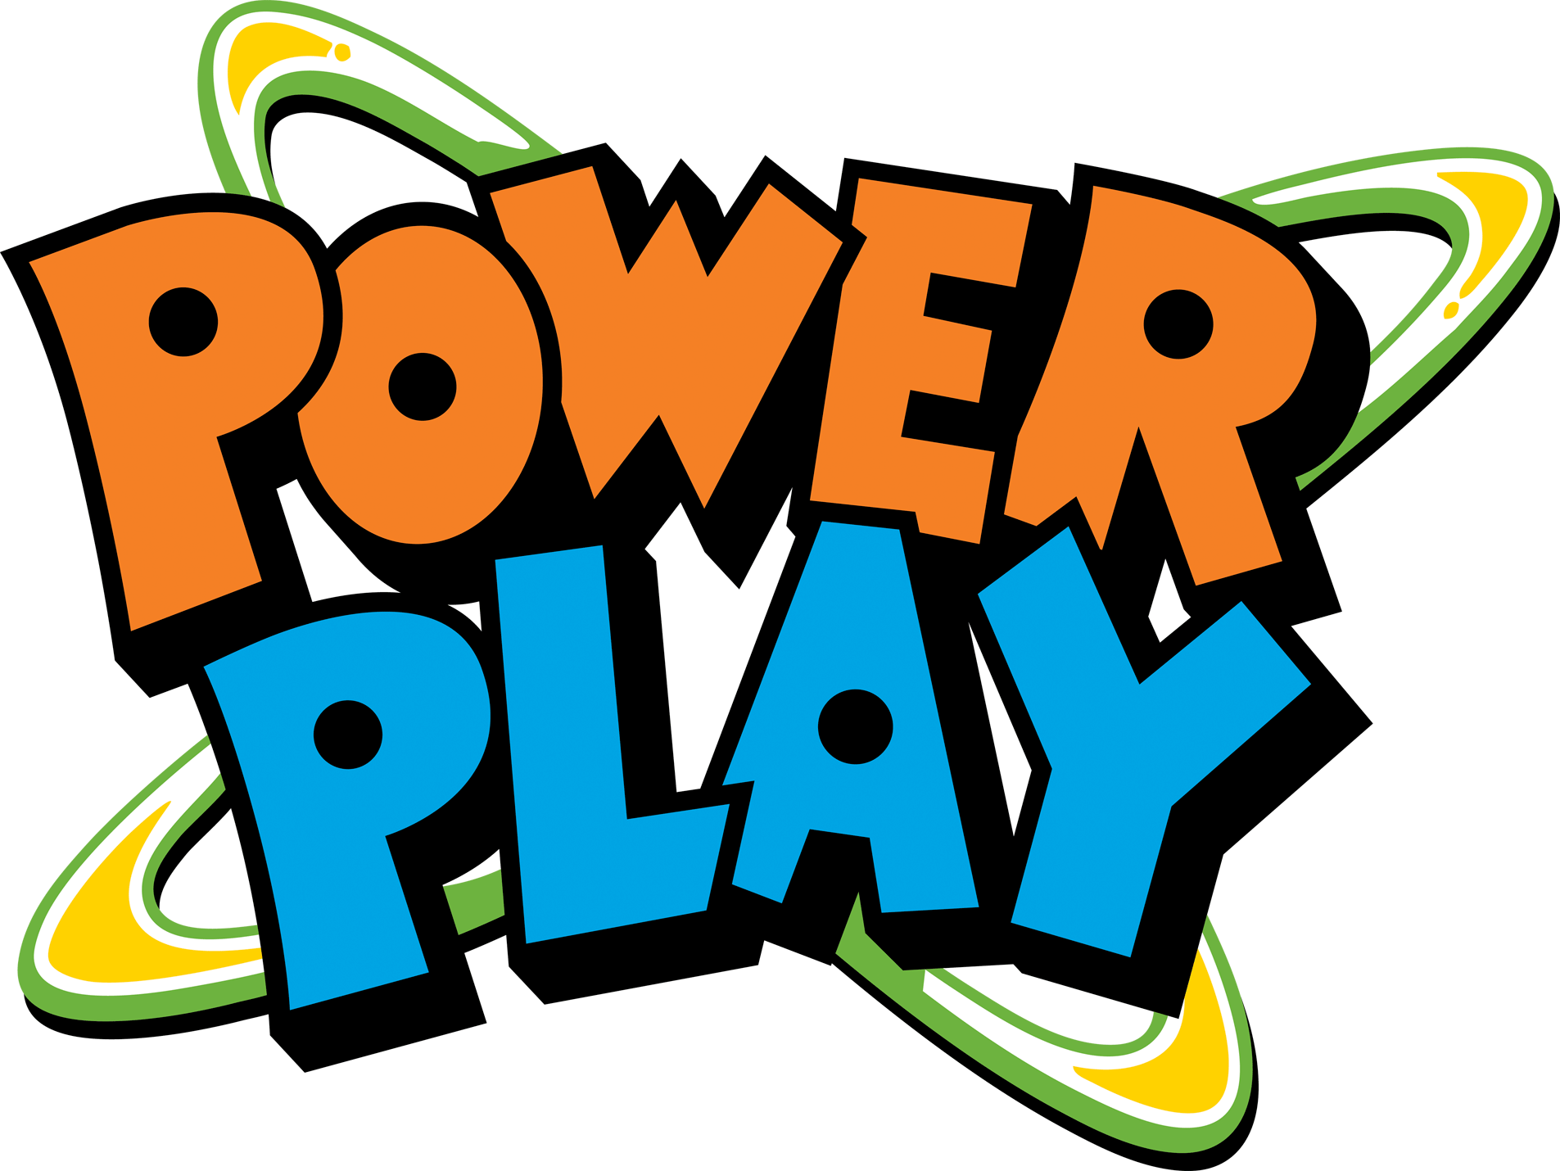
"Let-us" Conga!
An energizer adapted from
Power Up for Learning! Physical Activity Supplement

Slide 2
Let-us get started!
Form a conga line with your table mates
Place your hands on the shoulders of the person in front of you
When the name of a fruit/veggie is called:
  Reach “high” if the f/v grows high
  Reach to the “side” for medium growing f/v
  Squat “low” for low growing f/v
READY??

Slide 3
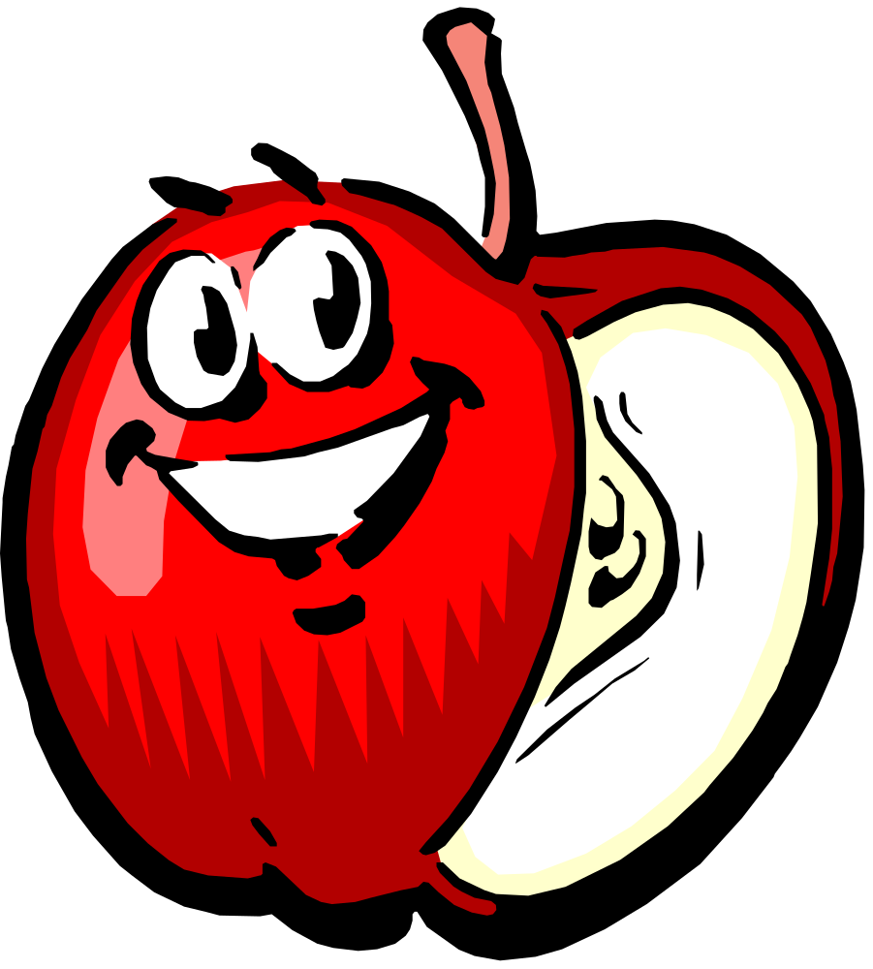
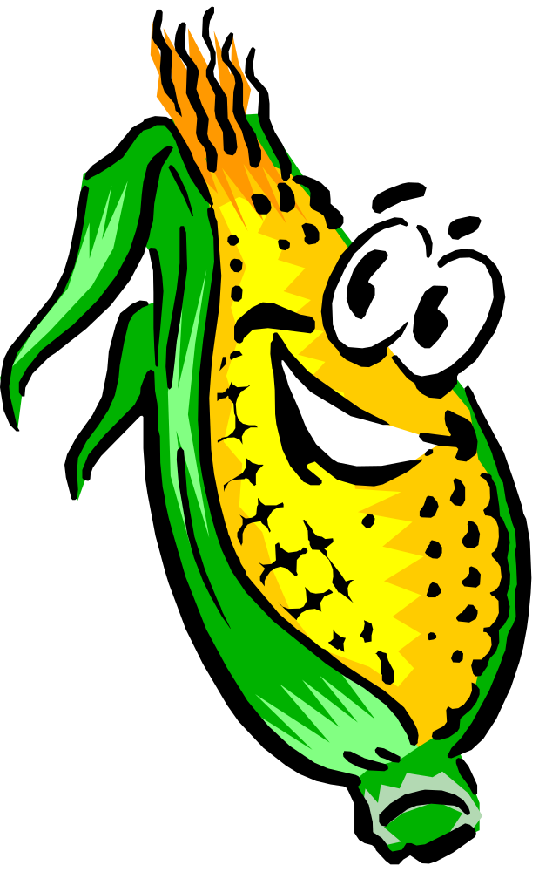
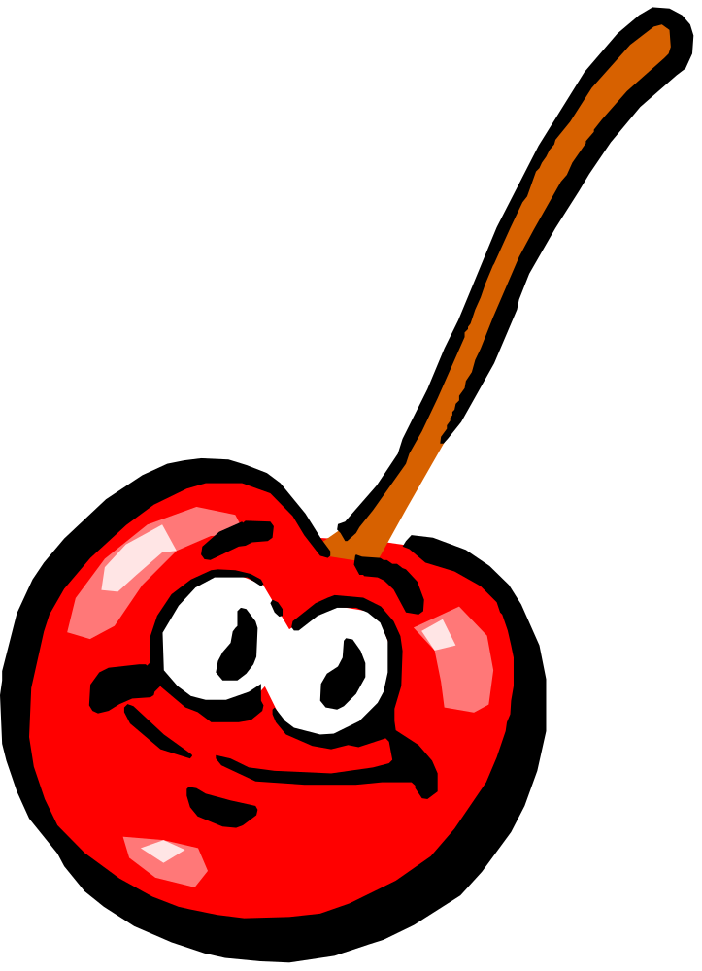
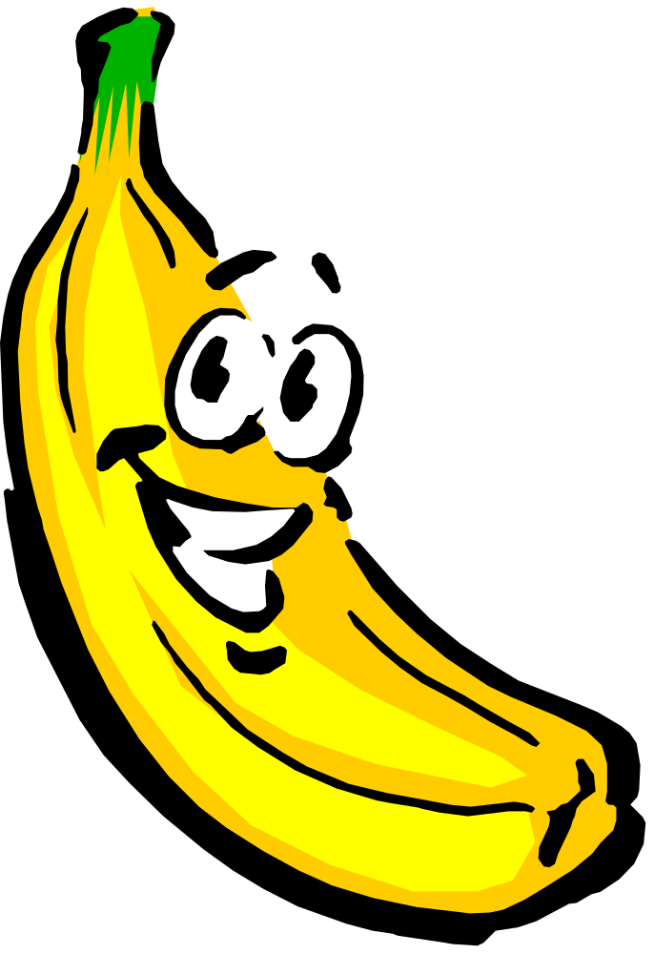
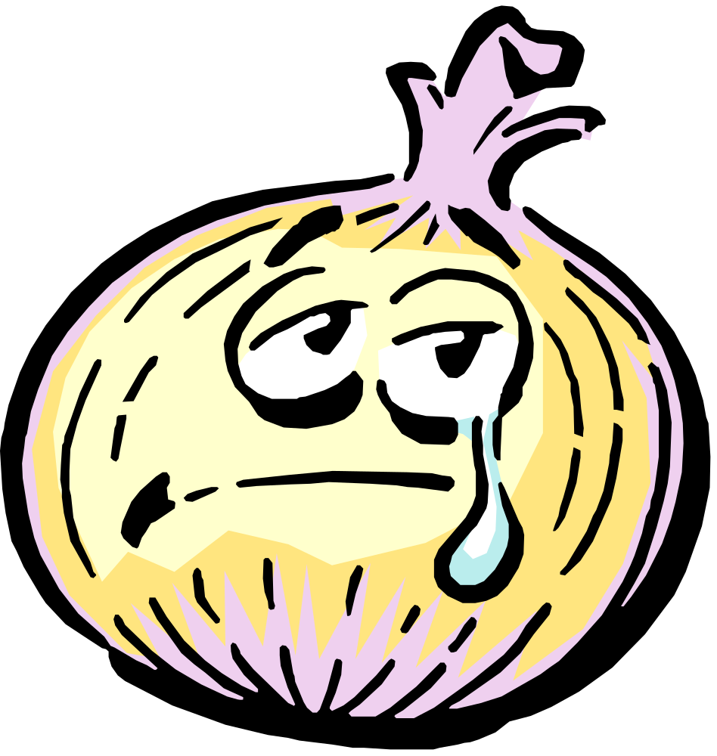
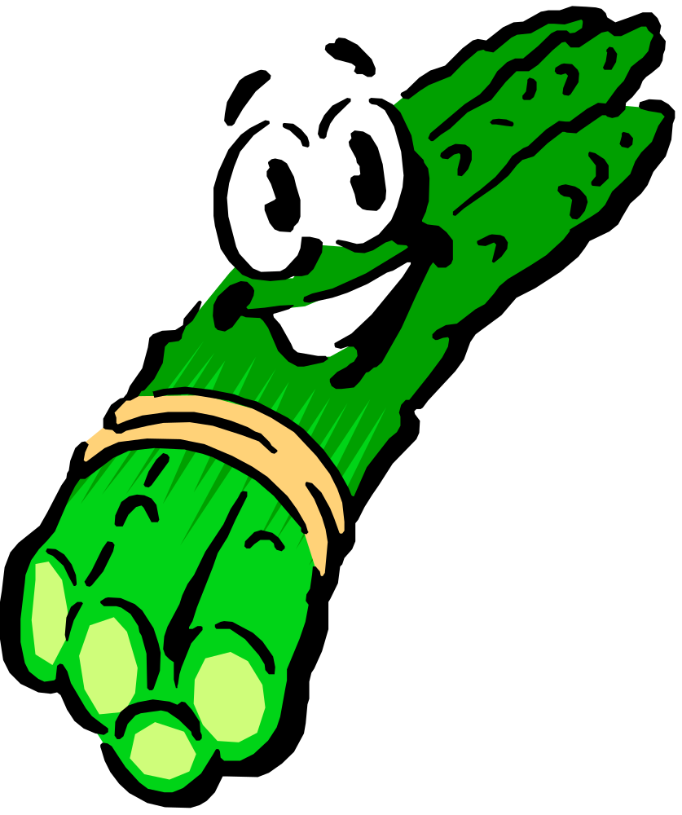
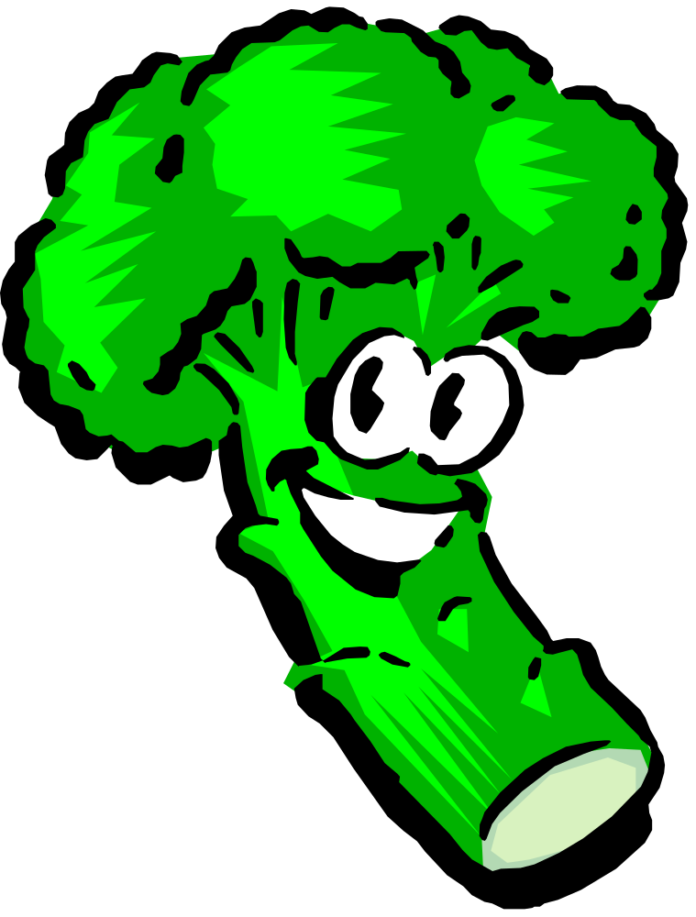
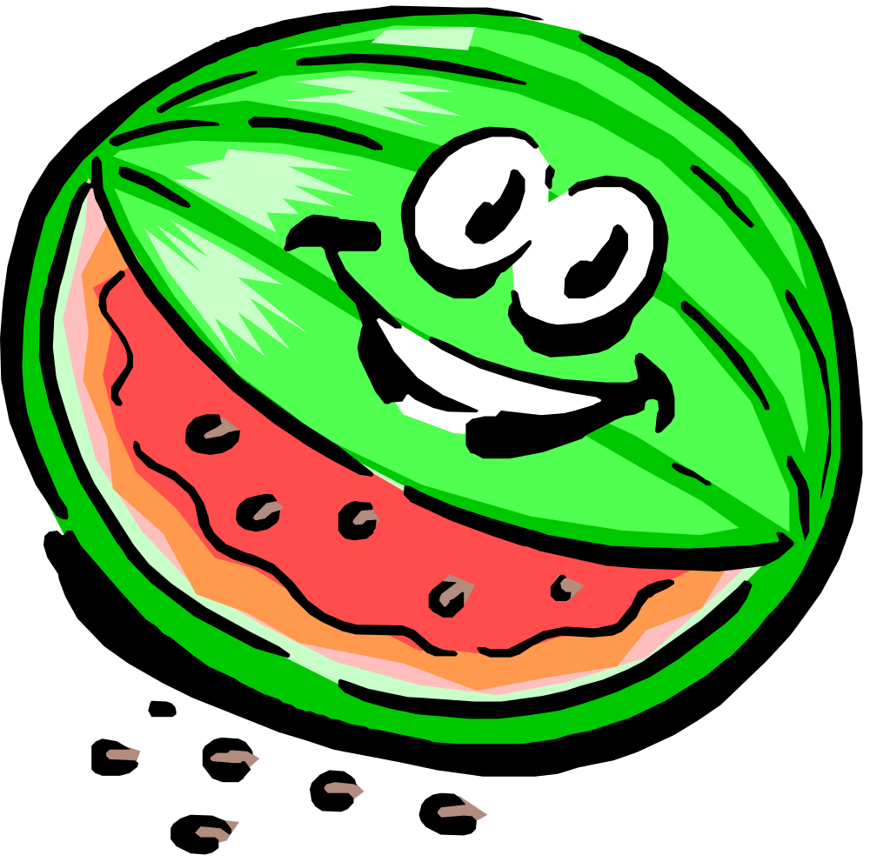
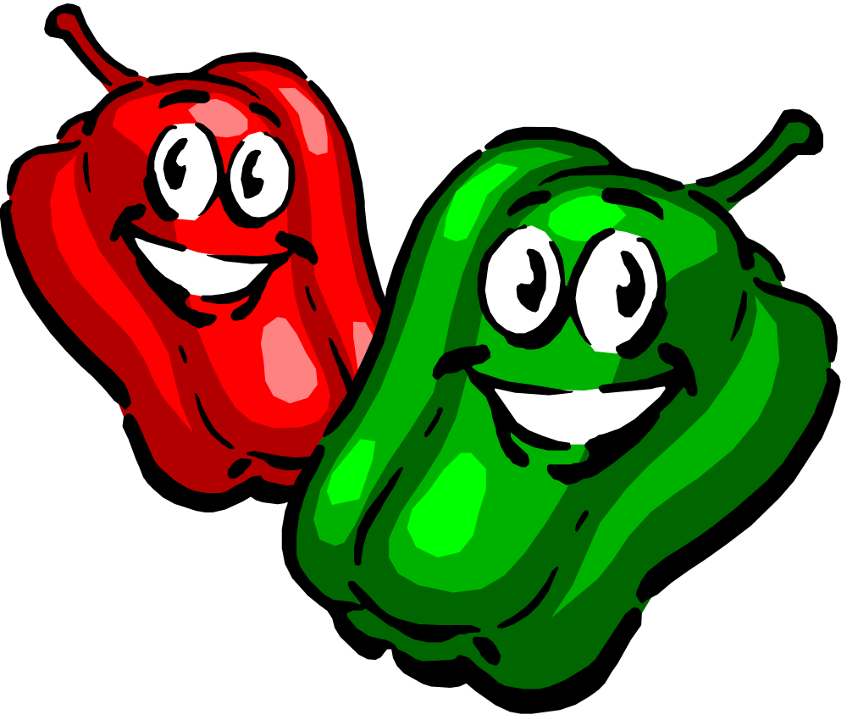
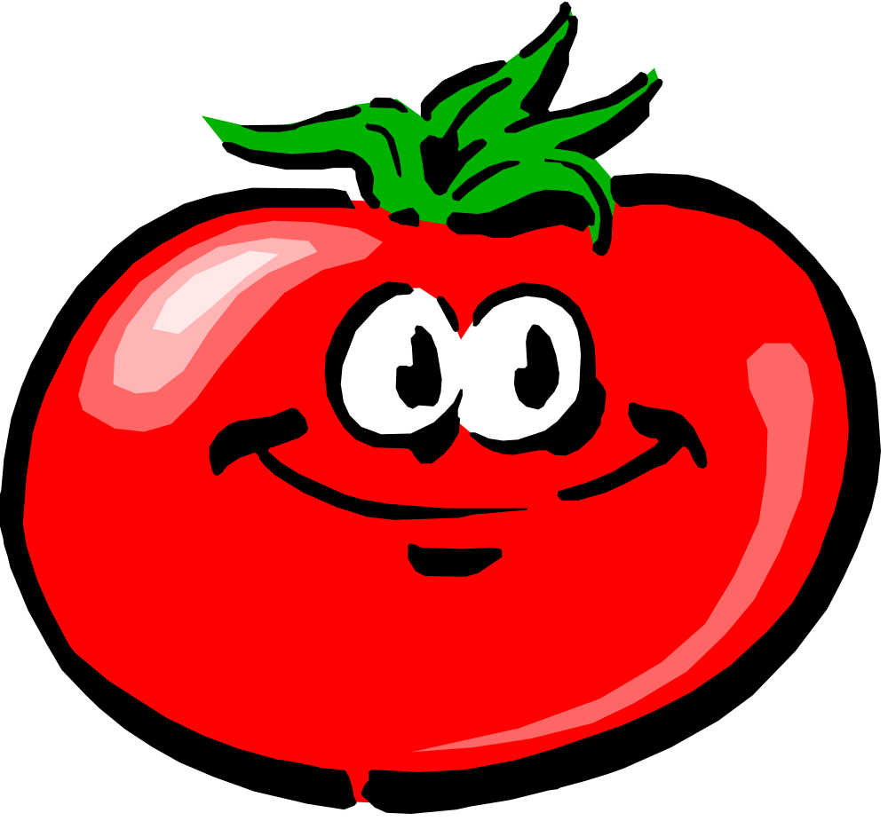

C
O
N
G
A
!!

Slide 4
"Let-us" Conga!
We hope you enjoyed the physical activity break.
Try to incorporate at least 60 minutes of PA into every day!

