Slide 1


Slide 2
Strengths of SDFSCA
State Grants Program
Only program available to LEA’s in every state providing backbone necessary to address youth substance abuse and violence
Administered through SEA’s to LEA’s mandating comprehensive prevention planning and use of science-based programs
Ensures that LEA’s have a district contact responsible for addressing the impact of alcohol, other drugs and violence on the school learning environment
Often the foundation of effective prevention planning built by LEA’s and in turn used to leverage other national, state and local resources

Slide 3
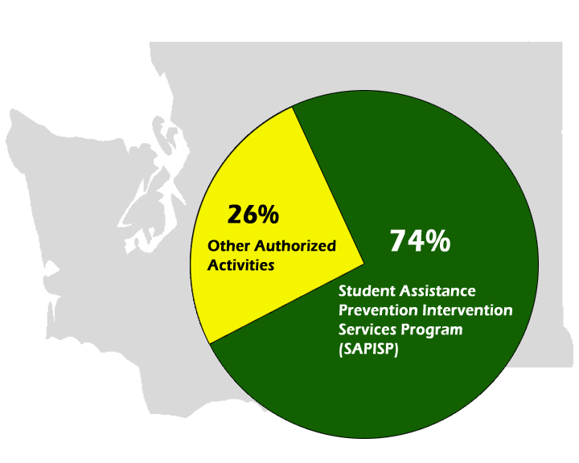
Washington State SDFSCA Program

Slide 4
Washington State SDFSCA Program
Authorized Activities Provided by LEA’s:
  Project Alert
  Olweus Bullying Prevention
  Strengthening Families
  Steps to Respect
  Life Skills Training
  Second Step
  Project Northland
  Reconnecting Youth
  Project SUCCESS

Slide 5
2005-06 Washington State SAPISP
Mission: Provide a comprehensive model of student assistance program prevention, intervention, and support services to assist students in achieving academic excellence and realizing their personal potential.
Goals: Services Provided10% of youth participants will show a reduction in tobacco, alcohol, and marijuana use.
  10% of youth participants will show an increase in understanding of perceived risk toward substance abuse.
  10% of youth participants will show an increase in school bonding
Documented Services:
  12,708 universal prevention awareness activities
  18,446 indicated student engagements (3 or more visits with Specialist)

Slide 6
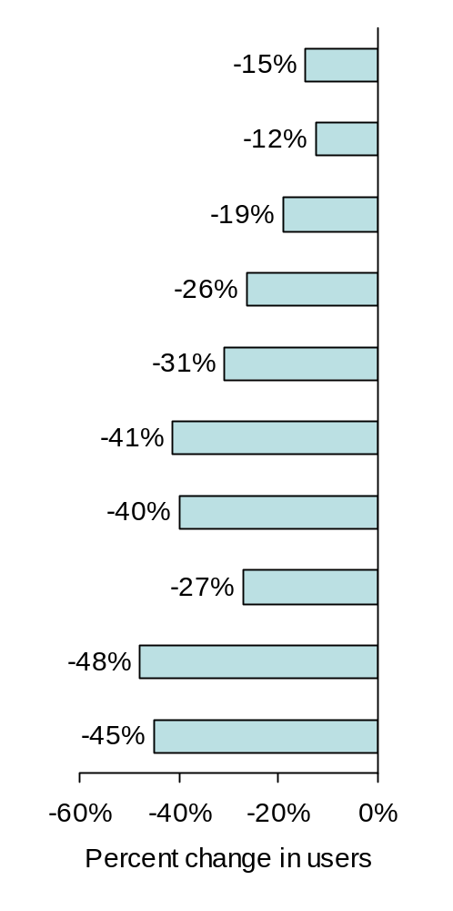
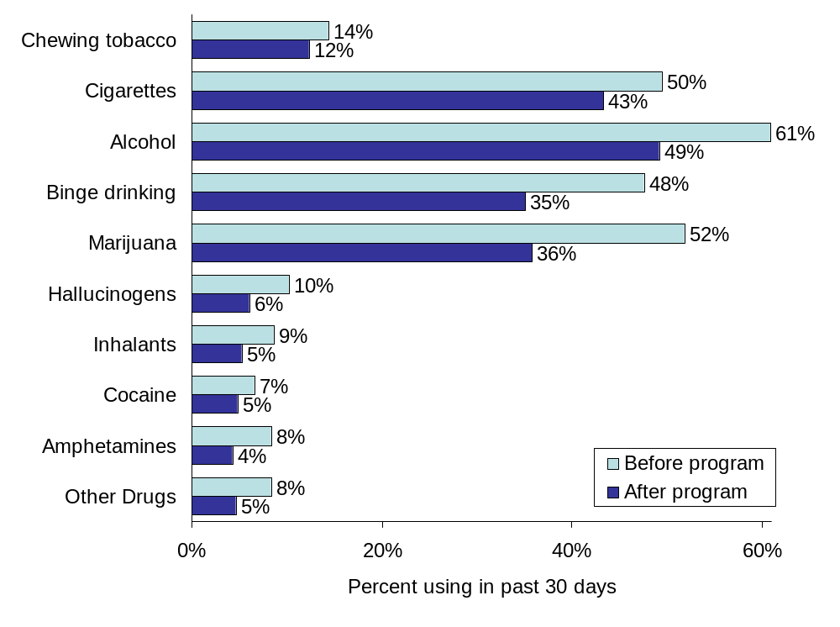
2005-06 Outcomes: Substance Use
State (n = 3,873) Includes only students with a substance related intervention goal.

Slide 7
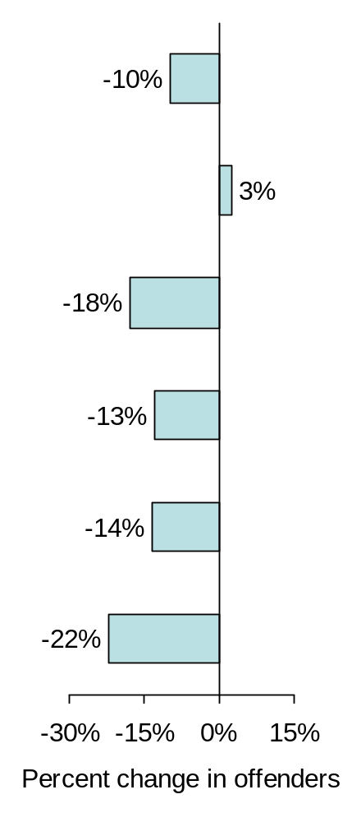
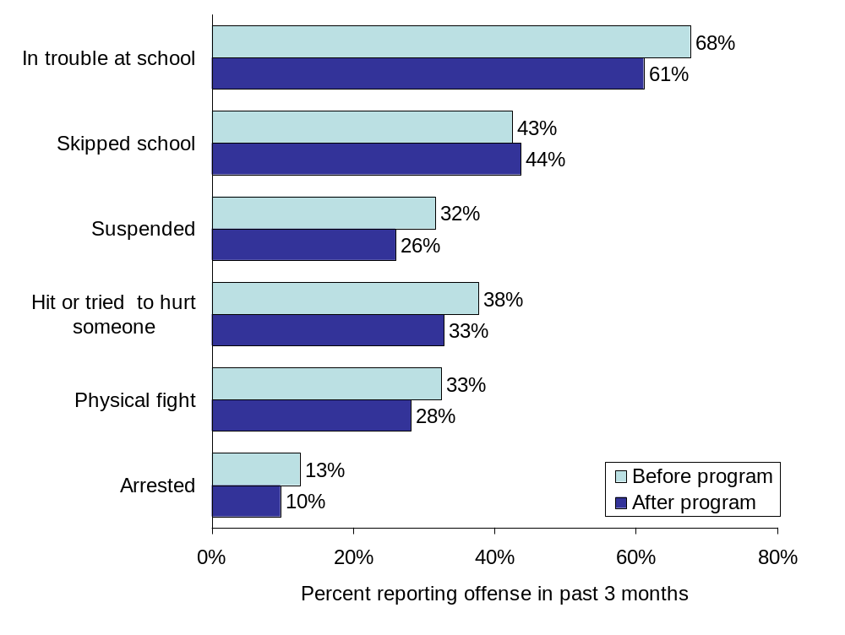
2005-06 Outcomes: School Behavior
State (n = 3,356) Includes only students with a behavior intervention goal.

Slide 8
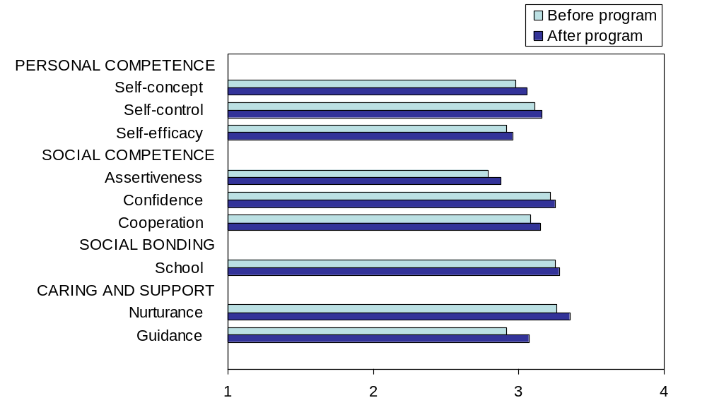
2005-06 Outcomes: Protective Factors
Very negative
Very positive
Average Protection
State (n = 6,694) Includes all students with matched pre/post data.

Slide 9
2005-06 LEA Outcomes:
South Kitsap School District SAPISP
10,400 Students
$48,874.00 SDFS funds
Goals:
  Reduction in alcohol, tobacco & marijuana use by students participating in program
  Increase in school bonding for participating youth
Outcomes:
  24% reduction in use, alcohol, tobacco and marijuana use
  11% increase in school bonding
  Measured by participant pre and post tests
Queets Clear Water School District
40 Students
$1,521.00 SDFS funds
Goals:
  Train 100% of staff in Second Step;
  Measure decrease in problem behavior and increase in classroom learning
Outcomes:
  100% of staff trained
  21% decrease in problem behavior
  15% increase in classroom learning
  Measured by teacher survey and behavior tracking

Slide 10
Leadership Role of SEA
Provide Technical Assistance
Connect SDFSCA to larger mandates of NCLB
Provide Professional Development
Facilitate state and local prevention collaboration and capacity building
Develop systematic comprehensive data collection and outcome measures
Maintain accountability at local, state and federal levels

Slide 11
Current Challenges
37% reduction of SDFSCA funds in Washington State over last 10 years
  Decreased resources but increased accountability
  Communities resilient and being stretched dangerously thin
Need coordinated leadership at federal level across prevention agencies
Need to tie SDFSCA program to larger work in schools focusing on NCLB, supportive learning environments, and student achievement

Slide 12
Recommendations
Increase funding and resources – Our schools are ready for more not less!
Maintain emphasis on comprehensive prevention planning (POE’s) and science-based programming
Provide coordinated federal leadership, guidance and technical assistance
Evaluate program in context of school improvement linking to NCLB and in turn providing support to disenfranchised youth

