Slide 1
Requirements Gathering, Validation, and Concept Studies
GOES Users’ Conference
Boulder, CO
October 1-3, 2002

Slide 2
Integrated Approach to Observations
User Needs
Other Data
Polar
POES
(Today)
w/METOP
(2005)
NPOESS
(2009)
Geostationary
GOES I-Series
(Today)
GOES N-Series
(2004)
GOES R-Series
(2012)
Other Satellites
NASA
DoD
International
Commercial

Slide 3
Baseline GOES-R Architecture
West
East
Advanced Baseline Imager
Hyperspectral Environmental Suite
Space Environmental Monitor
Solar X-ray Imager
Services
Advanced Baseline Imager
Hyperspectral Environmental Suite
Space Environmental Monitor
Solar X-ray Imager
Services
Additional Instruments Under Consideration
Multi-Function Imager
Microwave Sounder
Coronagraph

Slide 4
Opportunities & Challenges for GOES-R
Observation Requirements
Temporal Resolution
Spectral Coverage & Resolution
Spatial Resolution
Radiometric Performance
User Needs
Architecture Solutions
Opportunities & Challenges
Instruments
Processing & Communication Technologies
End-to-End Architectures

Slide 5
Opportunities & Challenges for GOES-R
Observation Requirements
Temporal Resolution
Spectral Coverage & Resolution
Spatial Resolution
Radiometric Performance
User Needs
Instruments
Multispectral
Hyperspectral
Passive Microwave
Multi-mode suites
Architecture Solutions
Opportunities & Challenges
Instruments
Processing & Communication Technologies
End-to-End Architectures

Slide 6
Opportunities & Challenges for GOES-R
Observation Requirements
Temporal Resolution
Spectral Coverage & Resolution
Spatial Resolution
Radiometric Performance
User Needs
Communications & Processing
2 Orders of Magnitude increase in instrument data throughput
  Product distribution and throughput
Integration of multiple instruments & platforms
On-board processing options
Architecture Solutions
Opportunities & Challenges
Instruments
Processing & Communication Technologies
End-to-End Architectures

Slide 7
Opportunities & Challenges for GOES-R
Observation Requirements
Temporal Resolution
Spectral Coverage & Resolution
Spatial Resolution
Radiometric Performance
User Needs
End-to-End Architectures
Formation vs single satellite
Multi-mode operations
Replenishment & sparing strategies
Distribution between on-board & ground processing
Data distribution options
Architecture Solutions
Opportunities & Challenges
Instruments
Processing & Communication Technologies
End-to-End Architectures

Slide 8
Multi-Satellite GOES-R Architecture
West
East
Advanced Baseline Imager
Solar X-ray Imager
Services
Advanced Baseline Imager
Solar X-ray Imager
Services
Hyperspectral Environmental Suite
Space Environmental Monitor
Multi-Function Imager
Services
Hyperspectral Environmental Suite
Space Environmental Monitor
Multi-Function Imager
Services
Additional Instruments could be flown on existing satellites or as free-flyers
  Microwave Sounder - Coronagraph

Slide 9
Requirements Flow to GOES-R Architecture Development
User Needs
Potential solutions to fulfill mission needs
End-to-End Systems
Space & Launch
Command & Control
Product Generation & Distribution
Archive & Access
User Interface & Assimilation
Architecture I
2 GEO Satellite Constellation
Architecture II
Multi-Satellite Constellation
Architecture III
Med Earth Orbit Constellation
Cost
Cost
Cost
Performance
Performance
Performance
Comprehensive assessment with Cost Benefit Analysis as cornerstone
Recommend Alternative(s)

Slide 10
Cost and Benefit Analysis Strategy/Methodology
Focus analysis on determining
  Linkages from improved GOES-R sensors to economic benefits
  Avoidable economic losses due to improved advanced warnings of events and improved forecast accuracy
Characterize information flow from sensors to "end-users”
Determine impacts of the instrument improvements on our products - current emphasis on ABI/HES
Identify key benefit domains
Hold user forums to elicit insight into improved product benefits
Notes:
Obtain information on the specific economic activities that would benefit from the estimated product improvements
Understand how specific satellite and sensor data and/or derived products are used by constituents
reduce costs) for specific activities in their industries.
Understand how the data impacts/benefits user operations

Slide 11
Benefit Areas Investigated
Agriculture
Reduction of temperature error
  Reduce unnecessary and expensive frost/freeze mitigation activities
Improved soil moisture measurement accuracy
  Reduce over-irrigation
Aviation
Improve convective weather forecasts
  Improve route planning
  Reduce delays/deviations/cancellations; reduce fuel consumption
Volcanic Ash Avoidance
  Reduce $M in damage and potential loss of lives

Slide 12
Benefit Areas Investigated
Recreational Boating
Improve hurricane lead time: Reduce boat loss and damage
Trucking
Improve severe weather lead time / location: Reduce # of accidents/deaths
Utilities (Electric, Natural Gas)
Improve temperature accuracy: Improve load forecasting and reduce expensive spot purchases

Slide 13
Ongoing Benefit Areas Analysis
- Not Yet Included in Report
Commercial Shipping
Improve tropical cyclone track and intensity forecasts; Improve ship routing
Emergency Management
Increase lead time on severe weather forecasts and hazardous environmental matter; Improve planning and deployment *

Slide 14
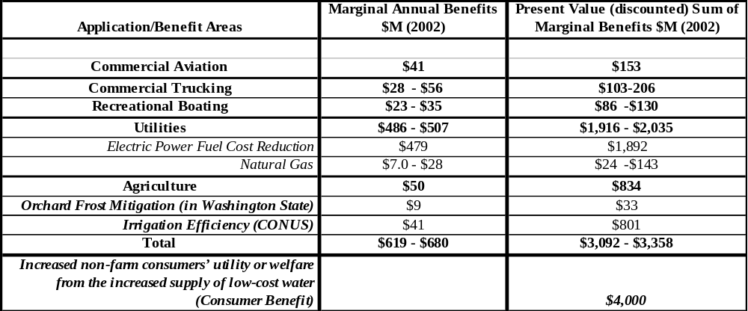
Economic Benefits* Summary for GOES-R Series (2013-2027)
*These benefits are over and above those achieved by the current GOES baseline

Slide 15
GOES-R System Selection Timeline
Variety of Instrument Combinations
Reduced Scope of Instrument Combinations
Selected Instrument Suite
3 Basic Space Architectures
Architecture A
Architecture B
Selected System
Variety of Ground Architectures
Reduced Scope of Ground Architectures
Apr 03
Sep 04
Dec 05
Architecture A 2 GEOs
Cost & Performance Spectrum
Architecture B Multi-Satellites
Architecture C MEOs

Slide 16
Goal - Transition from Individual Systems to “System of Systems” Architecture
Today
2012
2020+
Polar Satellites
Geo Satellites
GOES R
NPOESS
Integrated System
Other Data Sources
Other Data Sources
Programs formulated independent of one another
Formulate integrated system – GOES R with
  Defined NPOESS
  Structured approach to including Other Data Sources
Programs formulated as one integrated system

