Slide 1


Engineering for Data
Protection and Accountability
Michelle Finneran Dennedy
Sun Microsystems, Inc.
michelle.dennedy@sun.com
www.sun.com

Slide 2
Agenda
Basic Considerations- Where should technology fit?
The Dynamic Data Environment
Business/ Organization Goals for Data Protection
Engineering Goals for Data Protection
Tools and Techniques for Data Governance and Accountability
Final Comments

Slide 3
Basic Considerations- Where should technology fit?
What information does a company need to protect?
What do I need my systems to do for my organization?
How is the information being used?
Who will the users be?
What happens to information after it is no longer necessary for a business purpose?
Organizations tasked with data protection must have the tools they need to fulfil privacy promises

Slide 4
The Dynamic Data Environment
Data and applications are built to invite two way participation by users and systems owners
Increased data creation and movement create both risk and opportunity
Protection of data becomes the foundation of control
A foundation of control creates the possibility for governance
Good governance creates a culture of accountability

Slide 5
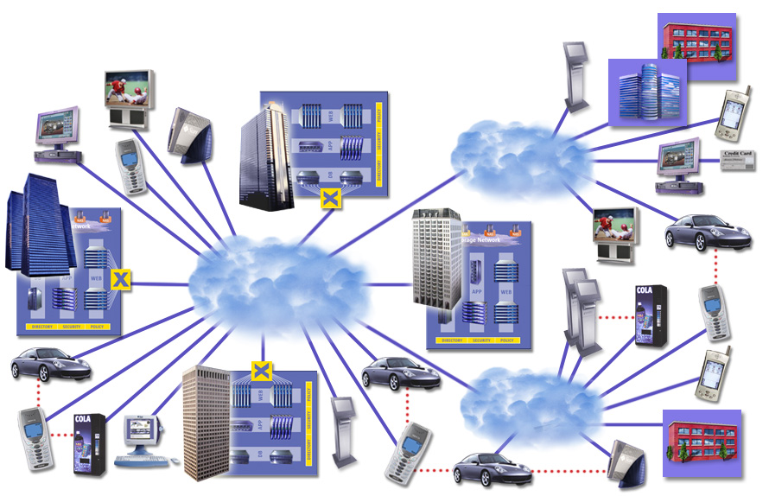

Participation on the Network Drives Governance and Accountability Challenges

Slide 6
Business Goals for Data Protection
What information does a company need to protect?
What do I need my systems to do for my organization?
How is the information being used?
Who will the users be?
What happens to information after it is no longer necessary for a business purpose?
How much will this cost?

Slide 7
Engineering Goals for Data Protection
How will the company plan to protect information?
How will systems adapt to changing business requirements?
How is the information being used?
Who will the users be?
How will the business begin to shape this system?
How much do I have to spend?

Slide 8



Governance Requires a Systemic View
Secure from unauthorized access and use
Data Collected
Securely
Data Stored
Securely
Data Accessed/
Distribute/Used
Securely
Data Deleted/
System/ Access
Terminated
Securely

Slide 9
Tools & Techniques for Data Governance and Accountability
Confidentiality/ Classification of data
Systemic Security – A layered approach
Information Lifecycle Management
Data Stewardship
Standards
Identity Management
Data Minimization
Secure Storage and Encryption

Slide 10
Final Comments
Increased data flows accompany economic growth
Data flows will continue to expand and become more complex
Tools and techniques exist to manage data flows
A systemic approach that considers the entire life cycle of data can help create governance and accountability
That one begins the process to build governance systems and culture is more important than where one begins.

Slide 11
  Thank You
Michelle Dennedy
  michelle.dennedy@sun.com

