Slide 1
California Public Employees’ Retirement System
A
Office of Audit Services
Risk Assessment

Slide 2
Risk Assessment
Quantitative and qualitative methods to assess the likelihood and potential impact of risk events and the current responses in place to address those risks.

Slide 3
Risk Assessment
Build on Prior Year
Prepare by reviewing Strategic Plan, Division Mission, upcoming changes
Conduct interviews with Management
Risk Score and Ranking
Internal Audit Discussion/Other Factors
Apply Internal Audit Resources

Slide 4
Resources for Risk Assessment
Board of Administration
Finance Committee
Executive Management
Senior Management
External Auditors
Internal Auditors

Slide 5
Internal Audit Programs
Assurance and Consulting
CalPERS’ Core Business Areas
  Retirement
  Health
  Investments
CalPERS Support Divisions
Third Party Administrators

Slide 6
Internal Risk Factors
Adequacy and Effectiveness of Controls
Character and Complexity of Business Activity
Dollar Size or Transaction Volume
Board or Management Interest
Results and Time of Previous Audits
Degree of Changes in Operations
Sensitivity of Application Information

Slide 7
Develop Audit Plan
Rank High to Low
Apply Judgment
Some “Soft” factors
Incorporate FISMA and other Mandatory
Apply resources

Slide 8
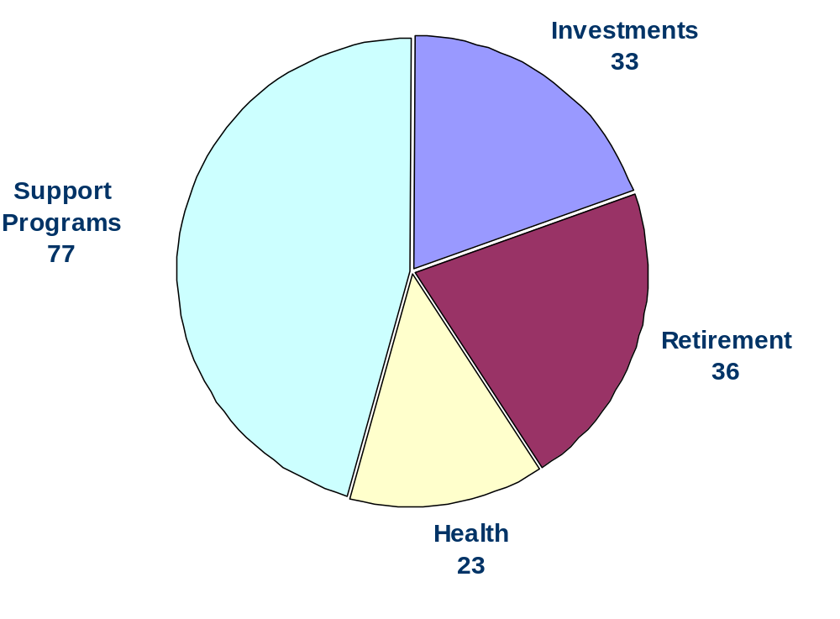
Internal Audit Program
Auditable Activities/Entities
Total = 169

