Slide 1


Intermediate Asset Management Training
State of Indiana
Instructor: Bob Hegyi

Slide 2
Agenda
Welcome
Expectations:
  Manual Additions
  Adjustments / Transfers
  Retirement / Reinstatement
  Integration Process
  Consolidation / Unitization
  Parent-Child Assets
  Correcting ChartField Errors

Slide 3
Expectations
Refresher course:
  AM presentation and process demonstrations
  PM open lab to complete exercises (optional)
Using the system:
  Primary focus will be on the ENCOMPASS system and changes
  Training database used for demos / exercises

Slide 4
Training Materials
Presentation
Exercises
Participant Data sheet
Training Manual
Materials available on ENCOMPASS website:
  ENCOMPASS Documents > Training > Asset Management Class

Slide 5
Ground Rules for Training
Please be on time.
Put cell phones on vibrate.
Forget about the “office.”
Stay focused on “Learning the System.”
  No reading of emails.
Ask questions.
Limit sidebar conversations.
Respect others.

Slide 6
Chapter 1
Asset Management Overview

Slide 7
AM Business Processes
Plan Capital
Purchase, Lease,
Capitalize Asset
Acquisitions
or Build Asset with
via Integration/
Acquisition Details
Interfacing
Retire and
Track and Manage
Dispose of Assets
Capital and
Operating Leases
Perform Physical
Inventory
Adjust and
Transfer Assets
Track Physical
Asset Location
Perform Financial
and Custodian
Accounting
Track Insurance
Replacement
Perform Tax
Value
Calculations
Track Warranties
Track Regulatory
Produce Reports
and Maintenance
Compliance

Slide 8
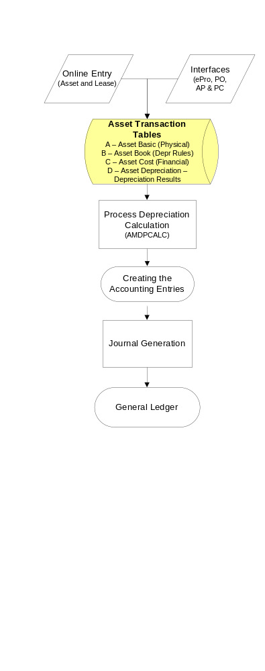
AM Process Flow

Slide 9
Data Tables
Component | Table | Navigation to View | Description
Asset Basic Information | Asset | Asset Management > Owned Assets > Basic Add | Physical information (non-financial) such as Description, Tag Number, Status & Manufacturer Information
Asset Book Definition | Book | Asset Management > Owned Assets > Asset Book Information > Define Depr Criteria | Depreciation Rules, such as Method, Life, In Service Date, Convention
Asset Cost Adjust/ Transfer | Cost | Asset Management > Financial Transactions > Cost Adjust/Transfer > Asset | Financial information such as Cost, Quantity, ChartFields, Category
Asset Depreciation | Depreciation | Asset Management > Review Cost/Depr Activity > Asset Depreciation | Results of depreciation such as Accumulated Depreciation and Depreciation Adjustments
Any activity to the tables above (A, B, or C) creates Open Transactions. Running Depreciation (AMDPCALC) updates the Depreciation table (D):

Slide 10
Integration Points
eProcurment (Requisitions / Purchase Orders)
  Sends key information: Category Code, Profile ID
PO Receipts
  Sends non-financial information: Tag Number, Location, Custodian, Serial Number, Manufacturer ID, Model Number
Accounts Payable
  Sends financial information: Acquisition Date, Cost, Chartfield Values
Projects
  Sends Asset Transactions for Capital Projects
General Ledger
  Receives input from AM to create Journal Entries for: Additions, Adjustments, Retirements, Depreciation

Slide 11
Chapter 3
Manually Adding Assets

Slide 12
All Assets
Assets must be entered into ENCOMPASS
  Valued at $500 or Greater
  Agencies can (optional) enter assets valued at less than $500
Assets must include the following information:
  Tag Number
  Location
  Custodian (active employee listed in HR)
  Chartfields (Fund, Department, Program, Bud Ref.)
    Agencies may require additional fields: Project, Product, Locality

Slide 13
All Assets
The State requires all Assets be acquired via Procurement Applications
  Assets will be added via the Integration Process: Purchasing, Receiving, Accounts Payable
Basic Add
  Used in limited situations
Express Add
  No longer used

Slide 14
Workflow
All Financial Transactions require Financial Asset Manager (FAM) approval:
  Basic Adds
  Adjustments/Transfers
  Retirements/Reinstatements
Assets valued at $20,000 and greater will require Auditor of State approval:
  Exception: Retirements
Note - if a transaction is denied, the AM Entry User receives an email with the FAM’s denial comments.

Slide 15
Basic Add
Only to be used in specific circumstances:
  Donated Assets
  Surplus acquired Assets
  Assets discovered during inventory
Transaction Date = In Service Date
Assets are sent to the AM Approver by clicking the “Submit Workflow” button
Assets are capitalized automatically by the final approval
Note - Asset Status can be reviewed by using the Review Approvals page.

Slide 16
Basic Add – Required Info.
Profile ID
  Defaults in: Asset Class, Book, Category, Depreciation
Acquisition, Placement, and In Service dates
Purchased Amount
Tag number *
  Last 3 digits of Agency’s BU and affixed Bar Code
Location *
  A 7 digit alpha‑numeric field defined by the Agency
Custodian *
  The person responsible for (or primary user) of the asset
* Required for all Assets valued at $500 or greater

Slide 17
Update: Physical Attributes
Physical Attributes are changed via Basic Add
Changes to Location and Custodian
  Insert new Effective Dated Row to update, and maintain history.
  If Effective Sequence field has a value of 1 or higher, click on the Include History button to view Effective Dated Rows.
Changes to Tag Number and Description
  Replace current value with new value.

Slide 18
Copy an Asset
Copy an Asset can be used when:
  There are multiple number of Assets to be added.
  The asset shares similar Physical and Financial information to the original Asset.
Copy an Asset Options:
  Select the information to be copied.
  Change the Physical and Financial information as needed.
New Asset IDs are automatically assigned
Other adjustments can be made via Basic Add or Adjustment pages

Slide 19
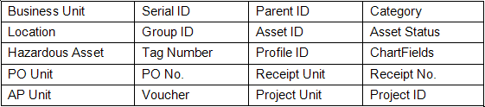
Asset Search Utility
Assets entered in the system can be located using the Search Utility
Criteria that can be used to locate assets include:
Navigation: Asset Management > Search for an Asset

Slide 20
Demo and Exercises
Are there any questions?
Demonstration
Exercises
  Exercise 1 – Add an Asset
  Exercise 2 – Change Custodian
  Exercise 3 – Change Location
  Exercise 4 – Change the Description

Slide 21
Chapter 4
Adjusting, Recategorizing and Transferring Assets

Slide 22
Adjust Assets
Adjustments are necessary to:
  Update Asset Records
  Correct Errors
  Add newly received information
Common types of adjustments include:
  Add a new cost row
  Adjust the total cost
  Recategorize an asset
  Transfer an asset to another Department, Business Unit, etc.
  Note – Financial changes cannot be made via Basic Add pages once the asset has been capitalized.

Slide 23
Transfer/Adjustment Steps
The State of Indiana uses a three-step process to transfer/adjust assets:
  Step 1: Enter the Asset Transfer/Adjustment
  Step 2: Approval by Financial Asset Manager
        AOS, for assets valued at $20,000 or greater
  Step 3: Run the Finalization

Slide 24
Transfers/Adjustments
Asset are not updated until:
  All necessary approvals have been received
  Finalization has been processed
        Additional changes can not be made until the previous changes have been approved, denied or finalized.
Changes are updated on the Cost History pages
  Not via Basic Add pages
Asset Changes must be sent to the AM Approver
  Click on the “Submit Workflow” button
Note - Asset Status can be reviewed by using the Review Approvals page.

Slide 25
Transfer Policy
State of Indiana Transfer Policy:
  All transfers, sales, retirements and other disposals of capital assets must be processed and approved by the State Surplus Property division of IDOA by submitting Form 13812, Notification of Surplus State-Owned Property.

Slide 26
Transfers
IntraUnit Transfer
  Transfer an Asset within a Business Unit, typically used to update Chartfield values.
        Fund, Department, Program, Project, etc.
InterUnit Transfer
  Transfer an Asset to another Business Unit.
        The chartfield values of receiving Business Unit are required to enter transaction.

Slide 27
Viewing Cost History
Cost History displays information for capitalized and non-capitalized assets
  List pages: shows history of asset’s transactions
  Detail pages: shows detailed information regarding financial transactions
Cost History displays all financial transactions that occurred to after the asset was capitalized
  Note - Basic Add only shows cost information from the time the asset was capitalized.

Slide 28
Demo and Exercises
Are there any questions?
Demonstration
Exercises
  Exercise 5 – Cost Adjustment
  Exercise 6 – Recategorize
  Exercise 7 – IntraUnit Transfer
  Exercise 8 – InterUnit Transfer

Slide 29
Chapter 5
Retiring and Reinstating Assets

Slide 30
Retirement Policy
Assets are considered retired if disposed of in any of the following ways:
  Sent to State Surplus (property division)
  Traded In
  Scrapped
  Sold at Public Auction
  Sold to Local Unit of Government
  Stolen (reported to Capital Police prior to processing)

Slide 31
Types of Retirement
Three 3 basic types of retirements:
  Full, when all quantities & costs of an asset are retired
  Partial, when only a portion of the quantities & costs of an asset are retired. (NOT used by SOI)
  Prior Period, when an asset is retired in a prior accounting period but not recorded until next period
Reinstatements can occur at any time, and are used:
  To correct errors
  To place an asset back into service

Slide 32
Retirement Options
The State of Indiana uses the following retirement options:
  Casualty Loss
  Disposal Due to Theft - (police report filed)
  Duplicate Asset
  Missing Asset
  Retirement by Sale
  Scrapped Asset - (no value to surplus)
  State Surplus
  Traded In for Another Asset
Accounting entries are automatically generated based on the retirement option selected

Slide 33
Retirement Warning
Retirements – cautionary notes:
  Assets can be retired, even if unprocessed Financial Transactions exist
  Once retired, Financial Transactions can not be Finalized
Verify all Financial Transactions have a status of “Completed” prior to retiring any asset
  Navigation: Asset Management > Asset Transactions > Financial Transactions > Review Transfer/Adj. Approvals

Slide 34
Reinstating Assets
Reinstatement can be used on retired Assets:
  To correct errors
  To place an asset back in service
When reinstatement occurs:
  All journal entries created for retired asset are reversed
  If depreciation has not processed for the retired asset, reinstatement will remove the RET transaction from the Cost table

Slide 35
Retirements/Reinstatements
When the Retirement/Reinstatement is saved:
  Asset status is immediately changed
    Retirement – status changes to “Disposed”
    Reinstatement – status changes to “In Service”
  Asset is automatically placed into workflow
If the retirement/reinstatement is denied:
  Asset status does not automatically return to previous status
  AM Entry must take necessary action to change the status
    Denied Retirement = Reinstate the asset
    Denied Reinstatement = Retire the asset

Slide 36
Disposal Worksheet
Disposal Worksheet is used to:
  Dispose of several assets at one time
  Dispose of assets that have common data, such as: Profile ID, Category, Department, etc.
Three step process:
  Select Assets for Disposal
  Approve Disposal Worksheet
  Process the Transaction Loader
    Locate the Interface ID
    Process the Transaction Loader

Slide 37
Demo and Exercises
Are there any questions?
Demonstration
Exercises
  Exercise 9 – Retire an Asset
  Exercise 10 – Reinstate an Asset

Slide 38
Chapter 2
Integrating with PeopleSoft Procurement

Slide 39
Asset Details
Asset Information Tab can be found on:
  Requisition, Purchasing, Receiving and Accounts Payable pages
Asset Information Tab contains:
  Business Unit, Asset ID and Profile ID
PO Receipt pages contains:
  Tag Number, Location and Custodian
Note – Asset Information will default in from the interfacing modules. However, interfaced data can be overwritten.

Slide 40
Appendix
Asset manual contains an appendix detailing where Asset Information is located for:
  Requisition
  Purchase Order
  Receipt
  Voucher
Asset manual is located on the ENCOMPASS Website, along with the other training materials:
  https://myshare.in.gov/sba/encompass/default.aspx
  AP Training documents: ENCOMPASS > ENCOMPASS Documents > Training > Asset Management Class > AM Course Manuals

Slide 41
Interfaces
Asset Status created by the Interface:
  PO Receipt adds the Asset Status of “Received (Not in Service)”
  AP Voucher automatically capitalizes the asset for the voucher amount and changes the Asset Status to “In Service”
Interfaces process automatically
  AM Entry Users can process the interfaces manually
Four steps to interface Receipts/Vouchers into Asset Management:
  Pre-Interface tables, Interface Loader, Consolidate / Unitize, and Transaction Loader

Slide 42
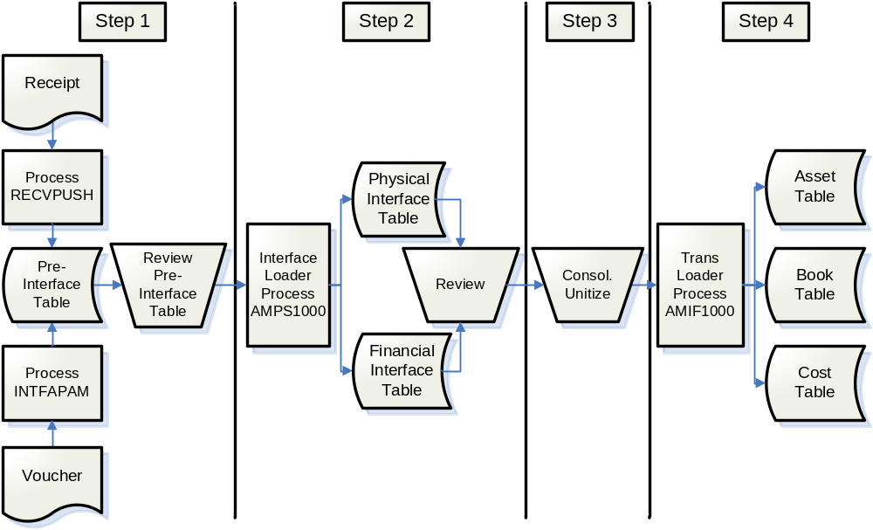
Integration Process Flow

Slide 43
Integration
Four integration steps involved:
  Step 1 involves pushing the Receipt or Voucher information from Procurement into AM. It will process automatically.
  Step 2 is the Interface Loader. It pulls information from the Pre-Interface table and populates the Physical and Financial tables. It will process automatically.
  Step 3 is Consolidation/Unitization. This is manually controlled and must be processed prior to Step 4.
  Step 4 is the Transaction Loader. It creates the asset. It will process automatically.

Slide 44
Consolidate / Unitize
Consolidation is used to combine several components into a single asset.
Unitization is used to convert asset lines from PO Receipts or Vouchers with multiple asset quantities into separate assets having a quantity of one.
Consolidation / Unitization must be completed prior to processing the Transaction Loader.

Slide 45
Demo and Exercises
Are there any questions?
Demonstration
Exercises
  Exercise 11 – Unitization of Assets
  Exercise 12 – Consolidation of Assts

Slide 46
Chapter 6
Maintaining Parent-Child Assets

Slide 47
Parent-Child Asset
Relationships
Parent-Child Assets:
  Grouped together for processing and reporting
  Three methods of grouping assets:
    Single asset with multiple acquisition detail lines for each component
    One component designated as the parent with the remaining components as child assets
    Parent only asset with each component as a child asset
  Each component can have its own cost, depreciation, and physical information
Navigation: Asset Management > Asset Transactions > Parent-Child Relationship > Review Parent - Child

Slide 48
Adding Parent-Child Assets
Parent-Child Assets are added via Basic Add
Parent Asset must be established prior to assigning any Child Assets
Child Assets can have a cost and depreciation independent of the Parent
Once established, special security is required to change a Parent-Child designation

Slide 49
Retiring Parent-Child Assets
Parent-Child Assets can be retired by:
  Retiring the parent and all child assets
  Retiring the parent and some child assets
  Retiring just the child assets
  Retiring just some of the child assets

Slide 50
Demonstration
Are there any questions?
Demonstration

Slide 51
Chapter 7
Correcting ChartField Errors

Slide 52
ChartField Edit
A custom Chartfield Edit process was created to run after Accounting Entries are created to:
  Validate ChartField values
  Validate Chartfield combinations
  Flag any Chartfield errors
Line errors must be correct in order to post accounting information to General Ledger
Note – Agencies are responsibility for reviewing and correcting any identified ChartField errors at the end of each month.

Slide 53
Demonstration
Are there any questions?
Demonstration

Slide 54
Post Go Live Support
Post Go Live Support
  “Report an Issue” link on the Sign In page
  “Report an Issue” link under the ENCOMPASS menu
  Call 317-234-HELP to create a helpdesk ticket
Encompass Website
  https://myshare.in.gov/sba/encompass/default.aspx
  AP Training documents: ENCOMPASS > ENCOMPASS Documents > Training > Asset Management Class

Slide 55
Evaluations
Course evaluation
  Please be honest
  Provide suggestions for improvements
  Evaluations are used to adjust the class

Slide 56


